Slide 1
Driver Modeling相关内容梳理总结

Slide 2
目录
01
03
Driver-Modeling 简介
Incremental Driver-Modeling
02
Driver-Modeling Code 梳理

Slide 3
一、Driver-modeling 简介
01

Slide 4
Driver-modeling 简介
什么是driver-modeling

Slide 5
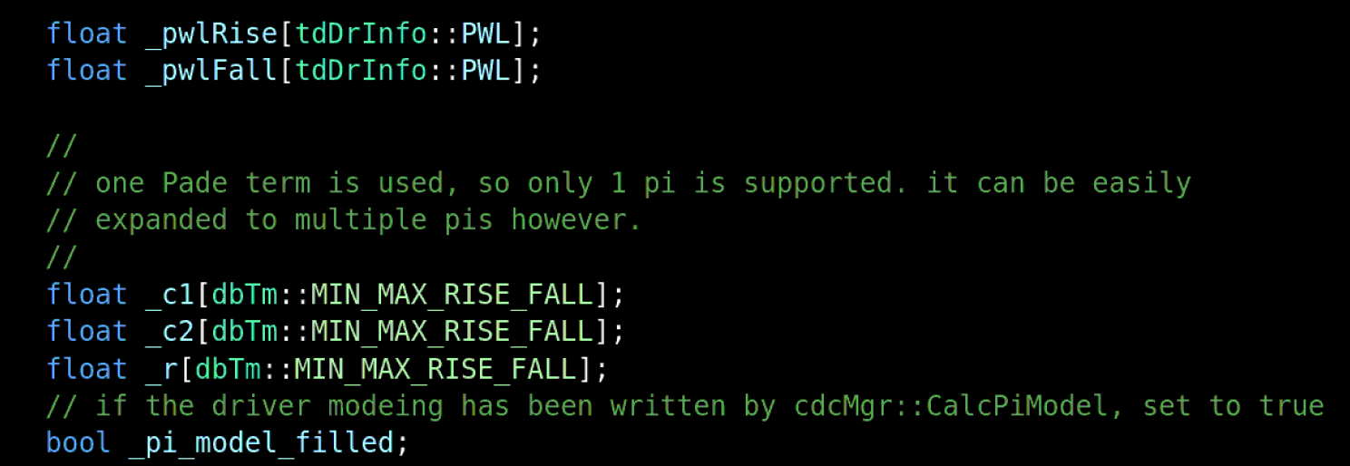
Driver-modeling 简介
什么是driver-modeling(in code)

Slide 6
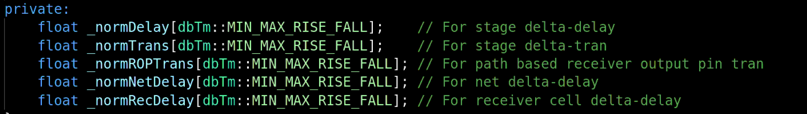
Driver-modeling 简介
什么是ROPdrinfo

Slide 7
Driver-modeling 简介
为什么要driver-modeling

Slide 8
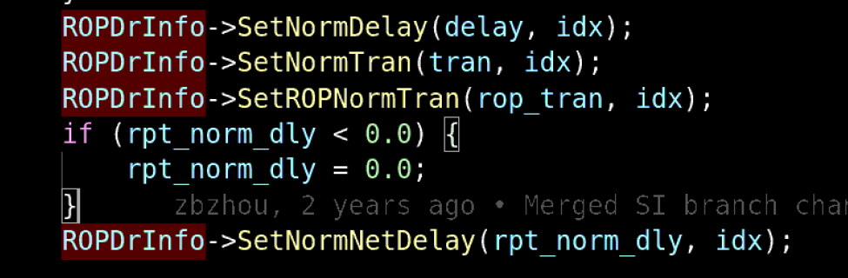
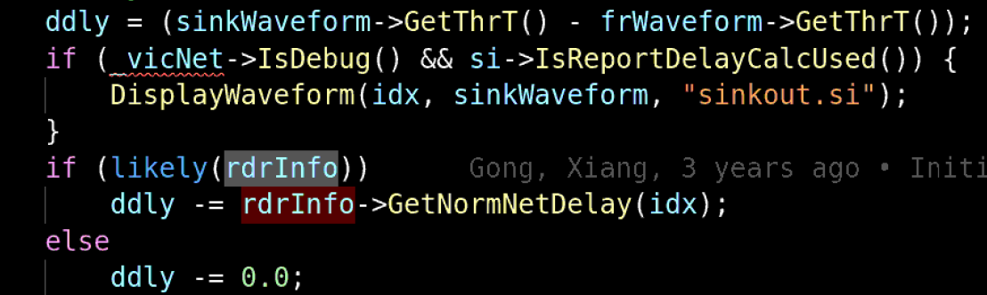
Driver-modeling 简介
为什么要ROPdrinfo

Slide 9
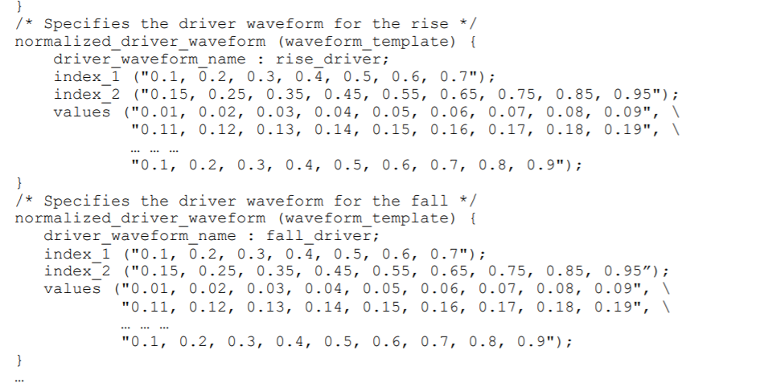
Driver-modeling 简介
怎么做driver-modeling
Input wave（normalized waveform）

Slide 10
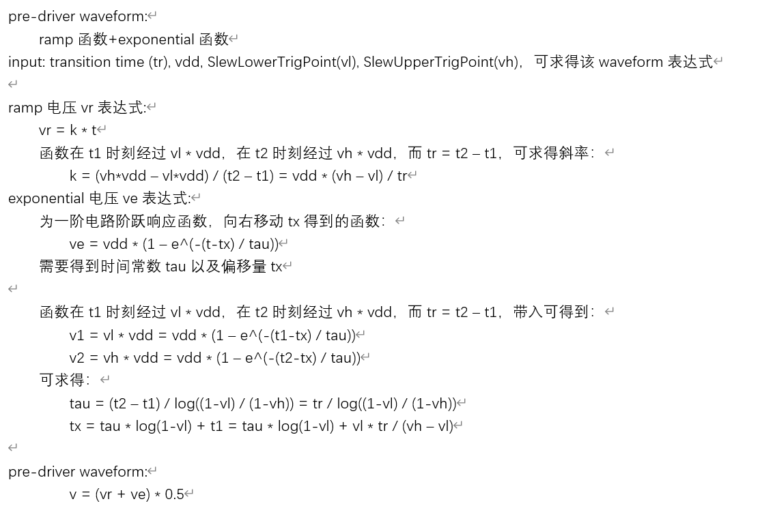
Driver-modeling 简介
怎么做driver-modeling
Input wave (pre-driver waveform)

Slide 11










Driver-modeling 简介
怎么做driver-modeling
$${v1}_{t_{n}}$$
PI型网络分析
$${v2}_{t_{n}}$$
Vin
V1
r
V2
Backward Euler等效
$${i1}_{t_{n}}$$
$$r$$
$${i2}_{t_{n}}$$
ccb
Vin
ccb
I
I
c1
c2
$$\frac{c_{1}+c_{m}}{∆t}{v1}_{t_{n−1}}$$
$$\frac{∆t}{c_{1}+c_{m}}$$
$$\frac{∆t}{c_{2}}$$
$$\frac{c_{2}}{∆t}{v2}_{t_{n−1}}$$
$$c_{m}\frac{∆v_{in}}{∆t}$$
cm

Slide 12
二、Driver-modeling code 梳理

Slide 13
Driver-modeling 流程梳理
compute-timing flow

Slide 14
Driver-modeling 流程梳理
compute-timing Pi flow

Slide 15
Driver-modeling 流程梳理
compute-timing Pi and VM flow

Slide 16
Driver-modeling 流程梳理
compute-timing Pi and VM flow

Slide 17
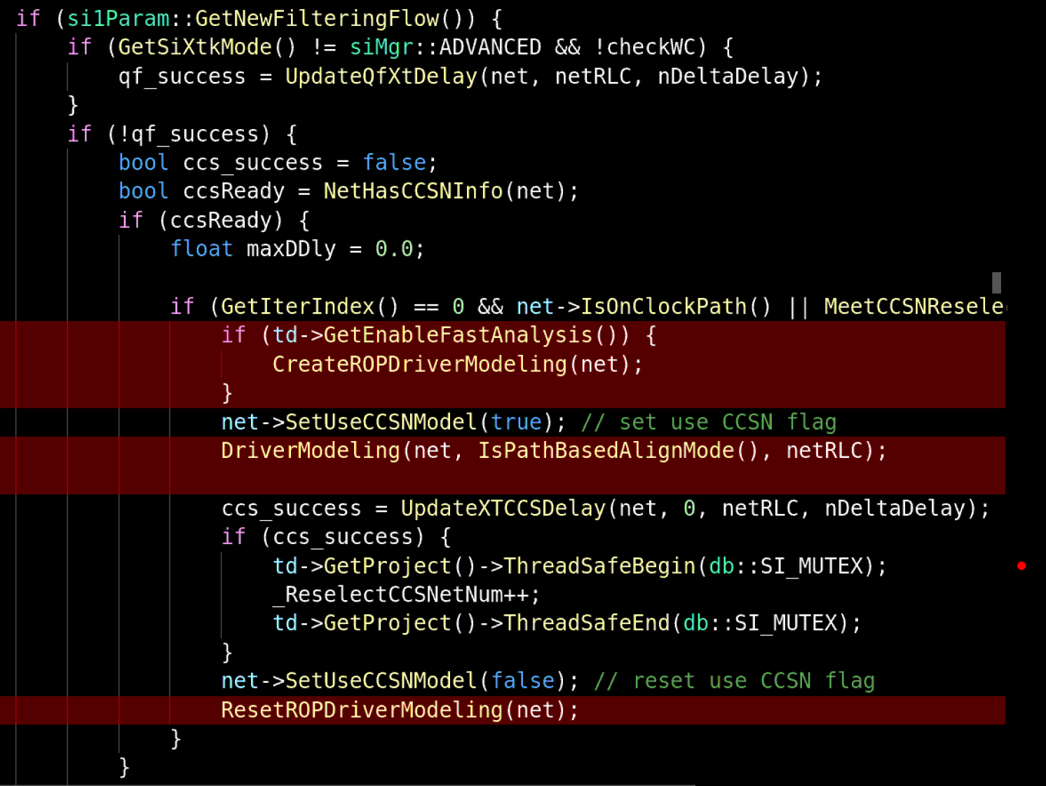
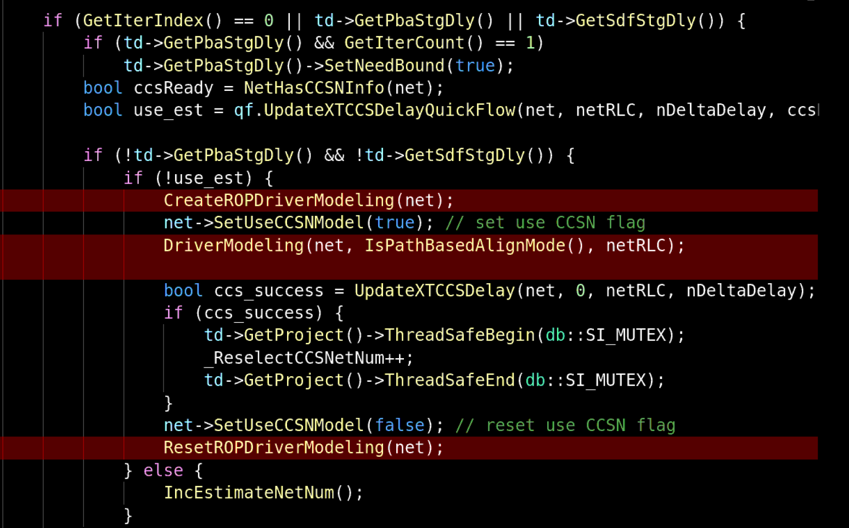
Driver-modeling 流程梳理
ROP flow

Slide 18
三、Incremental Driver-modeling

Slide 19

Incremental driver-modeling
VM pool的选择
在释放内存时，tuVMAlloc的pool能一次释放pool的所有内存，tuVMObj的pool能删除对单个object的内存

Slide 20
Incremental driver-modeling
Incremental compute_timing flow

Slide 21
Incremental driver-modeling
Incremental all flow

Slide 22
Thank You

