Slide 1

ROM
Xin Xie
2024/7/18
打造完整的国产芯片数字EDA平台

Slide 2






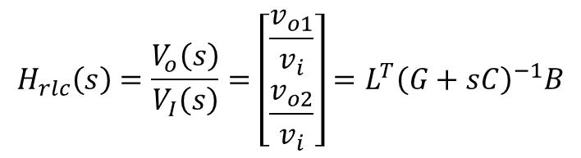








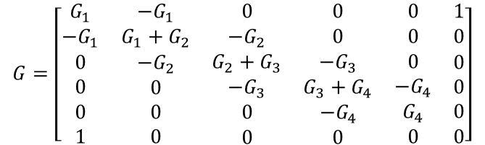



MNA (modified nodal analysis)-RLC tree
RLC tree的传递函数具有n个极点：n通常很大
节点电压方程：
$$\left(G+sC\right)X={BV}_{I}$$
$$v_{n1}$$
$$v_{n2}$$
$$v_{n3}$$
$$v_{n4}$$
$$v_{n5}$$
$$V_{I}(s)$$
$$V_{O}(s)$$
输出方程：
$$V_{o}=L^{T}X$$
$$i_{I}$$
$$i_{O}$$
$$H_{rlc}\left(s\right)=\frac{V_{o}\left(s\right)}{V_{I}\left(s\right)}=\left[\begin{aligned}\begin{aligned}\frac{v_{o1}}{v_{i}} \\ \frac{v_{o2}}{v_{i}}\end{aligned}\end{aligned}\right]=L^{T}{\left(G+sC\right)}^{−1}B$$
传递函数：
输入电压
$$G=\left[\begin{matrix}G_{1} & −G_{1} & 0 & 0 & 0 & 1 \\ −G_{1} & {G_{1}+G}_{2} & {−G}_{2} & 0 & 0 & 0 \\ \begin{aligned}0 \\ 0 \\ 0 \\ 1\end{aligned} & \begin{aligned}{−G}_{2} \\ 0 \\ 0 \\ 0\end{aligned} & \begin{aligned}G_{2}+G_{3} \\ −G_{3} \\ 0 \\ 0\end{aligned} & \begin{aligned}−G_{3} \\ G_{3}+G_{4} \\ {−G}_{4} \\ 0\end{aligned} & \begin{aligned}0 \\ {−G}_{4} \\ G_{4} \\ 0\end{aligned} & \begin{aligned}0 \\ 0 \\ 0 \\ 0\end{aligned}\end{matrix}\right]$$
$$C=\left[\begin{matrix} & & & & & \\ \begin{aligned} \\ \\ \\ \\ \end{aligned} & \begin{aligned}c_{1} \\ \\ \\ \\ \end{aligned} & \begin{aligned} \\ c_{2} \\ \\ \\ \end{aligned} & \begin{aligned} \\ \\ c_{3} \\ \\ \end{aligned} & \begin{aligned} \\ \\ \\ c_{4} \\ \end{aligned} & \begin{aligned} \\ \\ \\ \\ \end{aligned}\end{matrix}\right]$$
$$X=\left[\begin{aligned}v_{n1} \\ v_{n2} \\ v_{n3} \\ v_{n4} \\ v_{n5} \\ i_{I}\end{aligned}\right]$$
$$B=\left[\begin{matrix}0 & 0 \\ \begin{aligned}0 \\ 0 \\ 0 \\ 0 \\ 1\end{aligned} & \begin{aligned}0 \\ 0 \\ 0 \\ 1 \\ 0\end{aligned}\end{matrix}\right]$$
$$L=\left[\begin{matrix}0 & 0 \\ \begin{aligned}0 \\ 0 \\ 0 \\ 0 \\ 1\end{aligned} & \begin{aligned}0 \\ 0 \\ 0 \\ 1 \\ 0\end{aligned}\end{matrix}\right]$$
$$V_{I}=\left[\begin{aligned}v_{i} \\ i_{O}\end{aligned}\right]$$
$$V_{o}=\left[\begin{aligned}\begin{aligned}i_{I} \\ v_{o}\end{aligned}\end{aligned}\right]$$
电纳矩阵
节点电压
输出电压
电导矩阵

Slide 3
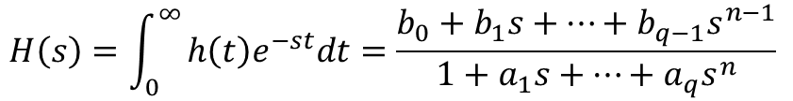

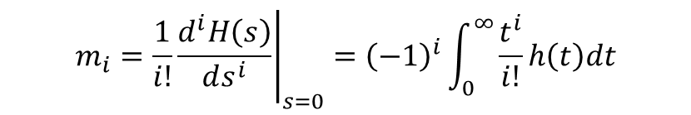
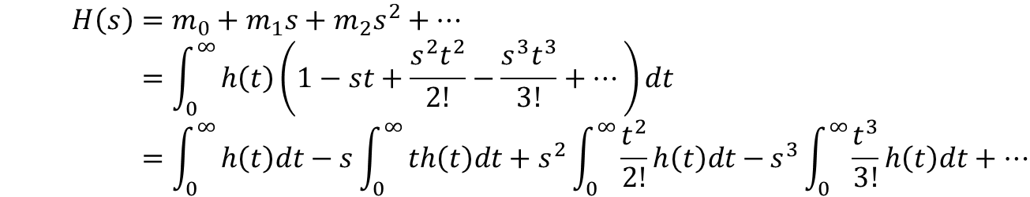
moment
传输函数: 时域$h(t)$，频域$H(s)$
s=0处泰勒展开：
moment定义：
$$H\left(s\right)=\int_{0}^{∞}{h\left(t\right)e^{−st}dt=\frac{b_{0}+b_{1}s+…+b_{q−1}s^{n−1}}{1+a_{1}s+…+a_{q}s^{n}}}$$
频域展开
$$H\left(s\right)=m_{0}+m_{1}s+m_{2}s^{2}+… \\ =\int_{0}^{∞}{h\left(t\right)\left(1−st+\frac{s^{2}t^{2}}{2!}−\frac{s^{3}t^{3}}{3!}+…\right)dt} \\ =\int_{0}^{∞}{h\left(t\right)dt−s\int_{0}^{∞}{th\left(t\right)dt+s^{2}{\int_{0}^{∞}{\frac{t^{2}}{2!}h\left(t\right)dt−}s}^{3}\int_{0}^{∞}{\frac{t^{3}}{3!}h\left(t\right)dt+…}}}$$
时域展开
$$m_{i}={\left.\frac{1}{i!}\frac{d^{i}H\left(s\right)}{ds^{i}}\right|}_{s=0}={\left(−1\right)}^{i}\int_{0}^{∞}{\frac{t^{i}}{i!}h\left(t\right)dt}$$

Slide 4






moment计算(path tracing algorithm)
$$\left(G+sC\right)X={BV}_{I}$$
冲击响应的拉普拉斯变换：
$$δ\left(t\right)→1$$
$$X=m_{0}+m_{1}s+m_{2}s^{2}+…$$
$$\left(G+sC\right)\left(m_{0}+m_{1}s+m_{2}s^{2}+…\right)=B$$
$$Gm_{0}+s\left(Gm_{1}+Cm_{0}\right)+s^{2} \left({Gm}_{2}+{Cm}_{1}\right)+…=B$$
$$Gm_{0}=B$$
$$⇒$$
$$Gm_{i}=−Cm_{i−1} ∀ i≥1$$
$m_{0}$的计算：原始电路施加单位冲击电压源；各节点电压的稳态值即为$m_{0}$
$m_{i}$的计算：原始电路电压源短路，电流开路；电容替换为电流源$Cm_{i−1}$；各节点电压的稳态值即为$m_{i}$

Slide 5




































moment计算(path tracing algorithm)
$$v_{n2}$$
$$v_{n3}$$
$$v_{n4}$$
$$v_{n5}$$
$$−4$$
$$−7$$
$$−9$$
$$−10$$
$$V_{I}(s)$$
$$i_{I}$$
$$1$$
$$1$$
$$1$$
$$1$$
$$1$$
$$1$$
$$1$$
$$1$$
$$1$$
$$1$$
$$1$$
$$1$$
$$X={\left[\begin{matrix}v_{n1} & v_{n2} & v_{n3} & v_{n4} & v_{n5} & i_{I}\end{matrix}\right]}^{T}$$
$$m_{1}={\left[\begin{matrix}0 & −4 & −7 & −9 & −10 & −4\end{matrix}\right]}^{T}$$
$$1$$
$$1$$
$$1$$
$$1$$
$$1$$
$$30$$
$$56$$
$$75$$
$$85$$
$$−4$$
$$−7$$
$$−9$$
$$−10$$
$$1$$
$$m_{0}={\left[\begin{matrix}1 & 1 & 1 & 1 & 1 & 0\end{matrix}\right]}^{T}$$
$$m_{2}={\left[\begin{matrix}0 & 30 & 56 & 75 & 85 & 30\end{matrix}\right]}^{T}$$

Slide 6



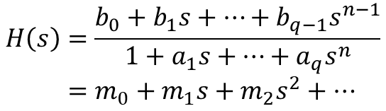


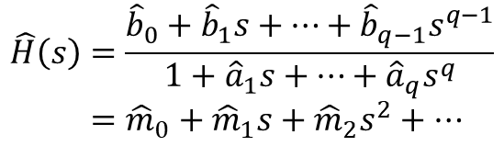






AWE(Asymptotic waveform evaluation)
Pade approximations :
moment matching:
分母右移
$$H\left(s\right)=\frac{b_{0}+b_{1}s+…+b_{q−1}s^{n−1}}{1+a_{1}s+…+a_{q}s^{n}} \\ =m_{0}+m_{1}s+m_{2}s^{2}+…$$
$$\hat{H}\left(s\right)=\frac{{\hat{b}}_{0}+{\hat{b}}_{1}s+…+{\hat{b}}_{q−1}s^{q−1}}{1+{\hat{a}}_{1}s+…+{\hat{a}}_{q}s^{q}} \\ ={\hat{m}}_{0}+{\hat{m}}_{1}s+{\hat{m}}_{2}s^{2}+…$$
$$q≪n$$
$一般q≤4，$再高不稳定
$${\hat{m}}_{i}=m_{i} 0≤i<2q$$
$${\hat{b}}_{0}+{\hat{b}}_{1}s+…+{\hat{b}}_{q−1}s^{q−1}=\left(1+{\hat{a}}_{1}s+…+{\hat{a}}_{q}s^{q}\right)\left(m_{0}+m_{1}s+m_{2}s^{2}+…\right)$$
$${\hat{b}}_{0}=m_{0}$$
$$0=m_{q}+m_{q−1}{\hat{a}}_{1}+…+m_{0}{\hat{a}}_{q}$$
$${\hat{b}}_{1}=m_{1}+m_{0}{\hat{a}}_{1}$$
$$0=m_{q+1}+m_{q}{\hat{a}}_{1}+…+m_{1}{\hat{a}}_{q}$$
$$s\sim s^{q−1}$$
$q$个方程得${\hat{b}}_{i}$
$$s^{q}\sim s^{2q−1}$$
$q$个方程得${\hat{a}}_{i}$
$${\hat{b}}_{2}=m_{2}+m_{1}{\hat{a}}_{1}+m_{0}{\hat{a}}_{2}$$
$$0=m_{q+2}+m_{q+1}{\hat{a}}_{1}+…+m_{2}{\hat{a}}_{q}$$
$$⋮$$
$$⋮$$
$${\hat{b}}_{q−1}=m_{q−1}+m_{q−2}{\hat{a}}_{1}+…+m_{0}{\hat{a}}_{q−1}$$
$$0=m_{2q−1}+m_{2q−2}{\hat{a}}_{1}+…+m_{q−1}{\hat{a}}_{q}$$

Slide 7
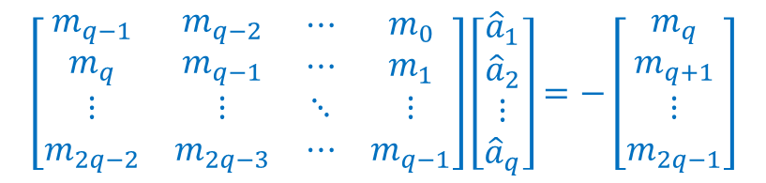
AWE(Asymptotic waveform evaluation)
Padé approximations :
moment matching:
分母右移
$$H\left(s\right)=\frac{b_{0}+b_{1}s+…+b_{q−1}s^{n−1}}{1+a_{1}s+…+a_{q}s^{n}} \\ =m_{0}+m_{1}s+m_{2}s^{2}+…$$
$$\hat{H}\left(s\right)=\frac{{\hat{b}}_{0}+{\hat{b}}_{1}s+…+{\hat{b}}_{q−1}s^{q−1}}{1+{\hat{a}}_{1}s+…+{\hat{a}}_{q}s^{q}} \\ ={\hat{m}}_{0}+{\hat{m}}_{1}s+{\hat{m}}_{2}s^{2}+…$$
$$q≪n$$
$一般q≤4，$再高不稳定
$${\hat{m}}_{i}=m_{i} 0≤i<2q$$
$${\hat{b}}_{0}+{\hat{b}}_{1}s+…+{\hat{b}}_{q−1}s^{q−1}=\left(1+{\hat{a}}_{1}s+…+{\hat{a}}_{q}s^{q}\right)\left(m_{0}+m_{1}s+m_{2}s^{2}+…\right)$$
$${\hat{b}}_{0}=m_{0}$$
$${\hat{b}}_{1}=m_{1}+m_{0}{\hat{a}}_{1}$$
$$\left[\begin{matrix}\begin{aligned}m_{q−1} \\ m_{q}\end{aligned} & \begin{aligned}m_{q−2} \\ m_{q−1}\end{aligned} & \begin{aligned}⋯ \\ ⋯\end{aligned} & \begin{aligned}m_{0} \\ m_{1}\end{aligned} \\ ⋮ & ⋮ & ⋱ & ⋮ \\ m_{2q−2} & m_{2q−3} & ⋯ & m_{q−1}\end{matrix}\right]\left[\begin{matrix}\begin{aligned}{\hat{a}}_{1} \\ {\hat{a}}_{2}\end{aligned} \\ ⋮ \\ {\hat{a}}_{q}\end{matrix}\right]=−\left[\begin{matrix}\begin{aligned}m_{q} \\ m_{q+1}\end{aligned} \\ ⋮ \\ m_{2q−1}\end{matrix}\right]$$
$$s\sim s^{q−1}$$
$q$个方程得${\hat{b}}_{i}$
$$s^{q}\sim s^{2q−1}$$
$q$个方程得${\hat{a}}_{i}$
$${\hat{b}}_{2}=m_{2}+m_{1}{\hat{a}}_{1}+m_{0}{\hat{a}}_{2}$$
$$⋮$$
$${\hat{b}}_{q−1}=m_{q−1}+m_{q−2}{\hat{a}}_{1}+…+m_{0}{\hat{a}}_{q−1}$$

Slide 8
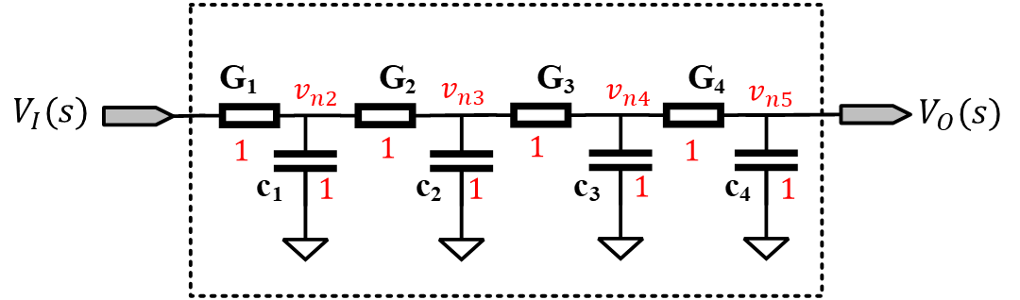



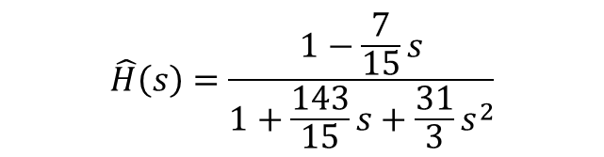


AWE(Asymptotic waveform evaluation)
例子：
$$H_{o}\left(s\right)=H_{n5}\left(s\right)=1−10s+85s^{2}−707s^{3}+…$$
$$\hat{H}\left(s\right)=\frac{{\hat{b}}_{0}+{\hat{b}}_{1}s}{1+{\hat{a}}_{1}s+{\hat{a}}_{2}s^{2}}, q=2$$
$${\hat{b}}_{0}+{\hat{b}}_{1}s=\left(1−10s+85s^{2}−707s^{3}+…\right)\left(1+{\hat{a}}_{1}s+{\hat{a}}_{2}s^{2}\right)$$
$${\hat{b}}_{0}=1$$
$$0={\hat{a}}_{2}−10{\hat{a}}_{1}+85$$
$${\hat{b}}_{1}={\hat{a}}_{1}−10$$
$$0=−10{\hat{a}}_{2}+85{\hat{a}}_{1}−707$$
$$\hat{H}\left(s\right)=\frac{1−\frac{7}{15}s}{1+\frac{143}{15}s+\frac{31}{3}s^{2}}$$

Slide 9
AWE(Asymptotic waveform evaluation)
no guarantee that a given approximate will be stable
numerical stability

Slide 10

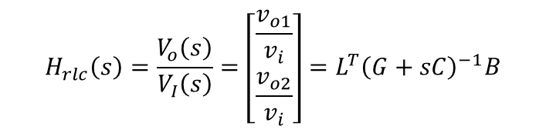














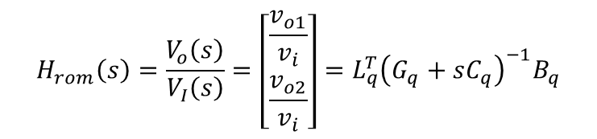
Arnoldi-based ROM (reduced order model)
arnoldi算法求$n×q$投影矩阵$V_{q}$：将网络由$n$阶降低到$q$（=4）阶
$$G_{q}=V_{q}^{T}GV_{q}$$
$$B_{q}=V_{q}^{T}B$$
$${H_{q}=V}_{q}^{T}AV_{q}$$
$$C_{q}=V_{q}^{T}CV_{q}$$
$$L_{q}=V_{q}^{T}L$$
$$R_{q}=V_{q}^{T}R$$
$$\left(G+sC\right)X={BV}_{I}$$
节点电压方程
$$\left(G_{q}+sC_{q}\right)X_{q}={B_{q}V}_{I}$$
$$V_{o}=L^{T}X$$
输出方程
$$V_{o}=L_{q}^{T}X_{q}$$
$$H_{rlc}\left(s\right)=\frac{V_{o}\left(s\right)}{V_{I}\left(s\right)}=\left[\begin{aligned}\begin{aligned}\frac{v_{o1}}{v_{i}} \\ \frac{v_{o2}}{v_{i}}\end{aligned}\end{aligned}\right]=L^{T}{\left(G+sC\right)}^{−1}B$$
$$H_{rom}\left(s\right)=\frac{V_{o}\left(s\right)}{V_{I}\left(s\right)}=\left[\begin{aligned}\begin{aligned}\frac{v_{o1}}{v_{i}} \\ \frac{v_{o2}}{v_{i}}\end{aligned}\end{aligned}\right]=L_{q}^{T}{\left(G_{q}+sC_{q}\right)}^{−1}B_{q}$$
$$defining:$$
$$A=−G^{−1}C, R=G^{−1}B$$
传递函数
$$defining:$$
$$H_{q}=−G_{q}^{−1}C_{q}, R_{q}=G_{q}^{−1}B_{q}$$
$$H_{rlc}\left(s\right)=L^{T}{\left(I−sA\right)}^{−1}R$$
$$H_{rom}\left(s\right)=L_{q}^{T}{\left(I−sH_{q}\right)}^{−1}R_{q}$$

Slide 11
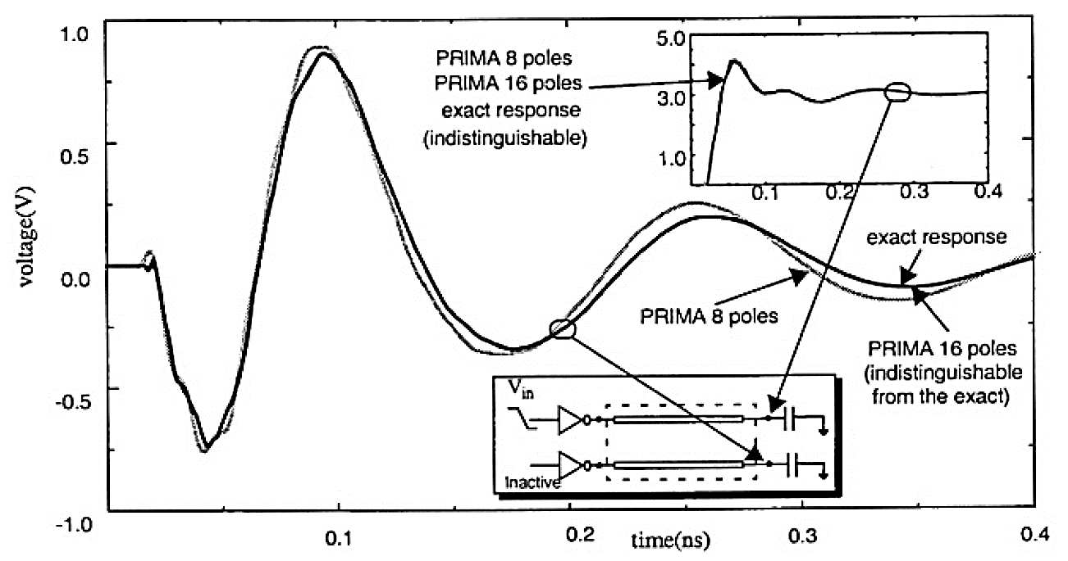
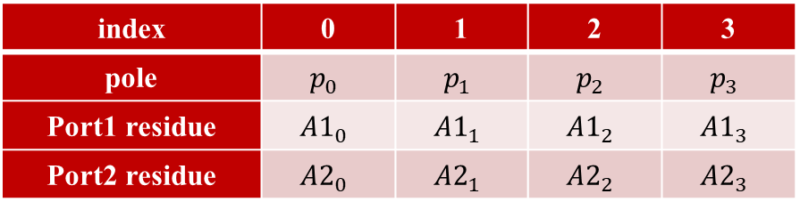









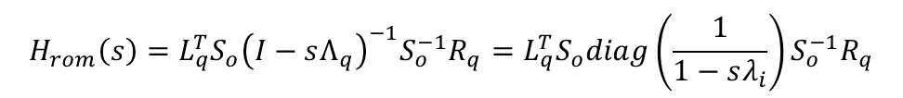

Arnoldi-based ROM (reduced order model)
$$H_{q}=S_{o}Λ_{q}S_{o}^{−1}$$
$$⇒$$
$$H_{rom}\left(s\right)=L_{q}^{T}{S_{o}\left(I−sΛ_{q}\right)}^{−1}{S_{o}^{−1}R}_{q}=L_{q}^{T}S_{o}diag\left(\frac{1}{1−sλ_{i}}\right){S_{o}^{−1}R}_{q}$$
特征分解：
$$Λ_{q}=diag(λ_{1},λ_{2},…,λ_{q})$$
极点:
$$p_{i}=\frac{1}{λ_{i}},$$
留数:
$$\left[A_{i}\right]=L_{q}^{T}R_{q}$$
$$H_{rom_{n}}\left(s\right)=\frac{V_{o_{n}}\left(s\right)}{V_{I}\left(s\right)}=\sum_{i=0}^{q−1}{\frac{A_{i}^{′}}{s−p_{i}}=\sum_{i=0}^{q−1}{\frac{A_{i}}{1−{\frac{s}{p}}_{i} }}}$$
$A_{i}^{′}(=−A_{i}∗p_{i})为$residue，我们工具将$A_{i}$称为residue
$$4端口网络：16 poles对应4阶ROM$$
$其中$：
$p_{i}为$极点
$$CHT 4阶ROM$$
index | 0 | 1 | 2 | 3
pole | $$p_{0}$$ | $$p_{1}$$ | $$p_{2}$$ | $$p_{3}$$
Port1 residue | $${A1}_{0}$$ | $${A1}_{1}$$ | $${A1}_{2}$$ | $${A1}_{3}$$
Port2 residue | $${A2}_{0}$$ | $${A2}_{1}$$ | $${A2}_{2}$$ | $${A2}_{3}$$

Slide 12



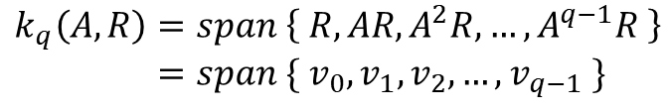
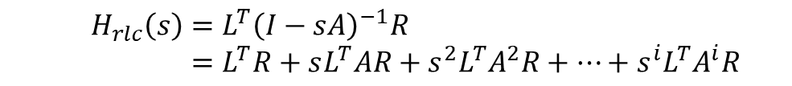



Arnoldi-based ROM (reduced order model)
传输函数：
Krylov subspace:
其中$：A=−G^{−1}C, R=G^{−1}B$
$$H_{rlc}\left(s\right)=L^{T}{\left(I−sA\right)}^{−1}R \\ =L^{T}R+sL^{T}AR+s^{2}L^{T}A^{2}R+…+s^{i}L^{T}A^{i}R+…$$
$$m_{i}=L^{T}A^{i}R$$
$$k_{q}\left(A,R\right)=span \left\{ R, AR, A^{2}R,…, A^{q−1}R \right\} \\ =span \{ v_{0},v_{1},v_{2},…,v_{q−1} \}$$
$$v_{i}^{T}v_{j}=0, ∀ i≠j$$
$$v_{i}$$
标准正交基:
$$v_{i}^{T}v_{i}=1, ∀ i$$

Slide 13









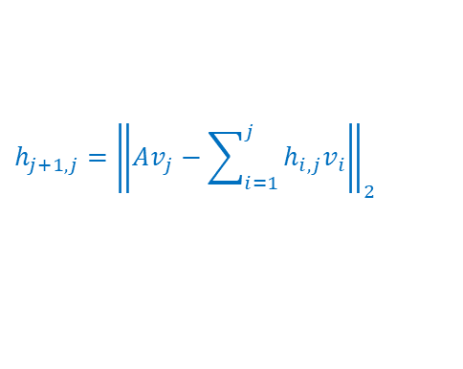


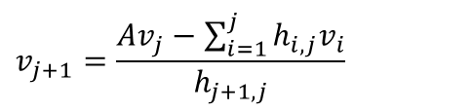



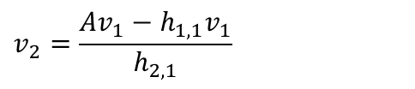
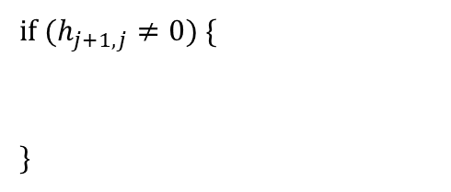

Arnoldi-based ROM (reduced order model)
$$k_{q}\left(A,−R\right)=span \left\{ −R, −AR, {−A}^{2}R,…, {−A}^{q−1}R \right\}$$
arnoldi 算法：
$$v_{0}=−R$$
$$v_{1}=\frac{−R}{{\left\|R\right\|}_{2}}$$
$$h_{0,0}=\sqrt{v_{0}^{T}v_{0}}$$
$$h_{1,1}=\left\langle Av_{1},v_{1}\right\rangle$$
$$v_{1}=\frac{v_{0}}{h_{0,0}}$$
$$v_{2}=\frac{Av_{1}−h_{1,1}v_{1}}{h_{2,1}}$$
内积
数学表达
$$h_{2,1}={\left\|Av_{1}−h_{1,1}v_{1}\right\|}_{2}$$
2-范数
for (j =1; j<=q; j++) {
for (i=1; i<=j; i++) {
}
}
$$w=Av_{j}$$
$$⋮$$
$$v_{j+1}=\frac{Av_{j}−\sum_{i=1}^{j}{h_{i,j}v_{i}}}{h_{j+1,j}}$$
$$h_{i,j}=\left\langle Av_{j},v_{i}\right\rangle$$
$$h_{i,j}=\sqrt{w^{T}v_{i}}$$
$$h_{j+1,j}={\left\|Av_{j}−\sum_{i=1}^{j}{h_{i,j}v_{i}}\right\|}_{2}$$
$$w=w−h_{i,j} v_{i}$$
$$h_{j+1,j}=\sqrt{w^{T}w}$$
$$V_{q}=[v_{1},v_{2},v_{3},…,v_{q}]$$
if ($h_{j+1,j}≠0)${
}
$$H_{q}=\left[\begin{matrix}\begin{aligned}h_{1,1} \\ h_{2,1} \\ 0\end{aligned} & \begin{aligned}h_{1,2} \\ h_{2,2} \\ h_{3,2}\end{aligned} & \begin{aligned}⋯ \\ ⋱ \\ ⋱\end{aligned} & \begin{aligned}⋯ \\ ⋱ \\ ⋱\end{aligned} & \begin{aligned}h_{1,q} \\ h_{2,q} \\ h_{3,q}\end{aligned} \\ ⋮ & ⋱ & ⋱ & ⋱ & ⋮ \\ 0 & ⋯ & 0 & h_{q,q−1} & h_{q,q}\end{matrix}\right]$$
$$v_{j+1}=\frac{w}{h_{j+1,j}}$$
Hessenberg矩阵

Slide 14



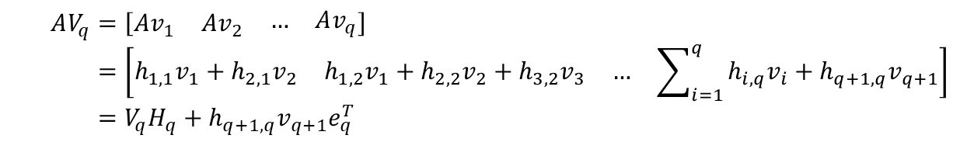

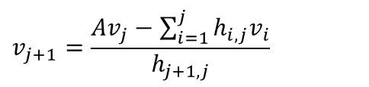
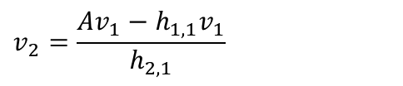
Arnoldi-based ROM (reduced order model)
Arnoldi算法的性质
$$v_{1}=\frac{−R}{{\left\|R\right\|}_{2}}$$
$$AV_{q}=\left[\begin{matrix}Av_{1} & \begin{matrix}Av_{2} & \begin{matrix}… & Av_{q}\end{matrix}\end{matrix}\end{matrix}\right] \\ =\left[\begin{matrix}h_{1,1}v_{1}+h_{2,1}v_{2} & \begin{matrix}h_{1,2}v_{1}+h_{2,2}v_{2}+h_{3,2}v_{3} & \begin{matrix}… & \sum_{i=1}^{q}{h_{i,q}v_{i}}+h_{q+1,q}v_{q+1}\end{matrix}\end{matrix}\end{matrix}\right] \\ =V_{q}H_{q}+h_{q+1,q}v_{q+1}e_{q}^{T}$$
$$v_{2}=\frac{Av_{1}−h_{1,1}v_{1}}{h_{2,1}}$$
$$⋮$$
$$AV_{q}≅V_{q}H_{q}$$
$$v_{j+1}=\frac{Av_{j}−\sum_{i=1}^{j}{h_{i,j}v_{i}}}{h_{j+1,j}}$$
$$H_{q}=V_{q}^{−1}AV_{q}=V_{q}^{T}AV_{q}$$

Slide 15














Arnoldi-based ROM (reduced order model)
为保持降阶系统的渐近稳定性，对原系统做变换 $\hat{X}=C^{\frac{1}{2}}X$
稳定证明：
  $G正定$且可逆$⟹$ $\hat{A}负$定$⟹$ $\hat{A}$经过Arnoldi算法产生的Hessenberg矩阵负定$⟹$ 特征$值（极点）<0⟹$系统渐近稳定
$\hat{X}下$的Arnoldi变换：
$$\left(G+sC\right)X={BV}_{I}$$
节点电压方程
$$\left(GC^{−\frac{1}{2}}+sC^{\frac{1}{2}}\right)\hat{X}={BV}_{I}$$
$$V_{o}=L^{T}X$$
输出方程
$$V_{o}=L^{T}C^{−\frac{1}{2}}\hat{X}$$
$$H\left(s\right)=L^{T}{\left(I−sA\right)}^{−1}R$$
传递函数
$$H\left(s\right)={\hat{L}}^{T}{\left(I−s\hat{A}\right)}^{−1}\hat{R}$$
$$\hat{A}=−{C^{\frac{1}{2}}G}^{−1}C^{\frac{1}{2}}$$
$$\hat{R}={C^{\frac{1}{2}}G}^{−1}B$$
$${\hat{L}}^{T}=L^{T}C^{−\frac{1}{2}}$$
$$\hat{X}=C^{\frac{1}{2}}X$$
$$\left\langle w,v\right\rangle ={\left(C^{\frac{1}{2}}w\right)}^{T}\left(C^{\frac{1}{2}}v\right)==w^{T}Cv$$
$$\left\langle w,v\right\rangle =w^{T}v$$
$X$ 空间下的内积
$\hat{X}$ 空间下的内积

Slide 16








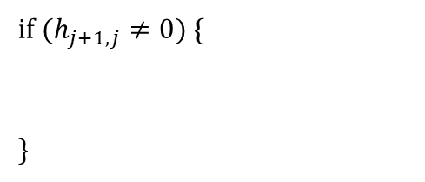


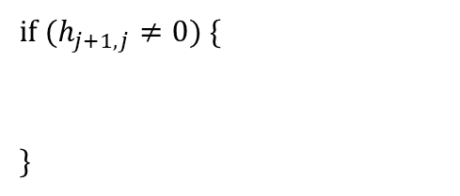






Arnoldi-based ROM (reduced order model)
C 正交 arnoldi 算法：
$$k_{q}\left(A,−R\right)=span \left\{ −R, −AR, {−A}^{2}R,…, {−A}^{q−1}R \right\}$$
$$v_{0}=−R$$
$$v_{0}=−R$$
$$h_{0,0}=\sqrt{v_{0}^{T}v_{0}}$$
$$h_{0,0}=\sqrt{v_{0}^{T}{Cv}_{0}}$$
$$v_{1}=\frac{v_{0}}{h_{0,0}}$$
$$v_{1}=\frac{v_{0}}{h_{0,0}}$$
for (j =1; j<=q; j++) {
for (i=1; i<=j; i++) {
}
}
for (j =1; j<=q; j++) {
for (i=1; i<=j; i++) {
}
}
$$w=Av_{j}$$
$$w=Av_{j}$$
$$h_{i,j}=\sqrt{w^{T}v_{i}}$$
$$h_{i,j}=\sqrt{w^{T}{Cv}_{i}}$$
$$w=w−h_{i,j} v_{i}$$
$$w=w−h_{i,j} v_{i}$$
$$h_{j+1,j}=\sqrt{w^{T}w}$$
$$h_{j+1,j}=\sqrt{w^{T}Cw}$$
if ($h_{j+1,j}≠0)${
}
if ($h_{j+1,j}≠0)${
}
$$v_{j+1}=\frac{w}{h_{j+1,j}}$$
$$v_{j+1}=\frac{w}{h_{j+1,j}}$$
标准正交 arnoldi 算法
C 正交 arnoldi 算法

Slide 17

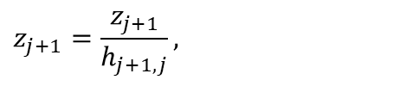















Arnoldi-based ROM (reduced order model)
C 正交 arnoldi 算法：(CHT和论文的表示)
$$v_{0}=−R$$
$$solve:Gv_{0}=−B$$
$$z_{0}={Cv}_{0}$$
$$V_{q}=[v_{1},v_{2},v_{3},…,v_{q}]$$
$$h_{0,0}=\sqrt{v_{0}^{T}z_{0}}$$
$$z_{1}=z_{0}/h_{0,0}$$
$$H_{q}=\left[\begin{matrix}\begin{aligned}h_{1,1} \\ h_{2,1} \\ 0\end{aligned} & \begin{aligned}h_{1,2} \\ h_{2,2} \\ h_{3,2}\end{aligned} & \begin{aligned}⋯ \\ ⋱ \\ ⋱\end{aligned} & \begin{aligned}⋯ \\ ⋱ \\ ⋱\end{aligned} & \begin{aligned}h_{1,q} \\ h_{2,q} \\ h_{3,q}\end{aligned} \\ ⋮ & ⋱ & ⋱ & ⋱ & ⋮ \\ 0 & ⋯ & 0 & h_{q,q−1} & h_{q,q}\end{matrix}\right]$$
$$v_{1}=v_{0}/h_{0,0}$$
for (j =1; j<=q; j++) {
for (i=1; i<=j; i++) {
}
}
$$w=Av_{j}$$
$$solve:Gw=−z_{j}$$
$$h_{i,j}=\sqrt{w^{T}z_{i}}$$
$$w=w−h_{i,j} v_{i}$$
蓝色部分用LU分解G之后求解，避免求$G^{−1}$
$$z_{j+1}=Cw$$
$$h_{j+1,j}=\sqrt{w^{T}z_{j+1}}$$
if ($h_{j+1,j}≠0)${
}
$$z_{j+1}=\frac{z_{j+1}}{h_{j+1,j}},$$
$$v_{j+1}=\frac{w}{h_{j+1,j}}$$

