Slide 1
2024
芯之所至 皆有鸿芯
MNA
打造完整的国产芯片数字EDA平台

Slide 2
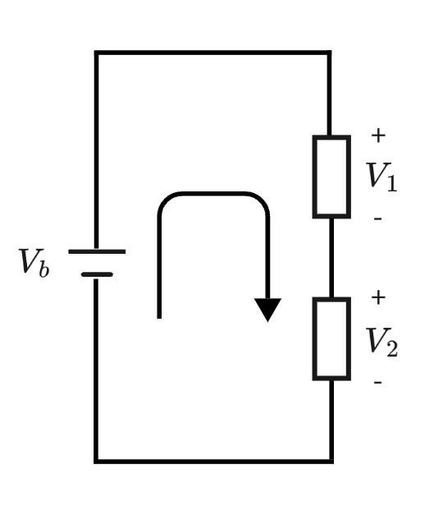
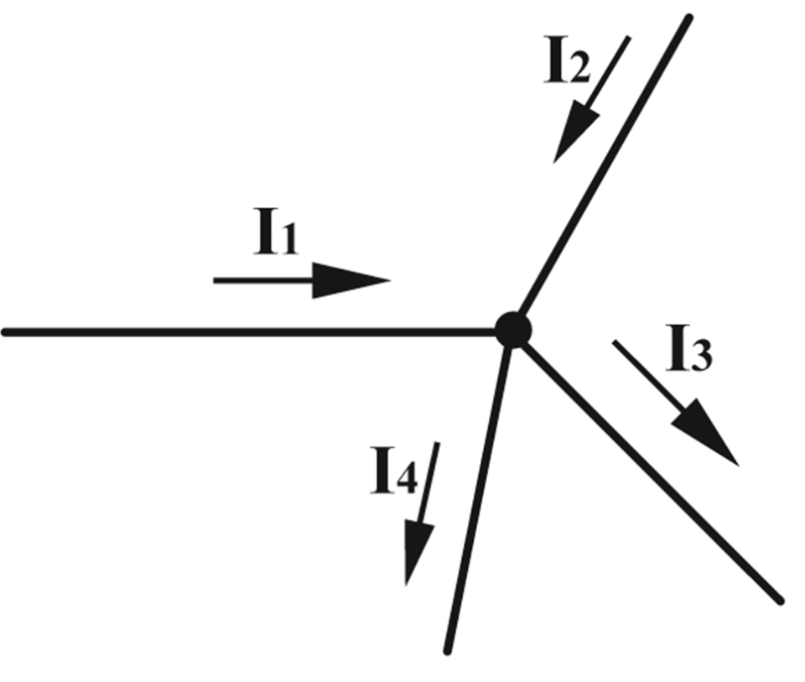
Kirchhoff's laws
Kirchhoff's Current Law (KCL)
the sum of currents flowing into the node equals the sum of currents flowing out of it
$$\sum{I_{in}}=\sum{I_{out}}$$
Kirchhoff's Voltage Law (KVL)
the sum of all voltages around any closed loop in a circuit is equal to zero.
$$\sum{V}=0$$
$$I_{1}+I_{2}=I_{3}+I_{4}$$
$$V_{b}−V_{1}−V_{2}=0$$

Slide 3
Passive element
an element is a two-terminal electrical device
passive element：has voltage across it and the current through it
element equation
$$v=f(i) or i=f(v)$$
resistive
A resistive passive element is called a resistor
element equation depend on derivative
$$v=f(i, i^{’}) or i=f(v, v^{’})$$
dynamic
capacitor: $i(t)=C\frac{dv}{dt}$
inductor: $v(t)=L\frac{di}{dt}$
An element is said to be linear if $f(∙)$ is a linear function,
otherwise it is nonlinear.

Slide 4
Active element
voltage source or current source
$v=constant or v=f(t)$, independent voltage source
$i=constant or i=f(t)$, independent current source
$v=f(I_{x})$, current-controlled voltage source (CCVS)
$v=f(v_{x})$, voltage-controlled voltage source (VCVS)
$I=f(I_{x})$, current-controlled current source (CCCS)
$I=f(v_{x})$, voltage-controlled current source (VCCS)
$I_{x}$：current on some other network element
$v_{x}$：voltage across some other network element

Slide 5
Topological Constraints
A network is characterized by network constraints.
Two types of network constraints:
Branch constraints element equations (branch equations)
Topological constraints arising from Kirchoff’s Current Law (KCL) and Voltage Law (KVL)
How to represent KCL and KVL in large scale circuits?

Slide 6
Network Graphs
graph theory
Define a directed graph $G_{d}$
Create a graph vertex corresponding to every network node
Create a graph edge corresponding to every network element
edge direction = current direction
By convention, the + voltage terminal is always at the tail of the arrow

Slide 7
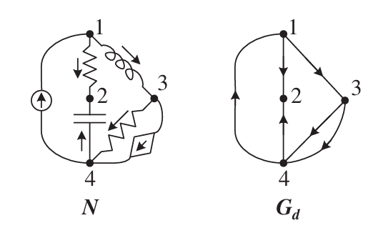
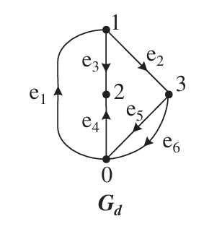
Network Graphs
For a network graph with n nodes and m edges,
one node will be identified as the reference node (denoted by the integer 0 or ground)
All other nodes will be numbered $1, 2, ..., n−1$.
graph nodes $V=\left\{0, 1, 2, ..., n−1\right\}$
graph edges $E=\left\{e_{1}, e_{2}, e_{3}, ..., e_{m}\right\}$

Slide 8
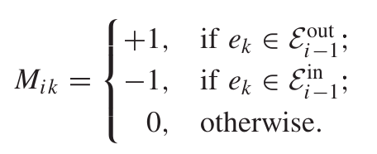
Incidence Matric（关联矩阵）
For a node j
$ε_{j}^{out}$: set of directed edges whose tail is connected to j
$ε_{j}^{in}$: set of directed edges whose head is connected to j

Slide 9
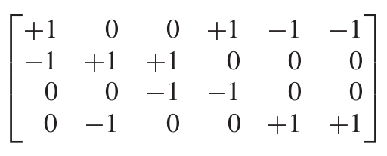
Incidence Matric（关联矩阵）
$$e_{1}$$
$$e_{2}$$
$$e_{3}$$
$$e_{4}$$
$$e_{5}$$
$$e_{6}$$
0
1
$$M=$$
2
3

Slide 10
Voltage Assignments
Considering the directed graph${ G}_{d}=(V, E)$
electric potential at every node 0, 1, ..., n-1 : $p=\left[\begin{aligned}p_{0} \\ p_{1} \\ ⋮ \\ p_{n−1}\end{aligned}\right]$
voltages across every edge $e_{1}, e_{2}, e_{3}, ..., e_{m}$ : $u=\left[\begin{aligned}u_{0} \\ u_{1} \\ ⋮ \\ u_{m}\end{aligned}\right]$
$$u_{j}$$
$$p_{t(e_{j})}$$
$$p_{h(e_{j})}$$
$$u_{j}=p_{t(e_{j})}−p_{h(e_{j})}$$
$$e_{j}$$
$$u=M^{T}p$$

Slide 11
Voltage Assignments
$$v_{j}=p_{j}−p_{0} → p_{j}=p_{0}+v_{j}$$
$$v_{0}=0$$
$$p=\left[\begin{aligned}p_{0} \\ p_{1} \\ ⋮ \\ p_{n−1}\end{aligned}\right]$$
$$u=M^{T}p$$
$$u=M^{T}p=M^{T}\left[\begin{aligned}p_{0} \\ p_{1} \\ ⋮ \\ p_{n−1}\end{aligned}\right]=M^{T}\left[\begin{aligned}p_{0}+v_{0} \\ p_{0}+v_{1} \\ ⋮ \\ p_{0}+v_{n−1}\end{aligned}\right]=M^{T}\left[\begin{aligned}p_{0} \\ p_{0} \\ ⋮ \\ p_{0}\end{aligned}\right]+M^{T}\left[\begin{aligned}0 \\ v_{1} \\ ⋮ \\ v_{n−1}\end{aligned}\right]=M^{T}\left[\begin{aligned}p_{0} \\ p_{0} \\ ⋮ \\ p_{0}\end{aligned}\right]+A^{T}v$$
$$v=\left[\begin{aligned}v_{1} \\ v_{2} \\ ⋮ \\ v_{n−1}\end{aligned}\right]$$
A is the matrix obtained from M by removing its first row.
0 is ground node, $p_{0}=0$
KVL $⇔ u{=A}^{T}v$

Slide 12
Current Assignment
If $i, i_{2}, i_{3}, ..., i_{m} are the currents in e_{1}, e_{2}, e_{3}, ..., e_{m}$
$$KCL ⇔\sum_{e_{k}∈ε_{j}^{out}}{i_{k}}−\sum_{e_{l}∈ε_{j}^{in}}{i_{l}}=0$$
If $i={[i, i_{2}, i_{3}, ..., i_{m}]}^{T} ⇔ Mi=0$
Because one row of M can always be written in terms of all the rest, then one equation of $Mi=0$ is redundant.
KCL $⇔ Ai=0$

Slide 13
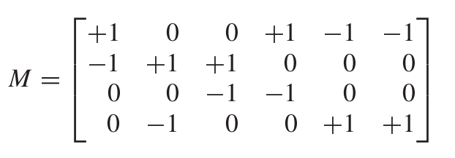
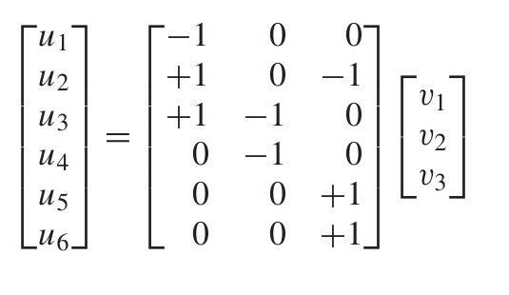
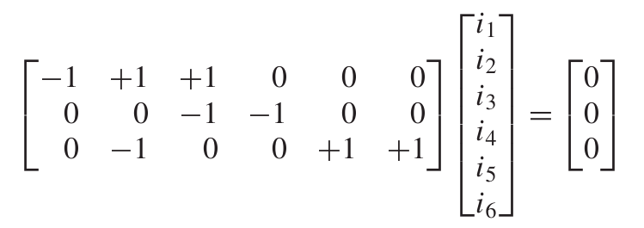
Example
KVL $⇔ u{=A}^{T}v$
KCL $⇔ Ai=0$

Slide 14
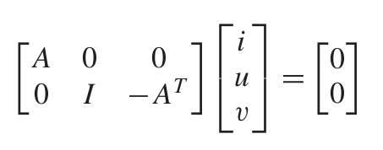
Combined Form
KVL $⇔ u{=A}^{T}v$
KCL $⇔ Ai=0$
The above matrix is highly sparse, which turns out to be a major advantage for solving large circuits.

Slide 15
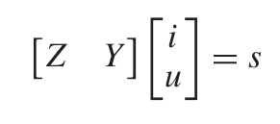
Sparse Tableau Analysis
Two types of network constraints:
Branch constraints element equations (branch equations)
Topological constraints arising from Kirchoff’s Current Law (KCL) and Voltage Law (KVL)
for each $e^{k}$
$$resistor ⇒ u_{k}−Ri_{k}=0$$
$$independent source ⇒ u_{k}=V or i_{k}=I$$
$$VCVS ⇒ u_{k}=αu_{x}$$
$$CCVS ⇒ u_{k}=αi_{x}$$
$$VCCS ⇒ i_{k}=αu_{x}$$
$$CCCS ⇒ i_{k}=αi_{x}$$
$$⇒$$
$$Zi+Yu=s$$

Slide 16
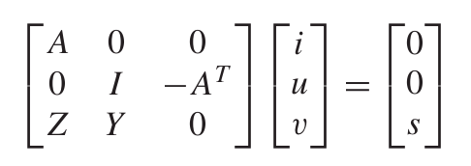
Sparse Tableau Analysis
Topological constraints
Branch constraints
sparse tableau analysis (STA) formulation
STA has some key advantages:
it is very general
tableau matrix is very sparse, is key advantage in simulation of large circuits
disadvantage:
has some independent variables, such as u and v

Slide 17
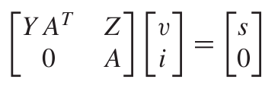
Reduced Tableau Form
STA has some redundant variable so we can eliminate these redundant variable and Modified nodal analysis (MNA) is one such approach.
substitute $u{=A}^{T}v, KVL$ into $Zi+Yu=s$ and rearrange to get Reduced Tableau Form
Thus, we have eliminated all the branch voltage variables

Slide 18
Nodal Analysis
(Simplifying Assumption) The network contains no voltage sources (neither independent nor controlled).
$$Zi+Yu=s$$
resistor, capacitor, inductor
independent voltage source
independent current source
CCVS, VCVS, CCCS, VCCS
no voltage sources
resistor
independent current source
CCCS, VCCS
$$⇒$$
$$i=Yu+s$$
$$u=A^{T}v$$
$$i=Yu+s=YA^{T}v+s$$
$$Ai=0$$
$$Ai=AYA^{T}v+As=0$$
nodal analysis formulation
So Nodal Analysis completely eliminate all current.
$$AYA^{T}v=−As$$

Slide 19
Modified Nodal Analysis
However, insisting on this form makes it impossible to include voltage sources in the formulation.
To handle voltage sources, the key idea is to not insist on eliminating their currents.
standard MNA retains the following:
1. All voltage source currents, be they independent or controlled.
2. Any current that is a control variable for a CCVS or a CCCS.
3. Any current that is a user-specified simulation output.

Slide 20
Modified Nodal Analysis
(Element Groups)
All elements whose currents are to be eliminated will be referred to as being in group 1,
while all other elements will be referred to as group 2.
$$i=\left[\begin{aligned}i_{1} \\ i_{2}\end{aligned}\right]$$
$$u=\left[\begin{aligned}u_{1} \\ u_{2}\end{aligned}\right]$$
element equations
$$KCL A_{1}i_{1}+A_{2}i_{2}=0$$
$$Zi−Yu=s$$
$$KVL u_{1}=A_{1}^{T}v u_{2}=A_{2}^{T}v$$
Top part
Bottom part

Slide 21
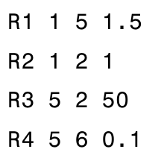
Modified Nodal Analysis
Modified Nodal Analysis (MNA) formulation
In practice, in a simulator, we do not use the above matrix equations to construct the MNA system of equations.
Instead, it can be built gradually.
spice network

Slide 22
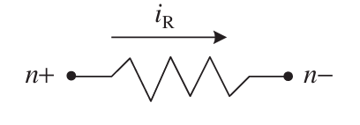
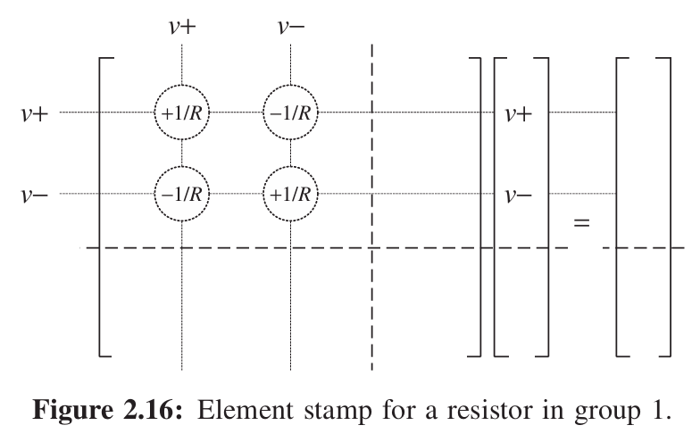
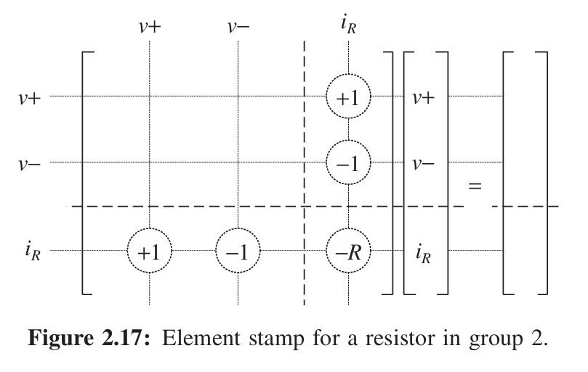
Element Stamp
Top part: For every node other than the reference node, write KCL, then:
(a) Eliminate all currents of group 1 elements using branch equations.
(b) Replace all branch voltages in terms of node voltages using KVL.
Bottom part: For every group 2 element, write its branch equation,
then replace all branch voltages in terms of node voltages using KVL.
$$i_{R}=\frac{1}{R}v^{+}−\frac{1}{R}v^{−}$$
for node $n^{+}$, contribution of R is $i_{R}$
for node $n^{−}$, contribution of R is -$i_{R}$

Slide 23
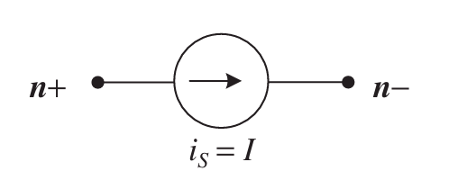
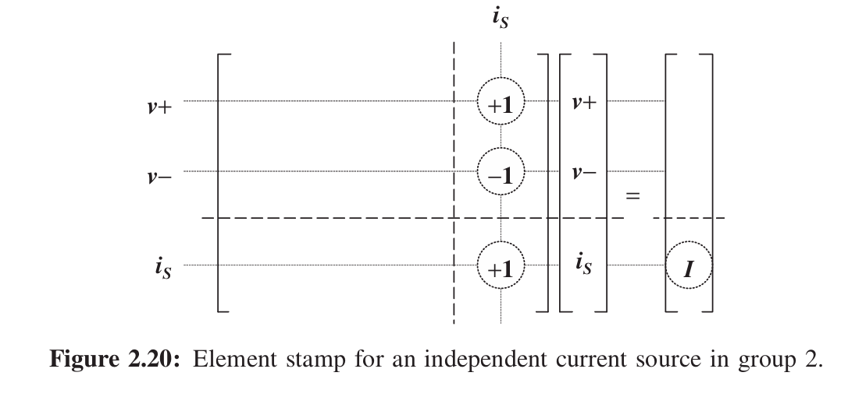
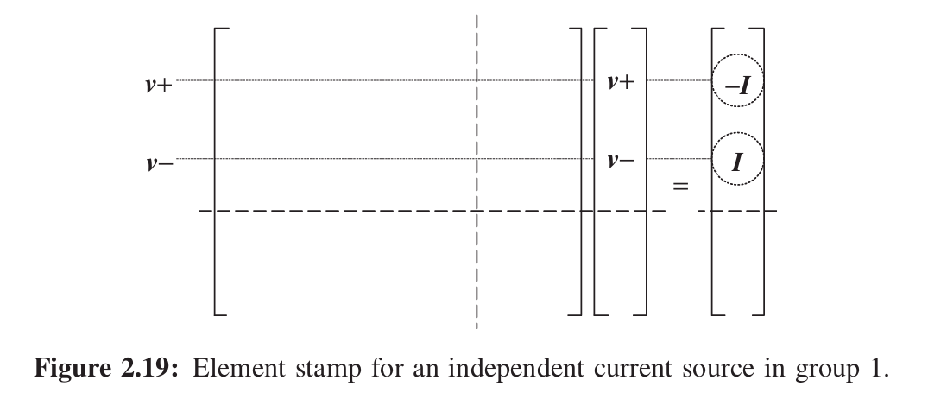
Element Stamp
independent current source
RHS
RHS
right-hand side (RHS)

Slide 24
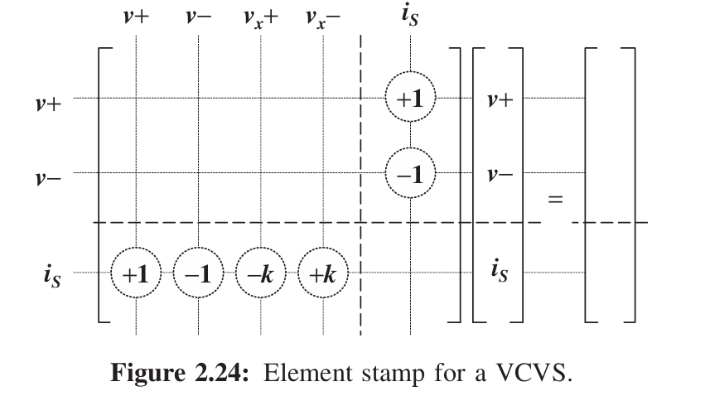
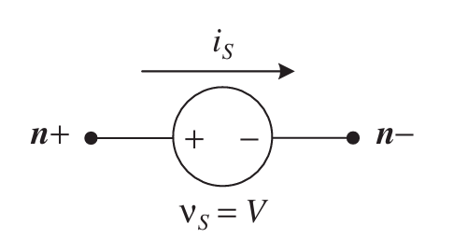
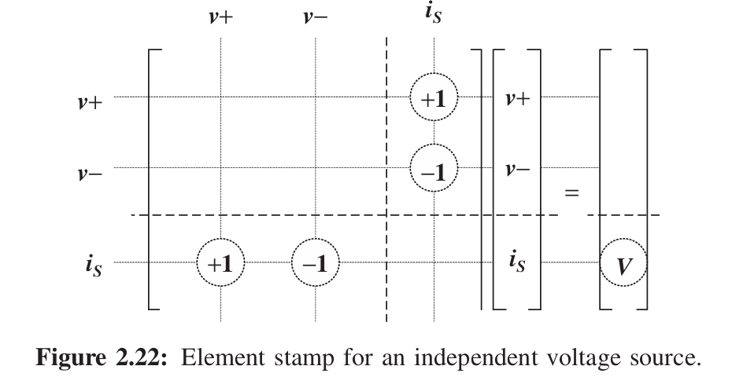
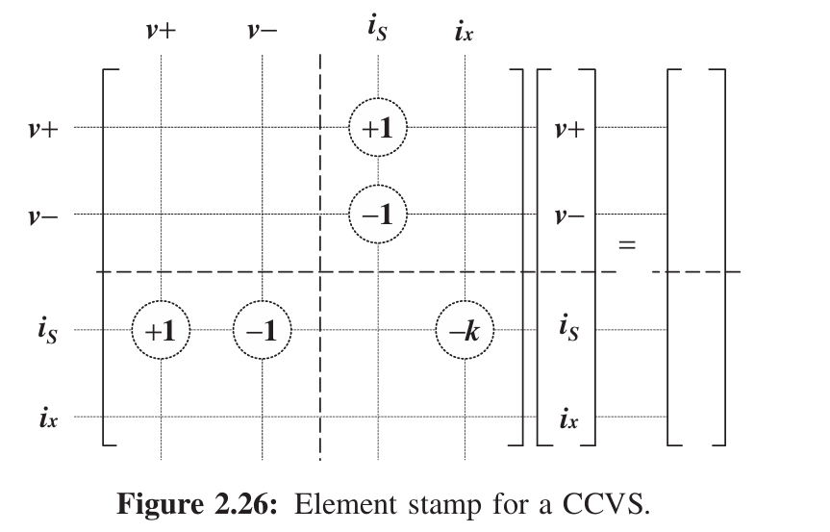
Element Stamp
voltage source

Slide 25
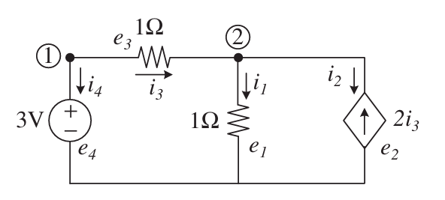
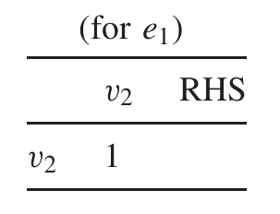
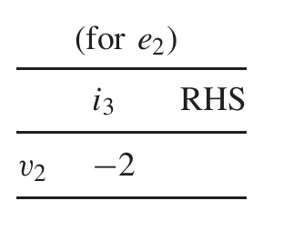
Example
$$e_{1}, e_{2} in group 1 (need to be eliminated)$$
$$e_{3}, e_{4} in group 2 (retain)$$
$e_{3}$ is controlling element for $e_{3}$ (CCCS)
$$e_{4} is voltage source current$$

Slide 26
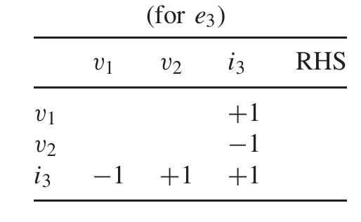
Example
$$e_{1}, e_{2} in group 1 (need to be eliminated)$$
$$e_{3}, e_{4} in group 2 (retain)$$

Slide 27
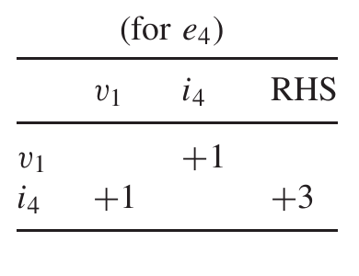
Example
$$e_{1}, e_{2} in group 1 (need to be eliminated)$$
$$e_{3}, e_{4} in group 2 (retain)$$

Slide 28
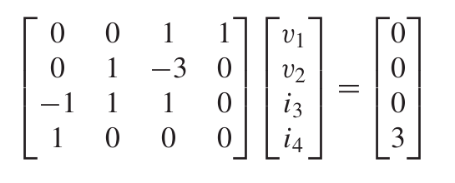
Example

Slide 29
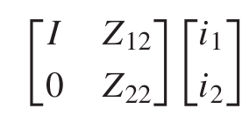
Linear Dynamic Equations
$$i=\left[\begin{aligned}i_{1} \\ i_{2}\end{aligned}\right]$$
$$i^{’}=\left[\begin{aligned}i_{1}^{’} \\ i_{2}^{’}\end{aligned}\right]$$
$$u=\left[\begin{aligned}u_{1} \\ u_{2}\end{aligned}\right]$$
$$u^{’}=\left[\begin{aligned}u_{1}^{’} \\ u_{2}^{’}\end{aligned}\right]$$
MNA in the dynamic case

Slide 30
THANK YOU
WWW.GIGA-DA.COM
电话：0755-61018899
邮箱：info@GIGA-DA.COM
邮编：518000

