Slide 1
effective trans
Xin Xie
2024/8/7

Slide 2
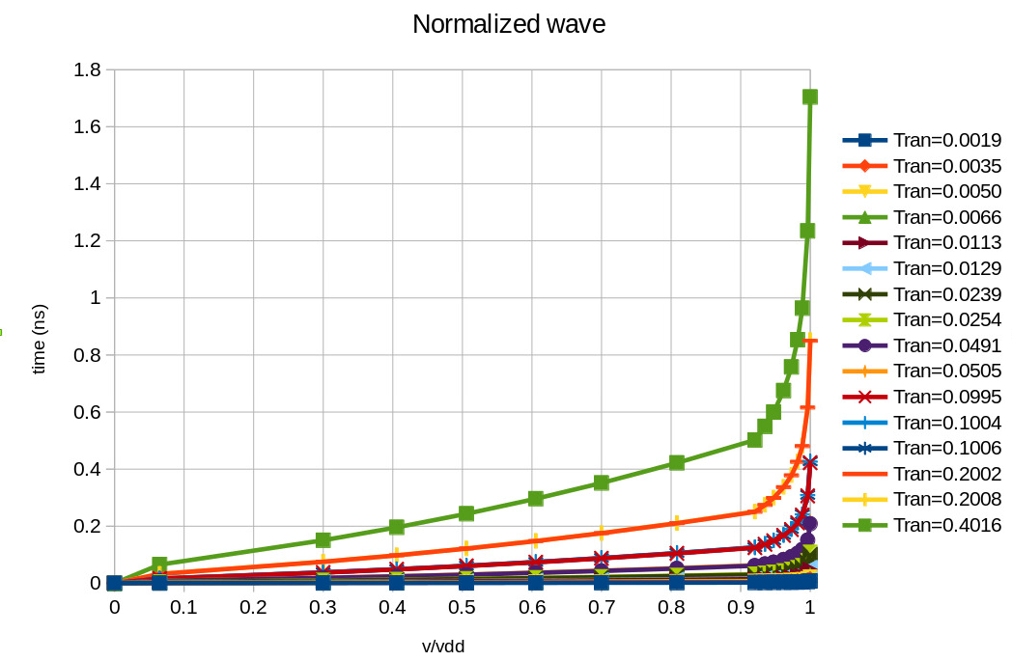
Normalized wave
trans
v/vdd

Slide 3
reg trans and effective trans
reg trans：真实波形量测的trans值
effective trans: 波形匹配得到的等效normalized wave对应的trans值
$$v$$
$$Vdd$$
fitting_norm_wave
real_wave
$$0.7Vdd$$
$$0.5Vdd$$
$$0.3Vdd$$
reg_trans
eff_trans
$$t$$

Slide 4
波形匹配
将vl-vh之间的电压波形以vstep为间隔进行切片，截取时间值$t_{k}$：
vl: waveform_fitting_lower_threshold
vh: waveform_fitting_upper_threshold
vstep: waveform_fitting_voltage_step
以vl=0.1, vh=0.9, vstep=0.1为例， 波形被切割成10段
$$v/v_{dd}$$
$$0.9$$
$$0.2$$
$$0.1$$
$$t_{1}$$
$$t_{2}$$
$$t_{9}$$
$$t$$

Slide 5
波形匹配
$$v/v_{dd}$$
$$0.9$$
电压切片成10段(n=9个点)，截取时间值$t_{k}$：
real wave: $t_{k}, k = 1\sim n$；对应trans: $s$
normalized wave1:$t1_{k}, k = 1\sim n$；对应trans: $s_{1}$
normalized wave2: ${t2}_{k}, k = 1\sim n$；对应trans: $s_{2}$
$sum_{t}=\sum_{k=1}^{n}{t_{k}}$
$sum_{t1t2}=\sum_{k=1}^{n}{\left({t1}_{k}−t2_{k}\right)}$
$sum_{t_t1t2}=\sum_{k=1}^{n}{t_{k}\left({t1}_{k}−t2_{k}\right)}$
$$0.2$$
$$0.1$$
$$t_{1}$$
$$t_{2}$$
$$t_{9}$$
$$t$$
$$α=(sum_{t}∗sum_{t1t2}−n∗sum_{t_t1t2})−(sum_{t1}∗sum_{t1t2}−n∗sum_{t1_t1t2})$$
$$k_{t}$$
$$k_{t1}$$
$$β=(sum_{t2}∗sum_{t1t2}−n∗sum_{t2_t1t2})−(sum_{t1}∗sum_{t1t2}−n∗sum_{t1_t1t2})$$
$$k_{t2}$$
$$k_{t1}$$
$$\frac{α}{β}= \left\{\begin{aligned}<−0.1 , return false \\ −0.1≤\frac{α}{β}≤1.1 \\ >1.1 , return false\end{aligned}\right.$$
$$\frac{s−s_{1}}{s_{2}−s_{1}}=\frac{k_{t}−k_{t1}}{k_{t2}−k_{t1}}$$
$$s=s_{1}+\frac{k_{t}−k_{t1}}{k_{t2}−k_{t1}}(s_{2}−s_{1})=s_{1}+\frac{α}{β}\left(s_{2}−s_{1}\right)$$

