Slide 1
SI CCS Flow

Slide 2
Overview
paper: A robust cell-level crosstalk delay change analysis
Aggressor responses(current + voltage)
Select alignment
Victim Driver output response
Victim Driver output response(consider aggressor current)
Victim Receiver input response
Victim Receiver input response(consider aggressor voltage)
Victim Receiver output response
Victim Receiver output response
Normal delay
SI delay
delta delay

Slide 3
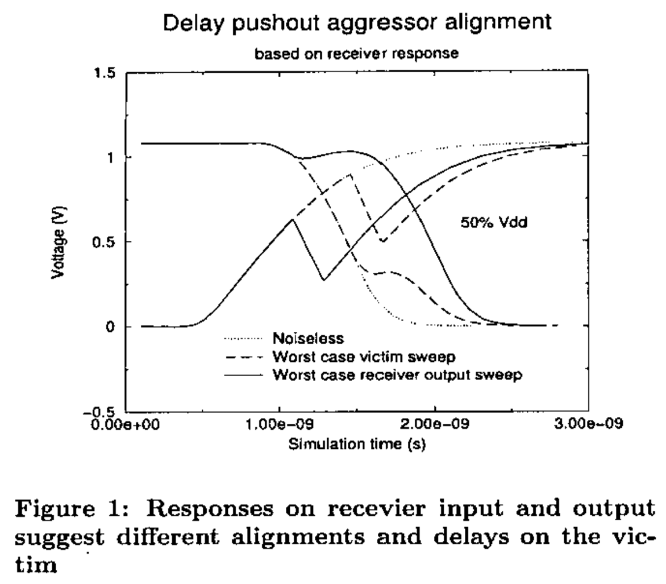
Why receiver output?
ROP(receiver-output probing)

Slide 4
Overall Flow
siCCS::UpdateXTCCSDelayNormal
filter aggressor+建RC mesh
ROM
计算各aggressor到vic driver的注入电流
计算各aggressor到vic sink的bump
计算vic normal delay
计算各aggr window ratio
各vic sink
align aggressor
各align point
计算vic si delta delay

Slide 5
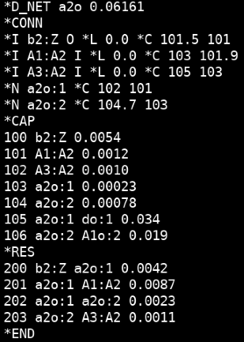
GenMesh
siMT.cpp: lpNetRLC* netRLC = GetSI()->GetTd()->GetNetRLCWithXcap(net, ck);
拿到vic的RC信息。
lpRLCNode上的cap值为对地电容与耦合电容之和。
lpRLCCouple记录耦合点。
vicSink1
vicDriver
RC tree only with coupled node
vicSink2
filter aggressor+GenMesh:
AggrDriver1
AggrSinks
加入了aggressor的RC信息。
这里不考虑二次耦合。
vicDriver
coupled RC tree
vicSink1
AggrDriver2
vicSink2

Slide 6

Normal delay计算
1. 生成vic driver input波形，再solve ccb解出vic driver output波形；
2. vic driver output波形通过卷积计算得到sink pin波形；
3. sink pin波形再去解ccb的到sink out波形，并得到normal delay。
source
sink

Slide 7
计算注入电流
Replacing k-th aggressor driver with corresponding voltage source and short-circuiting all other drivers.
aggDr
rc
vicDr
n1
rc
r1
n1
r2
n2
rc
若vicDr有连接电容，为方便测量注入电流，在建mesh后会加一小电阻。
vicDr
r3
n3
vicDr
r1
n1
rc
vic driver不连接电容时，计算到n1, n2, n3三点的电压(卷积)，再分别除以r1, r2, r3得到电流波形后相加。
计算aggr到n1的电压，除以r1的到电流。

Slide 8
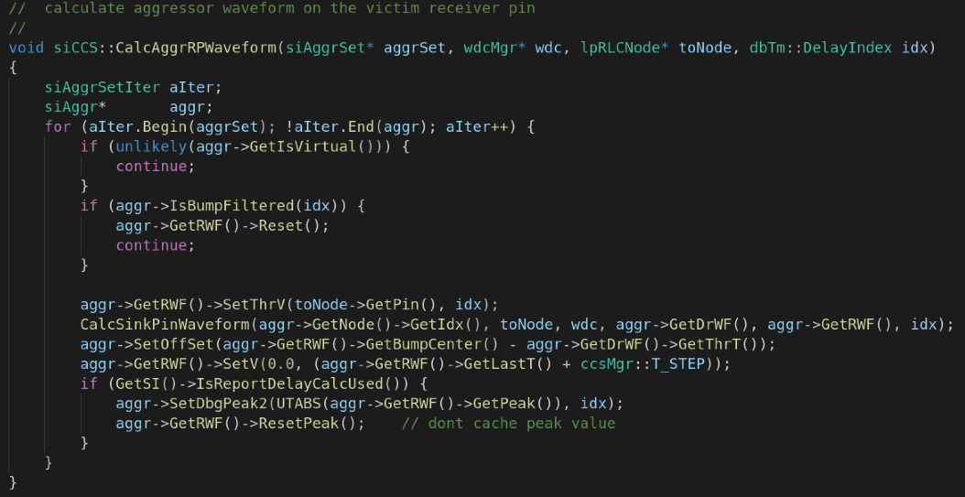
计算bump
Replacing k-th aggressor driver with corresponding voltage source and short-circuiting all other drivers.
aggDr
rc
r1
n1
r2
n2
rc
r3
n3

Slide 9
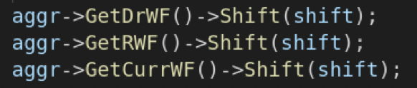
align
vdd
0.9vdd
0.5vdd
rise max
t1
t2
t3

Slide 10
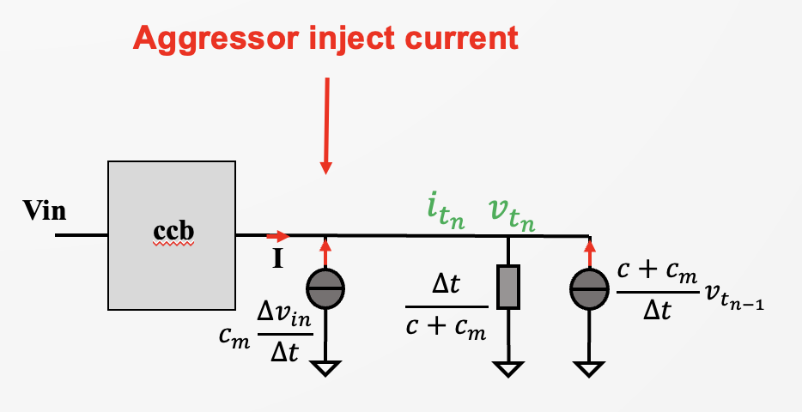
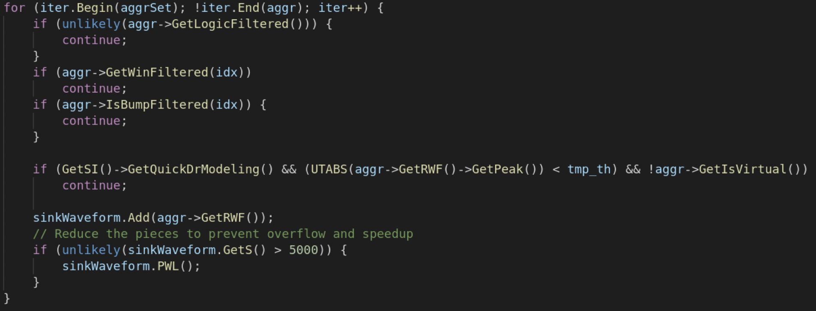





SI delay计算
1. normal delay时生成的vic driver input波形，考虑注入电流，solve ccb解出vic driver output波形；
2. vic driver output波形通过卷积计算得到sink pin波形；
3. sink pin波形叠加aggressor bump；
4. 再去solve ccb的到sink out波形，并得到si delay。
source
sink
+

Slide 11

THANK YOU
WWW.GIGA-DA.COM
电话：0755-61018899
邮箱：info@GIGA-DA.COM
邮编：518000

