Slide 1
SI Quick Flow

Slide 2
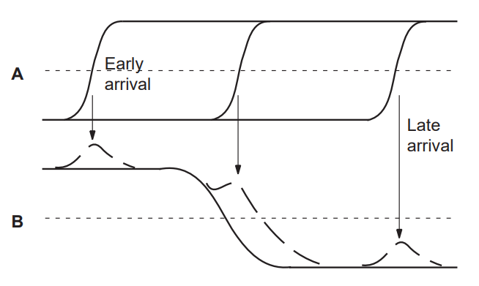
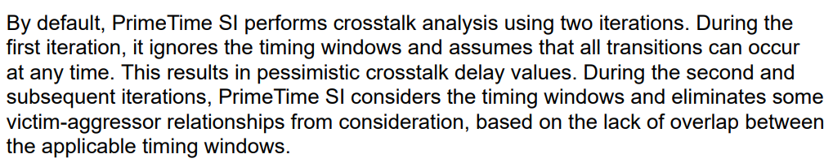
SI Overview
aggr/dr
aggr/sink
cc
vic/dr
vic/sink
·

Slide 3

Overall Flow

Slide 4
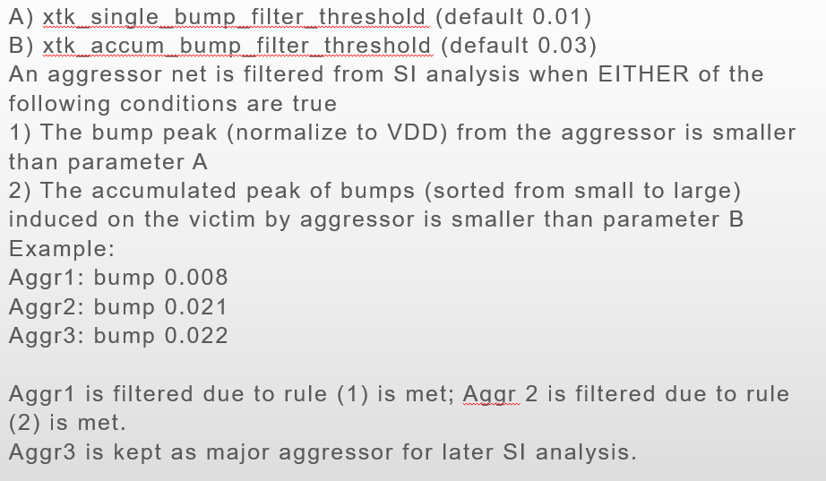
Filtering
Cap Filtering：
  xcap < xcap_abs_threshold, filtered
Bump Filtering：

Slide 5
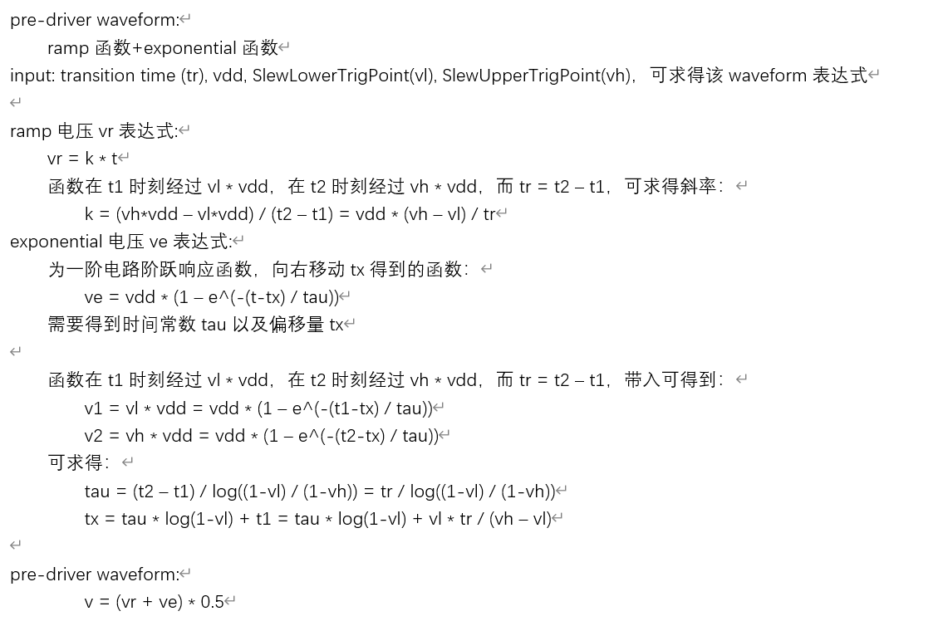
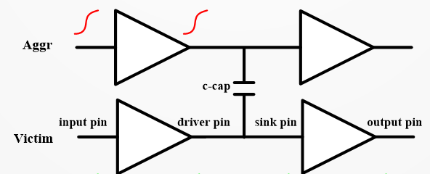
Bump calculation
Input wave：from DrModeling or pre-driver
solveCCB

Slide 6






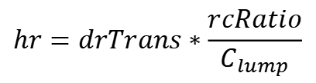


Bump calculation
rs: rCoupleToDrv, from RLCTree
hr: holding resistance
inw
aggr/dr
aggr/sink
$$hr=drTrans∗\frac{rcRatio}{C_{lump}}$$
cc
$$\frac{v}{v_{0}}=(1−e^{−\frac{t}{rc}})$$
rise：
vic/dr
rs
outw
vic/sink
$$t=−rc∗log⁡(1−\frac{v}{v_{0}})$$
cl
hr
$${t_{2}−t}_{1}=−rc∗\log\left(\frac{1−upRise}{1−downRise}\right)=0.9∗trans∗derate$$
RiseRcRatio：
$$\frac{rc}{trans}=0.9∗derate/\log\left(\frac{1−downRise}{1−upRise}\right)$$
fall：
$$\frac{v}{v_{0}}=e^{−\frac{t}{rc}}$$
cc
inw
outw
$$t=−rc∗log⁡(\frac{v}{v_{0}})$$
hres
cl
$$t_{2}−t_{1}=−rc∗\log\left(\frac{downFall}{upFall}\right)=0.9∗trans∗derate$$
$$hres=hr+rs$$
fallRcRatio：
$$\frac{rc}{trans}=0.9∗derate/\log\left(\frac{upFall}{downFall}\right)$$

Slide 7
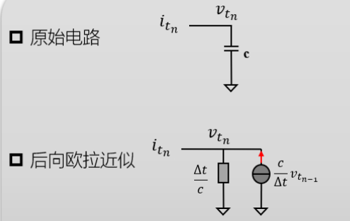










Bump calculation
cc
inw
outw
hres
cl
$$hres=hr+rs$$
$$vi$$
$$tmp=\frac{{c_{c}+c}_{l}}{∆t}$$
$$vo$$
$$a11=\frac{1}{h_{res}}+tmp$$
$$\frac{c_{c}}{∆t}∆vi$$
$$h_{res}$$
$$\frac{∆t}{{c_{c}+c}_{l}}$$
$$\frac{{c_{c}+c}_{l}}{∆t}{vo}_{t_{n−1}}$$
$$a11∗vo_{t_{n}}=\frac{c_{c}}{∆t}∆vi+tmp∗{vo}_{t_{n−1}}=rhs$$
$$vo_{t_{n}}=\frac{rhs}{a11}$$

Slide 8
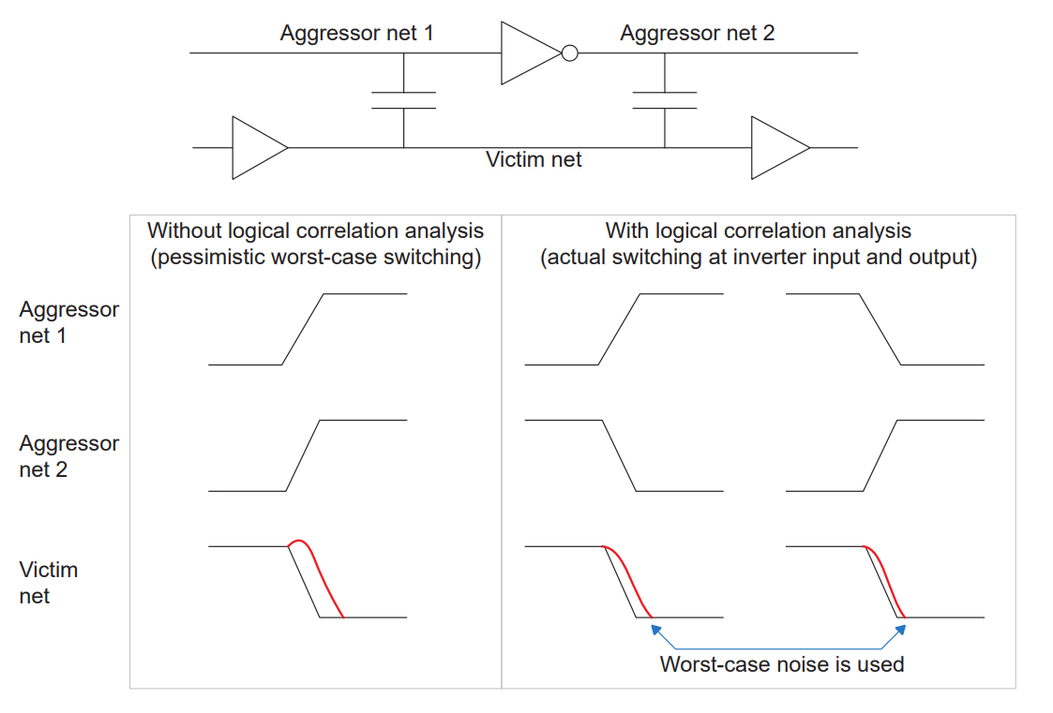
Logic Correlation

Slide 9

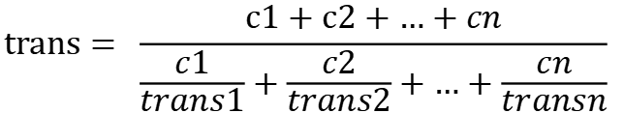
Virtual attacker
Virtual attacker coupling cap
Virtual attaker trans
Virtual attacker Rs
$$cc=aggrNumRatio ∗ \sqrt{{c1}^{2}+{c2}^{2}+…+{cn}^{2}}$$
$$trans= \frac{c1+c2+…+cn}{\frac{c1}{trans1}+\frac{c2}{trans2}+…+\frac{cn}{transn}}$$
$$Rs= \frac{c1∗Rs1+c2∗Rs2+…+cn∗Rsn}{c1+c2+…+cn}$$

Slide 10
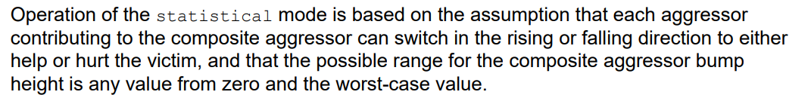
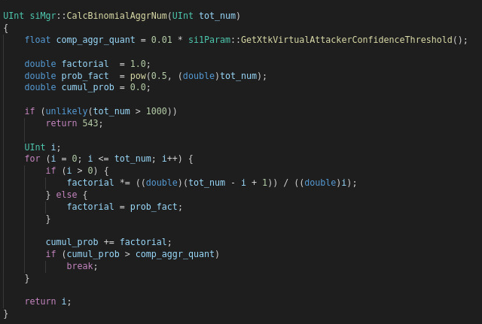



Statistical method
Binomial Distribution
$$P\left\{ε ≤N\right\}>confidenceThreshold$$
$$aggrNumRatio=N/n$$

Slide 11
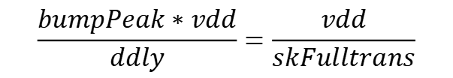
Delta-Delay estimation
y
Assume sink wave is ramp
vdd
$$\frac{bumpPeak∗vdd}{ddly}=\frac{vdd}{skFulltrans}$$
bumpPeak*vdd
0.5vdd
ddly
$$ddly=sinkFullTrans ∗ bumpPeak$$
0
x

Slide 12


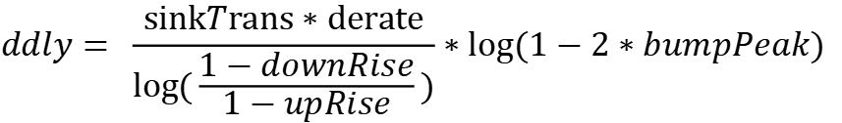
Delta-Delay estimation
y
Assume sink wave is exponential
$$\frac{v}{v_{dd}}=(1−e^{−\frac{t}{rc}})$$
vdd
bumpPeak*vdd
$$\frac{rc}{trans}=derate/\log\left(\frac{1−downRise}{1−upRise}\right)$$
0.5vdd
ddly
$$ddly= \frac{sinkTrans∗derate}{log(\frac{1−downRise}{1−upRise})}∗log⁡(1−2∗bumpPeak)$$
0
x

Slide 13
Window strategy
Second SI iteration needs consider timing window
Ddly = win_ratio * ddly
Win_ratio shows the overlap degreed between victim and aggressor
How to calc win_ratio?
  Get victim driver timing window (maybe multiple clock domain)
  For each clock:
    Get aggressor driver timing window
    Window extension
    Calc win_ratio according to victim window, aggressor window and extension
  Pick the worst win_ratio

Slide 14
Window strategy
以min_rise为例
arrival time
ovelap condition:
vicWindowLeftSide-vExt1< aggWindowRightSide+aExt
aggWindowLeftSide-aExt2< vicWindowRightSide+vExt2
$$aExt2$$
$$aExt$$
aggressor
aggr window
victim window
aggr window
victim
arrival_time
victim window
$$0.5V_{dd}$$
$$vExt1$$
$$vExt2$$

Slide 15
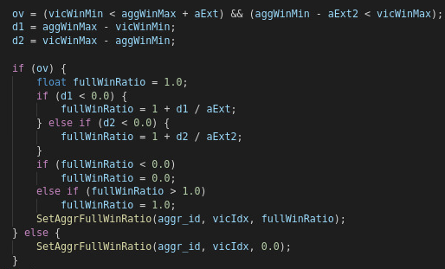


Window strategy
arrival time
aExt
$$aExt2$$
$$aExt$$
aggr window
-d1
victim window
arrival_time
$$0.5V_{dd}$$
$$vExt1$$
$$vExt2$$
$$vExt1=vExt2=0$$
$$aExt2=t_{left}$$
$$aExt=t_{right}$$

Slide 16

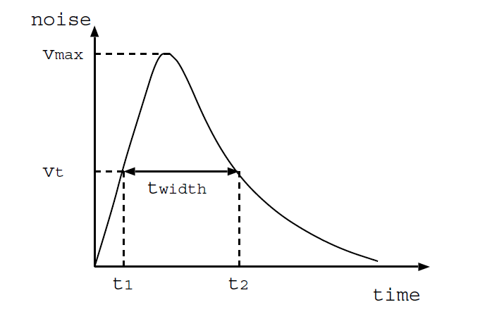


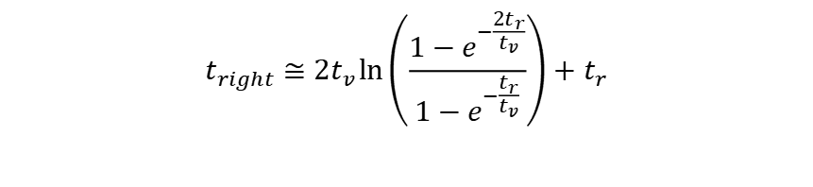


Window extension
According to paper “Improved Crosstalk Modeling for Noise Constrained Interconnect Optimization”:
cc
outw
inw
hres
cl
$$h_{res}=h_{r}+r_{s}$$
$$t_{left}=t_{r}≤aggSinkRiseMaxFullTrans$$
$$t_{right}≅2t_{v}\ln\left(\frac{1−e^{−\frac{2t_{r}}{t_{v}}}}{1−e^{−\frac{t_{r}}{t_{v}}}}\right)+t_{r}$$
$$t_{v}=(h_{r}+r_{s})C_{lump}$$
$$t_{left}$$
$$t_{right}$$
Code：

Slide 17
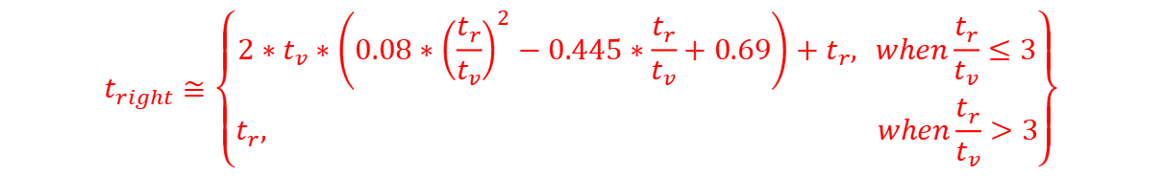


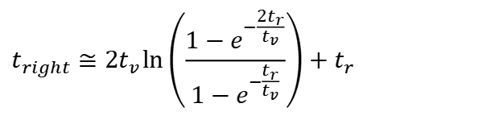
t_right approximation
$$t_{right}≅2t_{v}\ln\left(\frac{1−e^{−\frac{2t_{r}}{t_{v}}}}{1−e^{−\frac{t_{r}}{t_{v}}}}\right)+t_{r}$$
$$t_{right}≅\left\{\begin{aligned}2∗t_{v}∗\left(0.08∗{\left(\frac{t_{r}}{t_{v}}\right)}^{2}−0.445∗\frac{t_{r}}{t_{v}}+0.69\right)+t_{r}, when\frac{t_{r}}{t_{v}}≤3 \\ t_{r}, when\frac{t_{r}}{t_{v}}>3\end{aligned}\right\}$$
令$x=\frac{t_{r}}{t_{v}}, 令y_{x}=\ln\left(\frac{1−e^{−2x}}{1−e^{−x}}\right)，则：$
$$t_{right}≅2t_{v}y_{x}+t_{r}=\left(\frac{{2y}_{x}}{x}+1\right){∗t}_{r}$$
$由$图可知：x>3时，2y/x < 0.03，对tright影响忽略不计
从图可知：2次函数拟合y在x取值范围[0~3]内的精度非常高

