Slide 1
Wire delay用Elmore和Arnoldi的计算方法

Slide 2

01.
Arnoldi flow

Slide 3
Arnoldi flow
数据准备：Net, NetRLC
Build ROM并得到极点：SetupWDC()、BuildROM()
遍历所有的sink pin:
  设置driver waveform参数(is rise/fall,trans,shift)：PrepareDrWaveform()
  用卷积进行求解，牛顿迭代进行搜索得到delay和trans: CalcWireDelay()

Slide 4

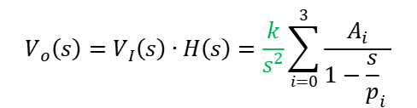

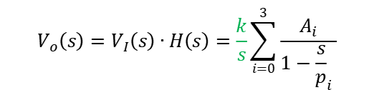

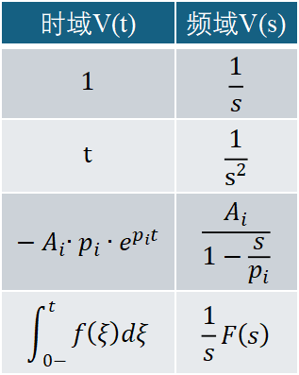






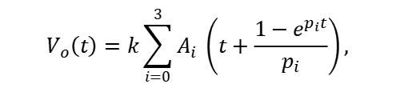
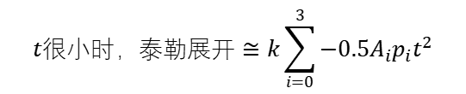
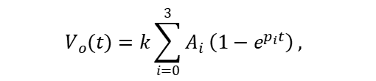
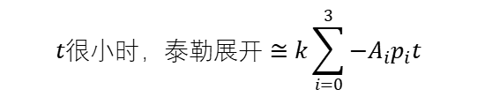

Arnoldi flow
时域V(t) | 频域V(s)
$$1$$ | $$\frac{1}{s}$$
$$t$$ | $$\frac{1}{s^{2}}$$
$$−A_{i}{∙p}_{i}∙e^{p_{i}t}$$ | $$\frac{A_{i}}{1−\frac{s}{p_{i}}}$$
$$\int_{0−}^{t}{f\left(ξ\right)dξ}$$ | $$\frac{1}{s}F\left(s\right)$$
v
$$V_{I}(s)$$
$$V_{o}(s)$$
v
t
t
$$H_{rom}\left(s\right)=\frac{V_{o}\left(s\right)}{V_{I}\left(s\right)}=\sum_{i=0}^{3}{\frac{A_{i}^{′}}{s−p_{i}}=\sum_{i=0}^{3}{\frac{A_{i}}{1−{\frac{s}{p}}_{i} }}}$$
$$V_{I}为step波形时$$
v
$$V_{I}\left(t\right)=ku(t)$$
$$V_{I}\left(s\right)=\frac{k}{s}$$
$$V_{o}\left(s\right)=V_{I}\left(s\right)∙H\left(s\right)=\frac{k}{s}\sum_{i=0}^{3}{\frac{A_{i}}{1−{\frac{s}{p}}_{i} }}$$
$$V_{o}(t)=k\sum_{i=0}^{3}{A_{i} \left(1−e^{p_{i}t}\right) , }$$
$$t很小时，泰勒展开≅k\sum_{i=0}^{3}{{−A}_{i}p_{i}t}$$
t
$$V_{I}为ramp波形时$$
Inverse Laplace transform
v
$$V_{I}\left(s\right)=\frac{k}{s^{2}}$$
k = $\frac{vdd}{full trans}$
$$V_{I}\left(t\right)=kt$$
$$V_{o}\left(s\right)=V_{I}\left(s\right)∙H\left(s\right)=\frac{k}{s^{2}}\sum_{i=0}^{3}{\frac{A_{i}}{1−{\frac{s}{p}}_{i} }}$$
$$V_{o}\left(t\right)=k\sum_{i=0}^{3}{A_{i} \left(t+\frac{1−e^{p_{i}t}}{p_{i}}\right)},$$
$$t很小时，泰勒展开≅k\sum_{i=0}^{3}{{−0.5A}_{i}p_{i}t^{2}}$$
t
Inverse Laplace transform
参考：wdcUtil::EvalRampFunc(…), wdcUtil::EvalStepFunc(…)

Slide 5




Arnoldi flow
用牛顿迭代分别求得0.5/0.3/0.7vdd对应的时间val/val1/val2
$$v$$
$$tranRamp$$
$$v_{ramp}$$
$$v_{out}$$
0.7vout
0.5vout
$$ddelay$$
0.3vout
Val_dr
val1 val val2
$$t$$
Net delay = val - valdr = val – 0.5 * dr_fullTrans
Sink effective trans = val2 – val1
If (waveform flow)
reg_trans = sinkEffTrans/drEffTrans * drRegTrans

Slide 6
Elmore flow
数据准备：Net, NetRLC
计算net的elmore delay ：rlcTree->CalcElmoreDelay()
遍历所有的sink pin:
  计算slew degradation ，得到delay和trans： CalcElomoreSlewDegradation
  检测drPin和sink Pin的voltage/lib中的threshold和derate是否一致，不一致的话对trans进行比例换算：ScaleElmoreTransByOpCond

Slide 7





Elmore flow: Slew Degradation
  When calculate slew degradation:
  elmore delay >1ps or
  drTrans !=0 && elmore delay / drTrans > 1%
输入波形函数：
V(t)
$$v_{in} \left(t\right)=\frac{1}{drFullTrans}t$$
vdd
经过拉普拉斯变换：
t
$$V_{in}\left(s\right)=\frac{1}{drFullTrans}\frac{1}{s^{2}}$$
drFullTrans
已知传输函数：
$$H\left(s\right)=\frac{1}{1+a_{1}s}, H\left(s\right)=\frac{1}{1−\frac{s}{p}},$$
$$p=−\frac{1}{T_{D}} ,$$
那么输出端：
$$V_{out}\left(s\right)=V_{in}\left(s\right)∗H\left(s\right)=\frac{1}{drFullTrans}\frac{1}{s^{2}}\frac{p}{p−s}$$

Slide 8
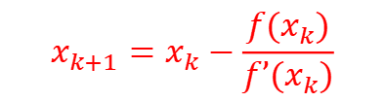





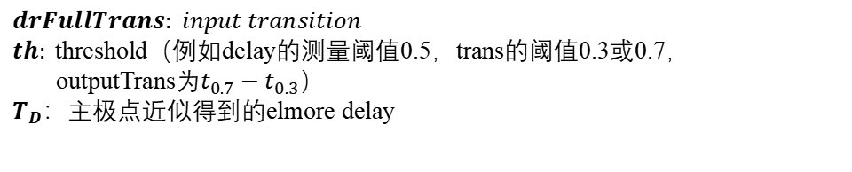

Elmore flow: Slew Degradation
$$drFullTrans: input transition$$
$th:$threshold（例如delay的测量阈值0.5，trans的阈值0.3或0.7，
outputTrans为$t_{0.7}−t_{0.3}$）
$T_{D}：主极点$近似得到的elmore delay
对其进行拉普拉斯逆变换：
$$v_{out}\left(t\right)=\frac{1}{drFullTrans}\left(t+\frac{1−e^{pt}}{p}\right)$$
$将x=−pt, t=−\frac{x}{p}, p=−\frac{1}{T_{D}}$，代入上式中：
$$令f\left(x\right)=\frac{drFullTrans}{T_{D}}∗th−x+1−e^{−x}$$
$$v_{out}\left(x\right)=−\frac{T_{D}}{drFullTrans} \left(−x+1−e^{−x}\right),$$
$$f′(x)=−1+e^{−x}$$
$$th=−\frac{T_{D}}{drFullTrans} \left(−x+1−e^{−x}\right),$$
牛顿迭代
$x_{0}=$ $\frac{drFullTrans}{T}$
$\frac{drFullTrans}{T_{D}}∗th−x+1−e^{−x}$=0
$$x_{k+1}=x_{k}−\frac{f(x_{k})}{f’(x_{k})}$$

Slide 9
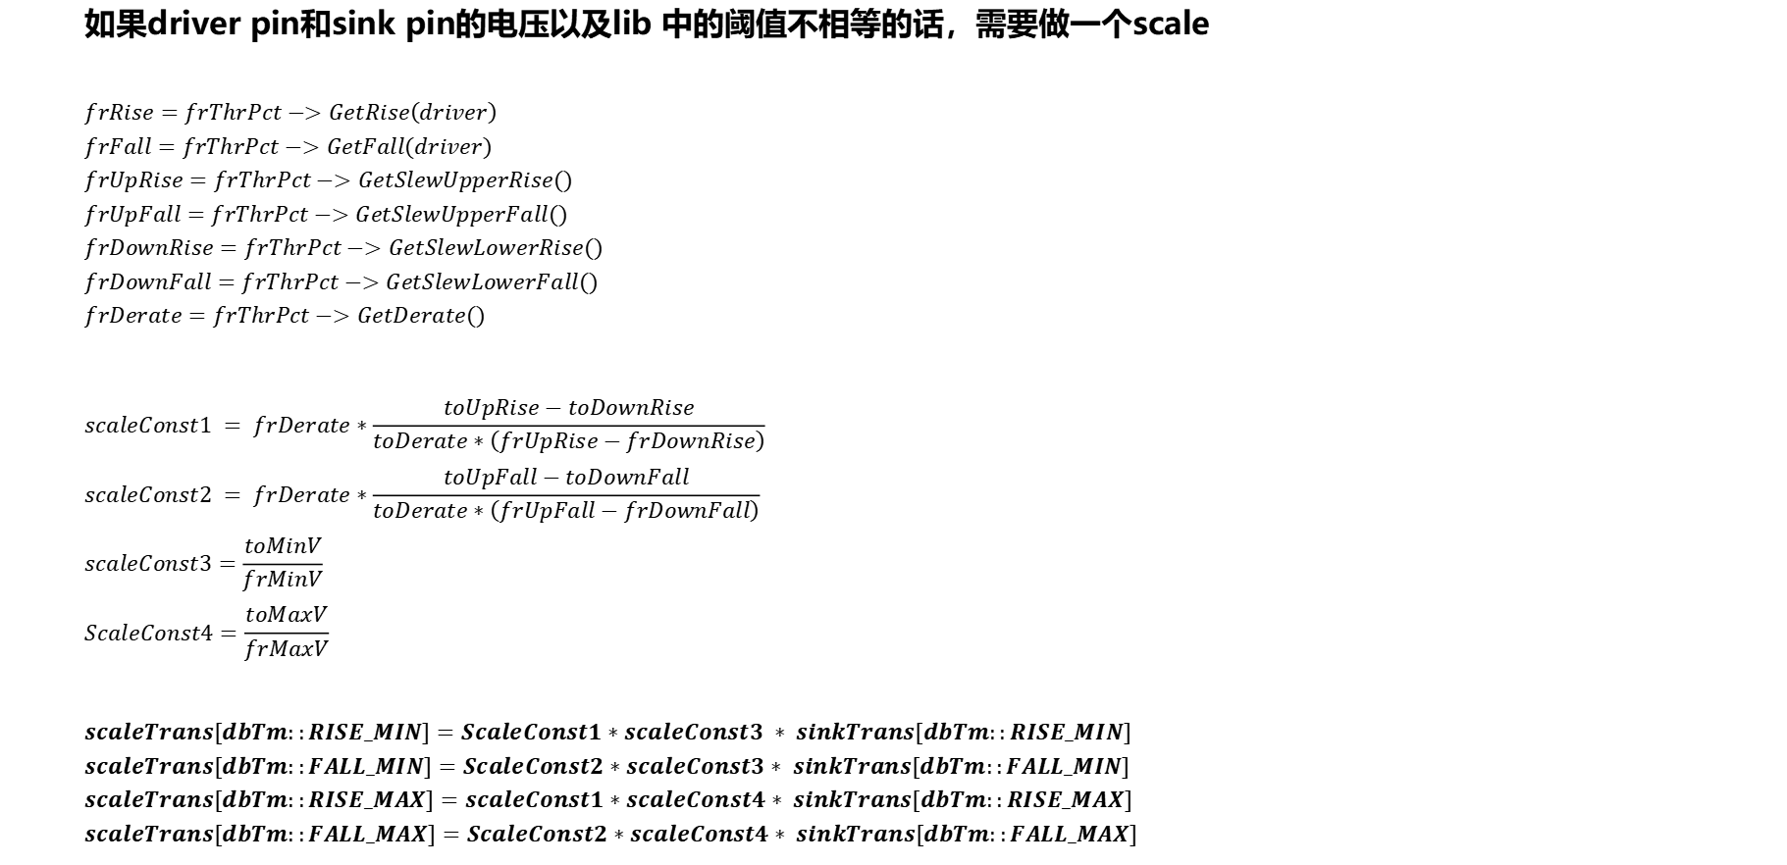
Elmore flow: ScaleElmoreTransByOpCond
  如果driver pin和sink pin的电压以及lib 中的阈值不相等的话，需要做一个scale
  $$frRise=frThrPct−>GetRise\left(driver\right)$$
  $$frFall=frThrPct−>GetFall(driver)$$
  $$frUpRise=frThrPct−>GetSlewUpperRise()$$
  $$frUpFall=frThrPct−>GetSlewUpperFall()$$
  $$frDownRise=frThrPct−>GetSlewLowerRise()$$
  $$frDownFall=frThrPct−>GetSlewLowerFall()$$
  $$frDerate=frThrPct−>GetDerate()$$
  $$scaleConst1 = frDerate∗\frac{toUpRise−toDownRise}{toDerate∗\left(frUpRise−frDownRise\right)}$$
  $$scaleConst2 = frDerate∗\frac{toUpFall−toDownFall}{toDerate∗\left(frUpFall−frDownFall\right)}$$
  $$scaleConst3=\frac{toMinV}{frMinV}$$
  $$ScaleConst4=\frac{toMaxV}{frMaxV}$$
  $$scaleTrans[dbTm::RISE_MIN]=ScaleConst1∗scaleConst3 ∗ sinkTrans[dbTm::RISE_MIN]$$
  $$scaleTrans[dbTm::FALL_MIN]=ScaleConst2∗scaleConst3∗ sinkTrans[dbTm::FALL_MIN]$$
  $$scaleTrans[dbTm::RISE_MAX]=scaleConst1∗scaleConst4∗ sinkTrans[dbTm::RISE_MAX]$$
  $$scaleTrans[dbTm::FALL_MAX]=ScaleConst2∗scaleConst4∗ sinkTrans[dbTm::FALL_MAX]$$

