Slide 1
driver delay用NLDM和CCSD table的计算方法

Slide 2
CalcDrDelay
CalcDrDelay
Driver cell analysis mode == advanced
Driver pin has ccsd table
CalcDrDelayAdvanced
CalcDrDelayBasic
updateCellCCS
Use ccsd table to calculate delay
updateCell
Use nldm table to calculate delay

Slide 3
CCSD-updateCellCCS
计算effective cap
插值拼接得到driver waveform
波形匹配
得到driver trans和delay

Slide 4
CCSD-effective cap
基本思想: 平均电流相等, 即电荷量相等
常用：输出电压波形为ramp，$t_{l}$时刻相等
$$\frac{1}{t_{l}}\int_{0}^{t_{l}}{I_{pi}dt} =\frac{1}{t_{l}}\int_{0}^{t_{l}}{I_{c_{eff}}dt}$$
$$v_{o}=\left\{\begin{aligned}\frac{V_{dd}}{t_{r}}t, t<t_{r} \\ V_{dd}, t≥t_{r}\end{aligned}\right.$$
$$c_{eff}=c_{near}+c_{far}\left[1−\frac{rc_{far}}{t_{l}}\left(1−e^{−\frac{t_{l}}{rc_{far}}}\right)\right]$$
参考： Gate_Delay_Estimation_With_Library_Compatible_Current_Source_Models_and_Effective_Capacitance

Slide 5
CCSD-driver waveform
建电压波形查找表$V(t)$：
$I(t)$曲线对电容充电，转换成电压波形$V(t)$
inpute trans
v
v
v
v
trans_1
t
t
t
t
v
v
v
v
trans_2
t
t
t
t
v
v
v
v
t
t
t
t
v
v
v
v
trans_m
t
t
t
t
output cap
cap_1
cap_2
cap_n
电压波形查找表
参考：dbCCSVect->DoBuildVoltageTbl(……）

Slide 6
CCSD-driver waveform
电压波形内插(对trans和cap进行插值）：
根据input trans找出邻近的两行的电压波形，根据effective cap1找出邻近的两行的电压波形，根据effective cap2找出邻近的两行的电压波形
对每个相同电压点，对时间进行内插
插值方法：z为time, x为input trans, y为output net cap
计算出ABCD后，得到c1对应的波形和c2对应的波形，在0.5vdd的点对两个波形进行拼接得到最后的电压波形。
测量波形得到cell delay和output trans。
$$z=A+Bx+Cy+Dxy$$
$$\left[\begin{matrix}1 & x_{1} & y_{1} & x_{1}y_{1} \\ 1 & x_{2} & y_{1} & x_{2}y_{1} \\ 1 & x_{1} & y_{2} & x_{1}y_{2} \\ 1 & x_{2} & y_{2} & x_{2}y_{2}\end{matrix}\right]\left[\begin{aligned}A \\ B \\ C \\ D\end{aligned}\right]=\left[\begin{aligned}z_{1} \\ z_{2} \\ z_{3} \\ z_{4}\end{aligned}\right]$$

Slide 7
NLDM-updateCell
用frTrans和lumpCap查NLDM表得到出drTrans
算出effective cap1和cap2
用frTrans和eff_C1和eff_C2查NLDM表得到drTrans1和trans2
用frTrans和eff_C1查NLDM表得到delay
Merge drTrans1和drTrans2
Trans = ratio*trans1+(1-ratio)*trans2
Ratio = (rise – downRise) / (upRise - downRise)

Slide 8
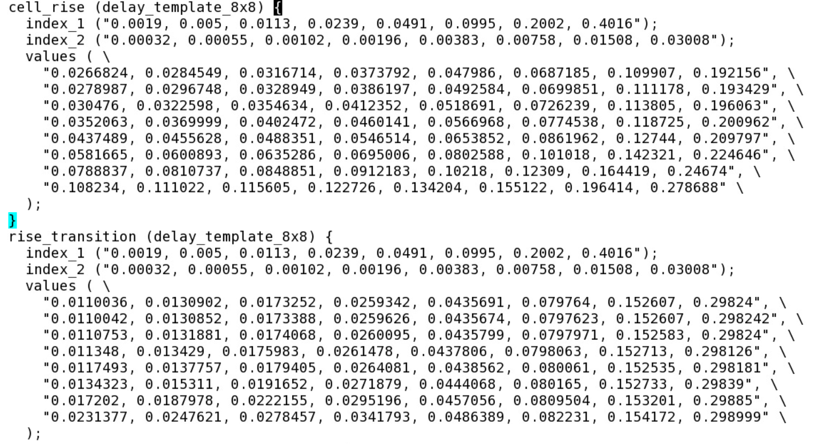
NLDM—查找表
cell delay查找表: cell_rise/fall
index1: input trans
index2: output net cap
output trans查找表: rise/fall_transition
index1: input trans
index2: output net cap
基本原理:
z为cell delay或output trans, x为input trans, y为output net cap
使用方法：
查找与input trans相近的两行x1,x2
查找与output net cap相近的两列y1, y2
计算ABCD值
用公式计算cell delay或output trans
$$\left[\begin{matrix}1 & x_{1} & y_{1} & x_{1}y_{1} \\ 1 & x_{2} & y_{1} & x_{2}y_{1} \\ 1 & x_{1} & y_{2} & x_{1}y_{2} \\ 1 & x_{2} & y_{2} & x_{2}y_{2}\end{matrix}\right]\left[\begin{aligned}A \\ B \\ C \\ D\end{aligned}\right]=\left[\begin{aligned}z_{1} \\ z_{2} \\ z_{3} \\ z_{4}\end{aligned}\right]$$
$$z=A+Bx+Cy+Dxy$$

Slide 9
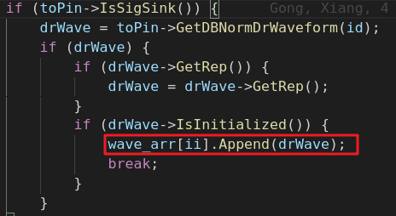
NLDM—waveform flow
Save all sinkpin’s normalized waveform
遍历wave_arr，查找每个与sink normal wave相同的drpin对应的transition table，查出相应的drTrans，最后比较得到最worst的trans

