Slide 1
Noise Flow

Slide 2
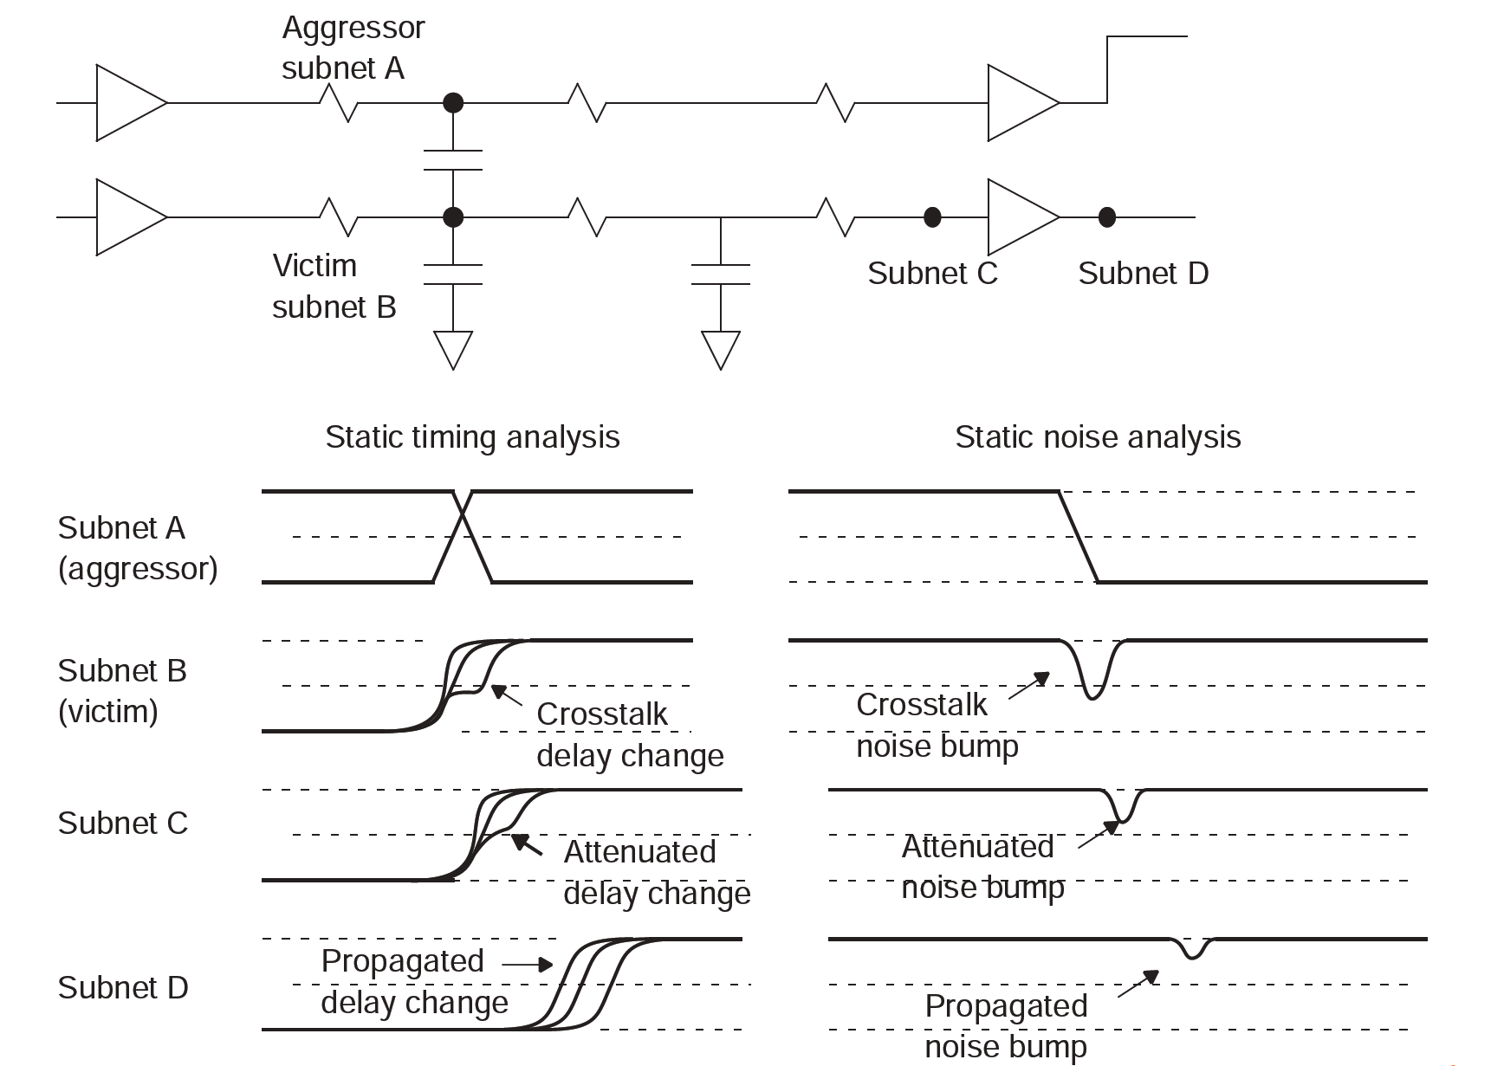
Noise Overview

Slide 3
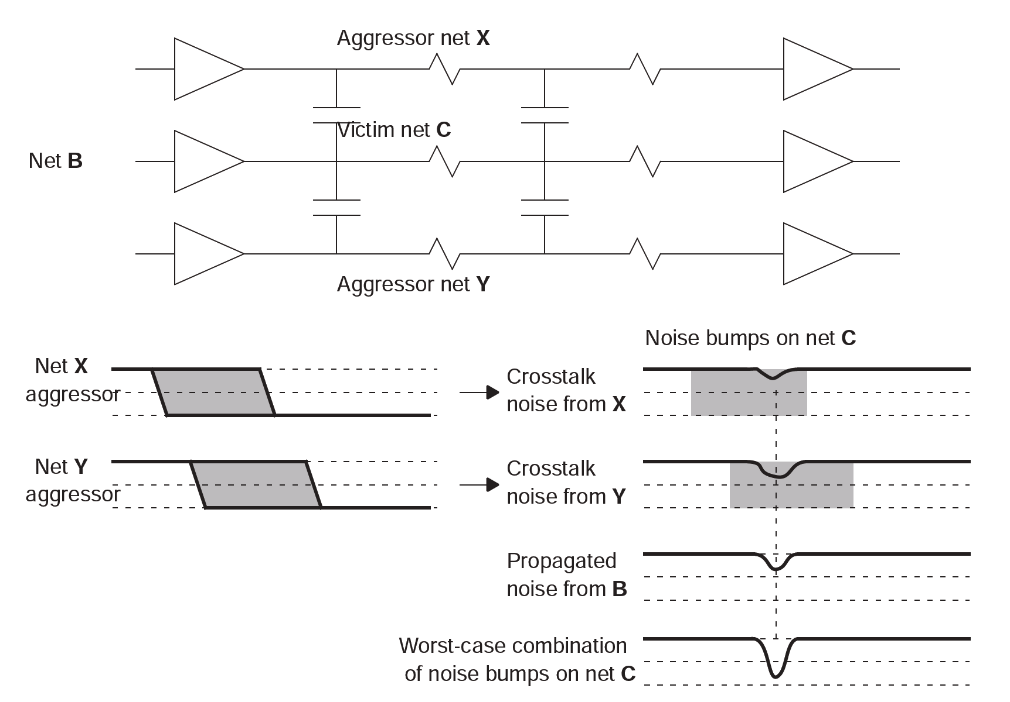
Noise Overview

Slide 4
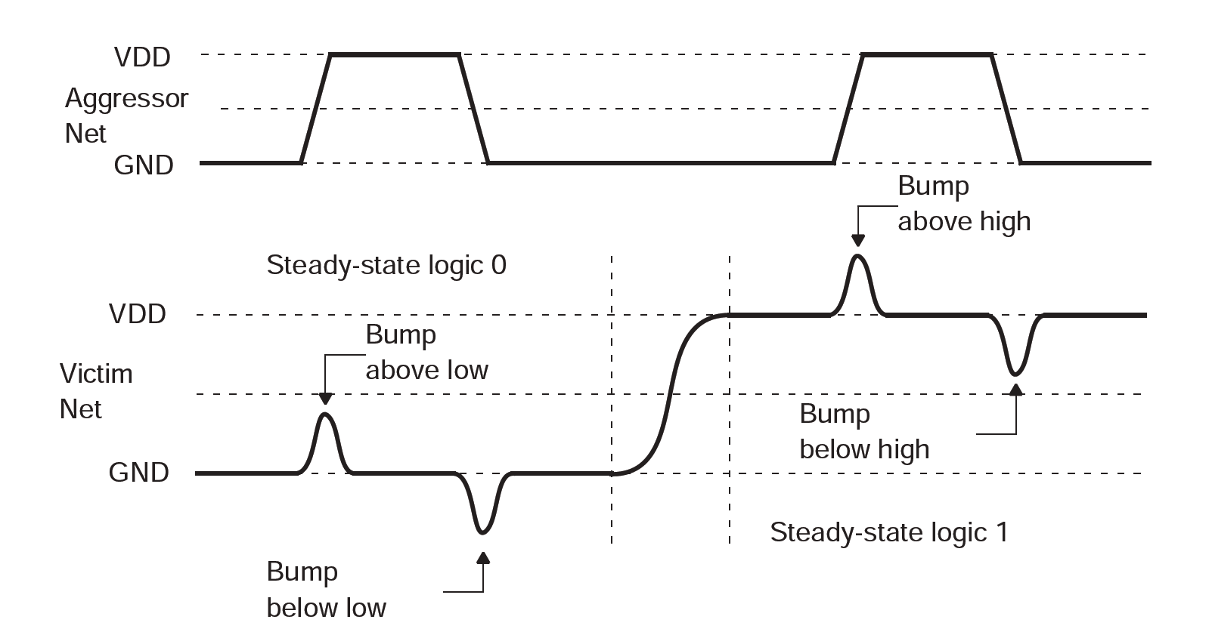
Noise Overview

Slide 5
Overall Flow

Slide 6
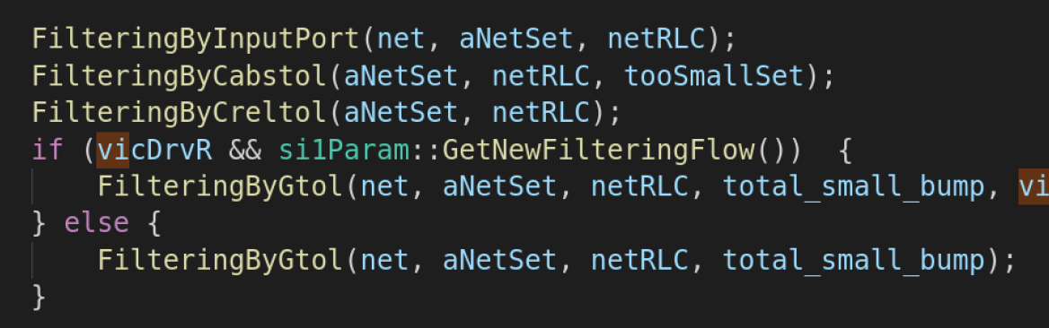
Gen Noise Mesh
1 Filter

Slide 7
Gen Noise Mesh
2 Gen Mesh
vicSink1
vicDriver
RC tree only with coupled node
vicSink2

Slide 8
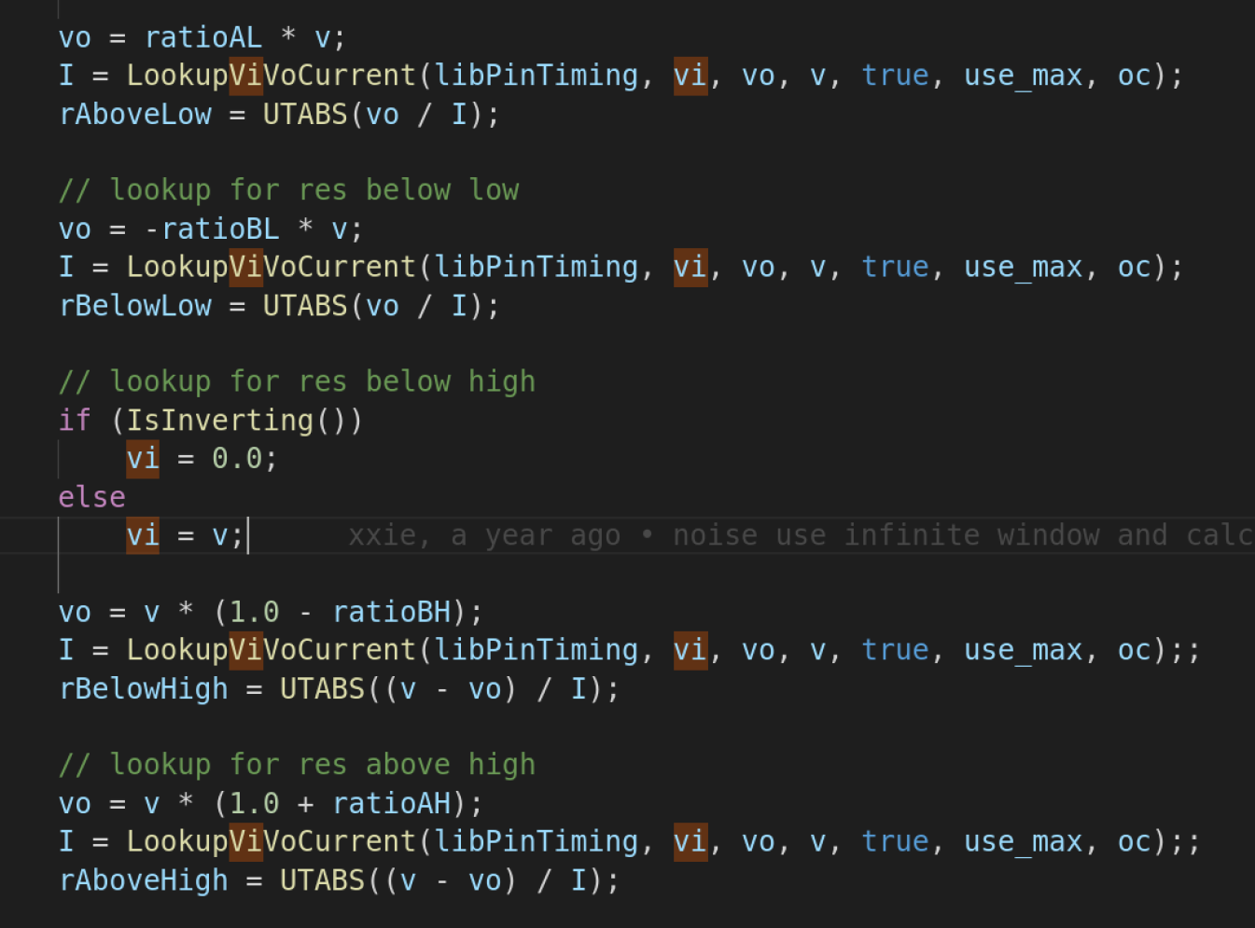
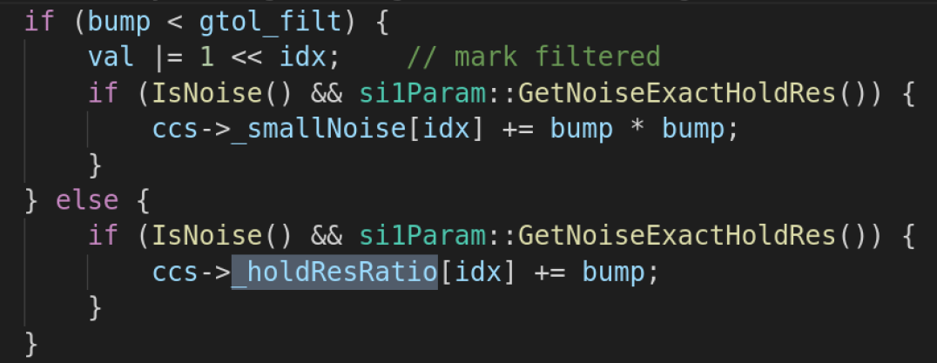
Gen Noise Mesh
3 HoldR

Slide 9
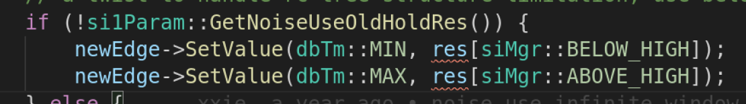

ROM
两次rom

Slide 10

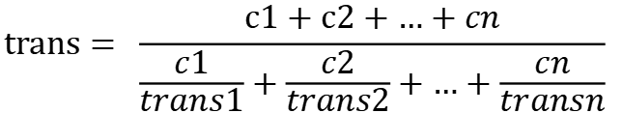
Virtual attacker
Virtual attacker coupling cap
Virtual attaker trans
Virtual attacker Rs
$$cc=aggrNumRatio ∗ \sqrt{{c1}^{2}+{c2}^{2}+…+{cn}^{2}}$$
$$trans= \frac{c1+c2+…+cn}{\frac{c1}{trans1}+\frac{c2}{trans2}+…+\frac{cn}{transn}}$$
$$Rs= \frac{c1∗Rs1+c2∗Rs2+…+cn∗Rsn}{c1+c2+…+cn}$$

Slide 11
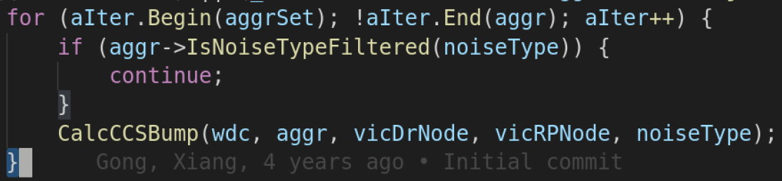
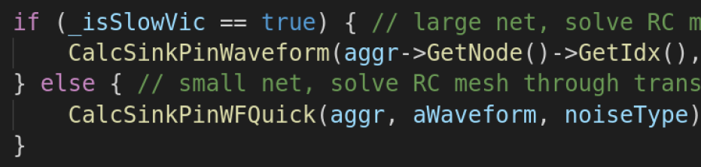
Calcbump

Slide 12
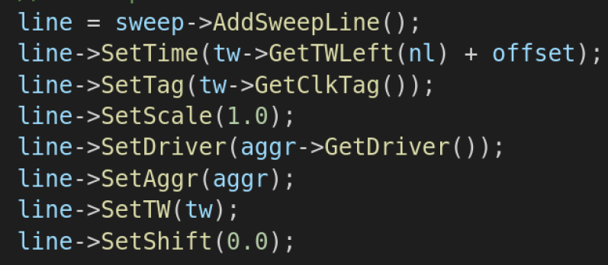
Sweep line

Slide 13
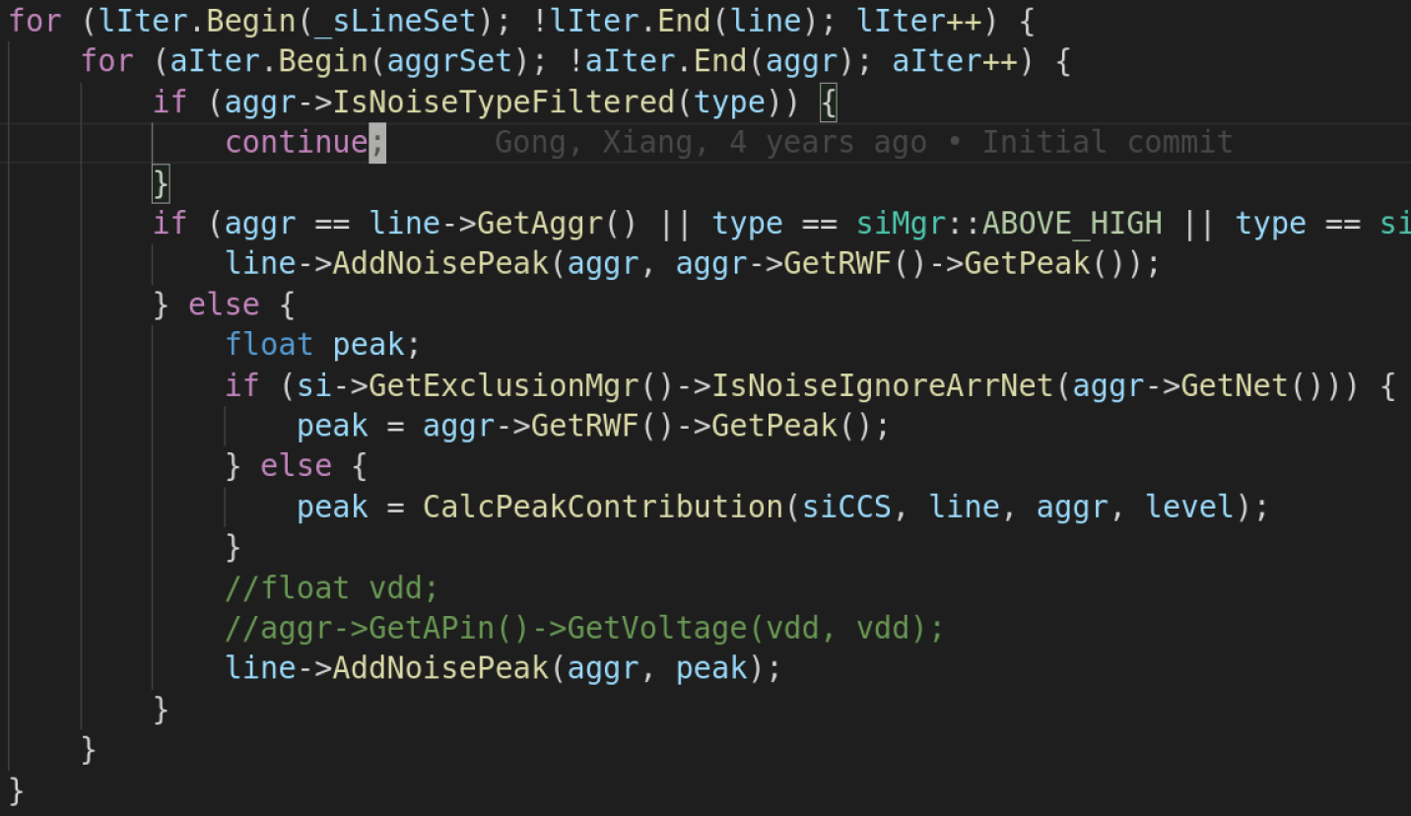
Sweep line

Slide 14
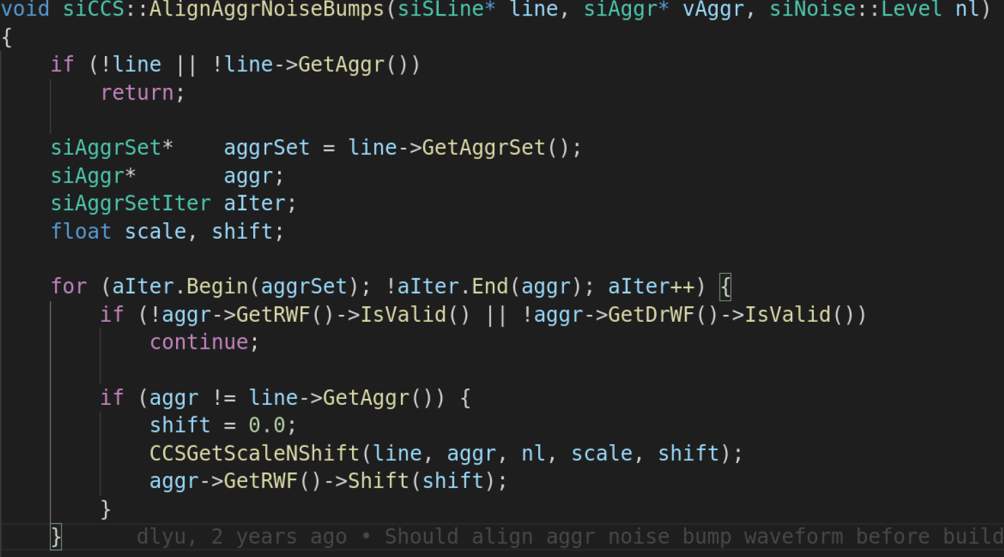
Align
x

Slide 15
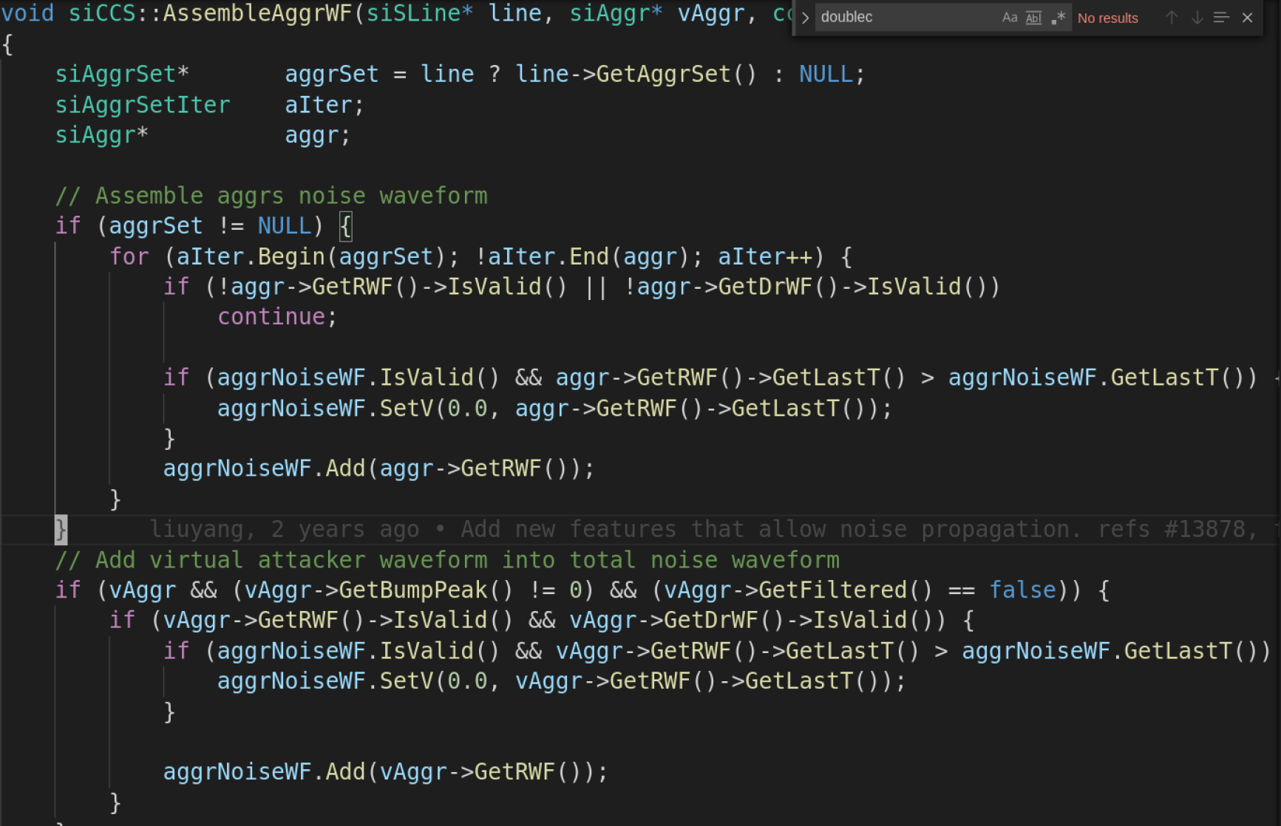
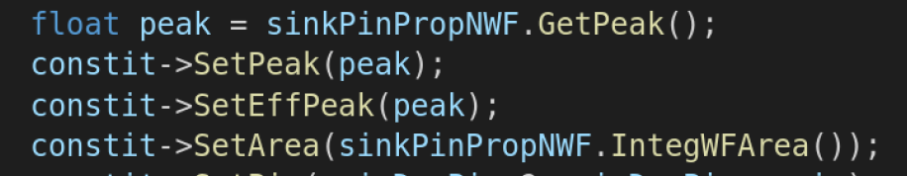
Build Wave

Slide 16
Propagation

Slide 17
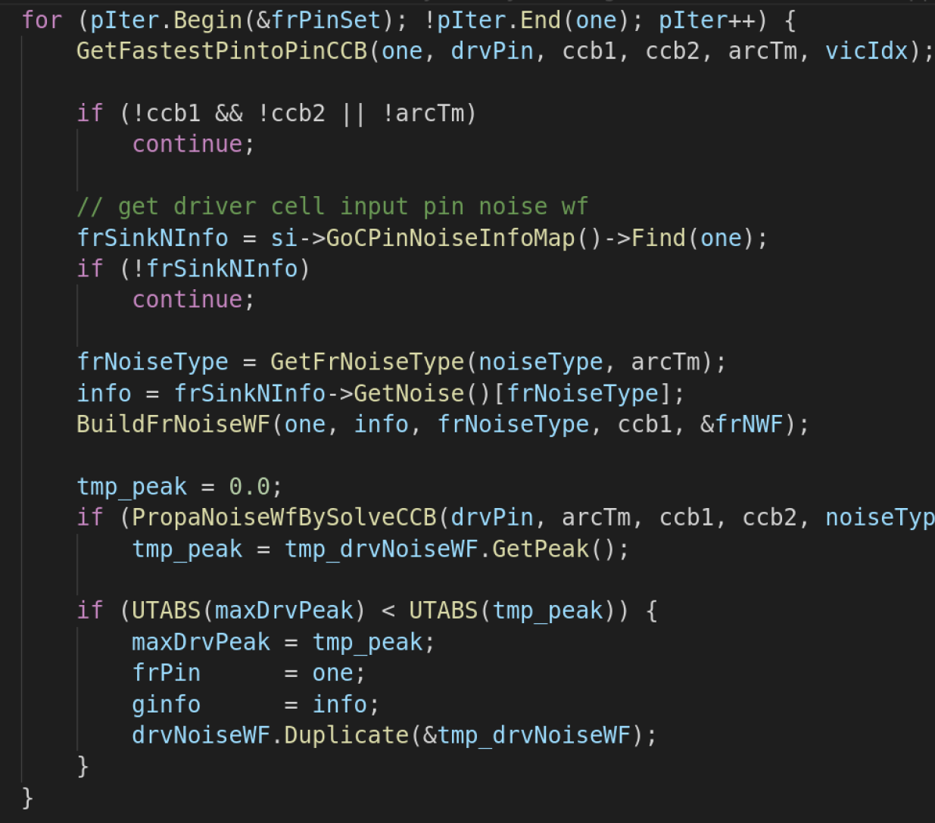
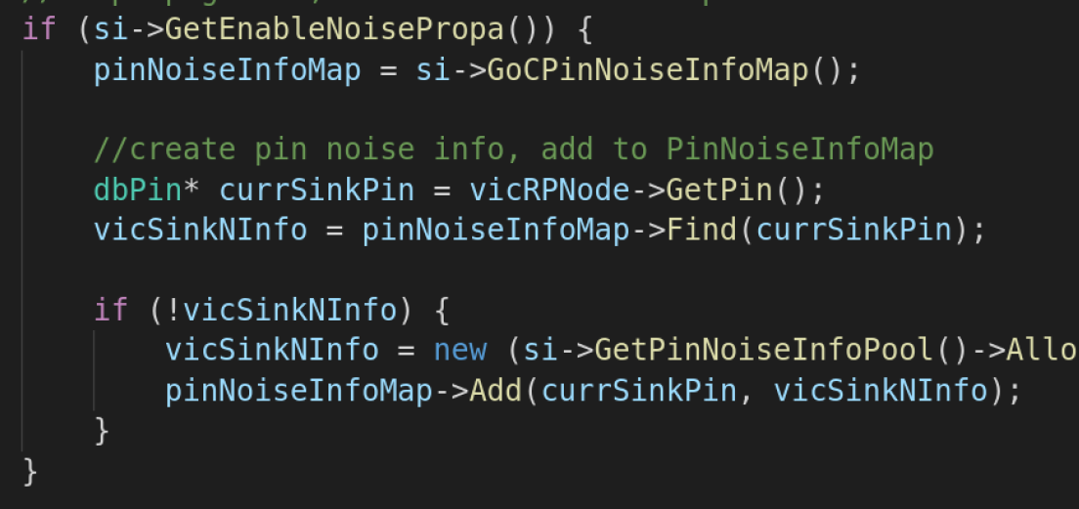
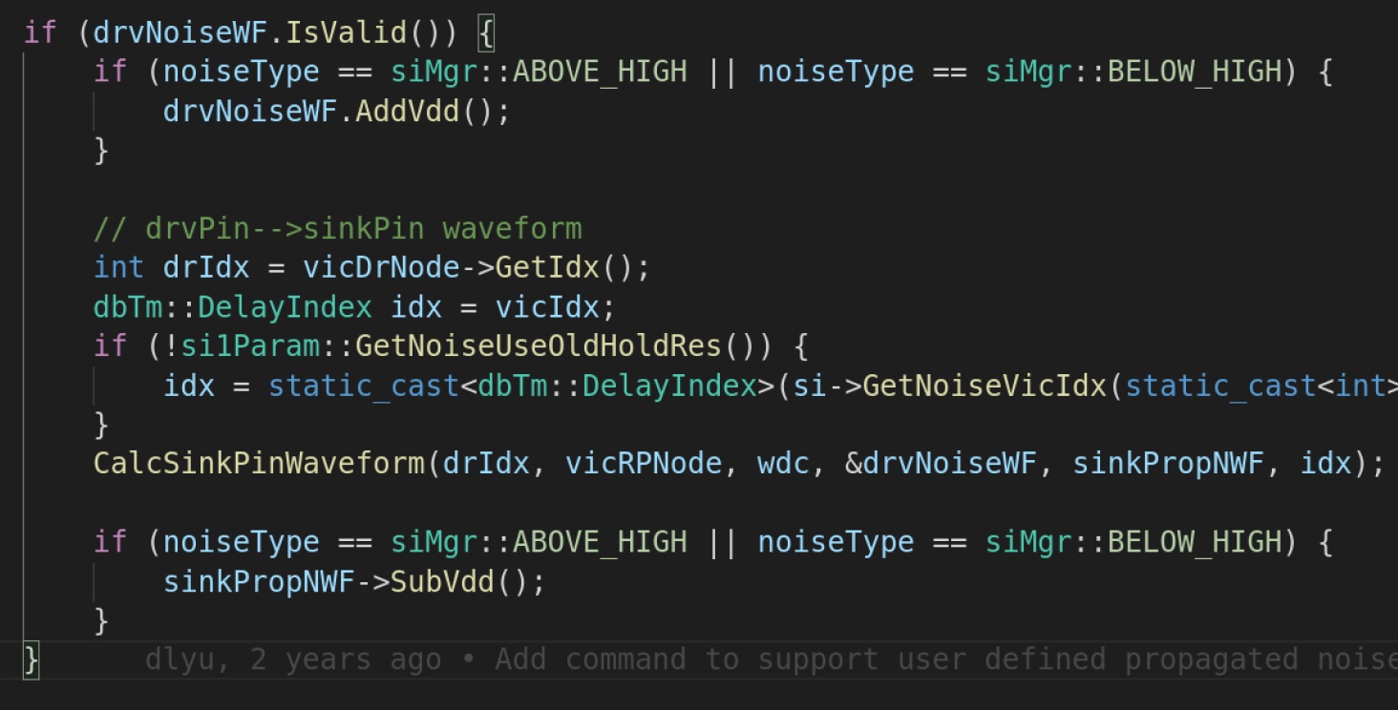
Propagation

