Slide 1
Discussion for illegal input interception xin xie 2020/11/3
Discussion for illegal input interception xin xie 2020/11/3

Slide 2
Report_ta_crpr issue: wrong pin will crash
report_ta_crpr -from_objects pin/port -to_objects pin/port
When not give pin/port:
Current QHH will push a ERROR: MissArgVal, and stop running
No need to intercept it；
In some old versions, program will keep running. Use “!_to_obj” to intercept it.
When give wrong Pin/Port：
Current QHH will push a WARNING:EmptyColl, and keep running
Need use “_to_obj->GetObjCount() == 0” to intercept it
Suggestion：
For robustness, use “!_to_obj || _to_obj->GetObjCount() == 0” to intercept them.
Run command with wrong pin name:
*_to_obj= {
static NoGetNameCB = 0x0,
static NoGetBBoxCB = 0x0,
static NoDeleteCB = 0x0,
static NoUndelCB = 0x0,
static _hierStrPool = {0x3e6723f0, 0x0 <repeats 47 times>},
static _inMirrorEco = {false <repeats 48 times>},
static _inSyncEco = false,
_id = 3344384,
_dbFlags0 = 0 '\000’,
_dbFlags1 = 0 '\000',
_dbFlags2 = 0 '\000’,
_dbFlags3 = 0 '\000’},
_flags = { _type = 0, _userType = 0,
_isNullGroup = 0, _isLocked = 0,
_isDbId = 0, _frDiffProj = 0,
_noUse = 0},
_project = 0x7ffff3985050,
_next = 0x1949a918,
_prev = 0x0,
_objList = 0x3b6435d0,
_tclObj = 0x0,
_tclStr = 0x0,
_objSet = 0x0}
Add _to_obj->GetObjCount() == 0 for robustness

Slide 3
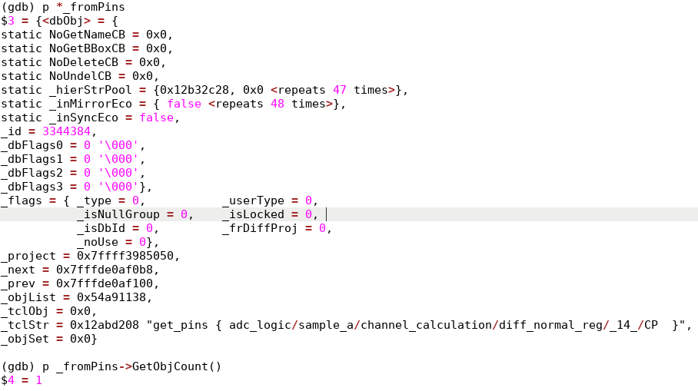
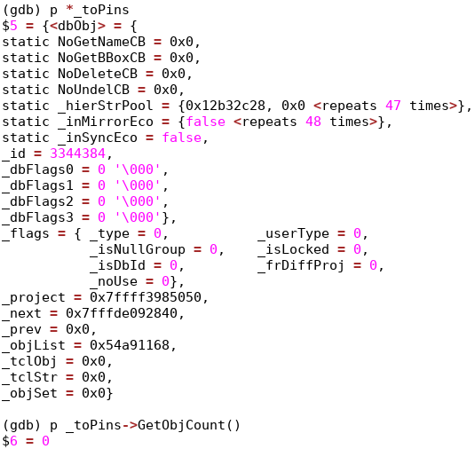
Example : export_spice

Slide 4
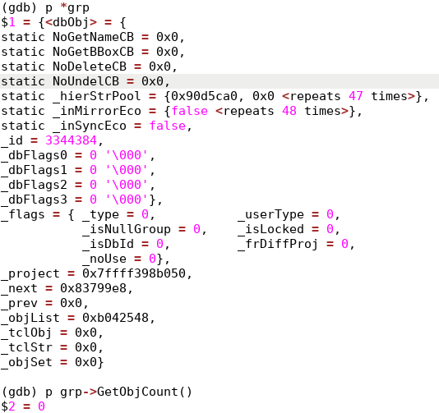
Example : set_max_transition

Slide 5
Thanks !

