Slide 1
芯之所至 皆有鸿芯
PBA/GBA correlation
sqli 2023.2.22
打造完整的国产芯片数字EDA平台

Slide 2
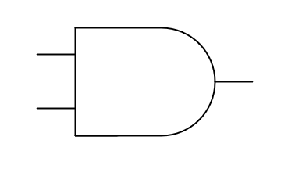
PBA/GBA
What is PBA/GBA?
Cell with multi inputs will have the difference between PBA and GBA
PBA：(Path Based Analysis) 优点：结果更精确， 缺点：runtime更大
GBA：(Graph Based Analysis) 优点：runtime更小；缺点：结果更悲观
悲观：对max而言，更悲观意味着值更大；对于min而言，更悲观意味着值更小。
0.066565 (r)
0.066565 (r)
0.032855 (r)
0.043877 (r)
A
A
B
B
0.043877 (r)
0.043877 (r)
0.363629 (r)
0.363629 (r)
PBA
GBA

Slide 3
PBA/GBA
Relationship of TransitionTime, Celldelay, Ddelay, Slack in PBA/GBA
TransitionTime: PBA ≤ GBA(max), PBA ≥ GBA(min)
Celldelay: PBA ≤ GBA(max), PBA ≥ GBA(min)
例如 Celldelay ~ (input transition , output cap)
举例(max)：较之GBA，PBA Celldelay ↓ ~ (input transition ↓ , output cap→)
Delta-delay: PBA ≤ GBA
Ddelay ~ arrival window (earliest and the latest arrival times)
agg
agg
vic
vic
PBA
GBA

Slide 4
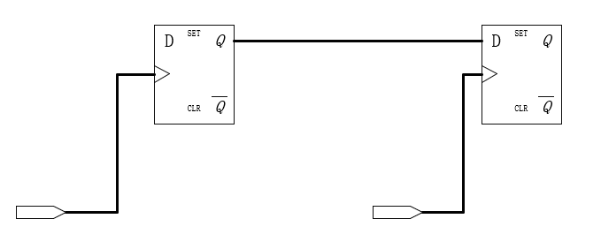
PBA/GBA
Relationship of TransitionTime, Celldelay, Ddelay, Slack in PBA/GBA
Slack: PBA ≥ GBA
较之PBA，GBA更悲观：
如果仅在arrival上有多输入cell:
setup slack ↓ = min→ - max ↑
hold slack ↓ = min ↓ - max →
如果仅在require上有多输入cell:
setup slack ↓ = min↓ - max→
hold slack ↓ = min→ - max ↑

Slide 5
PBA/GBA
How to use PBA/GBA when analysis timing
CHT： report_timing_path -pba_mode none（default） | path | complete
REF： report_timing -pba_mode none（default） | path | exhaustive
None：Disable PBA and enable ordinary GBA, this is the fast mode
Path：Perform PBA on paths after they have been gathered by GBA, producing more accurate timing results for those paths, to control the ordering of the paths, set pba_path_mode_sort_by_gba_slack variable.
pba_path_mode_sort_by_gba_slack ：false(default), if you use report_timing -slack_lesser_than 0 -pba_mode path, GBA slack = -1(√, set to true), PBA slack =1(√, set to false)
Exhaustive: Performs an exhaustive path-based-analysis to determine the truly worst-case paths in the design.

Slide 6
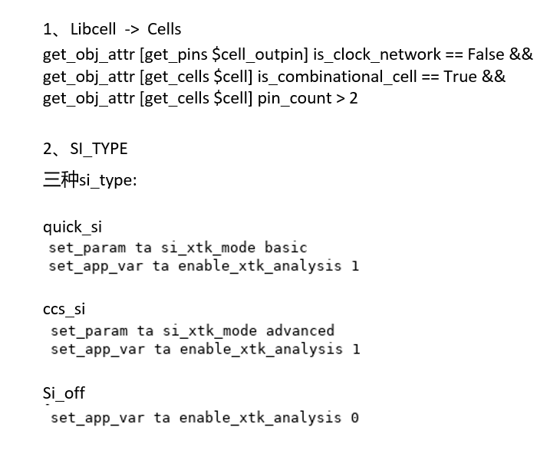
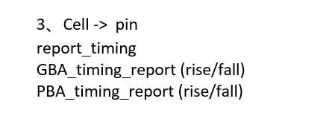
PBA/GBA
How script process timing data
i 指的是 input pin 的编号，比如有三个pin: A ，B，SEL

Slide 7
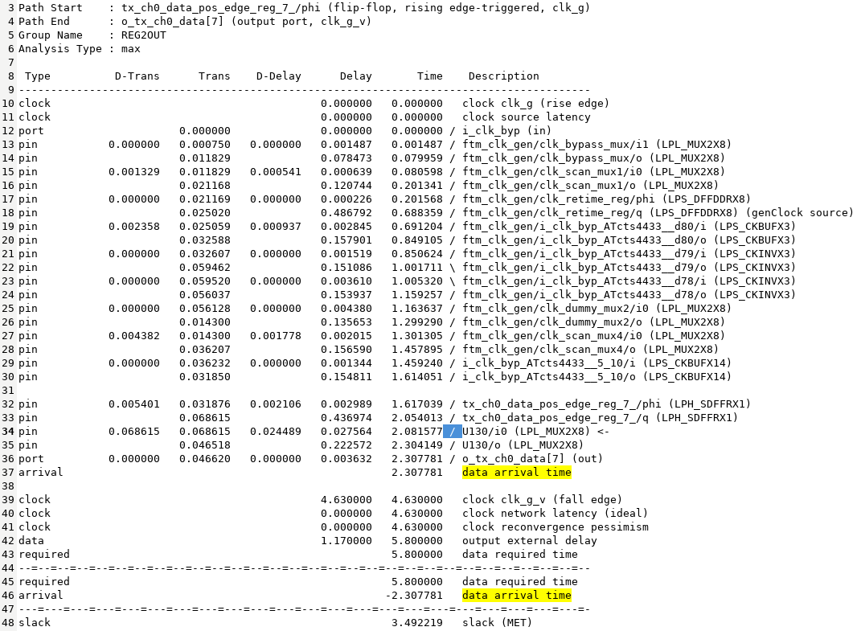
PBA/GBA

Slide 8
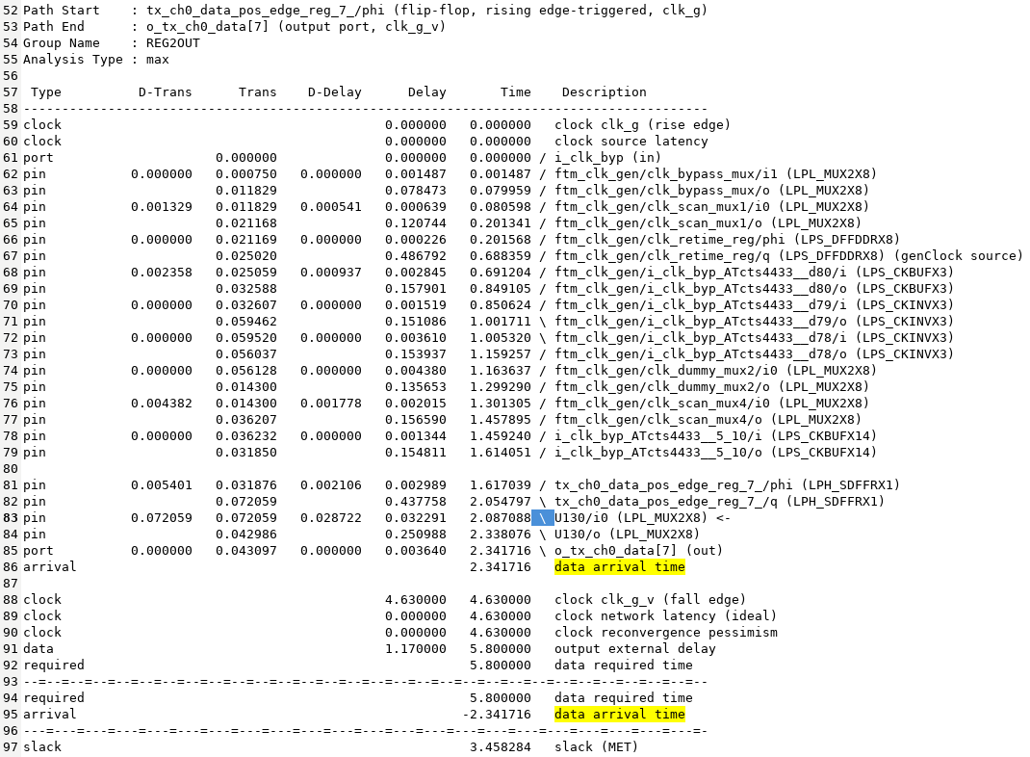
PBA/GBA

Slide 9
PBA/GBA
How script process timing data
4. data extraction
SI_TYPE == quick_si / ccs_si => PATH_TRANS, PATH_CDELAY, PATH_DDELAY, PATH_SLACK
SI_TYPE == si_off => PATH_TRANS, PATH_CDELAY, PATH_SLACK
5. compare data and generate check report

Slide 10
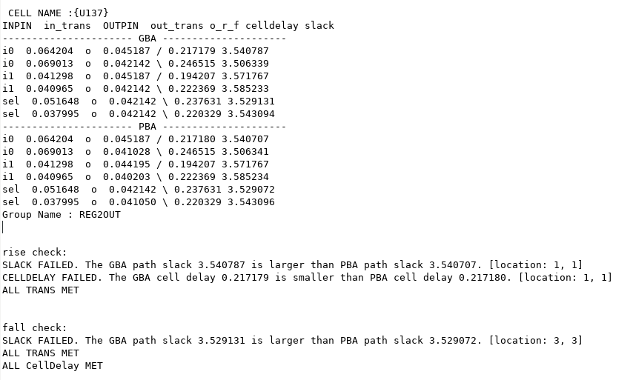
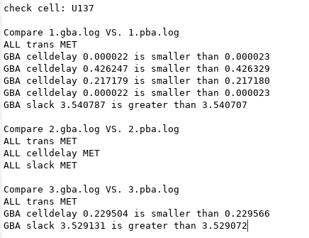
PBA/GBA

Slide 11
PBA/GBA
Verify REF result with script
The relationship between GBA and PBA all met.
举例： cell delay failed，GBA cdelay 0.000027 is smaller than PBA cdelay 0.000028
所有fail的情况绝对值都只差0.000001
issues
ticket | description | status
#15212 | Si off, GBA slack > PBA slack | submit
#15419 | (ftm_top LPL_MUX2X8) GBA is more optimistic than PBA | submit
#15421 | (ftm_top LPH_AND2X1) GBA is more optimistic than PBA | submit
#15424 | (ftm_top LPH_AOI2111X1 ) GBA is more optimistic than PBA | submit

