Slide 1
ngSPICE
Engine

Slide 2
ngSPICE
Frontend, command line
spicelib
misc
math
Malloc,
data structures
Sparse solver
Derivitive
Fft
Poly…
devices
parser
analysis
Up to bsim4 v7

Slide 3
Download source code
git clone https://git.code.sf.net/p/ngspice/ngspice download_dir
Ubuntu install Dependency
autoconf (suto apt-get update; suto apt-get install autoconf)
libtoolize (suto apt install libtool)
automake (already installed)
yacc lex (sudo apt-get install flex bison)

Slide 4
Only install binary (No need to install adms)
$ ./autogen.sh
$ mkdir release
$ cd release
$ ../configure --without-x # new env doesn’t fully support X11
$ make
$ sudo make install
Install binary and shared library
Make release directory
Cd to release
../configure --with-ngshared --prefix=PATH/bin/
will do check and copy necessary files into release/
See /rnd/jchen/ngspice34/ for example pre-compiled ngspice

Slide 5
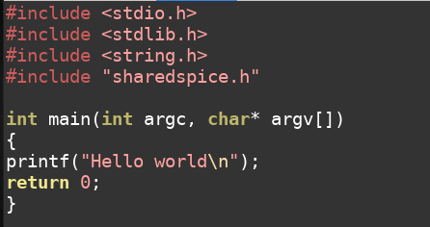
How to link with static library (for fast run-time purpose)
Step 1: include head file in source code
Double click to download lib example
Step 2: suppose shared lib is complied as libngspice.so
option 1 :export LD_LIBRARY_PATH=/lib:/usr/lib:/usr/local/lib
option 2 : under local directory
gcc main.c -Wall -s -lngspice -lpthread -ldl –L. -o ./bin/Debug/ng_sh
-s remove symbol table
-l add static link library between lib, and so.
-L add link library search path

Slide 6
Search more options for gcc
Option Index - Using the GNU Compiler Collection (GCC)
More backgrounds on compile flow
configure、 make、 make install 背后的原理(翻译) - 知乎 (zhihu.com)

