Slide 1
Auto package-netlist-generation tool
Siqi

Slide 2
Summary
The script can be used to automatically generate package RLCK netlist.
The script can separately generate netlist for
  input pin cap module
  R-mesh
  output pin inductance/mutual inductance module
  output pin capload module
  The whole package netlist with instantiation

Slide 3
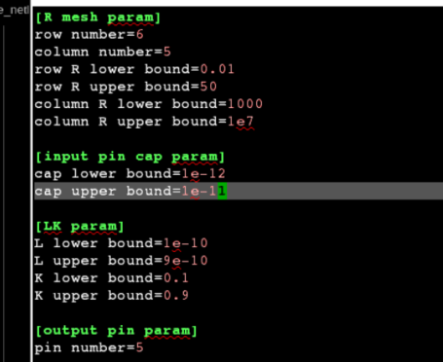
Usage
Script Path
  /rnd/sqchen/importand_thing/scripts/feature_test/spice/generate_netlist/
Usage
  ./auto_gene.py –c<config_file> -f <output format>
    You can use ./auto_gene.py –h to check details
    config_file is the confile file that contains parameters script needs to read in.
    The format must be like this:
      Used configparser
      Will report error if no input file
      Can refer to “param.cfg”
      under the path for details

Slide 4
Usage
Usage
  ./auto_gene.py –c<config_file> -f <output format>
    Output format should be one of the below:
      R: will only generate R-mesh module netlist
      Outpin: will generate LK module netlist at output pin
      Inpin: will generate cap module netlist at input pin
      Capload: will generate cap module netlist at output pin
      All: will generate an entire package RLCK module netlist, together will v/I source setting and instantiation subckts.

Slide 5

Usage
R-mesh in package
Input from PCB
Output to Chip
Capload
VDD1=0.93V
VDD2=0.85V
VSS=0.00V

Slide 6
Notes
Should be noted that:
  The R-mesh row number should be equal or bigger than number of input pins!
  The number of output pins should not be bigger than number of R-mesh nodes.
    For example, if MxN R-mesh, then Noutpin <= (M*(N-1))+((M-1)*N)

Slide 7
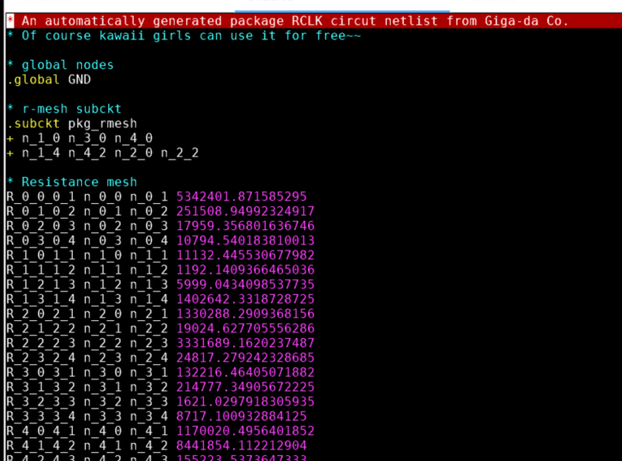
Output
Here are some output results

Slide 8
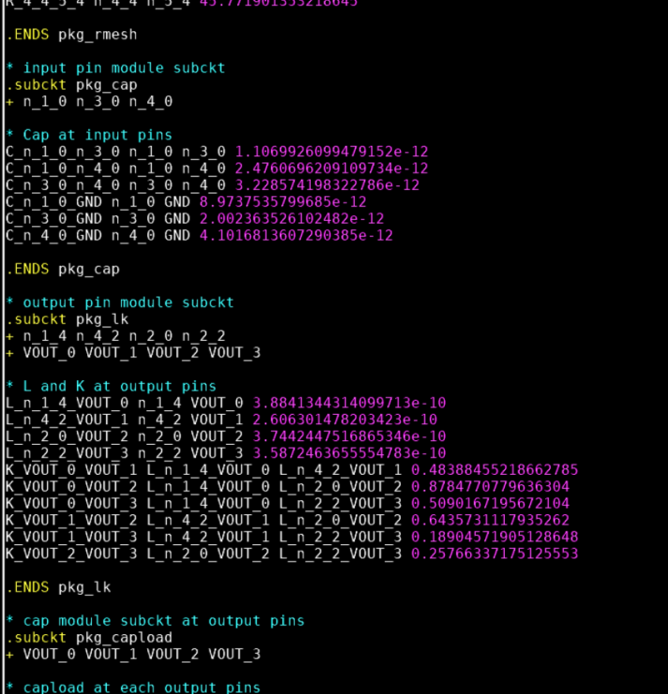
Output
Here are some output results

Slide 9
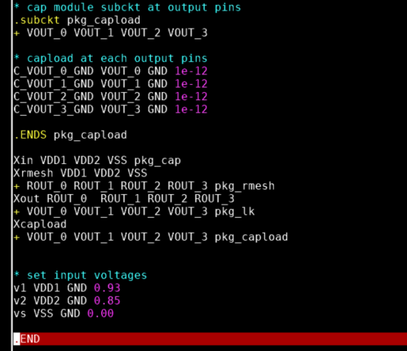
Output
Here are some output results

