Slide 1
Sweeping netlist and drawing histogram tool Siqi

Slide 2
Summary
The script can sweep one netlist, flatten it, and summarize all R,L,C,K,V,I instances.
Will draw histogram for each instance to see the distribution status

Slide 3
Usage
Path
/rnd/sqchen/importand_thing/scripts/feature_test/spice/sweep_netlist
Usage
./sweep_netlist.py –n <XX.sp>
XX.spis the
Since some netlists source or include other netlist, so will do flattening before sweeping.
Will generate a “temp.sp” at running path for flattening procedure
Will generate a “final_expanded.sp” at running path, which is the final flattened netlist

Slide 4
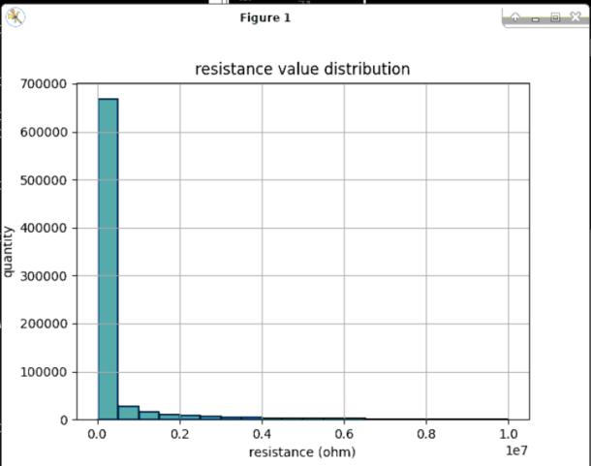

Slide 5
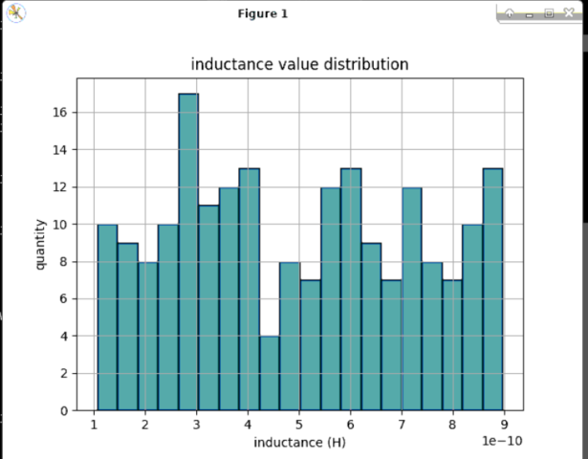

Slide 6
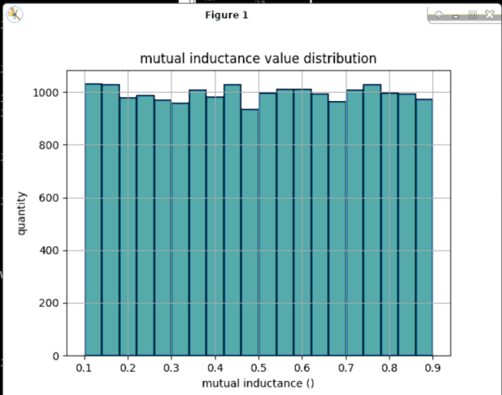
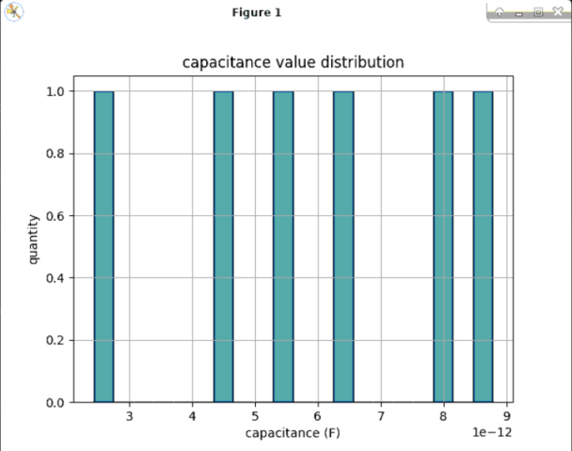

Slide 7
