Slide 1
SPICE Regression System Introduction
Siqi Chen
打造完整的集成电路设计国产EDA平台

Slide 2
01
System Outline
Contents
02
System Structure
目 录
03
Single Case Generation
04
Structure Usage
05
Structure Running Procedure
06
Further Development

Slide 3
System Outline
Brand recognition system

Slide 4
The system is meant for SPICE regression automatic running. While after some modification, it can be used for any other product cases
The reasons why we don’t use WUKONG regression system are:
WUKONG can only support directly reading in tcl files. While for some products like SPICE, it needs to read in netlist files.
Even if I transfer netlist into tcl formats by some ways, it can’t meet all the needs for the regression case. For example, I can use tcl file to include a netlist, but I can’t add checking procedures at the same time
WUKONG is connected with AG and VP tightly. Many API and commands were designed among them exclusively. It may lack in universality for other new products

Slide 5
System Structure
Brand recognition system

Slide 6
The system is composed by the top level main framework, and bottom level single case format.
Main Framework
The main framework was mainly written by Python.
It will read in parameters you set, and use them for the whole regression running procedure
The main framework is mainly made up by the following parts:
Setup env and make preparation before running cases
Collect input parameters and submit cases to farm
Monitor bjobs status continuously
Result check and report generation

Slide 7
Single case format
The single case format is managed by Makefile.
Every case has a Makefile. It includes all you need for running this case.
When you want to run a single case, you just need to type in “make” under case path.

Slide 8
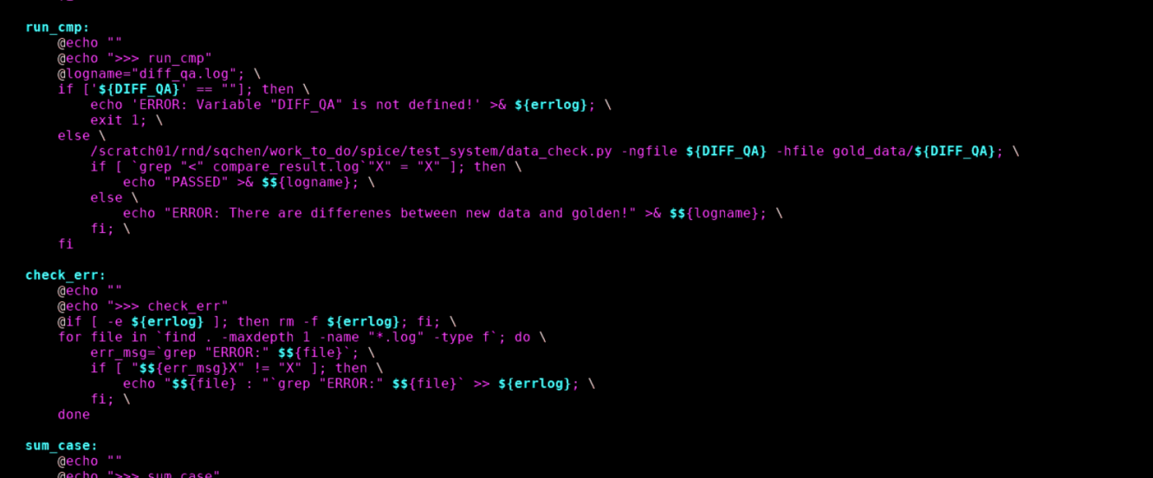
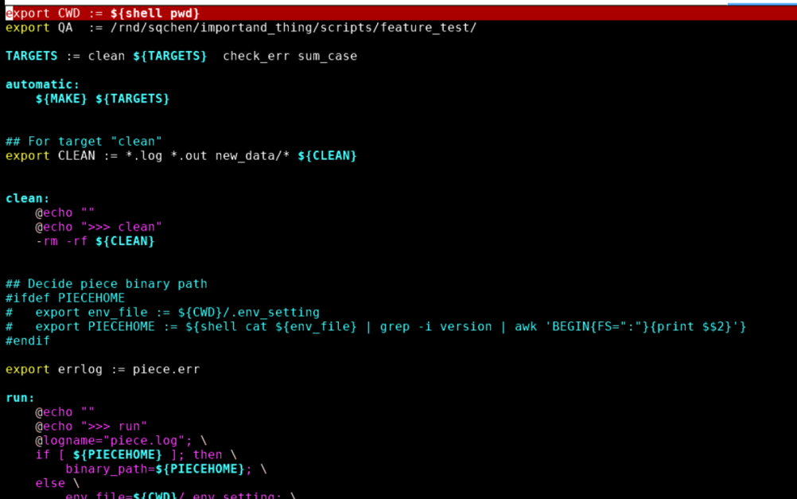
Single case format
There is a “Makefile_top” file, which should be included by every Makefile. It contains some basic settings and functions for running cases.

Slide 9
Single Case Generation
Brand recognition system

Slide 10
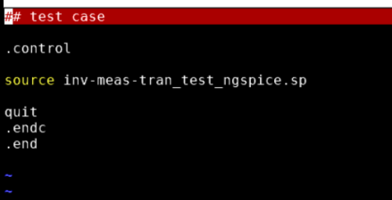
If you add new cases into regression system, it must obey some rules.
Must include the Makefile_top
In the “TARGETS” row, assign procedures you wish to run.
There are default targets. At the very beginning, it will clean the directory; at the ending, it will check errors in generate logs and reports, and summarize results
You need to assign “run”, “run_cmp”, or other new targets you write, and should be in running order
In “NETLIST”, set netlist you want to run
In the netlist, you need to write command to make it quit after finishing running
If it’s hard to add, you can use another netlist to include this netlist, and add quit command like the way below

Slide 11
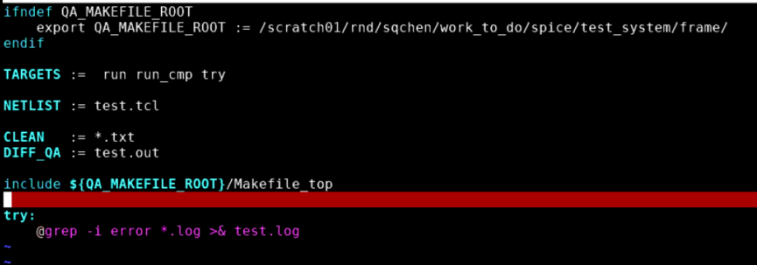
In “CLEAN”, you can add some extra files or directories that you need to clean before each run.
The default clean files for now are: *.log, *.out, new_data/*
We have a default target “run_cmp” now, it will do comparison for waveform results of TRAN, AC, DC between new data and golden data. If you need to use this function, you need to set targert “run_cmp” in TARGERTS row. Besides, you need to put waveform file name in “DIFF_QA” row
For the golden data, you should make a directory “gold_data” under case path, and put golden file under it
The name of generated waveform file and golden file should be same
If you need other targets to support your case, you can create them after the command of include Makfile_top, and put its name in TARGETS row

Slide 12
Structure Usage
Brand recognition system

Slide 13
Running single case
Enter case path.
If there is no “.env_setting” under that path, which contains ngspice version msg, you need to set a env parameter before running
setenv PIECEHOME /scratch01/rnd/sqchen/git_workspace/spice/ngspice34/release
Be noted that the path should be set to the path where “src” locates
If need to use .env_setting, should input following msg:
Run “make”. Case will run locally

Slide 14
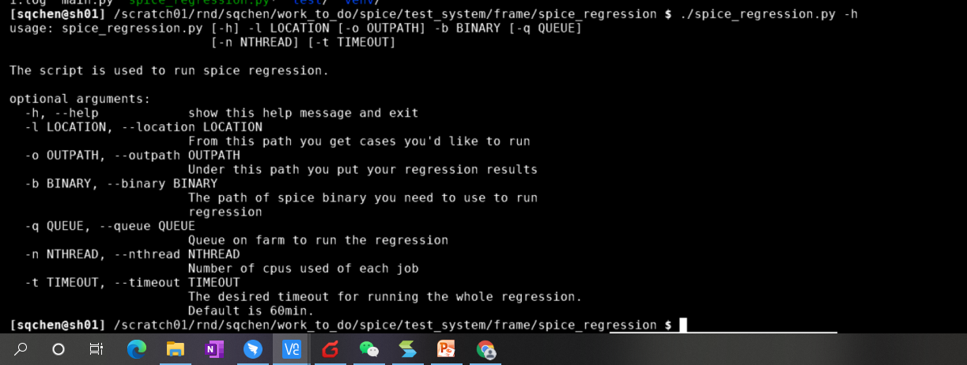
Running all cases
Script path: /scratch01/rnd/sqchen/work_to_do/spice/test_system/frame/spice_regression/spice_regression.py (may change later)

Slide 15
Running all cases
Must set parameter: -l (where you get cases) and –b (ngspice version, same format as PIECEHOME)
If set “-o”, will copy directory designated by “-l” to that path, if didn’t set “-o”, will copy directory at current path
-q and –n will work for all cases when when submitting jobs
-t is timeout time, unit is minute, default is 60mins

Slide 16
Structure Running Procedure
Brand recognition system

Slide 17
After running spice_regression.py, it will copy directory set by “-l”to designated path. The path name is “spice_regression_202108241225”, the numbers are time at that moment
It will find all “Makefile” to collect all the cases, and under each case path, it will create a “.env_setting”, which contains the ngspice version info
Then will submit all jobs to farm by “cd /XXX/XX/; make”, and meanwhile, record bsub msg in “bsub.log” under spice_regression_XXXXX
For each case,:
“bsub.o” will save bsub msg for this case, and “bsub.e” will save error msg of bsub
“piece.log” will record the whole running procedure for this case
“compare_result.log” will be created for saving data comparing data if “run_cmp” is used, and there will be “diff_qa.log”, which will include “PASSED”if no outliers, while “FAILED” if have outliers
After all checking targets finish, will check all logs and results, to find if there is “ERROR” msg. If so, will create “piece.err” which include error msg, and generate “piece.out” with “FAILED” in it; if not, will only create “piece.out” with “PASSED” in it

Slide 18
The system will keep checking every bjobs to see if they finish running. If it comes to timeout time set (or default 60mins), it will bkill all the unfinished cases.
After finishing or timeout, it will summarize results of all the cases by “pass case”, “fail case” and “unfinished case” (timeout cases). The result report“piece_result.log” will be created under “spice_regression_XXXXX”

Slide 19
Further Development
Brand recognition system

Slide 20
The system needs more enhancement and modification in the future
The structure make it easier to add new functions as a module block
Both “Makefile” and “main framework” can be enhanced in this way

Slide 21
THANK YOU
WWW.GIGA-DA.COM
电话：0755-61018899
邮箱：HR@GIGA-DA.COM
邮编：518000

