Slide 1
Spice3f5
Linux
Code Modify

Slide 2
Code change:
src/lib/fte/graf.c: add static void gr_resize_internal(), drawlegend()
src/lib/fte/grid.c add static void drawloggrid(), drawlingrid()
conf/default for LDFLAGS: remove –ltermlib (won’t use terminal UI lib, too old…)
src/lib/cp/complete.c add static function declaration
src/include/cpstd.h remove extern void setenv();
src/lib/mfb/mfbcaps.c add static declaration for MFBSkip(), MFBCapDecod()
src/lib/hlp/readhelp.c add static declaration for sortlist(), sortcmp()
Src/include/port.h add “#include “os_linux.h”
add “#define CONFIGURED”
Src/include add os_linux.h: (according to https://github.com/hedhyw/spice3f5)
/*
* Linux
*/
#include "os_unix.h"
/*#define WANT_X11*/ /* If the X11 Window System can work */
#define HAS_LIMITS_H /* limits.h */
#define HAS_FLOAT_H /* float.h */
#define HAS_STRCHR /* strchr( ) instead of index( ) */
#define HAS_STDLIB /* #include <stdlib.h> for libc defs */
#define HAS_VPERROR /* perror( ) defined by standard '.h's */
#define HAS_ATRIGH /* acosh( ), asinh( ), atanh( ) */
#define HAS_BCOPY /* bcopy( ), bzero( ) */
#define HAS_BSDRANDOM /* srandom( ) and random( ) */
#define HAS_BSDRUSAGE /* getrusage( ) */
#define HAS_DUP2 /* dup2(a, b) for shifting file descrs. */
#define HAS_ENVIRON /* getenv( ) */
#define HAS_GETWD /* getwd(buf) */
#define HAS_STRINGS /* use <strings.h> instead of <string.h> */
#define HAS_SYSVTTY
#define HAS_SYSVDIRS

Slide 3
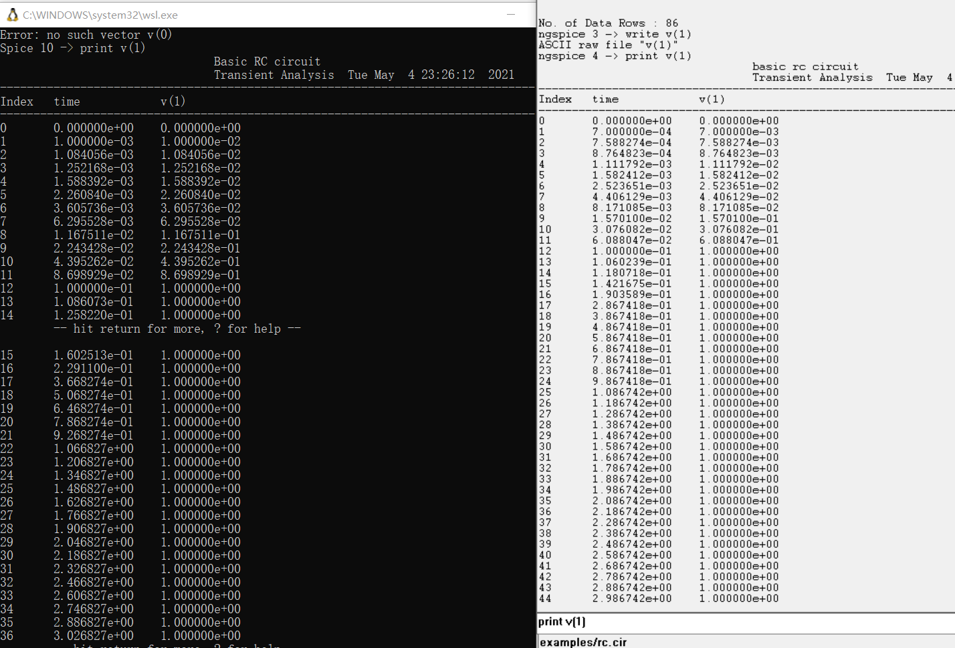
How to build under spice3f5:
util/ubild default
How to run spice3f5
../default/obj/bin/spice3 examples/rc.cir
use print v(1) , instead of plot (since X11 is not compiled)
Spice3f5 v.s. ngSPICE transient simulation, with RC circuit
Basic RC circuit
r 1 2 1.0
*l 1 2 1.0
c 2 0 1.0
vin 1 0 pulse (0 1) ac 1
.tran 0.1 7.0
*.ac dec 10 .01 10
* JUNC: work print v(2)
* plot does not work
*.plot tran v(2) i(vin)
*.plot ac vdb(2) xlog
.end

Slide 4
Lib-ckt
acan.c ac analysis
acaskq.c define “ACaskQuest()”
acssetp.c define “ACsetParm()”
cktaccpt.c driver program to iterate accept functions for the circuit(CKTcircuit)

