Slide 1
Coding Style requirements

Slide 2
Name
Do not use any number in the variable/function name
Use function overloading instead of similar function name
Using type alias instead of long type name
Using suffix Ptr for alias of shared_ptr/unique_ptr
Function name should explain what does the function do
Do not use meaningless abbreviations
Do not use ambiguous abbreviations
Do not use all upper case for enum value to avoid confliction with the macro

Slide 3
recommend
Use forward declaration instead of include header files
Make sure all types you used in the header file has declaration
Only include interface in the header file, implementation could be in the source file to speedup compile
Use enum class instead of string/int if it is available
Use CM_ENUM_HELPER_DECLARE/CM_ENUM_HELPER_IMPL to provide num_to_enum/string_to_enum/enum_to_string/operator<<
Use suffix interface for interface , Impl for implementation if it is avialable

Slide 4
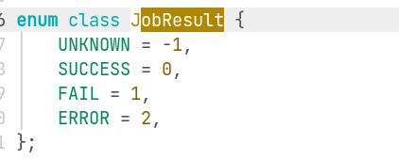

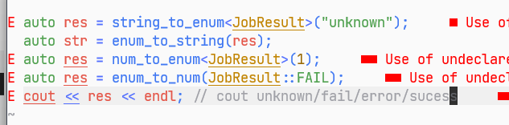
CM_ENUM_HELPER_DECLARE/CM_ENUM_HELPER_IMPL

Slide 5
recommend
Return general python dict/list in the user interface instead of c++ export data
Save the fixed data into file instead of calculated in every call
Do not do from xx import * which will involve all symbols and some symbols maybe override in local script
Use shared_ptr when you export class to python instead of default holder(unique_ptr)
A job function should declare all essential dependency by itself
Use func.deps_ or func.wait_flags_ to visit the function dependency list
Always assume there are more than 1000 partition to design your code
Reduce in parallel instead of in a loop
Use throw_message for message output

Slide 6
recommand
Check invalid condition at the begin of the function
Delay the variable definition to where it will be used
Do not use pybind11 outside of xxx/export, it will cost much time to compile pybind11
Return pos->second after pos=xx.end() instead of call operator[]
Save Id instead of name everywhere
Each function just do one things(do not too long)

Slide 7
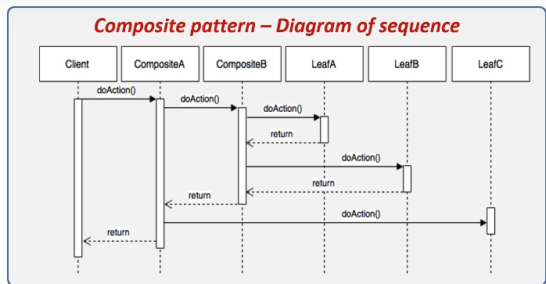
Composite pattern

Slide 8
Composite Pattern
Client
Interface
Impl1
Impl2
Composite Impl

Slide 9
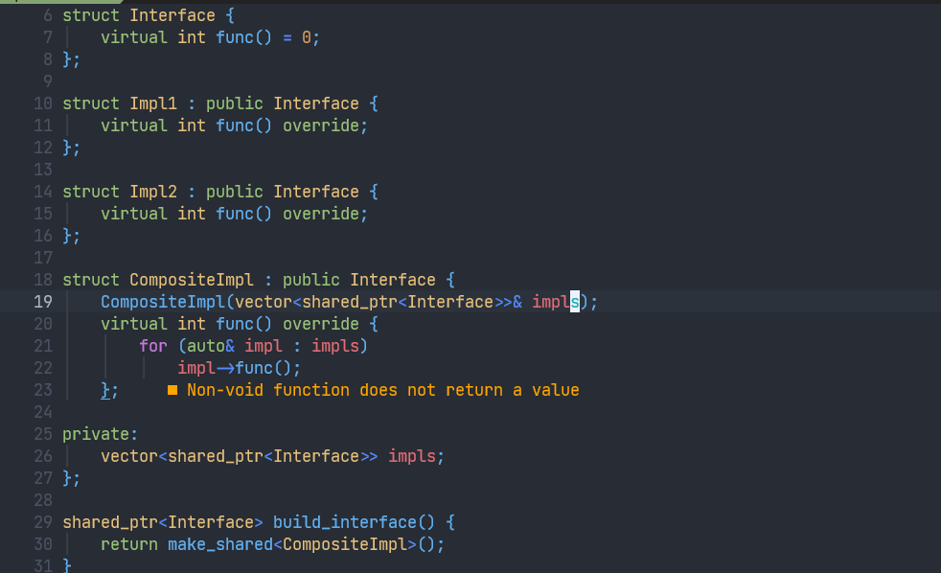

Slide 10
Name
Bad | sfsf

