Slide 1
Vesper Code Guideline

Slide 2
Compile structure
Sconstruct
Xx/SConscript
Xx/SConscript
Xx/SConscript
Xx/cpp/SConscript
Xx/export/SConscript
Xx/python/SConscript

Slide 3
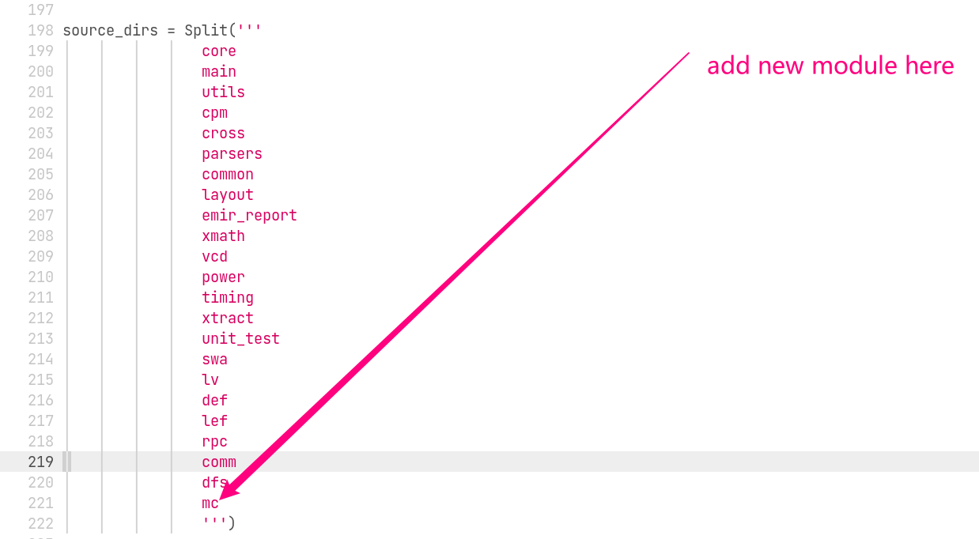
Sconstruct

Slide 4
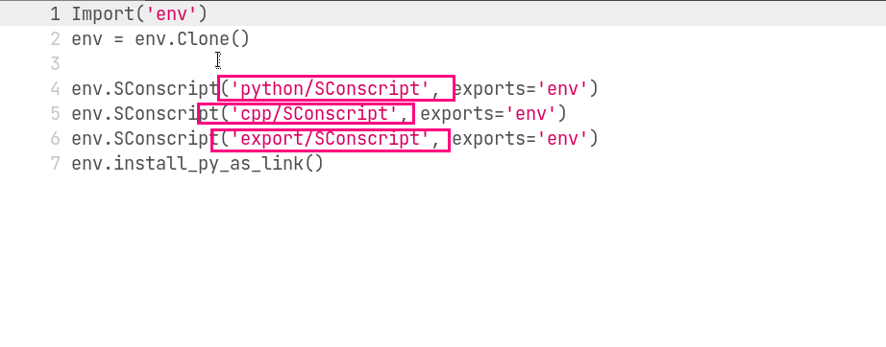
Xx/SConscript

Slide 5
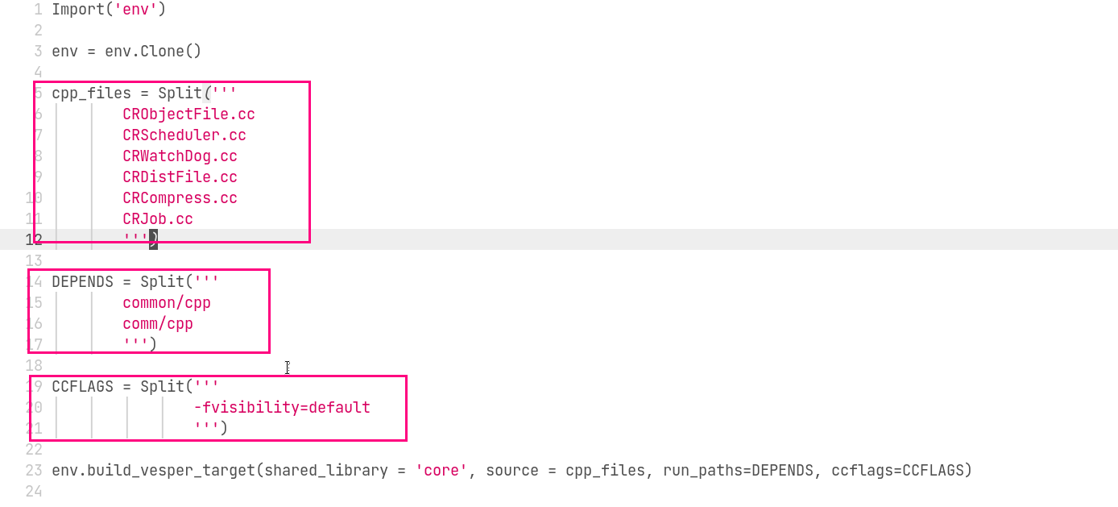
xxx/cpp/SConscript

Slide 6
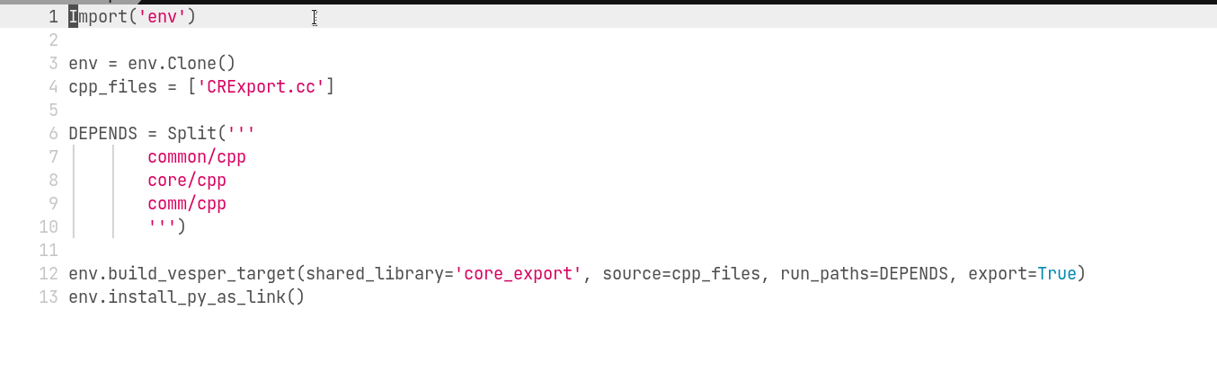
xxx/export/SConscript

Slide 7
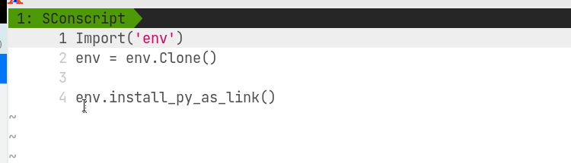
xxx/python/SConscript

Slide 8
Cpp/sconscrit introduction
cpp files list all source files which will be compiled
DEPENDS list all current model dependency which means this module should be compiled after the dependency
CCFlags add some extra compiling options to gcc
Build_vesper_target(shared_library ) mean compile so file

Slide 9
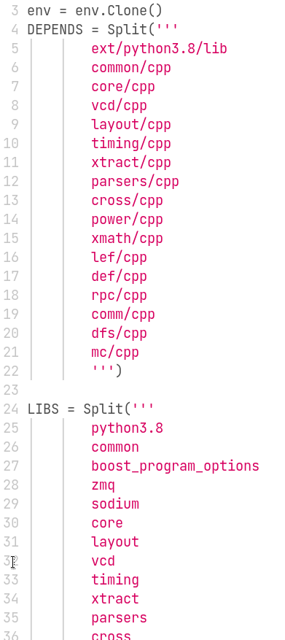
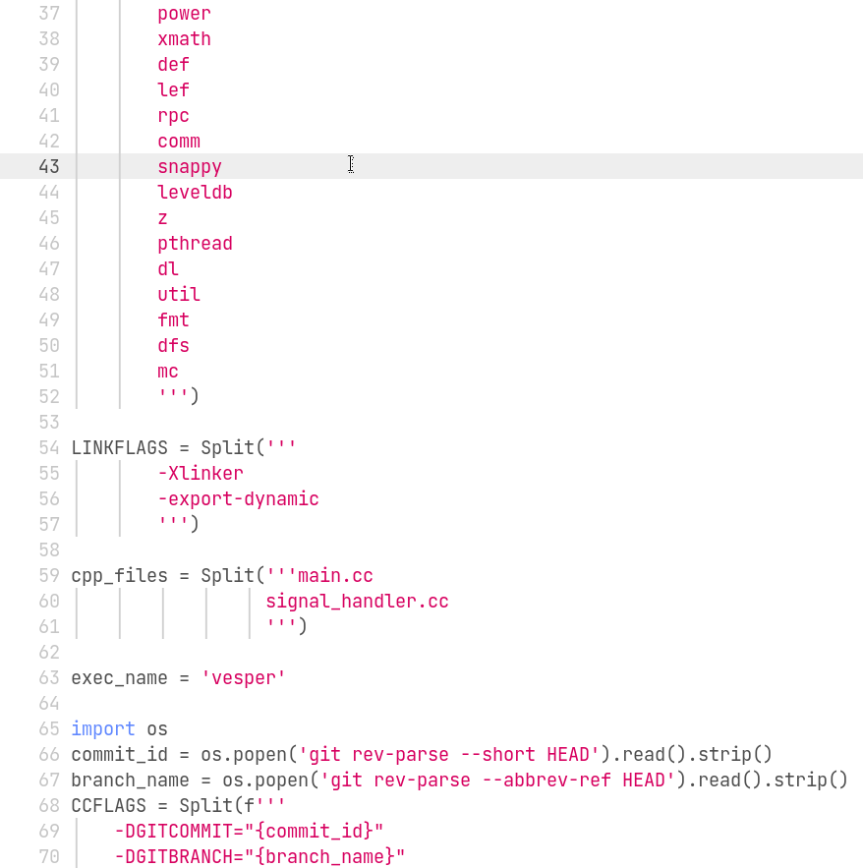
Main/cpp/SConscript

Slide 10
Main/cpp/Sconscript
main mod

