Slide 1
Vesper Usage

Slide 2
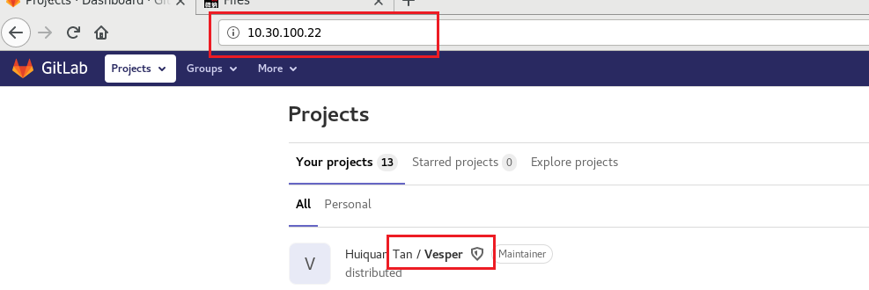
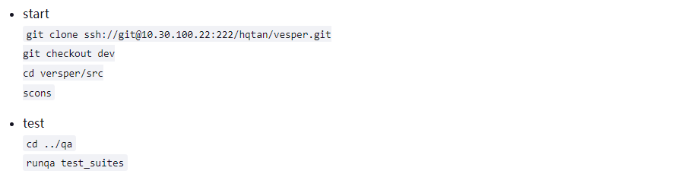
How to get vesper?

Slide 3
How to run Vesper
Any python script could be run with vesper after configure the python site-packages
General way: Vesper xxx.py
Interactive mode: vesper –i xxx.py or vesper –I

Slide 4
What can vesper do ?
Do compute job in parallel
Parse file in parallel
Save memory (trade-off b/t time and memory)

Slide 5
HVP
Power/VCD View
CPM View
EUTH
Application
MapReduce
Rpc Service
Job Graph
View
Service
Job scheduler
Distribute File Service (DFS)
Resource Manager
Engine
Disk
Disk
Disk
CPU
CPU
CPU
Resource

Slide 6
overview
Project
Scheduler
Mapreduce
Job
worker1
….
workern
DB(datalake)

Slide 7
UserScript
MapReduce
Job system
Resource Scheduler
Message system
DB
View
Namespace
File service
File system

Slide 8
Responsibility
Scheduler:
  Parse input script, schedule job and worker
  DONOT do heavy task on the scheduler!!!!
Worker:
  Execute jobs
  All business code should be executed on the workers

Slide 9
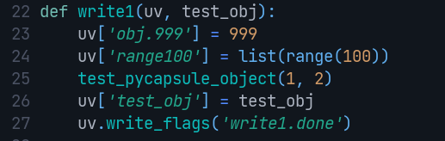
DB/Views
DB
DB is a linux directory
For general script, recommend UserView to hold data which worked same as dict
View1
Obj1
Obj2
View2
Obj1
Obj2

Slide 10
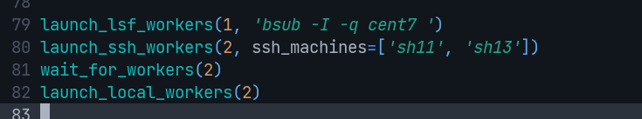
Launch workers
Launch_local_workers
Launch_lsf_workers
Launch_ssh_workers
Wait_for_workers: begin to parse script after specify number of workers ready, not essential

Slide 11
Useful functions
as_job: define a job with dependencies, no return value, any return will be ignored
Wait_flags: block to run while the dependency are satisfied, accept return value
MapReduce: Partition a big collection into many small collection to run in parallel jobs and finally reduce on those job results
Launch_xxx_workers: launch several workers

Slide 12
UserView
A dict like object
Usage:
  uv = UserView（）
  uv[‘name’] = ‘frank’
  Uv could be passed as job arguments

Slide 13
Job DAG
Job1
Job2
Indirect DAG caused by the job dependency, the dependency is always a file list, a name node service used to guarantee the dependency system works well
Job3
Job4
Job5

Slide 14
Sync/Async
Sync
Code(1m)
Sync
  Code executed one by one
Async
  Code executed in parallel
Job way Async, any business cost
Much time should be Async.
Code(1m)
Code(1m)
Code (1m)
Code(1m)
Code(1m)
Code(1m)
A=Func1(1)
B=Func2(1)
C = Func3(1)
Print(‘done’)
D = compute(A,B,C)
Func1()
Func2(1)
Func3(1)
Print(‘done’)
As_job(‘1.done’, ‘2.done’)
D = compute(A,B,C)

Slide 15
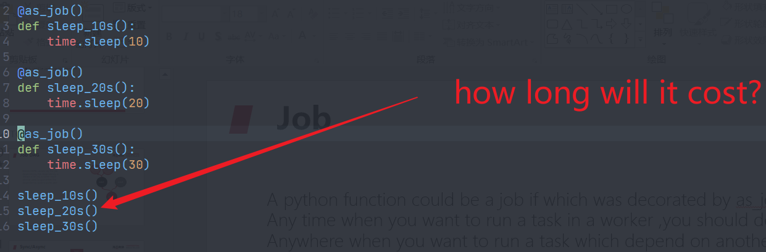
Job
A python function could be a job if which was decorated by as_job.
Any time when you want to run a task in a worker ,you should defined it as a job
Anywhere when you want to run a task which depend on another job, you should defined it as a job
Job could have simple return value such as
True/False/None

Slide 16
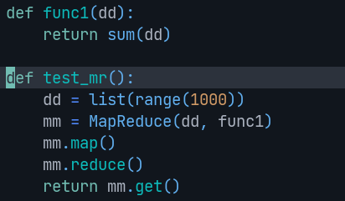
MapReduce
Mapreduce is a easy way to do some work in parallel, it is recommend for simple work such as numerical computation.
Map func
Reduce Func
Get
Mapreduce is always block

Slide 17
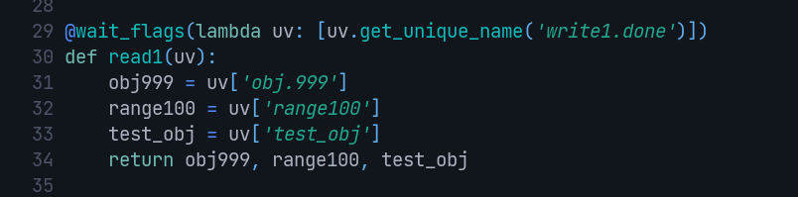

Wait_flags
Some time we need load data from a serialized file which was generated by a job, we need make sure it was generated successfully, in this case, wait_flags should be used as decorator to make sure the file was existed before reading.
Call wait_flags in a job
Add dependency to the job
Call this func with run_direct

Slide 18
Block function and non-blocked function
Block function: sync, general python function
Non-block function: async, function was decorated by as_job

Slide 19
Code Structure
module
cpp
SConscript
Source file
python
SConscript
Python file
__init__.py
Export
SConscript
source file
__init__.py
__init__.py
SConscript
test
a
b.py
func1

Slide 20
Compile System
SConstruct
Module/SConscript
Module/cpp/SConscript
Module/export/SConscript
Module/python/SConscript

Slide 21
__init__.py
Only expose the class/func you want
Hide internal implementation
From outside, we should import a class/func by from module import xxxx instead of from module.xxx import xxx
From . Xxx import yyy

Slide 22
SConscript
Dependency
  Defined which module should be compiled before current module
LIBS
  Usually unused
  Test need
Source_files
  Defined which cc files will be compiled

Slide 23
CPP
Include cc/.h files
Filename should be starts with module name abbr.
Focus on algorithm or parsing
Should consider the performance
Should not accept any python object directly
All class name should be start with module name abbr. or in a related namespace to avoid confliction b/t different modules
Generally we just need add dependency in Sconscript, no any libs need, because each cpp was compiled as a shared library, we just add libs in main module, as an exception, we should add used libs for unit test, because that will be compiled as a binary

Slide 24
python
Focus on flow, such as read some object data and pass to c++
Do not do heavy work on python side

Slide 25
export
The bridge b/t c++ and python
Any python object should be passed to those functions which was exported under export
Do not do any business/algorithm under export
Do not export too much to python, which is dangerous and lead to compile very slowly, just export data which you will use
Export class name should be start with upper module name abbr.
Export function name should be start with lower case module name abbr.

Slide 26
Compile Command
Scons –j16 ##compile parallel
Scons –cut ## create release
Scons VERBOSE=1 ##show detailed compile message
Scons –csc ## do coding style check only
Scons –c ## clean build/
Scons –init=<module name> ## generate a module tree
Git clean –xdf <dir> ## clean untracked files under dir
Use scons directly if you are working on the farm machines, else use bsub –q q7make scons

Slide 27
Unit test
Defined under unit_test/module/test_<module>.cc
Usually use to test some algorithm
Which will be test on compiling

Slide 28
Be Careful
Include vesper headers with <module/cpp/xxx.h> instead of xxx.h
Only include headers which you have used, headers such as pybind11/fmt.h include so much templates will cause very slowly compiling
Any code changes should be recompile

Slide 29
QA
Testsuites
Module
*.py
*.py.cfg
Design_data

Slide 30
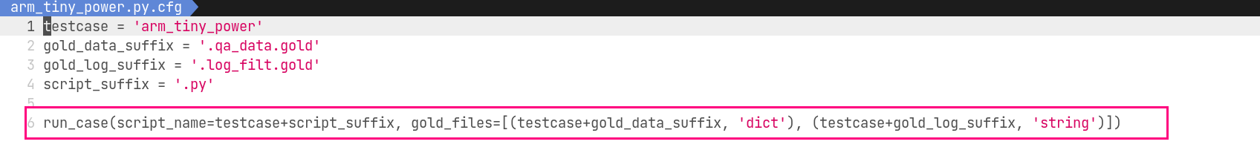
Case Config
Case script name
How to compare golden
timeout

Slide 31
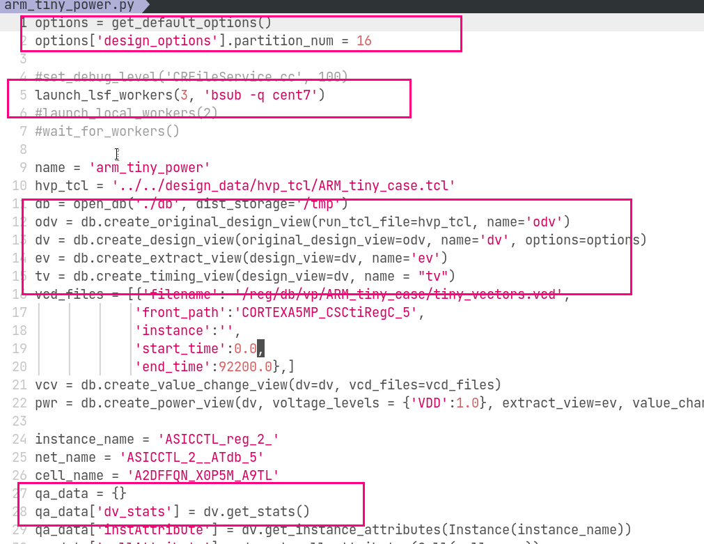
Case Script
Set option
Launch worker or not
Open db
Create view
Write compared data

Slide 32
Runqa/runqa_new
Runqa <dir> #run all cases under dir
Runqa –g <case config> #update gold of a case, do not runqa –g directly which will update all gold files which is always unexpected
Runqa –forever <case name or not> # run 999 times to check random issue
Runqa –times <case or not> # same as –forever but can specify run times
Runqa –debug # show debug message for runqa script
Runqa -j6 –use_farm

Slide 33
Be Careful
Do not use internal API in case, those API should be provided on related view
Just check a few data and save it
Compare by dict is better than string
All cases should be passed before file merge review request

