Slide 1
VESPER QA INTRODUCTION
2023/7/7
Hui Niu

Slide 2
What does qa contains
How to use our qa (-- option)
What does cases contain

Slide 3
What does qa contains

Slide 4
The composition of Vesper Qa
design_data: some necessary data, such as spef, twf, db and so on.
essential_cases_pass: These cases must be pass before you push code.
runqa: run cases conveniently.
QA
runqa_new: on the basis of script runqa , run cases in parallel.
scripts: some shared functions which apply in runqa and runqa_new.
test_suites: our regression cases.

Slide 5
How to use our qa (-- option)

Slide 6
Runqa and Runqa_new introduction
test_suites, default=[‘essential_cases’] , positional arguments
Usage:
runqa(runqa_new) : scripts run all the cases in essential_cases_pass
runqa(runqa_new) test_suites
runqa(runqa_new) test_suites/core
runqa(runqa_new) core = runqa(runqa_new) test_suites/core (recommended)

Slide 7
Runqa and Runqa_new introduction
2. -g (regolden)
Usage:
runqa(runqa_new) test_suites/core/test_help.py.cfg –g
runqa(runqa_new) test_suites/core -g
--times (run n times until cases fail)
Usage: runqa(runqa_new) test_suites/core/test_help.py.cfg –times n
-j (run cases in parallel in j process), default = 4
Usage: runqa(runqa_new) –j n
--stop (script exit once one case failed)
Usgae: runqa(runqa_new) --stop

Slide 8
Runqa and Runqa_new introduction
6. --build (specify which build you want)
Usage:
runqa(runqa_new) without --build
scripts use the default build (../build/(debug/release)/bin/vesper
runqa(runqa_new) --build build_path (abs_path/rel_path)
--build_type (specify which default build you want), default=[‘debug’]
Usage: runqa(runqa_new) --build_type debug/release
-ts (specify the scaling factor of timeout)
Usage: runqa(runqa_new) –ts n

Slide 9
Runqa and Runqa_new introduction
9. --group (run groups of marked cases)
Usage: runqa(runqa_new) --group mr help (…)

Slide 10
Runqa and Runqa_new introduction
10. --group_info (list which cases are in specified groups)
Usage: runqa(runqa_new) –group_info mr help (…)
Note: If there is nothing behind --group_info, scripts list all the groups and which cases in these groups

Slide 11
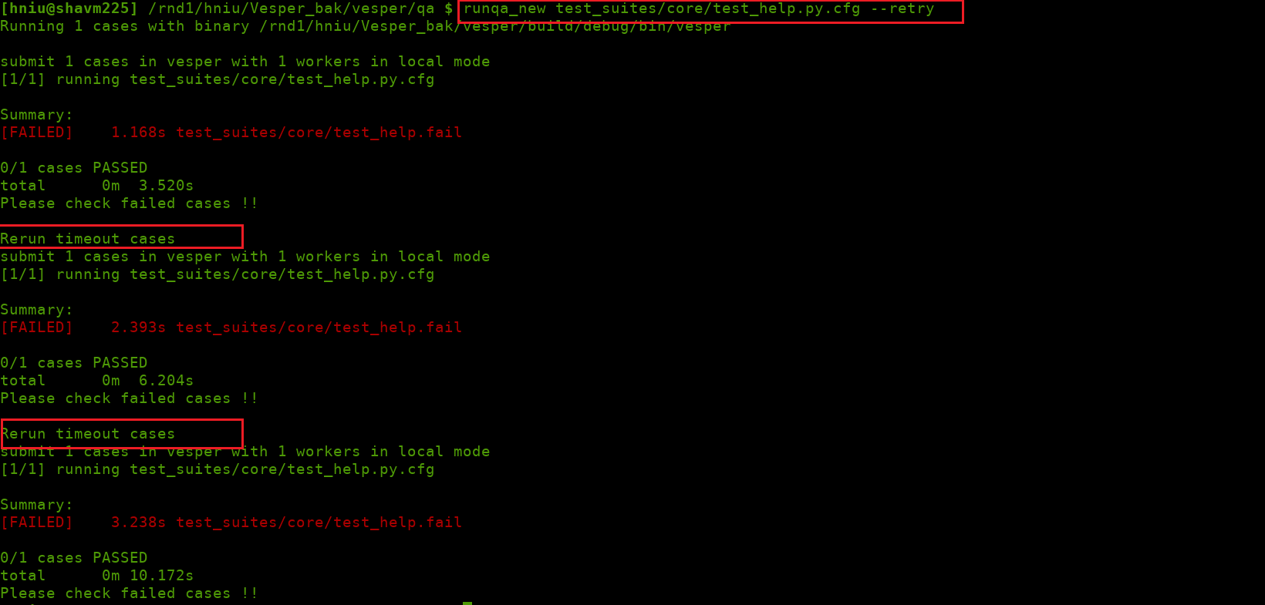
Runqa and Runqa_new introduction
11. --retry (rerun timeout cases twice automatically)
Usage: runqa(runqa_new) --retry

Slide 12
Runqa and Runqa_new introduction
12. --binary_search (find in which commit case failed or passed first time)
Usage: runqa --binary_search (must) --find_type (not a must), default=False, False represents you want to find the commit_id in which case failed first time and True represents you want to find the commit_id in which case passed first time) --start_commit (must) xxx --end_commit (must) xxx
Note: only runqa has such feature.

Slide 13
What does cases contain

Slide 14
What does cases contain
.cfg: configure file which needed by runqa or runqa_new, it tells scipts how to run, such as timeout, group_list and so on.

Slide 15
What does cases contain
.py: which needed by vesper, it tells vesper the following:
Files needed to load such as spef, twf, (…)
View needed to be create, such as odv, dv and so on.
Data needed to generate, such as qa_data, run_stats.
Tcl file needed by HVP.
Gold files: which used by scripts to do comparsion.
.log_filt.gold
Qa_data.gold
.run_stats.gold
and so on (you can generate everything you like)

Slide 16
What should we do when cases failed?
Timeout failed
Solution: pls add option –ts n or --retry

Slide 17
What should we do when cases failed?
Data diff
Solution:
Step1: confirm if your fix these diff
Step 2 : confirm is it reasonable or ask others

Slide 18
What should we do when cases failed?
3 Case quit abnormally
Solution:
Step1: open log

Slide 19
Thank You!

