Slide 1
Data to data check

Slide 2
Introduction
Data check: setup/hold check between two data pins
The setting of data check:
By lib using timing type:
non_seq_setup_rising
non_seq_setup_falling
non_seq_hold_rising
non_seq_hold_falling
By SDC
set_data_check

Slide 3
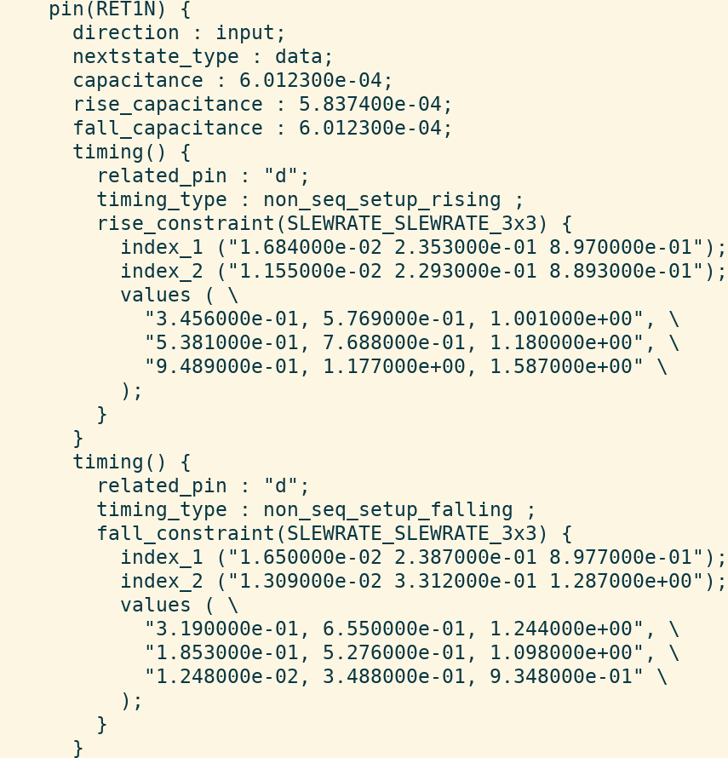
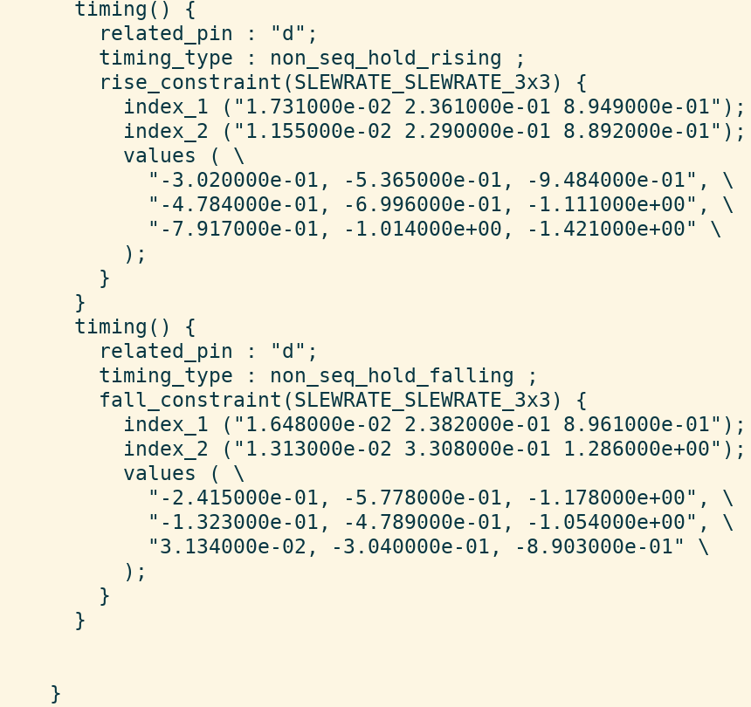
Data Check by lib

Slide 4
Data Check by SDC
set_data_check:
-setup
-hold
check_value
-from/-rise_from/-fall_from: specify the related pin
-to/-rise_to/-fall_to: specify the constrained pin
-clock: specify a clock domain at the related pin
-from -to normally specify data-path pins.
Tool does not prevent you from defining a data check in the clock network, but the results might be incorrect.

Slide 5
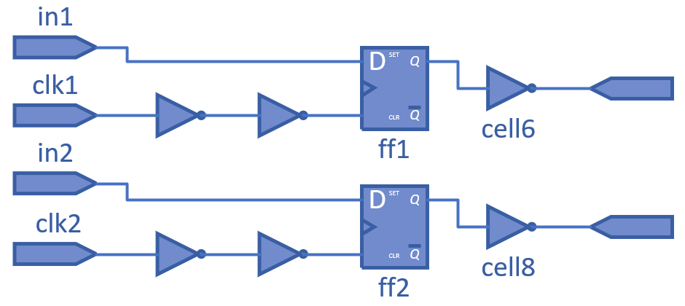
Case 1: Timing Exception by data check
Data check can be false path using:
-from capture sink pin
-through pins at capture data path
Example:
-from ff1/phi
-through cell6/i
-through cell6/o
-from ff2/phi
-through cell8/i
-to cell8/o
Different with false path, multicycle and max or min delay can only be set at launch paths.
For normal setup check, in1 -> ff1/d is not false path by set_false_path -from ff1/phi
set_data_check 1 -from cell6/o -to cell8/o

Slide 6
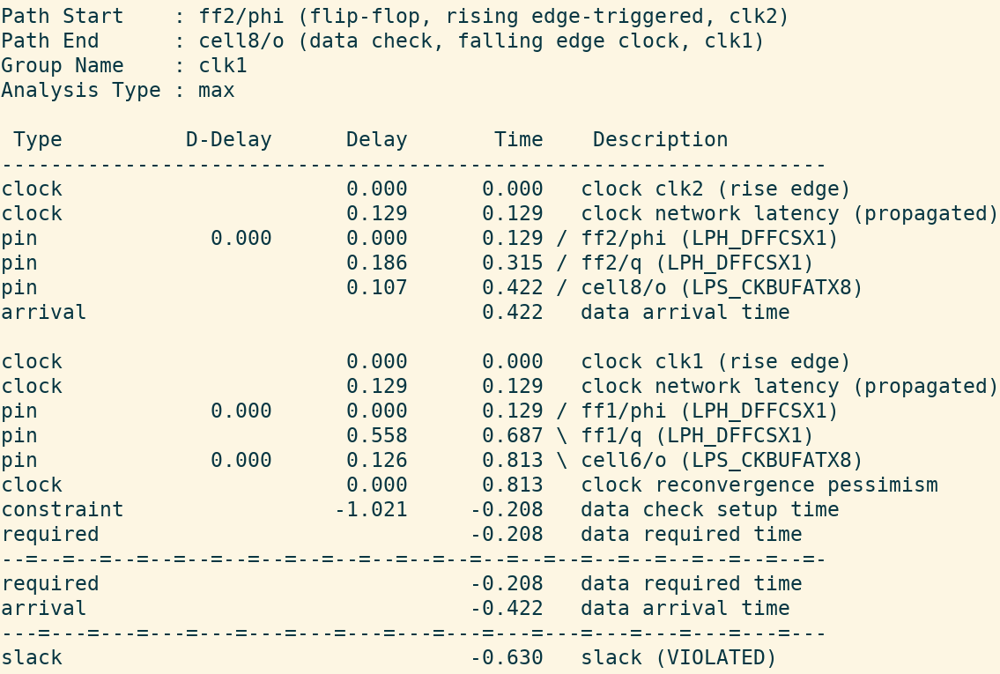
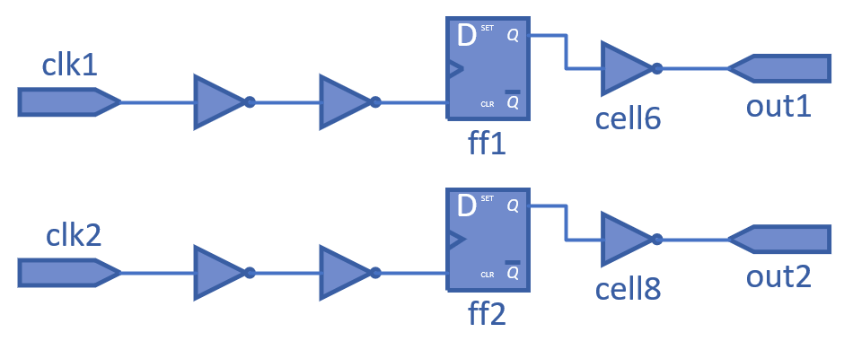
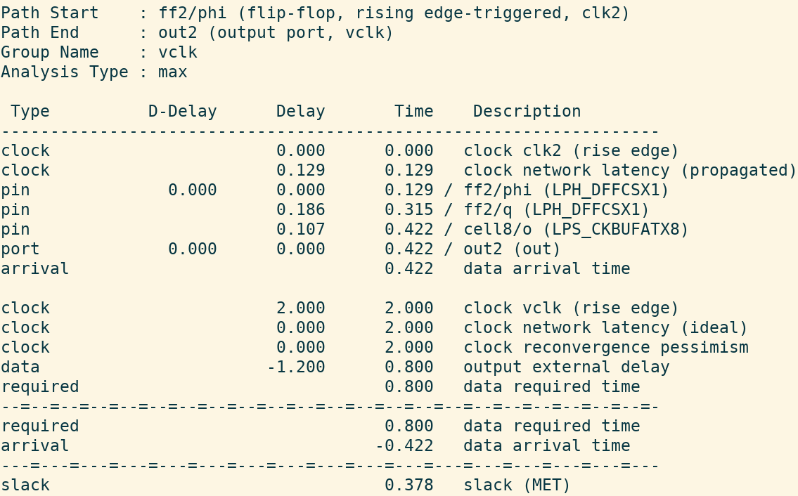
Case 2: Path not break by data check
Data check is non-sequential.
Path does not break at the related and constrained pins.
Path by data check
Path to out2
set_data_check 1.021 -from cell6/o -to cell8/o

Slide 7
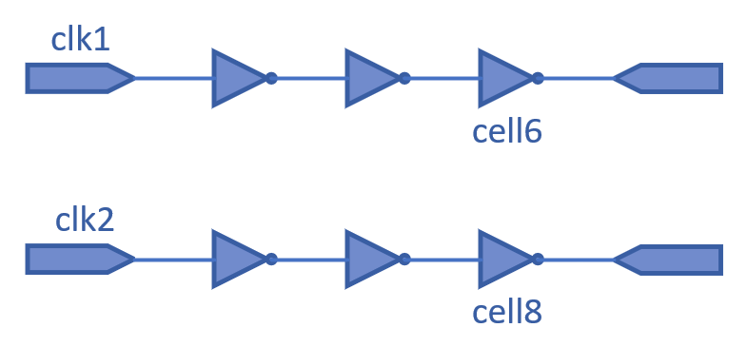
Case 3: Zero-cycle data check
#17034, an example to derive the edges by data check
Both constrained and related pins are at clock network with period 2 and waveform {0 1}.
For the launch clk2 and the capture clk1, they can be rise edge or fall edge to propagate.
The relationship of launch clk2 and capture clk1 is: rise/rise, fall/fall, fall/rise, rise/fall.
set_data_check 1.021 -from cell6/o -to cell8/o

Slide 8
Case 3: Zero-cycle data check
#17034 The relationship of launch clk2 and capture clk1:
Launch 0 (r) and capture 0 (r)
Launch 1 (f) and capture 1 (f)
Launch 1 (f) and capture 0 (r)
Launch 2 (r) and capture 1 (f)
Traditional setup check
Data-to-data setup check
Data-to-data setup check (repeated)
launch clk2
-2
-1
0
1
2
3
4
-2
-1
0
1
2
3
4
capture clk1
-2
-1
0
1
2
3
4
-2
-1
0
1
2
3
4

Slide 9
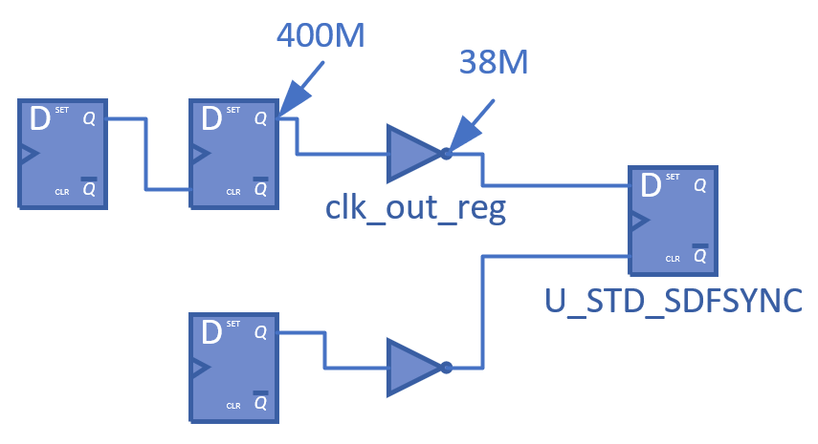
Case 4: Zero-cycle data check
#16648, another example to derive the edges by data check
Both constrained and related pins are at clock network with period 2.5.
The launch clock 38M has waveform {1.25 2.5} and the capture clock 400M has waveform {0 1.25}.
set_data_check -1.0272 -from clk_out_reg/o -to U_STD_SDFSYNC/d

Slide 10
Case 4: Zero-cycle data check
#16648 The relationship of launch 38M and capture 400M:
Launch 0 (f) and capture 0 (r)
Launch 1.25 (r) and capture 1.25 (f)
Launch 1.25 (r) and capture 0 (r)
Launch 2.5 (f) and capture 1.25 (f)
Traditional setup check
Data-to-data setup check
launch 38M
-1.25
0
1.25
2.5
3.75
5
-1.25
0
1.25
2.5
3.75
5
capture 400M
-2.5
-1.25
1.25
2.5
3.75
5
0
-2.5
-1.25
0
1.25
2.5
3.75
5

Slide 11
Test Summary
Data paths / Clock paths
-clock
report_ta / -number_of_worst_paths / full_clock_expanded
check_timing_setup
set_timing_derate -clock / -data
CRPR
Timing exceptions:
set_false_path
set_multicycle_path
set_max_delay
set_min_delay
12 tickets, 8 opened.

Slide 12
Ticket Summary
ticket | Description | check | status
17034 | 简化的16648，clk1 port和clk2 port分别创建时钟，两个路径独立，endpoint都是output port，中间都只经过三个INV，set_data_check -from cell6/o -to cell8/o，注意related pin cell6/o直接获得了clk1的clock signal，report_ta -number_of_worst_paths 10显示总共4个路径里：1. capture错误显示fall edge 2. 有2个路径launch和capture的起点错误
17010 | 基于16648，将clk_out_reg从FF改成INV，clk_out_reg/ZN是related pin，set_data_check -from clk_out_reg/ZN -to U_STD_SDFSYNC/D -clock [get_clocks 400M]，report_ta -number_of_worst_paths 10显示no path，加入-unconstrained_path显示uncons path
16648 | 将clk_out_reg从FF改成INV，clk_out_reg/ZN是related pin，set_data_check -from clk_out_reg/ZN -to U_STD_SDFSYNC/D，report_ta -number_of_worst_paths 10显示的全部path里：1. capture clock 400M是fall_edge，缺少rise_edge，2. 部分path的launch和capture edge起点不对。400M的电平和400M创建的U_CRG_DFF_RN/q pin的电平要一致
16229 | 一个clock port的clock signal在经过cell2后分岔两路，分别传入FF1和FF2，FF1传出到cell6，FF2传出到cell8。set_data_check 1 -from cell8/i -to cell6/i，capture是cell8所在的path，launch是cell6所在的path，但CHT没有正确认为cell2/o是common point，导致crpr value是0
16231 | 同样是16229的netlist。set_data_check 1 -from ff2/phi -to ff1/phi，capture是ff2所在的path，launch是ff1所在的path。set_timing_derate 0.8 -data -early和0.9 -clock -early，ff1所在的path前面没有正确取0.9作为clock path derate。其二，set_clock_latency 0.8 -source -max clk1 && set_clock_latency 0.5 -source -min clk1，正确的crpr value是0.3，REF不会显示cell2/o为common point，crpr只考虑source clock latency的max和min之差，不考虑cell2的max delay和min delay之差。其三，clock network latency (propagated)不会显示在data check的timing path。

Slide 13
Ticket Summary
ticket | Description | check | status
16612 | 基于15120的netlist，set_data_check -from clk_out_reg/q -to U_STD_SDFSYNC/d -clock [get_clocks 400M]，report_ta -path_report_format full_clock_expanded显示了错误的capture edge 1600M (fall_edge)，正确行为是capture edge 400M (rise_edge)。注意：这里总共报出4条path，400M都是rise_edge，因400M下一级的clk_out_reg只能被rise-triggered
16563 | 基于15120的netlist，set_data_check -from clk_out_reg/q -to U_STD_SDFSYNC/d -clock [get_clocks 400M]，set_timing_derate 0.8 -data -early和0.9 -clock -early，对于timing arc: clk_out_reg/q -> U_STD_SDFSYNC/d，report_ta -show_derate没有正确报出data derate of 0.8，而是误报clock derate 0.9
16561 | set_data_check -from 不存在的related pin，再写一次-from 正常的related pin，compute_timing crash
15120 | set_data_check -from clk_out_reg/q -to U_STD_SDFSYNC/d -clock [get_clocks 400M]，report_ta crash | Local bin | Done
15143 | 与15083相似。gclock 400M通过FF（clk_out_reg）连接下一级的FF（U_STD_SDFSYNC），clk_out_reg/q创建gclock 38M，clk_out_reg/q直连U_STD_SDFSYNC/d。set_data_check -from clk_out_reg/q -to U_STD_SDFSYNC/d -clock [get_clocks 38M]，report_ta错误报出38M同时作为launch和capture的path，有slack，同时check_timing_setup没有报出U_STD_SDFSYNC/d作为uncons。注意：q pin作为related pin，它获取data signal对应的clock是前面经过FF的400M，d pin作为constrained pin，它获取data signal对应的clock是38M，正确行为-clock指定400M | Local bin | Done
15083 | 对data2data check的特殊情况处理。clk1通过FF1连接mux/i0，clk2通过FF2连接mux/i1，set_data_check -from mux/i1 -to mux/i0 -clock [get_clocks clk1]，mux/i1是related pin，mux/i0是constrained pin，-clock指定的是related pin获取data signal对应的clock，但verilog描述的mux/i1和clk1无关联性，CHT没有正确报出mux/i0作为uncons。 | 22/12/16 | Done
14751 | 在lib定义cell的两个pin构成timing type: non_seg_setup_rising，这两个pin构成data to data check，如果这两个pin都来自于同一个时钟，且满足时序约束，无时序例外，这两个pin都不是uncons。 | 22/11/25 | Done

Slide 14
Thanks

