Slide 1

Advanced Tiling
For Matrix Multiplication
打造完整的国产芯片数字EDA平台

Slide 2
AGENDA
1D Convolution
Convert Convolution to Matrix Multiplication
Matrix Multiplication

Slide 3
Convolution Applications
Convolution is a widely-used operation in signal processing, image processing, video processing, and computer vision
Convolution applies a filter or mask or kernel* on each element of the input (e.g., a signal, an image, a frame) to obtain a new value, which is a weighted sum of a set of neighboring input elements
  Smoothing, sharpening, or blurring an image
  Finding edges in an image
  Removing noise, etc.
Applications in machine learning and artificial intelligence
  Convolutional Neural Networks (CNN or ConvNets)
* The term “kernel” may create confusion in the context of GPUs (recall a CUDA/GPU kernel is a function executed by a GPU)

Slide 4
1D Convolution Example
Commonly used for audio processing
Mask size is usually an odd number of elements for symmetry (5 in this example)
Calculation of P[2]:
N
N[0]
N[1]
N[2]
N[3]
N[4]
N[5]
N[6]
P
P[0]
P[1]
P[2]
P[3]
P[4]
P[5]
P[6]
1
2
3
4
5
6
7
3
8
57
16
15
3
3
Sum
M
M[0]
M[1]
M[2]
M[3]
M[4]
3
8
15
16
15
3
4
5
4
3
Partial products
Slide credit: Hwu & Kirk

Slide 5
1D Convolution Boundary Condition
Calculaton of output elements near the boundaries of the input array need to deal with “ghost” elements
Different policies(0, replicates of boundary values, etc.)
Calculation of P[1]:
N
N[0]
N[1]
N[2]
N[3]
N[4]
N[5]
N[6]
P
P[0]
P[1]
P[2]
P[3]
P[4]
P[5]
P[6]
0
1
2
3
4
5
6
7
3
38
8
16
15
3
3
M
M[0]
M[1]
M[2]
M[3]
M[4]
0
4
10
12
12
3
4
5
4
3
Partial products
Slide credit: Hwu & Kirk

Slide 6
1D Convolution Kernel with Boundary Condition Handling*
__global__ void convolution_1D_basic_kernel(float *N, float *M, float *P,
int Mask_Width, int Width) {
int i = blockIdx.x * blockDim.x + threadIdx.x; // Index of output element
float Pvalue = 0;
int N_start_point = i - (Mask_Width/2); // Index of first neighbor
for(int j = 0; j < Mask_Width; j++) {
// Check the boundaries
if(N_start_point + j >= 0 && N_start_point + j < Width) {
Pvalue += N[N_start_point + j] * M[j]; // Multiply and accumulate
}
}
P[i] = Pvalue; // Store output element
}
* All elements outside the image are 0 in this kernel

Slide 7
Memory Hierarchy in CUDA Programs
由于 CUDA 运行时知道在内核执行期间不会修改常量内存变量，并且不存在缓存一致性问题。因此它会指示硬件在内核执行期间主动缓存常量内存变量

Slide 8
Memory in the GPU Architecture
SM
SM
SM
Control
Control
Control
≈1 cycle
Registers
Registers
Registers
Core
Core
Core
Core
Core
Core
Core
Core
…
Core
Core
Core
Core
Core
Core
Core
Core
Core
Core
Core
Core
Core
Core
Core
Core
≈5 cycles
Constant Cache
Constant Cache
Constant Cache
Shared Memory
L1 Cache
Shared Memory
L1 Cache
Shared Memory
L1 Cache
≈5 cycles
L2 Cache
≈500 cycles
Global Memory
Slide credit: Izzat El Hajj
Notes:
A100 fine-grained structured sparsity prunes trained weights with a 2-out-of-4 non-zero pattern, followed by a simple and universal recipe for fine-tuning the non-zero weights. The weights are compressed for a 2x reduction in data footprint and bandwidth, and the A100 Sparse Tensor Core doubles math throughput by skipping the zeros (see https://developer.nvidia.com/blog/nvidia-ampere-architecture-in-depth/).

Slide 9
Storing the Mask in Constant Memory
We can store the mask in constant memory
  The mask is small
  It is constant
  It is accessed by all threads
Constant memory is cached inside each GPU core and it is particularly fast when all threads of a warp access the same value
1. Declare the mask as a global variable
#define MASK_WIDTH 5
__constant__ float M[MASK_WIDTH];
2. Initialize the mask from the host
  cudaMemcpyToSymbol(M, M_h, Mask_Width*sizeof(float));
Destination
Source
Size

Slide 10
1D Convolution Kernel with Boundary Condition Handling and Constant Cache for M
#define MASK_WIDTH 5
__constant__ float M[MASK_WIDTH];
__global__ void convolution_1D_basic_kernel(float *N, float *P,
int Mask_Width, int Width) {
int i = blockIdx.x * blockDim.x + threadIdx.x; // Index of output element
float Pvalue = 0;
int N_start_point = i - (Mask_Width/2); // Index of first neighbor
for (int j = 0; j < Mask_Width; j++) {
// Check the boundaries
if (N_start_point + j >= 0 && N_start_point + j < Width) {
Pvalue += N[N_start_point + j] * M[j]; // Multiply and accumulate
}
}
P[i] = Pvalue; // Store output element
}
Use it with caution! Constant cache is small (e.g., 64 KB)

Slide 11
Tiled 1D Convolution Basic Idea
Block 0
Block 1
Block 2
Block 3
P
0
1
2
3
4
5
6
7
8
9
10
11
12
13
14
15
N
0
1
2
3
4
5
6
7
8
9
10
11
12
13
14
15
Tile 0
ghost
0
1
2
3
4
5
Tile 1
2
3
4
5
6
7
8
9
halo
Tile 2
6
7
8
9
10
11
12
13
Tile 3
10
11
12
13
14
15
ghost
Slide credit: Hwu & Kirk

Slide 12
Tiled 1D Convolution Kernel
__global__ void convolution_1D_basic_kernel(float *N, float *P, int Mask_Width, int Width) {
int i = blockIdx.x*blockDim.x + threadIdx.x; // Index of output element
__shared__ float N_ds[TILE_SIZE + MAX_MASK_WIDTH - 1]; // Shared memory tile
int n = Mask_Width/2; // Halo width
// Load left halo
int halo_index_left = (blockIdx.x - 1)*blockDim.x + threadIdx.x;
if(threadIdx.x >= blockDim.x - n) {
N_ds[threadIdx.x - (blockDim.x - n)] = (halo_index_left < 0) ? 0 : N[halo_index_left];
}
// Load internal elements
N_ds[n + threadIdx.x] = N[blockIdx.x*blockDim.x + threadIdx.x];
// Load right halo
int halo_index_right = (blockIdx.x + 1)*blockDim.x + threadIdx.x;
if(threadIdx.x < n) {
N_ds[n + blockDim.x + threadIdx.x] = (halo_index_right >= Width) ? 0 : N[halo_index_right];
}
__syncthreads(); // Intra-block synchronization
float Pvalue = 0;
for(int j = 0; j < Mask_Width; j++) {
Pvalue += N_ds[threadIdx.x + j] * M[j]; // Convolution result
}
P[i] = Pvalue;
}
Slide credit: Hwu & Kirk

Slide 13
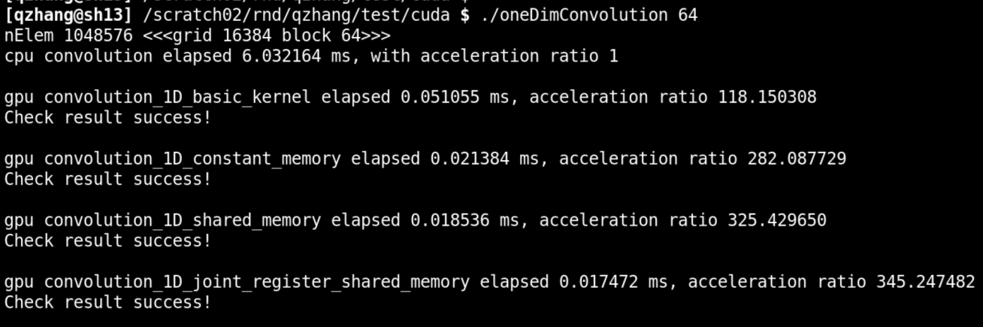
实操演示
文件位置：
  /scratch02/rnd/qzhang/test/cuda/oneDimConvolution.cu

Slide 14
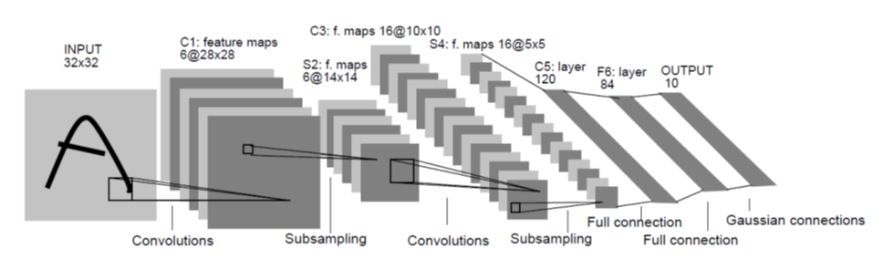
Some Observations
The amount of parallelism is quite high as long as the total number of pixels across all output feature maps is large
  For early stages, there are fewer but larger output feature maps (large Y dimension)
  For later stages, there are more but smaller output feature maps (large X dimension)
  This scheme keeps the total number of threads stable across the stages
Slide credit: Hwu & Kirk & PUMPS+AI 2022

Slide 15
Some Observations (2)
Each input tile is loaded from global memory multiple times (by multiple blocks), once for each block that calculates the output tile that requires the input tile
  Not very efficient in global memory bandwidth
Slide credit: Hwu & Kirk & PUMPS+AI 2022

Slide 16
Reducing Convolution Layers to Matrix Multiplications
Convolution layers are the compute intensive parts of a CNN
GPUs have extremely high-performance implementations of matrix multiplications
Tiling techniques for matrix multiplication naturally reuse input features across output feature maps
Converting convolutions in a convolution layer to a matrix multiplication helps to keep the level of parallelism stable across CNN layers
Slide credit: Hwu & Kirk & PUMPS+AI 2022

Slide 17
Example of the Forward Path of a Convolutional Layer
((N₁ - K₁+1) x (N₂ - K₂+1))
pixels each
(K₁ x K₂) pixels each
(N₁ x N₂) pixels each
Slide credit: Hwu & Kirk & PUMPS+AI 2022

Slide 18
Implementing a Convolutional Layer with Matrix Multiplication
01 void unroll(int C, int H, int W, int K,
float* X, float* X_unroll) {
02 int H_out = H – K + 1;
03 int W_out = W – K + 1;
04 for(int c = 0; c < C; c++) {
// beginning row index of the section for channel
// C input feature map in the unrolled matrix
05 w_base = c * (K*K);
06 for(int p = 0; p < K; p++)
07 for(int q = 0; q < K; q++) {
08 int h_unroll = w_base + p*K + q;
09 for(h = 0; h < H_out; h++)
10 for(int w = 0; w < W_out; w ++) {
11 int w_unroll = h * W_out + w;
12 X_unroll[h_unroll, w_unroll) =
X(c, h + p, w + q);
13 }
14 }
15 }
}
}
}
H_out=W_out=2
K*K=2*2
C = 3

Slide 19
Simple Matrix Multiplication
1 | 2 | 1 | 1
2 | 0 | 1 | 3
1 | 1 | 0 | 2
1 | 3 | 2 | 2
0 | 2 | 0 | 3
2 | 1 | 3 | 2
0 | 3 | 1 | 1
3 | 2 | 1 | 0
1 | 2 | 1 | 1
2 | 1 | 0 | 3
0 | 1 | 3 | 3
1 | 3 | 3 | 2
0
Each product matrix element is an output feature map pixel
This inner product generates element 0 of output feature map 0
Input Feature Maps
1
2
Convolution Filters
0
Output Feature Maps
1 | 1 | 2 | 2 | 1 | 1 | 1 | 1 | 0 | 1 | 1 | 0
1 | 0 | 0 | 1 | 2 | 1 | 2 | 1 | 1 | 2 | 2 | 0
14 | 20 | 15 | 24
12 | 24 | 17 | 26
1
Slide credit: Hwu & Kirk & PUMPS+AI 2022

Slide 20
Tiled Matrix Multiplication 2x2 Shared-Memory Tiling (Toy Example)
Each block calculates one 2x2 output tile – 2 elements from each output map
Each block loads one 2x2 filter tile and one 2x2 input tile into the shared memory and performs two dot product steps for all its 2x2 output elements
Each input element is reused 2 times in the shared memory
1 | 2 | 1 | 1
2 | 0 | 1 | 3
1 | 1 | 0 | 2
1 | 3 | 2 | 2
0 | 2 | 0 | 3
2 | 1 | 3 | 2
0 | 3 | 1 | 1
3 | 2 | 1 | 0
1 | 2 | 1 | 1
2 | 1 | 0 | 3
0 | 1 | 3 | 3
1 | 3 | 3 | 2
0
Input Feature Maps
1
2
Convolution Filters
0
Output Feature Maps
1 | 1 | 2 | 2 | 1 | 1 | 1 | 1 | 0 | 1 | 1 | 0
1 | 0 | 0 | 1 | 2 | 1 | 2 | 1 | 1 | 2 | 2 | 0
14 | 20 | 15 | 24
12 | 24 | 17 | 26
1
Slide credit: Hwu & Kirk & PUMPS+AI 2022

Slide 21
Tiled Matrix-Matrix Multiplication (I)
N
C = A x B
B
N
Step 1: Load the first tile of each input matrix to shared memory (each thread loads one element)
N
N
A
C
N
N
Slide credit: Izzat El Hajj

Slide 22
Tiled Matrix-Matrix Multiplication (II)
B_{tile}
C_{tile} = A_{tile} x B_{tile}
Step 2: Each thread computes its partial sum from the tiles in shared memory (threads wait for each other to finish)
A_{tile}
C_{tile}
Slide credit: Izzat El Hajj

Slide 23
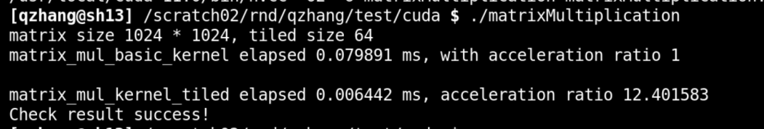
实操演示
文件位置：
  /scratch02/rnd/qzhang/test/cuda/matrixMultiplication.cu

Slide 24
Joint Register and Shared-Memory Tiling
Registers are accessed at extremely high throughput but
  Private to each thread
  Register tiling needs thread coarsening
Shared memory is accessed at lower throughput than registers but still much higher than global memory
  Visible to all threads in a block
  Does not need thread coarsening
  Still needs to be first loaded into registers before used by compute units
We typically use both for tiling different dimensions of a multidimensional data
One can use registers even more aggressively with warp programming and tensor cores
Slide credit: Hwu & Kirk & PUMPS+AI 2022

Slide 25
Memory Hierarchy in CUDA Programs

Slide 26
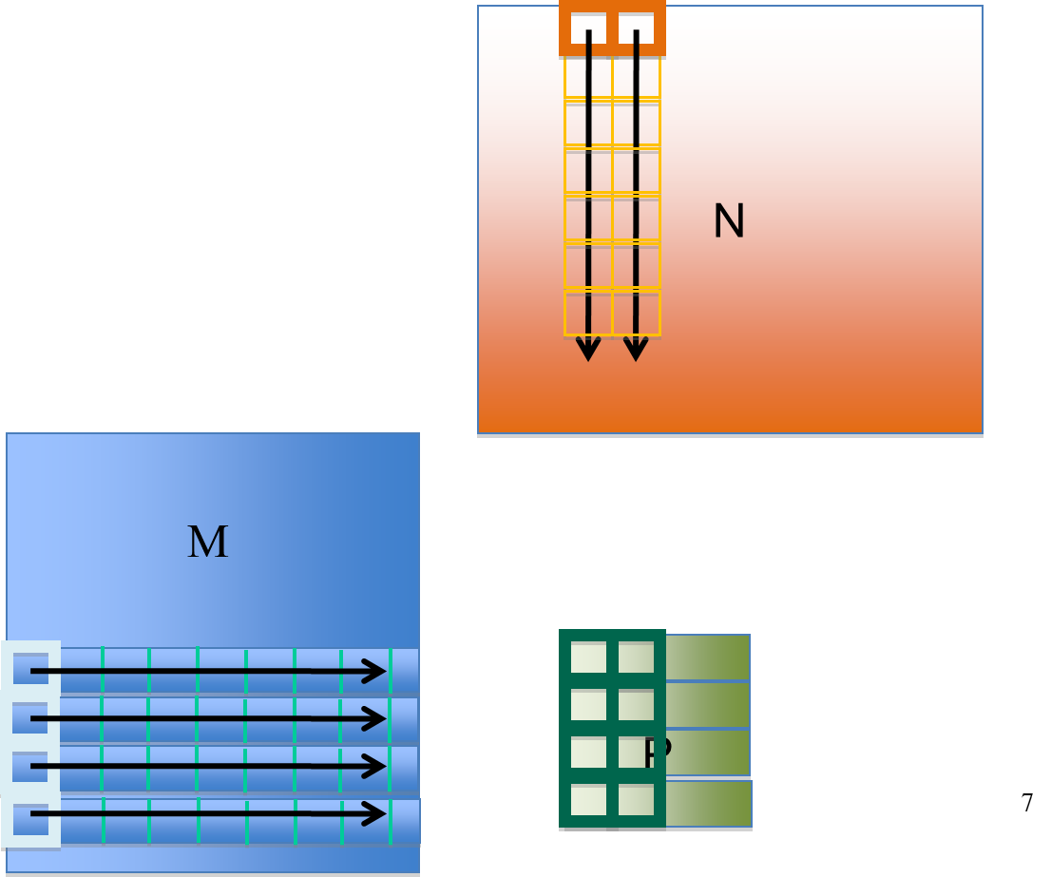
Joint Register and Shared Memory Tiling
Store input M tile and output P tile elements in registers
Store input N tile elements in shared memory
Decouple of M and N input tile widths
  TILE_WIDTH_M , TILE_WIDTH_N
Key quantities
  Number of threads = TILE_WIDTH_M
  Output tile size = TILE_WIDTH_M * TILE_WIDTH_N
  Reuses for each N element = TILE_WIDTH_M
  Reuses for each M element = TILE_WIDTH_N
  Each thread calculates TILE_WIDTH_N P elements
Example:
TILE_WIDTH_M = 4
TILE_WIDTH_N = 2
Slide credit: Hwu & Kirk & PUMPS+AI 2022

Slide 27
Joint Register and Shared Memory Tiling
Optimization 1: Thread Coarsening
Have each thread to calculate a horizontal strip of TILE_WIDTH_N P elements
Data loaded from M can be reused TILE_WIDTH_N times through registers
  Register tiling
M
N
M
Load 1 value from M into r1
r1 can be reused to compute 4 intermediate results for P
P[0] += r1 * n1;
P[1] += r1 * n2;
P[2] += r1 * n3;
P[3] += r1 * n4;
P
Slide credit: Hwu & Kirk & PUMPS+AI 2022

Slide 28
Joint Register and Shared Memory Tiling
Optimization 2: Shared Memory Tiling
Multiple threads collaborate to load TILE_WIDTH_N N elements into shared memory
B
N
M
T1-T4 cooperatively load 4 values from N, say n1~n4 into shared memory so T1-T4 can all use them
Accessed by T1
P
Accessed by T2
P
P
P
Slide credit: Hwu & Kirk & PUMPS+AI 2022

Slide 29
In One Iteration, Each Thread…
Accesses one M element from register, accesses TILE_WIDTH_N N elements from shared memory
  Calculates one step for TILE_WIDTH_N P elements
  TILE_WIDTH_N = ~16 in practice (limited by registers needed for P elements)
B
N
M
n1~n4 accessed from shared memory
Accessed by T1
P
Accessed by T2
P
Intermediate results computed by T1; stored in registers
P
P
Slide credit: Hwu & Kirk & PUMPS+AI 2022

Slide 30
In One Iteration, Each Block…
Has TILE_WIDTH_M threads
  64 or more in practice
Loads TILE_WIDTH_M M elements into registers, loads TILE_WIDTH_N N elements into shared memory
  TILE_WIDTH_N is number of threads folded into one thread in thread coarsening (16 or more in practice)
However, loading of N will involve only a subset of threads (divergence)
Slide credit: Hwu & Kirk & PUMPS+AI 2022

Slide 31
A More Balanced Approach
In each iteration, all threads in a block collaborate to load a TILE_WIDTH_N * K tile of N into shared memory
  K is set so that TILE_WIDTH_M = TILE_WIDTH_N * K
  Every thread loads one N element, no divergence
Each thread loads K M elements into registers
  Value of K is limited by the number of registers
  Each thread needs to use
    TILE_WIDTH_N registers for output elements
    K registers for M elements
Each block calculates K steps for
TILE_WIDTH_N * TILE_WIDTH_M P elements
Slide credit: Hwu & Kirk & PUMPS+AI 2022

Slide 32
Summary: Joint Register and Shared Memory Tiling
Each block has TILE_WIDTH_M threads
Each thread coarsened by TILE_WIDTH_N times
Each thread loads
  One N element into the shared memory
  K = TILE_WIDTH_M/TILE_WIDTH_N M elements
  To calculate K steps of TILE_WIDTH_N P elements
TILE_WIDTH_N
B
M
N
TILE_WIDTH_M
Accessed by T1
P
Accessed by T2
P
P
P
Slide credit: Hwu & Kirk & PUMPS+AI 2022

Slide 33
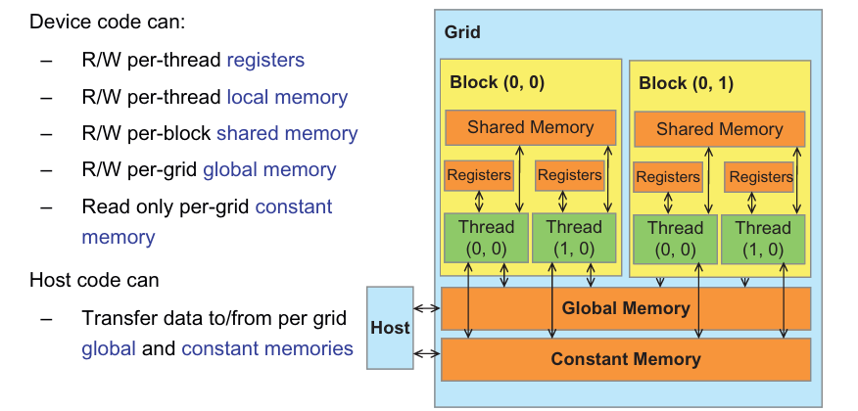
内存使用总结
Variable declaration | Memory | Scope | Lifetime
int LocalVar; | register | thread | thread
int localArr[N]; | local | thread | thread
__device__ __shared__ int SharedVar; | shared | block | block
__device__ int GlobalVar; | global | grid | application
__device__ __constant__ int ConstantVar; | constant | grid | application

Slide 34
内存使用总结
Constant Memory vs Global Memory
访问速度： Constant Memory > Global Memory
存储容量： Global Memory > Constant Memory
读写属性： Constant Memory 只读， Global Memory可读写
可见性：对所有grid均可见
Register vs Shared Memory vs Global Memory
访问速度： Register > Shared Memory > Global Memory
存储容量： Global Memory > Shared Memory > Register
可见性： Global Memory对所有grid均可见; Shared Memory对同一个block中的所有Thread可见； Register仅Thread自己可见

Slide 35
卷积在图像识别/显示中的应用

Slide 36

THANK YOU
WWW.GIGA-DA.COM
电话：0755-61018899
邮箱：info@GIGA-DA.COM
邮编：518000

