Slide 1
A Quick Look at RTL Synthesis
Daisy Li 2024/05/07
打造完整的国产芯片数字EDA平台

Slide 2
01.
02.
Digital IC design flow
RTL synthesis flow
03.
04.
Synthesis - translate
Synthesis - timing constraints
05.
06.
Synthesis - optimize
Synthesis - output data

Slide 3
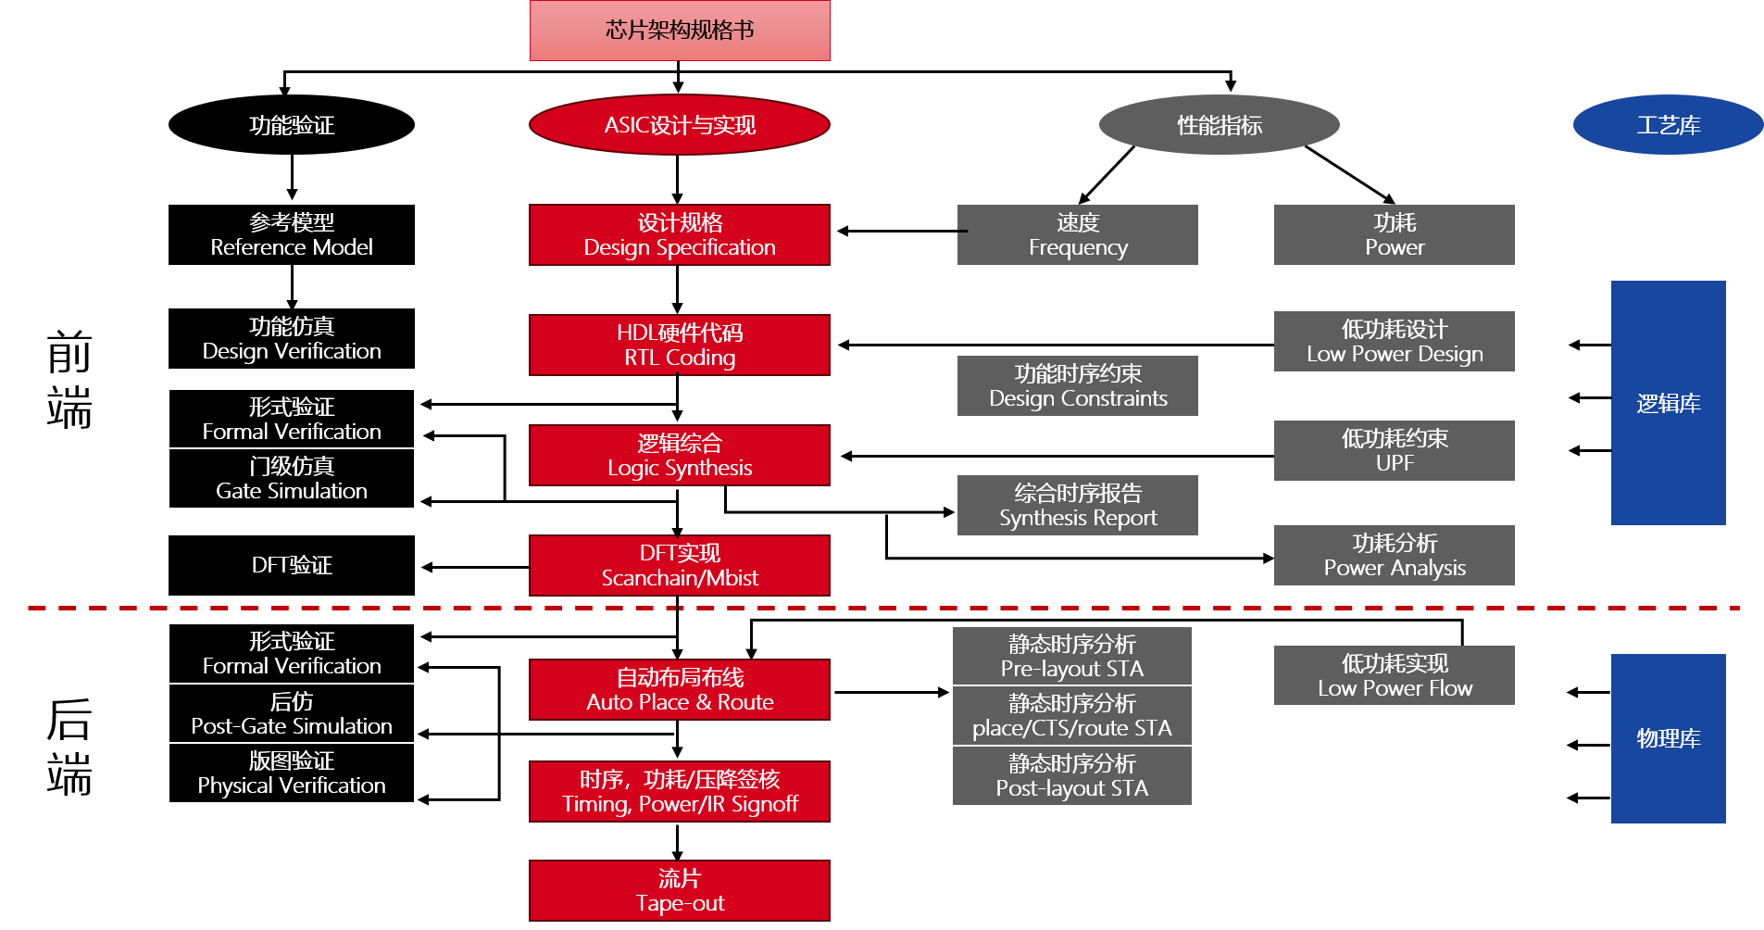
Digital IC Design Flow
图源：来自网路

Slide 4
What Synthesis Do?
synthesis = translation + logic optimization + gate mapping
RTL Source
residule = 16’h0000;
if (high_bits == 2’b10)
residue = state_table[index];
else
state_table[index] = 16’h000;
translate (read Verilog, vhdl, sverilog)
Generic Boolean Gates
GTECH, unmapped format
Constraints
set_max_area ...
create_clock ...
set_input_delay ..
Technology Specific Gates
Mapped format
optimize + map

Slide 5
RTL Synthesis Flow
Translation
Load designs and libraries
Create setup file
RTL Verilog, *.v
Liberty file, *.lib
Apply timing constraints
Create constraints file
Timing constraints
Environmental attributes
Optimization
Mapping
Synthesize the design
Select appropriate compile flow
Export files for physical design
Gate-level Verilog netlist
Constraints, *.sdc
SCAN-DEF.def
Write out design data

Slide 6
RTL Synthesis Flow
Translation
Load designs and libraries
Create setup file
RTL Verilog, *.v
Liberty file, *.lib
Apply timing constraints
Create constraints file
Timing constraints
Environmental attributes
Optimization
Mapping
Synthesize the design
Select appropriate compile flow
Export files for physical design
Gate-level Verilog netlist
Constraints, *.sdc
SCAN-DEF.def
Write out design data

Slide 7
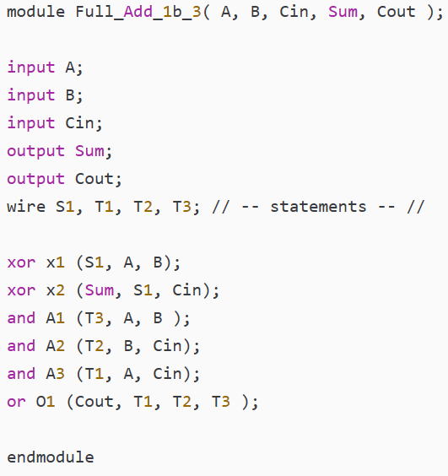
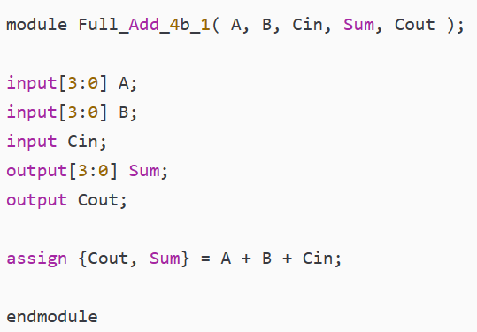
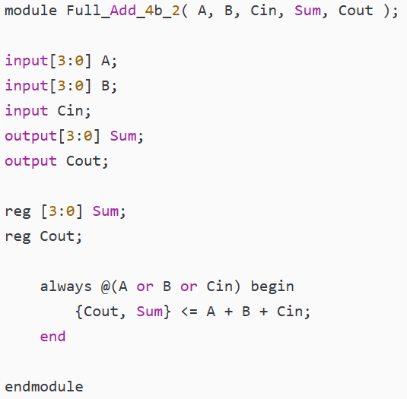
Verilog File
Gate-level ，结构化描述
RTL, 数据流描述
行为级描述
Reference:
https://zhuanlan.zhihu.com/p/458300788
https://blog.csdn.net/yinjian0924/article/details/125246107

Slide 8
Translate
Design
module TOP (A,B,C,D,CLK,OUT1);
input A, B, C, D, CLK;
output [1:0] OUT1;
wire INV1, INV0, bus1, bus0;
ENCODER U1 (.AIN (A), ... , Q1 (bus1));
INV U2 (.A (BUS0), .Z (INV0));
U3 (.A (BUS1), .Z (INV1));
REGFILE U4 (.D0 (INV0), .D1 (INV1), .CLK (CLK));
endmodule
Clock
Design
Port
TOP
U1
Cell
Net
U4
Reference
Net
Port
U2
A
AIN
Q0
INV
INV0
D0
Q[1: 0]
B
BIN
OUT[1: 0]
CIN
U3
INV1
C
Q1
INV
D1
Pin
Cell
Pin
D
DIN
CLK
Clock
ENCODER
Reference
REGFILE
CLK

Slide 9
RTL Synthesis Flow
Translation
Load designs and libraries
Create setup file
RTL Verilog, *.v
Liberty file, *.lib
Apply timing constraints
Create constraints file
Timing constraints
Environmental attributes
Optimization
Mapping
Synthesize the design
Select appropriate compile flow
Export files for physical design
Gate-level Verilog netlist
Constraints, *.sdc
SCAN-DEF.def
Write out design data

Slide 10
Timing Constraints
All input paths are constrained by set input delay.
All output paths are constrained by set output delay.
KOBE’S_DESIGEN
MY_DESIGEN
KING’S_DESIGEN
M
A
N
K
S
T
D
Q
D
Q
D
Q
D
Q
FF1
FF2
FF3
FF4
QN
QN
QN
QN
CLK
All register-to-register paths are constrained by create clock.

Slide 11
Constrain Register-to-register Paths
create_clock -period 2 [get_ports CLK]
Default Clock Behavior:
Clock rise at 0ns and has a 50% duty cycle;
Zero rise/fall transition time;
Zero skew
Zero insertion delay or latency
Max allowable delay for the reg-to-reg path “K”: 2ns-0.2ns
MY_DESIGEN
Tsetup, FF3=0.2ns
A
N
K
S
D
Q
D
Q
FF2
FF3
QN
QN
CLK
0ns
1ns
2ns

Slide 12
Model Clock Skew
create_clock -period 2 [get_ports CLK]
set_clock_uncertainty -setup 0.14 [get_clocks CLK]
Max allowable delay for the reg-to-reg path “K”:
2-0.14-0.2ns
MY_DESIGEN
Tsetup, FF3=0.2ns
A
N
K
S
D
Q
D
Q
FF2
FF3
CLK
QN
QN
0.14
0.2
0ns
1ns
2ns

Slide 13
Model Latency or Insertion Delay
create_clock -period 2 [get_ports CLK]
set_clock_uncertainty -setup 0.14 [get_clocks CLK]
set_clock_latency -source -max 3 [get_clocks CLK]
set_clock_latency -max 1 [get_clocks CLK]
D
Q
CLK
3ns
1ns
QN
origin of clock
source latency
network latency

Slide 14
Model Transition Time
create_clock -period 2 [get_ports CLK]
set_clock_uncertainty -setup 0.14 [get_clocks CLK]
set_clock_latency -source -max 3 [get_clocks CLK]
set_clock_latency -max 1 [get_clocks CLK]
set_clock_transition 0.08 [get_clocks CLK]
0ns
1ns
2ns
transition

Slide 15
Constrain Input/Output Paths
KOBE’S_DESIGEN
MY_DESIGEN
KING’S_DESIGEN
A
B
M
N
K
S
T
D
Q
D
Q
D
Q
D
Q
FF1
FF2
FF3
FF4
QN
QN
QN
QN
CLK
create_clock -period 2 [get_ports CLK]
set_clock_uncertainty -setup 0.14 [get_clocks CLK]
set_clock_latency -source -max 3 [get_clocks CLK]
set_clock_latency -max 1 [get_clocks CLK]
set_clock_transition 0.08 [get_clocks CLK]
set_input_delay -max 0.6 -clock CLK [get_ports A]
set_output_delay -max 0.8 -clock CLK [get_ports B]

Slide 16
Environmental Attributes
Apply environmental attributes to model timing effects of:
Input drivers and transition time
Output load capacitance
PVT operating conditions or corners
Interconnect parasitic RC: WLM
create_clock -period 2 [get_ports CLK]
set_clock_uncertainty -setup 0.14 [get_clocks CLK]
set_clock_latency -source -max 3 [get_clocks CLK]
set_clock_latency -max 1 [get_clocks CLK]
set_clock_transition 0.08 [get_clocks CLK]
set_input_delay -max 0.6 -clock CLK [get_ports A]
set_output_delay -max 0.8 -clock CLK [get_ports B]
set_input_transition 0.12 [get_ports A]
set_load 0.03 [get_ports B]
set_link_library “xxx_slow_proc.lib”
set_operating_conditions -max rcworst
set_wire_load_model -name xxx

Slide 17
RTL Synthesis Flow
Translation
Load designs and libraries
Create setup file
RTL Verilog, *.v
Liberty file, *.lib
Apply timing constraints
Create constraints file
Timing constraints
Environmental attributes
Optimization
Mapping
Synthesize the design
Select appropriate compile flow
Export files for physical design
Gate-level Verilog netlist
Constraints, *.sdc
SCAN-DEF.def
Write out design data

Slide 18
Optimize
Performs three levels of optimization:
Architectural-level or high level optimization
Logic-level or GTECH optimization
Gate-level or mapping optimization
Tries to mimimize area while meeting timing and other constaints
Arithmetic optimization:
Constant/operant folding: A+2*B-2+B-A+7 → 3*B+5
Common sub-expression sharing:
Z1=A+B+C; Z2=C+D+B → T=B+C; Z1=A+T; Z2=T+D
SOP -> POS transformation: A*C+B*C →(A+B)*C
Parallel constant multipliers optimization:
105=64+32+8+1, 621=105+512+4
load splitting and logic duplication
Boundary optimization
Test-ready synthesis, scan chain
Adaptive retiming
RTL Description
Architectural
Logic-level
Gate-level
Optimized Netlist

Slide 19
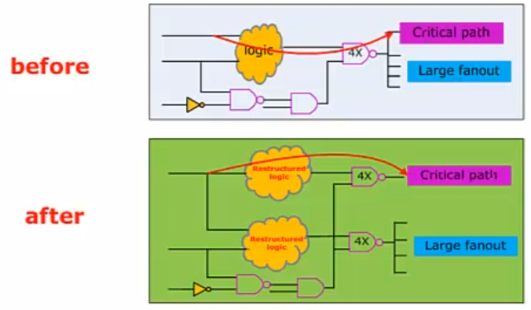
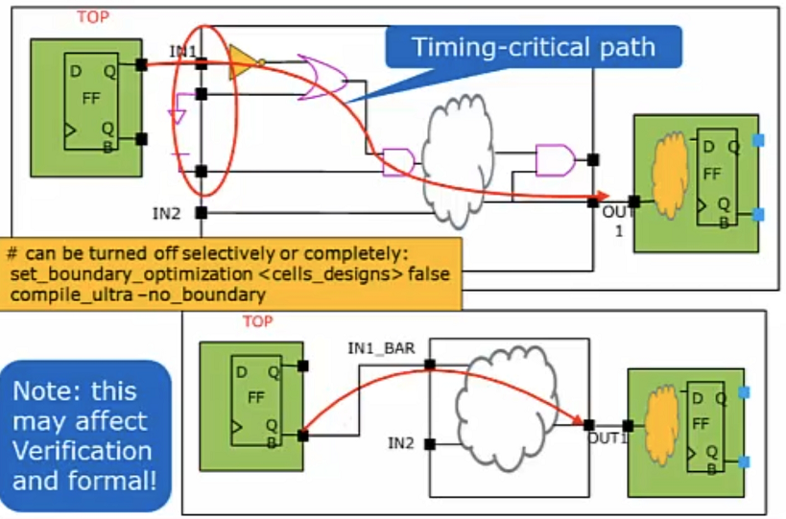
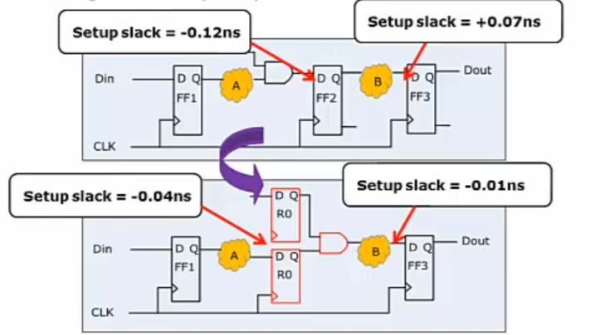
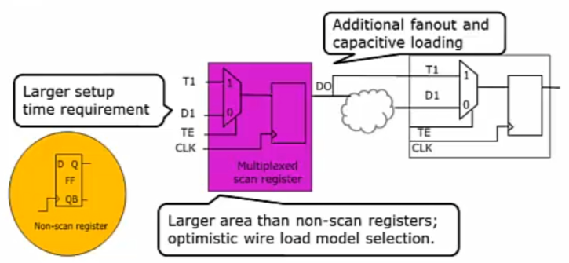
Optimization Examples
1-load splitting & logic duplication
2-boundary optimization
4-adaptive retiming
3-test-ready, scan chain

Slide 20
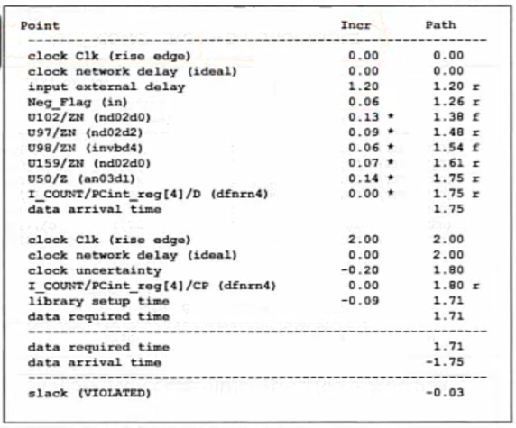
Generate Timing Report

Slide 21
RTL Synthesis Flow
Translation
Load designs and libraries
Create setup file
RTL Verilog, *.v
Liberty file, *.lib
Apply timing constraints
Create constraints file
Timing constraints
Environmental attributes
Optimization
Mapping
Synthesize the design
Select appropriate compile flow
Export files for physical design
Gate-level Verilog netlist
Constraints, *.sdc
SCAN-DEF.def
Write out design data

Slide 22
Q&A
Always 对应什么样的电路？
if...else.. 对应什么样的电路？MUX如何实现的？
output *.sdc：基于用户设置的constraint, 输出mapping之后更准确合理的sdc
综合最终关注哪些指标？
综合阶段如何考虑功耗
SPEF, VCD?
wire model如何给？WLM来源？
Synthesis目前仅考虑leakage; 也能基于vcd考虑动态功耗；

Slide 23
THANK YOU
WWW.GIGA-DA.COM
电话：0755-61018899
邮箱：info@GIGA-DA.COM
邮编：518000

Slide 24
Digital IC Design Flow
芯片架构规格书
功能验证
ASIC设计与实现
性能指标
工艺库
前
端
参考模型
Reference Model
设计规格
Design Specification
速度
Frequency
功耗
Power
逻辑库
功能仿真
Design Verification
HDL硬件代码
RTL Coding
低功耗设计
Low Power Design
功能时序约束
Design Constraints
形式验证
Formal Verification
逻辑综合
Logic Synthesis
低功耗约束
UPF
门级仿真
Gate Simulation
综合时序报告
Synthesis Report
DFT验证
DFT实现
Scanchain/Mbist
功耗分析
Power Analysis
后
端
形式验证
Formal Verification
静态时序分析
Pre-layout STA
自动布局布线
Auto Place & Route
低功耗实现
Low Power Flow
物理库
后仿
Post-Gate Simulation
静态时序分析
place/CTS/route STA
版图验证
Physical Verification
时序，功耗/压降签核
Timing, Power/IR Signoff
静态时序分析
Post-layout STA
流片
Tape-out

