Slide 1
2022
芯之所至 皆有鸿芯
打造完整的国产芯片数字EDA平台

Slide 2
图划分问题的概述（定义、应用...）
01.
02.
划分带坐标的点.
03.
划分不带坐标的点.
Kernighan-Lin Algorithm.
Spectral Bisection.
04.
Multilevel Acceleration.
05.
超图.

Slide 3
01.
图划分问题的概述

Slide 4
图划分问题
Given a graph G = (N, E, W_{N}, W_{E})
N = nodes (or vertices),
W_{N} = node weights
E = edges
W_{E} = edge weights
Ex: N = {tasks}, W_{N} = {task costs}, edge (j,k) in E means task j sends W_{E}(j,k) words to task k
Choose a partition N = N₁ U N₂ U … U N_{P} such that
The sum of the node weights in each N_{j} is “about the same”
The sum of all edge weights of edges connecting all different pairs N_{j} and N_{k} is minimized (shown in black) 我们在意的点
Ex: balance the work load, while minimizing communication
Special case of N = N₁ U N₂: Graph Bisection
2 (2)
1
3 (1)
2 (2)
1
3 (1)
1 (2)
4
2
4
4 (3)
1 (2)
2
4 (3)
2
3
1
2
3
1
2
2
5 (1)
1
8 (1)
5 (1)
1
8 (1)
5
6
5
6
6 (2)
7 (3)
6 (2)
7 (3)

Slide 5
图划分问题
按照内存开销分类：
offline，将整个图数据一次性载入内存中然后根据图的结构进行切分。
streaming，按批次读取图数据，实时的将图的边或者结点分配到指定的子图中。对于大规模图数据来说，单机的内存无法满足分割算法的需求这个时候流式分割显得尤为重要。
按照对图数据的切分方式分类：
点分割是将图的结点分配到各个子图中，维持结点之间子图的完整性，这个时候可能造成某些结点之间的边被切掉。
边分割是将图的边分配到各个子图中，每组分配的边构成子图，这个时候造成某些结点的冗余。

Slide 6
图划分的应用
Telephone network design
Original application, algorithm due to Kernighan
Load Balancing while Minimizing Communication
Sparse Matrix times Vector Multiplication (SpMV)
Solving PDEs
N = {1,…,n}, (j,k) in E if A(j,k) nonzero,
W_{N}(j) = #nonzeros in row j, W_{E}(j,k) = 1
VLSI Layout
N = {units on chip}, E = {wires}, W_{E}(j,k) = wire length
Sparse Gaussian Elimination
Used to reorder rows and columns to increase parallelism, and to decrease “fill-in”
Image Segmentation

Slide 7
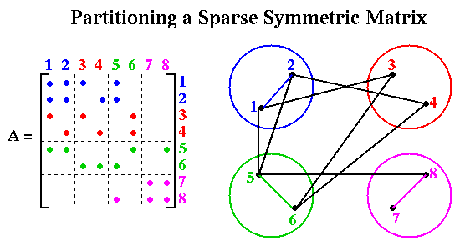
稀疏矩阵向量乘
… declare A_local, A_remote(1:num_procs), x_local, x_remote, y_local
y_local = y_local + A_local * x_local
for all procs P that need part of x_local
send(needed part of x_local, P)
for all procs P owning needed part of x_remote
receive(x_remote, P)
y_local = y_local + A_remote(P)*x_remote

Slide 8
图划分问题的复杂度
Many possible partitionings to search
Just to divide in 2 parts there are:
n choose n/2 = n!/((n/2)!)² ~
(2/(nπ))^{1/2} * 2^{n} possibilities 斯特林公式，等价于排列组合阶乘公式n取极限
Choosing optimal partitioning is NP-complete
(NP-complete = we can prove it is a hard as other well-known hard problems in a class Nondeterministic Polynomial time)
Only known exact algorithms have cost = exponential(n)
We need good heuristics

Slide 9
02.
划分带坐标的点.

Slide 10
划分带坐标的点
A planar graph can be drawn in plane without edge crossings
Ex: m x m grid of m² nodes: ∃ vertex separator N_{s} with |N_{s}| = m = |N|^{1/2} (see earlier slide for m=5 )
Theorem (Tarjan, Lipton, 1979): If G is planar, ∃ N_{s} such that
N = N₁ U N_{s} U N₂ is a partition,
|N₁| <= 2/3 |N| and |N₂| <= 2/3 |N|
|N_{s}| <= (8 * |N|)^{1/2}
Theorem motivates intuition of several algorithms

Slide 11
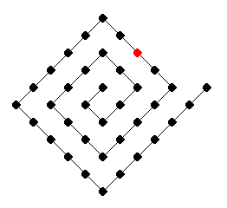
划分带坐标的点
Inertial partitioning, geometric mesh partitioning
Choose a dividing plane through the “center” of the nodes
These algorithms are efficient
Rely on graphs having nodes connected (mostly) to “nearest neighbors” in space
algorithm does not depend on where actual edges are!
Common when graph arises from physical model
Ignores edges, but can be used as good starting guess for subsequent partitioners that do examine edges
Can do poorly if graph connectivity is not to (most) nearest neighbors:

Slide 12
03.
划分不带坐标的点.

Slide 13
Kernighan-Lin Algorithm
Take a initial partition and iteratively improve it
Kernighan/Lin (1970), cost = O(|N|³) but easy to understand
Fiduccia/Mattheyses (1982), cost = O(|E|), much better, but more complicated
Given G = (N,E,W_{E}) and a partitioning N = A U B, |A| = |B|
T = cost(A,B) = Σ {W(e) where e connects nodes in A and B}
Find subsets X of A and Y of B with |X| = |Y|
Consider swapping X and Y if it decreases cost:
newA = (A – X) U Y and newB = (B – Y) U X
newT = cost(newA , newB) < T = cost(A,B)
Need to compute newT efficiently for many possible X and Y, choose smallest (best)
Repeat: choose x in A – X and y in B – Y s.t. swapping x,y lowers cost the most
Choose best sets of swapped x and y in sequence

Slide 14
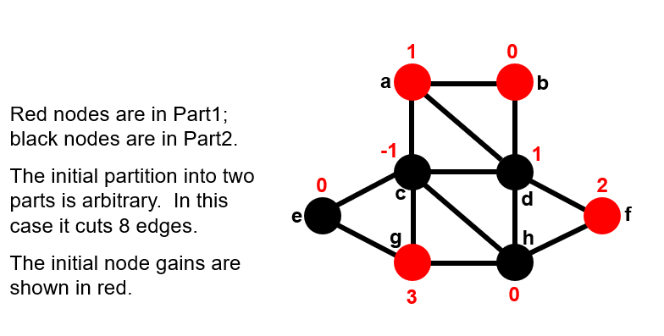
Kernighan-Lin Algorithm
节点上的数字表示，变换颜色后的收益。
如节点g，从红色边为黑色，需要断开的边减少3条，因此受益为3。

Slide 15
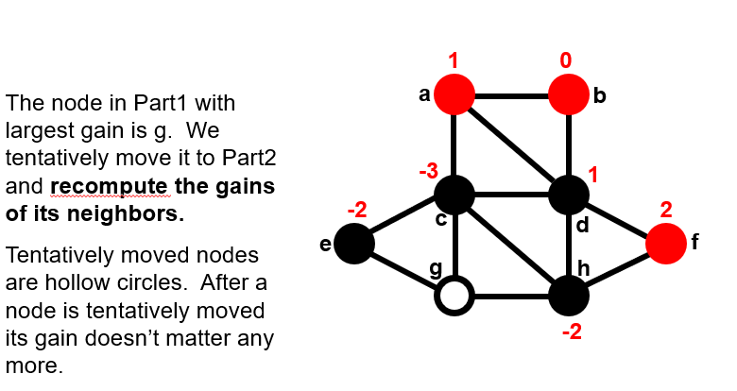
Kernighan-Lin Algorithm

Slide 16
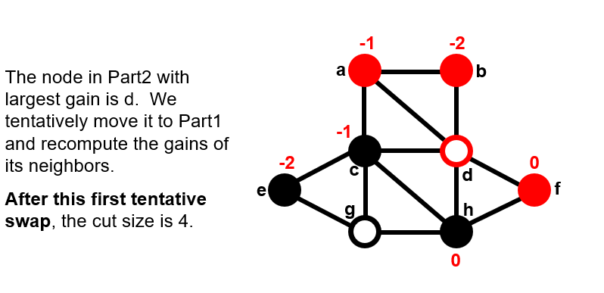
Kernighan-Lin Algorithm

Slide 17
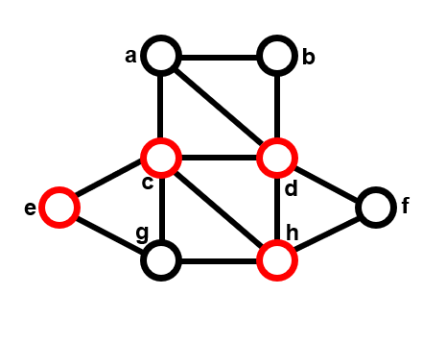
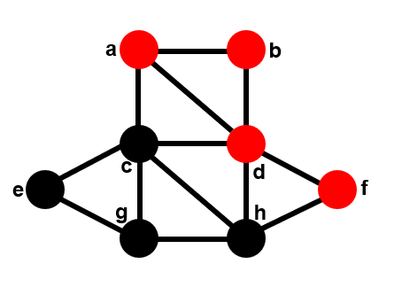
Kernighan-Lin Algorithm

Slide 18
Kernighan-Lin Algorithm
缺陷：
当图体量较大时收敛慢
K/L tested on very small graphs (|N|<=360) and got convergence after 2-4 sweeps
For random graphs (of theoretical interest) the probability of convergence in one step appears to drop like 2^{-|N|/30}
应用：
将图切小后，作用于较小的图

Slide 19
Spectral Bisection
原理，利用拉普拉斯矩阵性质以及与图的关系
1.根据graph构造拉普拉斯矩阵
2.计算拉普拉斯矩阵特征值（lanczos 算法）
3.找到第二小的特征值对应的特征向量（拉普拉斯矩阵是半正定对称矩阵，有至少一个为0的特征值，0特征值的数目对于图中联通分量的数目）
特征向量大于0的位置放入一个集合，其他的放入另一个
Definition: The Laplacian matrix L(G) of a graph G(N,E) is an |N| by |N| symmetric matrix, with one row and column for each node. It is defined by
L(G) (i,i) = degree of node i (number of incident edges)
L(G) (i,j) = -1 if i ≠ j and there is an edge (i,j)
L(G) (i,j) = 0 otherwise

Slide 20
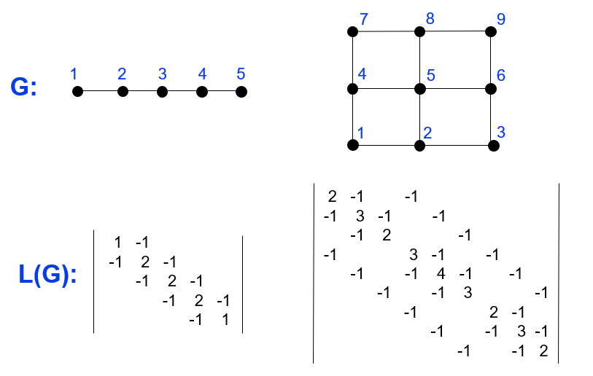
Spectral Bisection

Slide 21
04.
Multilevel Acceleration.

Slide 22
Coarsen graph and expand partition using maximal matchings
Improve partition using Kernighan-Lin
(5)
(2,3)
(4)
(5)
(2,3)
(4)
(5)
(2,3)
(4)
(1)

Slide 23
Definition: A matching of a graph G(N,E) is a subset E_{m} of E such that no two edges in E_{m} share an endpoint
Definition: A maximal matching of a graph G(N,E) is a matching E_{m} to which no more edges can be added and remain a matching
A simple greedy algorithm computes a maximal matching:
let E_{m} be empty
mark all nodes in N as unmatched
for i = 1 to |N| … visit the nodes in any order
if i has not been matched
mark i as matched
if there is an edge e=(i,j) where j is also unmatched,
add e to E_{m}
mark j as matched
endif
endif
endfor

Slide 24
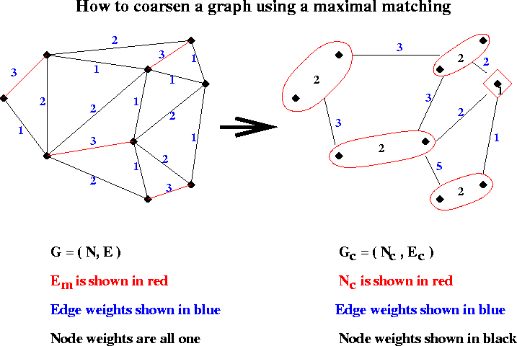

Slide 25
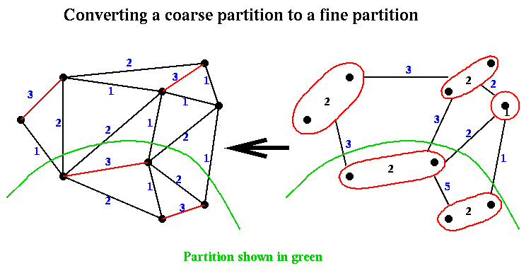

Slide 26
Coarsen graph and expand partition using maximal independent sets
(5)
(2,3)
(4)
(5)
(2,3)
(4)
(5)
(2,3)
(4)
(1)

Slide 27
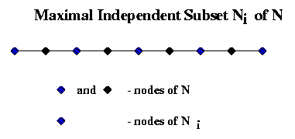
Definition: An independent set of a graph G(N,E) is a subset N_{i} of N such that no two nodes in N_{i} are connected by an edge
Definition: A maximal independent set (MIS) of a graph G(N,E) is an independent set N_{i} to which no more nodes can be added and remain an independent set
A simple greedy algorithm computes a maximal independent set:
let N_{i} be empty
for k = 1 to |N| … visit the nodes in any order
if node k is not adjacent to any node already in N_{i}
add k to N_{i}
endif
endfor

Slide 28
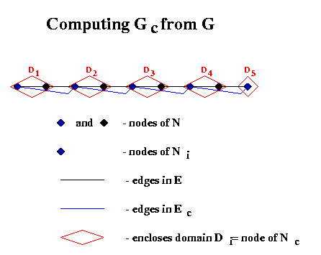

Slide 29
05.
超图.

Slide 30
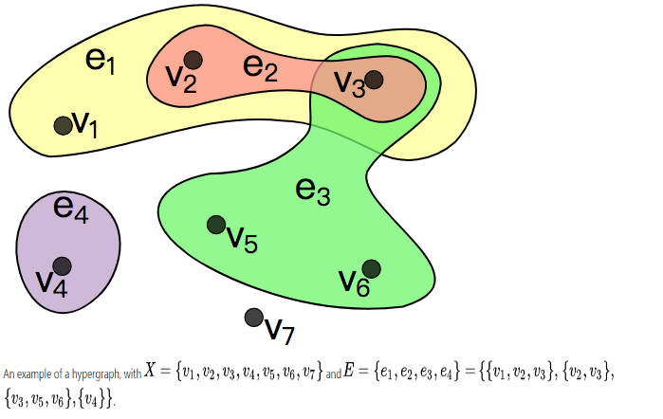
什么是超图
 | v1 | v2 | v3 | v4 | v5 | v6 | v7
e1 | 1 | 1 | 1 | 0 | 0 | 0 | 0
e2 | 0 | 1 | 1 | 0 | 0 | 0 | 0
e3 | 0 | 0 | 1 | 0 | 1 | 1 | 0
e4 | 0 | 0 | 0 | 1 | 0 | 0 | 0

Slide 31
A sparse matrix in the graph model
P
P
1
2
3
4
5
6
7
8
9
10
1
2
1
1
1
v
2
v
1
v
4
2
4
2
4
6
2
2
2
2
3
P
3
3
2
2
2
4
1
4
4
v
2
v
5
=
5
5
v
4
2
5
4
2
4
8
2
4
v
9
3
6
6
6
2
7
7
7
2
2
2
8
P
8
8
9
2
9
9
v
4
2
5
2
v
4
10
10
10
5
v
7
10
y
A
x
edge (v_{i}, v_{j}) ∈ E ⇒
y(i) ← y(i) + A(i,j) x(j) and y(j) ← y(j) + A(j,i) x(i)
P₁ performs: y(4) ← y(4) + A(4,7) x(7) and
y(5) ← y(5) + A(5,7) x(7)
x(7) only needs to be communicated once !

Slide 32
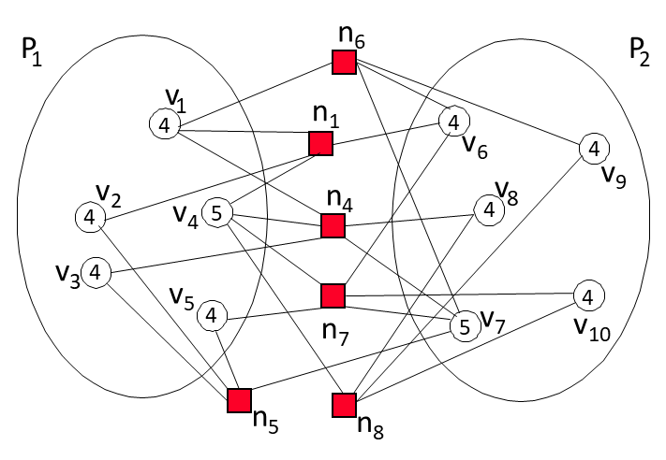
A sparse matrix in the hypergraph model
1
2
3
4
5
6
7
8
9
10
1
1
1
2
2
2
3
P
3
3
4
1
4
4
5
=
5
5
6
6
6
7
7
7
8
P
8
8
9
2
9
9
10
10
10
y
A
x
Column-net model for block-row distributions
Rows are vertices, columns are nets (hyperedges)
Each {vertex, net} pair represents unique nonzero net-cut metric: cutsize(Π) = Σ_{n ∈ NE} w(n)
connectivity-1 metric: cutsize(Π) = Σ_{n ∈ NE} w(n) (c(n) - 1)
Connectivity is about the number of *parts* the hyperedge connects, not its number of pins (which is size)

Slide 33
Hypergraph Summary
Pros and cons
When matrix is non-symmetric, the graph partitioning model (using A+A^{T} ) loses information, resulting in suboptimal partitioning in terms of communication and load balance.
Even when matrix is symmetric, graph cut size is not an accurate measurement of communication volume
Hypergraph partitioning model solves both these problems
However, hypergraph partitioning (PaToH) can be much more expensive than graph partitioning (METIS)
Hypergraph partitioners: PaToH, HMETIS, ZOLTAN

Slide 34
Q：1.STA超图是怎么划分，他们目前的解决方案
STA也没有直接用到超图划分，只是同样地，Net中存着多个Pin，将Pin视为vertex，Net视为edge，与超图非常类似，但是，Net中的Pin的连接关系是有方向的，并且STA的划分，最终要求补全的数目越少越好，这样的场景也与一般定义的超图划分问题（追求负载均衡以及切割的边最少）有很大区别。

Slide 35
Q2.拉普拉斯矩阵正定性证明
构造一个特殊的关联矩阵，col index表示vertex的index，row index表示edge的index，一条edge即一行中，会有两个非零值，即两个断点，col index小的为1，大的为-1。
（一般无向图的关联矩阵，矩阵中非零元的值都为1）

Slide 36
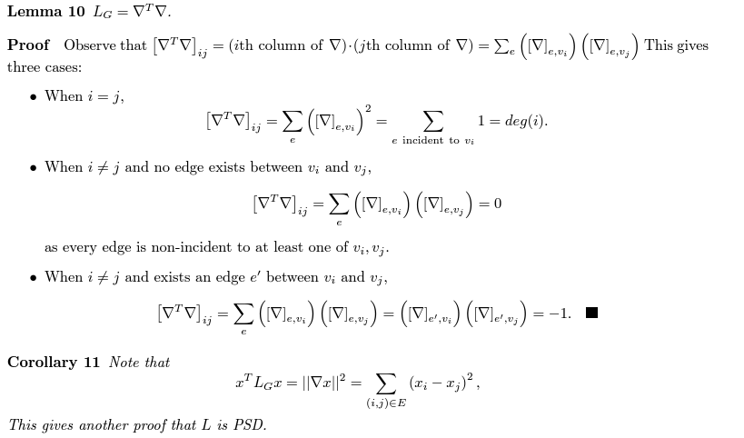
Q2.拉普拉斯矩阵正定性证明
1.证明拉普拉斯矩阵必然可以分解为，关联矩阵的转置乘以关联矩阵。
2.拉普拉斯矩阵二次型等于关联矩阵乘x向量的结果的模，最后得出的形式是一个平凡和，必定大于等于0。满足了半正定的定义。

Slide 37
Q3.为什么要用超图来解矩阵why，超图划分之后是怎么通信的how
1.超图在某些场景下可以更精准的描述问题
2.以SPMV为例，切到的net实际上就是通信要用到的vector元素的index

Slide 38
THANK YOU
WWW.GIGA-DA.COM
电话：0755-61018899
邮箱：info@GIGA-DA.COM
邮编：518000

