Slide 1
More on Communication-optimal Matmul (and beyond)
James Demmel
www.cs.berkeley.edu/~demmel
Notes:
25 minutes
Explain the mathematical ideas for optimal matmul tiliing,
How it extends to arbitrary code that looks like nested loops accessing arrays

Slide 2
Outline
Communication = moving data
Between main memory and cache
Between processors over a network
Most expensive operation (in time or energy)
Goal: Provably minimize communication for algorithms that look like nested loops accessing arrays
Includes matmul, linear algebra (dense and sparse), n-body, convolutional neural nets (CNNs), …
Simple case: n-body (sequential, with main memory and cache)
Communication lower bound and optimal algorithm
Extension to Matmul
Extension to algorithms that look like nested loops accessing arrays, like CNNs (and open questions)
Notes:
Illustrate using sequential case, parallel lecture later

Slide 3
Data access for n-body
A() = array of structures
A(i) contains position, charge on particle i
Usual n-body
for i = 1:n, for j = 1:n except i, F(i) = F(i) + force(A(i),A(j))
Simplify to make counting easier
Let B() = array of disjoint set of particles
for i = 1:n, for j = 1:n, e = e + potential(A(i),B(j))
Simplify more
for i = 1:n, for j = 1:n, access A(i) and B(j)

Slide 4
Data access for n-body
j
for i = 0:n
for j = 0:n
access A(i), B(j)
i
Notes:
TilePlot_1_1.jpg

Slide 5
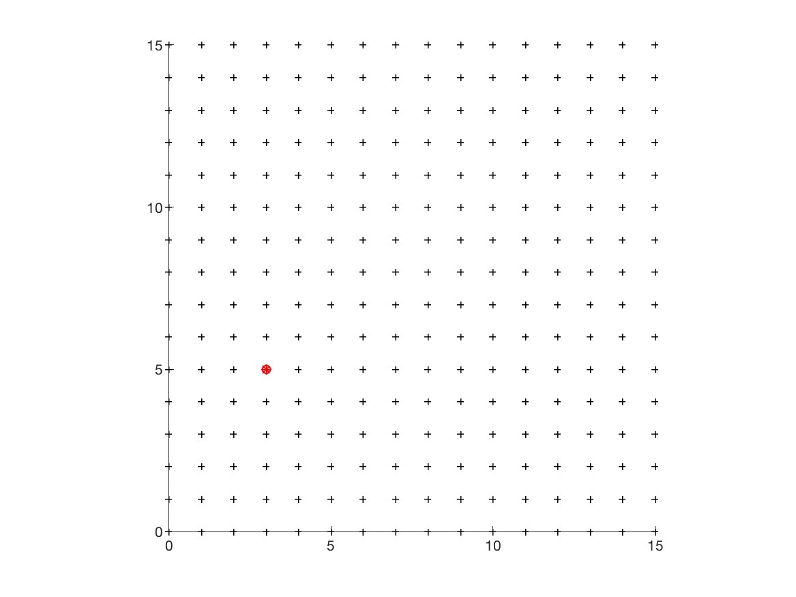
Data access for n-body
j
for i = 0:n
for j = 0:n
access A(i), B(j)
Ex: execute loop for
i = 3, j = 5
i
Notes:
TilePlot_1_1.jpg

Slide 6
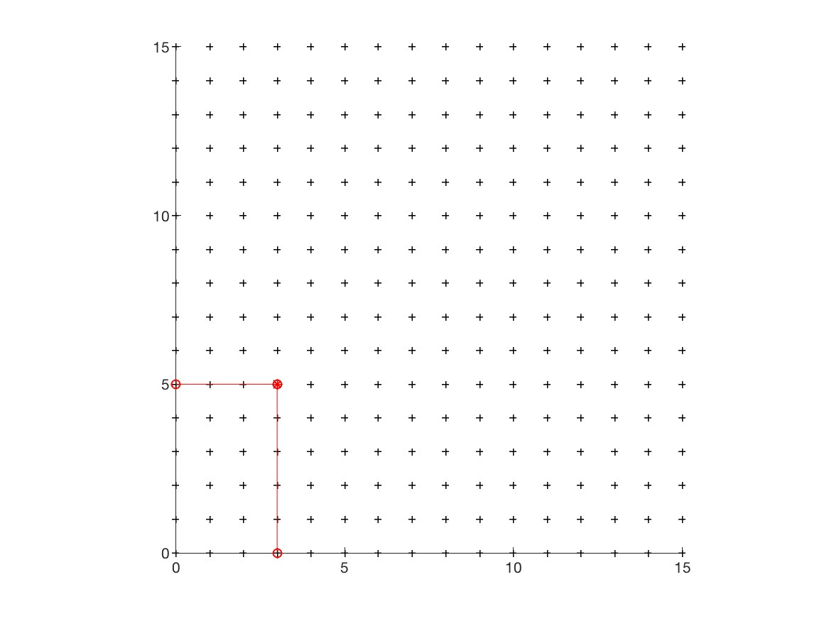
Data access for n-body
j
for i = 0:n
for j = 0:n
access A(i), B(j)
Ex: execute loop for
i = 3, j = 5
access A(3), B(5)
i
Notes:
TilePlot_1_1.jpg

Slide 7
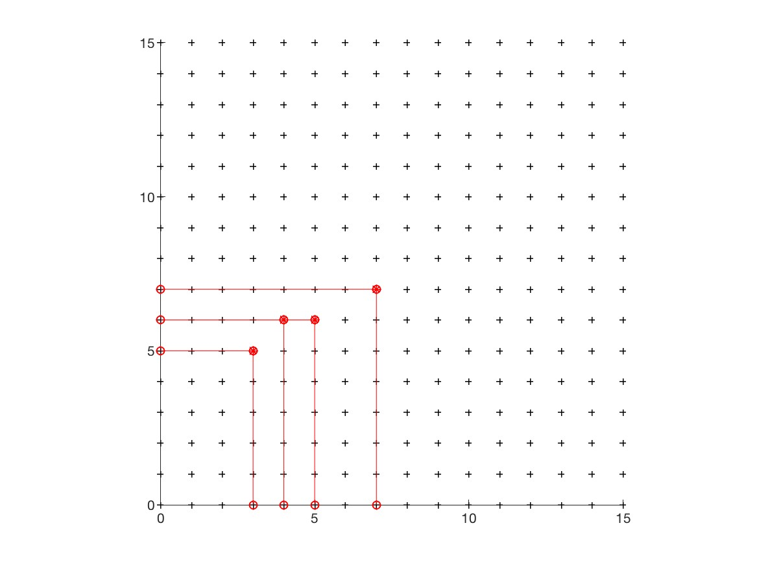
Data access for n-body
j
for i = 0:n
for j = 0:n
access A(i), B(j)
Ex: execute loop for
multiple pairs (i,j),
access multiple
A(i), B(j)
i
Notes:
TilePlot_1_1.jpg

Slide 8
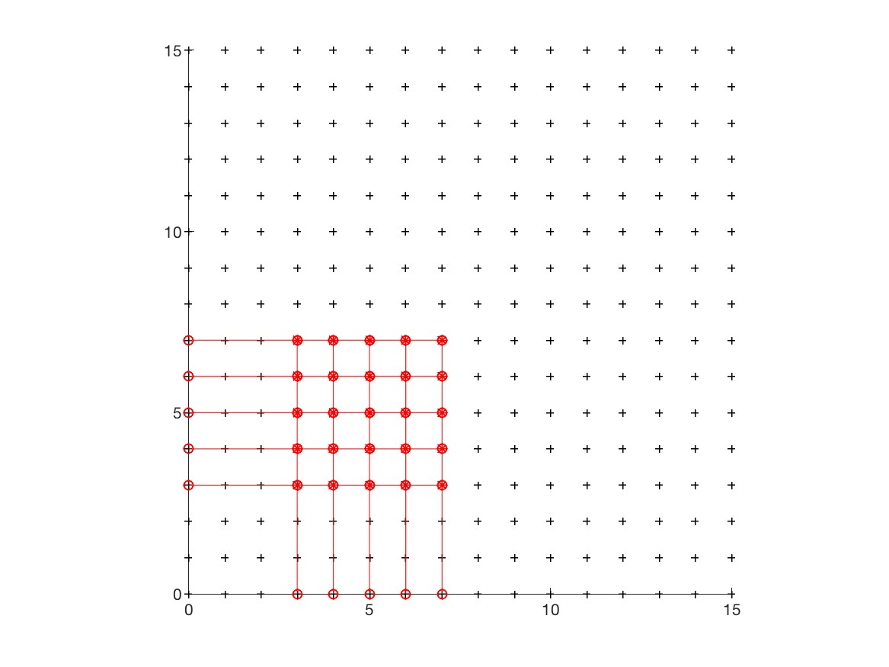
Data access for n-body
j
If we can only access 10 entries of A(i) and B(j), what is the max number of loop iterations we can do?
25 = 5 x 5
If we can access
M = cache size
entries, then we can do
(M/2)² = M²/4
loop iterations
i
Notes:
TilePlot_1_1.jpg

Slide 9
Communication lower bound for n-body (intuition)
for i=1:n, for j=1:n, access A(i), B(j)
With a cache of size M full of data, can only perform M²/4 loop iterations
To perform all n² loop iterations, need to (re)fill cache n²/(M²/4) = 4(n/M)² times
Filling cache costs M reads from slow memory
Need to do at least 4(n/M)² * M = 4n² / M reads
Can improve constant slightly
Write as Ω(n²/M) = Ω(#loop iterations / M)

Slide 10
Optimal tiling for usual n-body
j
for i = 0:n
for j = 0:n
access A(i), B(j)
Tiling (M=10)
Read 5 entries of A:
A([0,1,2,3,4])
Read 5 entries of B:
B([0,1,2,3,4])
Perform 5² = 25
loop iterations
i
Notes:
TilePlot_1_2.jpg

Slide 11
Optimal tiling for usual n-body
j
for i = 0:n
for j = 0:n
access A(i), B(j)
i
Notes:
TilePlot_1_3.jpg

Slide 12
Optimal tiling for usual n-body
j
for i = 0:n
for j = 0:n
access A(i), B(j)
i
Notes:
TilePlot_1_4.jpg

Slide 13
Optimal tiling for usual n-body
j
for i = 0:n
for j = 0:n
access A(i), B(j)
i
Notes:
TilePlot_1_5.jpg

Slide 14
Generalizing to other algorithms
Many algorithms look like nested loops accessing arrays
Linear Algebra (dense and sparse)
Grids (structured and unstructured)
Convolutional Neural Nets (CNNs) …
Matmul: C = A*B
for i=1:n, for j=1:n, for k=1:n
C(i,j) = C(i,j) + A(i,k) * B(k,j)

Slide 15
Proof of Communication Lower Bound on C = A·B (1/4)
Analogous to n-body:
Only M entries of A, B and C are available in cache
Find an upper bound F on the number of different iterations C(i,j) = C(i,j) + A(i,k)*B(k,j) we can perform
Need to refill cache n³/F times to complete algorithm
Need to read/write at least M n³/ F words to/from cache
Like n-body, represent iterations and data geometrically
Notes:
Ignore fact that T/F may not be an integer, fix later
(change # segments to # complete_segments, T/F to floor(T/F),
Then #complete_segments >= floor(T/F), otherwise, if
#complete_segments <= floor(T/F) – 1 < T/F - 1, then
#flops < F*((T/F)-1) + F = T, oops

Slide 16
Proof of Communication Lower Bound on C = A·B (2/4)
k
“C face”
Cube representing
C(1,1) += A(1,3)·B(3,1)
C(2,3)
C(1,1)
B(3,1)
A(1,3)
A(1,2)
B(2,1)
j
B(1,3)
B(1,1)
A(2,1)
A(1,1)
“B face”
i
If we have at most M “A squares”, “B squares”, and “C squares” on faces, how many cubes can we have?
“A face”

Slide 17
Proof of Communication Lower Bound on C = A·B (3/4)
k
x
C shadow
y
z
y
j
z
x
B shadow
A shadow
i
(i,k) is in A shadow if (i,j,k) in 3D set
(j,k) is in B shadow if (i,j,k) in 3D set
(i,j) is in C shadow if (i,j,k) in 3D set
Thm (Loomis & Whitney, 1949)
# cubes in 3D set = Volume of 3D set
≤ (area(A shadow) · area(B shadow) ·
area(C shadow)) ^{1/2}
# cubes in black box with
side lengths x, y and z
= Volume of black box
= x·y·z
= ( xz · zy · yx)^{1/2}
= (#A□s · #B□s · #C□s )^{1/2}

Slide 18
Proof of Communication Lower Bound on C = A·B (4/4)
# loop iterations doable with M words of data = #cubes
≤ (area(A shadow) · area(B shadow) ·area(C shadow)) ^{1/2}
≤ (M · M · M) ^{1/2} = M ^{3/2} = F
Need to read/write at least M n³/ F = Ω(n³/M ^{1/2}) = Ω(#loop iterations / M ^{1/2}) words to/from cache
Notes:
Still true if M > n^2

Slide 19
Recall optimal Matmul Algorithm
Analogous to n-body:
What is the largest set of C(i,j)+=A(i,k)*B(k,j) we can perform given M entries A(i,k), B(k,j), C(i,j)?
What is the largest set of (i,j,k) we can have, given a bound M on the number of (i,k), (k,j), (i,j)?
What is the shape of the largest 3D volume we can have, given a bound M on the area of its shadows in 3 directions?
Answer: A cube, with edge length O(M ^{1/2} ), volume O(M ^{3/2} )
Optimal ”blocked” Algorithm: 6 nested loops, 3 innermost loops do b x b matmul with b = O(M ^{1/2} )

Slide 20
Proof of Communication Lower Bound on C = A·B (4/4)
# loop iterations doable with M words of data = #cubes
≤ (area(A shadow) · area(B shadow) ·area(C shadow)) ^{1/2}
≤ (M · M · M) ^{1/2} = M ^{3/2} = F
Need to read/write at least M n³/ F = Ω(n³/M ^{1/2}) = Ω(#loop iterations / M ^{1/2}) words to/from cache
Parallel Case: apply reasoning to one processor out of P
”Fast memory” = local processor, “Slow memory” = other procs
Goal: lower bound # “reads/writes” = # words moved between one processor and others
# loop iterations = n³ / P (load balanced)
M = 3n² / P (each processor gets equal fraction of data)
# “reads/writes” ≥ M · (n³ /P) / (M)^{3/2} = Ω (n² / P^{1/2} )
Notes:
Still true if M > n^2
In lecture 2: This theorem was mentioned as due to Hong, Kung 1981.
The proof here is due to Irony/Tiskin/Toledo 2004, who did the parallel case
Tell story of using larger M, Nervana

Slide 21
Recursive Matrix Multiplication (RMM) (1/2)
C = = A · B = ·
=
= • =
Eventually, the matrices will fit in cache
Don’t need to optimized for size ☺
But call overhead is high ☹
C₁₁ C₁₂ C₂₁ C₂₂
A₁₁ A₁₂ A₂₁ A₂₂
B₁₁ B₁₂ B₂₁ B₂₂
A₁₁·B₁₁ + A₁₂·B₂₁ A₁₁·B₁₂ + A₁₂·B₂₂ A₂₁·B₁₁ + A₂₂·B₂₁ A₂₁·B₁₂ + A₂₂·B₂₂
C₁₁
C₁₂
A₁₁
A₁₂
B₁₁
B₁₂
A_{11*}B₁₁ + A_{12*}B₂₁
A_{11*}B₁₂ + A_{12*}B₂₂
C₂₁
C₂₂
A₂₁
A₂₂
B₂₁
B₂₂
A_{21*}B₁₁ + A_{22*}B₂₁
A_{21*}B₁₂ + A_{22*}B₂₂
Notes:
Divide-and-conquer
Review 2 slides from Kathy’s Lecture 2

Slide 22
Recursive Matrix Multiplication (2/2)
func C = RMM (A, B, n)
if n=1, C = A * B, else
{ C₁₁ = RMM (A₁₁ , B₁₁ , n/2) + RMM (A₁₂ , B₂₁ , n/2)
C₁₂ = RMM (A₁₁ , B₁₂ , n/2) + RMM (A₁₂ , B₂₂ , n/2)
C₂₁ = RMM (A₂₁ , B₁₁ , n/2) + RMM (A₂₂ , B₂₁ , n/2)
C₂₂ = RMM (A₂₁ , B₁₂ , n/2) + RMM (A₂₂ , B₂₂ , n/2) }
return
A(n) = # arithmetic operations in RMM( . , . , n)
= 8 · A(n/2) + 4(n/2)² if n > 1, else 1
= 2n³ -n² … same operations as usual, in different order
W(n) = # words moved between fast, slow memory by RMM( . , . , n)
= 8 · W(n/2) + 4· 3(n/2)² if 3n² > M_{fast} , else 3n²
= O( n³ / (M_{fast} )^{1/2} + n² ) … same as blocked matmul
Don’t need to know M_{fast} for this to work!
Notes:
Solve recurrence, just geometric series
Analysis not oblivious to cache size, but algorithm is.
Applies to L1, L2, L3, … any level of “fast memory”,
so optimizes all of them simultaneously.

Slide 23
Strassen’s Matrix Multiply
The traditional algorithm (with or without tiling) has O(n³) flops
Strassen discovered an algorithm with asymptotically lower flops
O(n^{2.81})
Consider a 2x2 matrix multiply, normally takes 8 multiplies, 4 adds
Strassen does it with 7 multiplies and 18 adds
Let C = C11 C12 = A11 A12 B11 B12
C21 C22 = A21 A22 B21 B22
Let P1 = (A12 - A22) * (B21 + B22) P5 = A11 * (B12 - B22)
P2 = (A11 + A22) * (B11 + B22) P6 = A22 * (B21 - B11)
P3 = (A11 - A21) * (B11 + B12) P7 = (A21 + A22) * B11
P4 = (A11 + A12) * B22
Then C11 = P1 + P2 - P4 + P6
C12 = P4 + P5
C21 = P6 + P7
C22 = P2 - P3 + P5 - P7
Extends to nxn by divide&conquer
Notes:
Published in 1969
Not good idea for 2x2 matmul, 7 multiplies plus 18 adds, vs 8 + 4,
But good for nxn matmul

Slide 24
Strassen (continued)
Asymptotically faster
Several times faster for large n in practice
Cross-over depends on machine
“Tuning Strassen's Matrix Multiplication for Memory Efficiency”, M. S. Thottethodi, S. Chatterjee, and A. Lebeck, in Proceedings of Supercomputing '98
Possible to extend communication lower bound to Strassen
#words moved between fast and slow memory = Ω(n^{log2 7} / M^{(log2 7)/2 – 1} ) ~ Ω(n^{2.81} / M^{0.4} ) (Ballard, D., Holtz, Schwartz, 2011, SPAA Best Paper Prize)
Attainable too, more on parallel version later
Notes:
Next slide:
World record due to Winograd and Coppersmith (1987) until 2011, then Virginia Williams,
Then Le Gall in 2014, now down to O(n^2.373)
Very complicated algorithm
Needs unrealistically enormous matrices

Slide 25
Other Fast Matrix Multiplication Algorithms
World’s record was O(n ^{2.37548...} )
Coppersmith & Winograd, 1987
New Record! 2.37548 reduced to 2.37293
Virginia Vassilevska Williams, UC Berkeley & Stanford, 2011
Newer Record! 2.37293 reduced to 2.37286
Francois Le Gall, 2014
Lower bound on #words moved can be extended to (some) of these algorithms (2015 thesis of Jacob Scott)
Possibility of O(n^{2+ε}) algorithm!
Cohn, Umans, Kleinberg, 2003
Can show they all can be made numerically stable
Demmel, Dumitriu, Holtz, Kleinberg, 2007
Can do rest of linear algebra (solve Ax=b, Ax=λx, etc) as fast , and numerically stably
Demmel, Dumitriu, Holtz, 2008
Fast methods (besides Strassen) may need unrealistically large n
Notes:
Virginia Vassilevskaya Williams: 2.373 in Fall 2011
Cohn, Umans, Kleinberg: reduces to group decomposition problem
Possible class projects either
try existing parallel 2.5D strassen on other architectures
try other algorithms like Bini (exponent = log_12 1000 = ?)
experimental and theoretical studies of numerical stability
Why is Strassen not more widely used? Forbidden by Top500
How to compute speed? (2/3)*n^3/measured_time
=> don’t bother optimizing Strassen
See webpage of Simons Institute semester on this topic in 2014

Slide 26
Approach to generalizing lower bounds
Matmul
for i=1:n, for j=1:n, for k=1:n,
C(i,j)+=A(i,k)*B(k,j)
=> for (i,j,k) in S = subset of Z³
Access locations indexed by (i,j), (i,k), (k,j)
General case
for i1=1:n, for i2 = i1:m, … for ik = i3:i4
C(i1+2*i3-i7) = func(A(i2+3*i4,i1,i2,i1+i2,…),B(pnt(3*i4)),…)
D(something else) = func(something else), …
=> for (i1,i2,…,ik) in S = subset of Z^{k}
Access locations indexed by “projections”, eg
φ_{C} (i1,i2,…,ik) = (i1+2*i3-i7)
φ_{A} (i1,i2,…,ik) = (i2+3*i4,i1,i2,i1+i2,…), …
Goal: Communication lower bounds, optimal algorithms for any program that looks like this
Notes:
Projections are really group homomorphisms

Slide 27
General Communication Lower Bound
Thm: Given a program with array refs given by projections φ_{j}, then there is an s_{HBL} ≥ 1 such that
#words_moved = Ω (#iterations/M^{sHBL-1})
where s_{HBL} is the the value of a linear program:
minimize s_{HBL} = Σ_{j} e_{j} subject to
rank(H) ≤ Σ_{j} e_{j}*rank(φ_{j}(H)) for all subgroups H < Z^{k}
Proof depends on recent result in pure mathematics by Christ/Tao/Carbery/Bennett
Generalization of Hölder-Brascamp-Lieb (HBL) inequality to Abelian groups
HBL generalizes Cauchy-Schwartz, Loomis-Whitney, …
Given S subset of Z^{k}, group homomorphisms φ₁, φ₂, …, bound |S| in terms of |φ₁(S)|, |φ₂(S)|, … , |φ_{m}(S)|
Thm (Christ/Tao/Carbery/Bennett): Given s₁,…,s_{m}
|S| ≤ Π_{j} |φ_{j}(S)|^{sj}
Notes:
Note: there are infinitely many subgroups H, but only finitely many possible constraints
Michael Christ (UCB), Terry Tao (UCLA), Anthony Carbery (Edinburgh), Jonathan Bennett (Birmingham),
Published in Geometric Functional Analysis, 2008

Slide 28
Is this bound attainable (1/2)?
But first: Can we write it down?
One inequality per subgroup H < Z^{d}, but still finitely many!
Thm (bad news): Writing down all inequalities in LP reduces to Hilbert’s 10th problem over Q (decideable or not? open question)
Thm (good news): Another LP has same solution, is decidable (but could be expensive)
Thm: (better news) Easy to write LP down explicitly in many cases of interest:
When at most 3 arrays
When at most 5 loop indices
When subscripts are subsets of indices
Also easy to get upper/lower bounds on e
Tarski-decidable to get superset of constraints (may get . s_{HBL} too large)
Notes:
3: comes from result of Dedekind in lattice theory (at most 28 inequalities)
Note: real “relaxation” is Tarski decidable.
Recent work by Wigderson et al on possible polynomial time algorithm in general

Slide 29
Is this bound attainable?
Thm: We can always construct an optimal tiling, that attains the lower bound
Assumptions/caveats/open questions
Attains lower bound Ω (#iterations/M^{sHBL-1}) in O() sense
Depends on loop dependencies
Not all tilings may compute the right answer
Best case: no dependencies, or just reductions (like matmul)
Assumes loop bounds are large enough to fit tile
Ex: same lower bound for matmul applies to matrix-vector-multiply, but not attainable
Recent extension to arbitrary loop bounds, assuming all subscripts “projective” eg (i), (i,j), (i,j,k) etc,

Slide 30
What CNNs compute
H
W
C
Image

Slide 31
What CNNs compute
H
W
S
S
R
R
…
K
C
C
Image
Filter

Slide 32
What CNNs compute
H
H
W
R
S
S
S
W
R
R
…
X
K
=
K
C
C
Image
Filter
Out

Slide 33
What CNNs compute
B copies
B copies
H
H
W
R
S
S
S
W
R
R
…
X
K
=
K
C
C
Image
Filter
Out

Slide 34
What CNNs compute
B copies
B copies
H
H
W
R
S
S
S
W
R
R
…
X
K
=
K
C
C
Image
Filter
Out
for k=1:K, for h=1:H, for w=1:W, for r=1:R, for s=1:S, for c=1:C, for b=1:B
Out(k, h, w, b) += Image(r+w, s+h, c, b) * Filter( k, r, s, c )

Slide 35
What CNNs compute
B copies
B copies
Hσ_{H}
H
Wσ_{W}
R
S
S
S
W
R
R
…
X
K
=
K
C
C
Image
Filter
Out
for k=1:K, for h=1:H, for w=1:W, for r=1:R, for s=1:S, for c=1:C, for b=1:B
Out(k, h, w, b) += Image(r+σ_{W}w, s+σ_{H}h, c, b) * Filter( k, r, s, c )

Slide 36
How a CNN is often done – 1D case
Ex: 1 1x3 filter, 1 1x5 image, shift σ = 1
[f1,f2,f3], [im1,im2,im3,im4,im5]
3 dot products of length 3
Convert image to matrix, do vector*matrix (BLAS2)
Multiple filters -> matrix*matrix (BLAS3)
im1 | im2 | im3
Im2 | im3 | im4
im3 | im4 | im5
[ f1, f2, f3 ] *

Slide 37
How a CNN is often done – 2D case
Same idea:
Convert each 2D image to a matrix: im2col (Matlab)
Convert each 2D filter into a row vector, stack them
Do matrix-matrix multiply
Ex: 2x2 filter => 1x4 vector
[f11,f21,f12,f22]
Ex: 5x5 image => 4x20 matrix (1 col per conv.)
im11 | im21 | im31 | im41 | im12 | … | im44
im21 | im31 | im41 | im51 | im22 | … | im54
im12 | im22 | im32 | im42 | im13 | … | im45
im22 | im32 | im42 | im52 | im23 | … | im55

Slide 38
CNN using Im2col
Same operations as 7 nested loops
Can exploit optimized matmul
Need to replicate data
Can we communicate less, by doing convolutions directly?
Ex: Intel MKL-DNN, some NVIDIA libraries

Slide 39
Communication Lower Bound for CNNs
Let N = #iterations = KHWRSCB, M = cache size
#words moved = Ω( max( … 5 terms
BKHW, … size of Out
σ_{H}σ_{W}BCWH, ... size of Image
CKRS, ... size of Filter
N/M, ... same lower bound as n-body
N/(M^{1/2} (RS/(σ_{H}σ_{W}))^{1/2} ) ... new lower bound )
New lower bound
Beats matmul by factor (RS/(σ_{H}σ_{W}))^{1/2}
Applies in common case when data does not fit in cache, but one RxS filter does
Tile needed to attain N/M too big to fit in loop bounds
Attainable (many cases, solved using Mathematica)

Slide 40
Optimal tiling for “slanted” n-body
j
for i = 0:n
for j = 0:n
access A(i), B(i+j)
i
Notes:
TilePlot_1_1.jpg

Slide 41
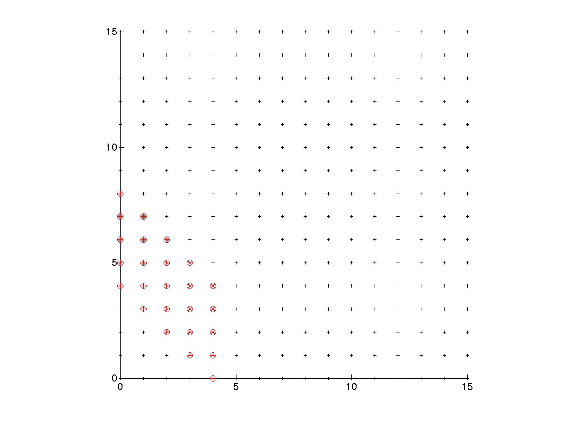
Optimal tiling for “slanted” n-body
j
for i = 0:n
for j = 0:n
access A(i), B(i+j)
Tiling:
Read 5 entries of A:
A([0,1,2,3,4])
Read 5 entries of B:
B([4,5,6,7,8])
Perform 5² = 25
loop iterations
i
Notes:
TilePlot_6_2.jpg

Slide 42
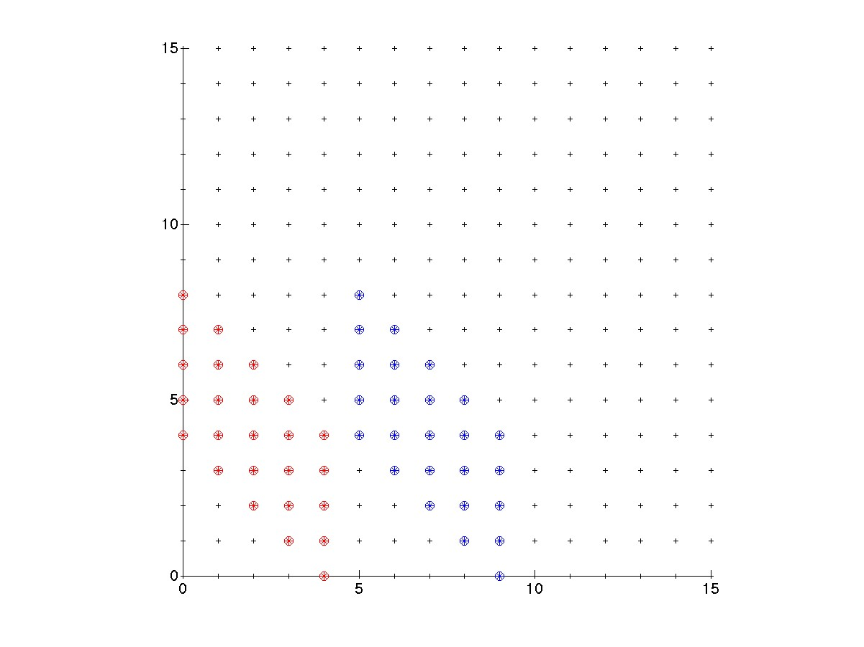
Optimal tiling for “slanted” n-body
j
for i = 0:n
for j = 0:n
access A(i), B(i+j)
i
Notes:
TilePlot_6_3.jpg

Slide 43
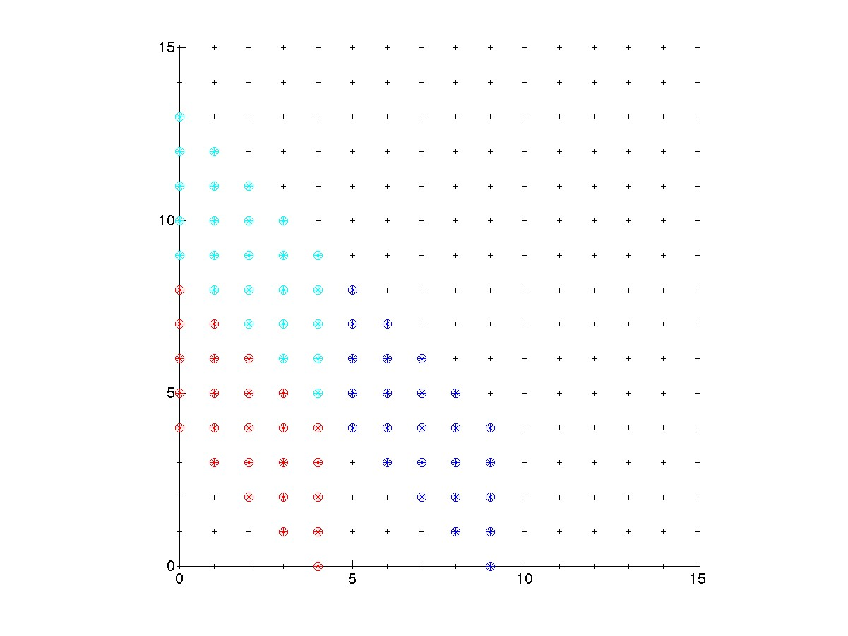
Optimal tiling for “slanted” n-body
j
for i = 0:n
for j = 0:n
access A(i), B(i+j)
i
Notes:
TilePlot_6_4.jpg

Slide 44
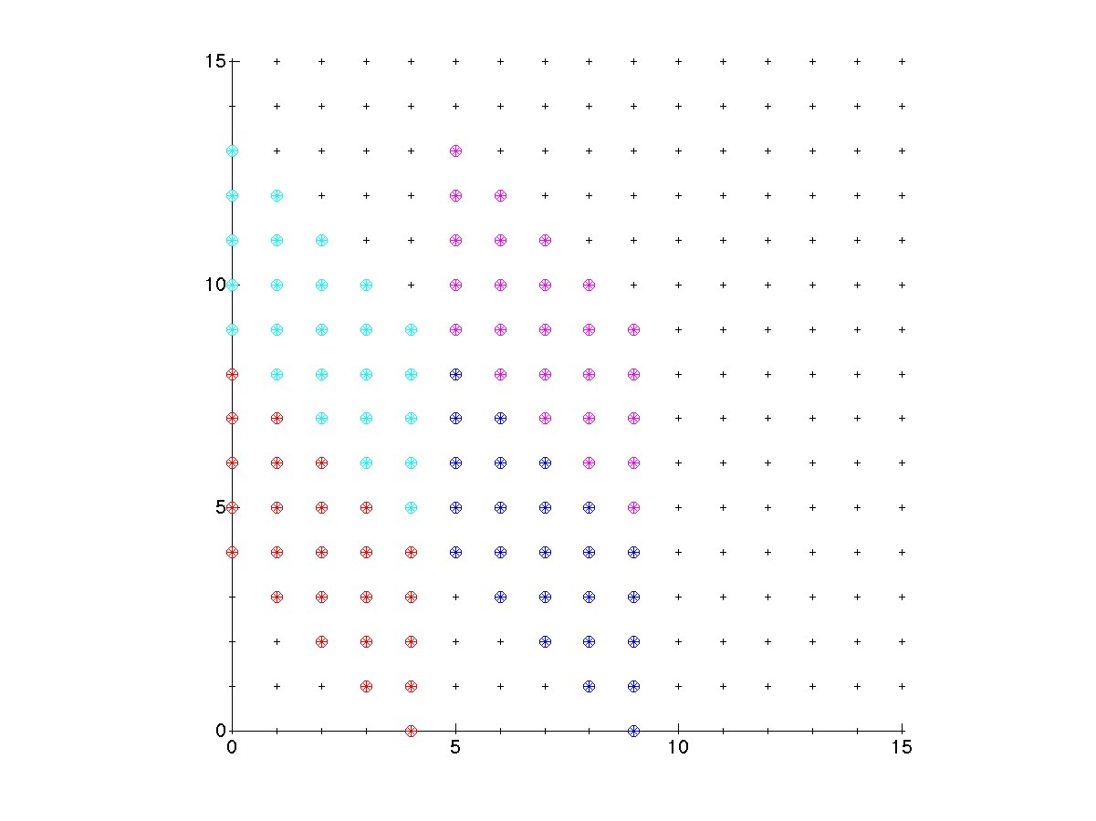
Optimal tiling for “slanted” n-body
j
for i = 0:n
for j = 0:n
access A(i), B(i+j)
i
Notes:
TilePlot_6_5.jpg

Slide 45
Optimal tiling for “twisted” n-body
j
for i = 0:n
for j = 0:n
access A(3*i-j),
B(i-2*j)
i
Notes:
TilePlot_2_1.jpg

Slide 46
Optimal tiling for “twisted” n-body
j
for i = 0:n
for j = 0:n
access A(3*i-j),
B(i-2*j)
Tiling:
Read 5 entries of A:
A([0,5,10,15,20])
Read 5 entries of B:
B([0,-5,-10,-15,-20])
Perform 5² = 25
loop iterations
i
Notes:
TilePlot_2_2.jpg

Slide 47
Optimal tiling for “twisted” n-body
j
for i = 0:n
for j = 0:n
access A(3*i-j),
B(i-2*j)
i
Notes:
TilePlot_2_3.jpg

Slide 48
Optimal tiling for “twisted” n-body
j
for i = 0:n
for j = 0:n
access A(3*i-j),
B(i-2*j)
i
Notes:
TilePlot_2_4.jpg

Slide 49
Optimal tiling for “twisted” n-body
j
for i = 0:n
for j = 0:n
access A(3*i-j),
B(i-2*j)
i
Notes:
TilePlot_2_5.jpg

Slide 50
Optimal tiling for “twisted” n-body
j
for i = 0:n
for j = 0:n
access A(3*i-j),
B(i-2*j)
i
Notes:
TilePlot_4_1.jpg

Slide 51
Optimal tiling for “twisted” n-body
j
for i = 0:n
for j = 0:n
access A(3*i-j),
B(i-2*j)
i
Notes:
TilePlot_4_2.jpg

Slide 52
Optimal tiling for “twisted” n-body
j
for i = 0:n
for j = 0:n
access A(3*i-j),
B(i-2*j)
i
Notes:
TilePlot_4_3.jpg

Slide 53
Optimal tiling for “twisted” n-body
j
for i = 0:n
for j = 0:n
access A(3*i-j),
B(i-2*j)
i
Notes:
TilePlot_4_4.jpg

Slide 54
Optimal tiling for “twisted” n-body
j
for i = 0:n
for j = 0:n
access A(3*i-j),
B(i-2*j)
i
Notes:
TilePlot_5_1.jpg

