Slide 1
Parallel Graph Algorithms
Siqi Chen
打造完整的国产芯片数字EDA平台

Slide 2
Graph Preliminaries

Slide 3
Graph Preliminaries
Define: Graph G = (V,E)
a set of vertices and a set of edges between vertices
Vertex
Edge
n=|V| (number of vertices)
m=|E| (number of edges)
D=diameter (max #hops between any pair of vertices)
Edges can be directed or undirected, weighted or not.
They can even have attributes (i.e. semantic graphs)
Sequences of edges <u₁,u₂>, <u₂,u₃>, … ,<u_{n-1},u_{n}> is a path from u₁ to u_{n}. Its length is the sum of its weights.

Slide 4
Applications

Slide 5
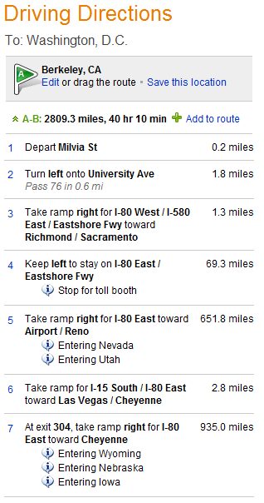
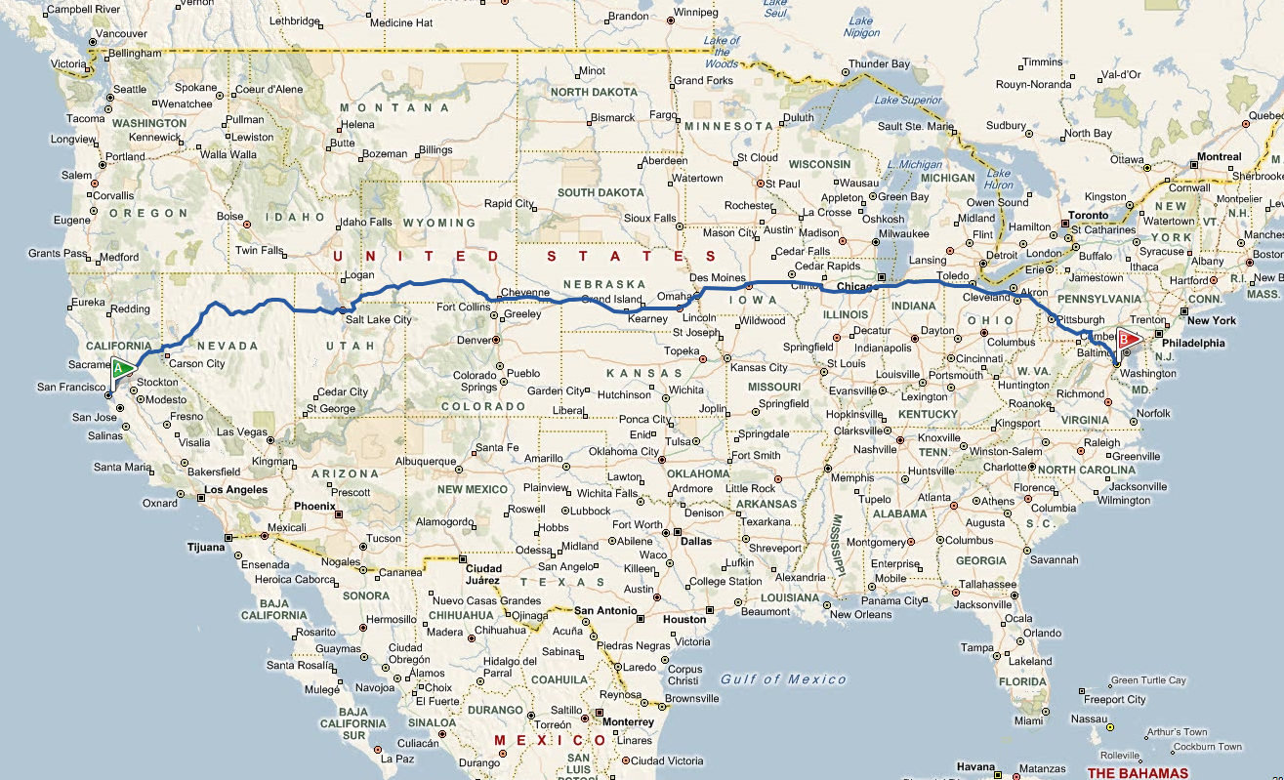
Routing in transportation networks

Slide 6
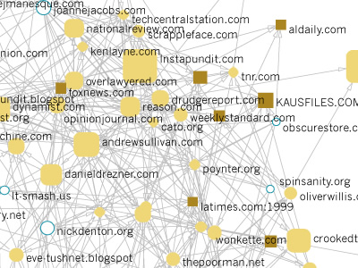
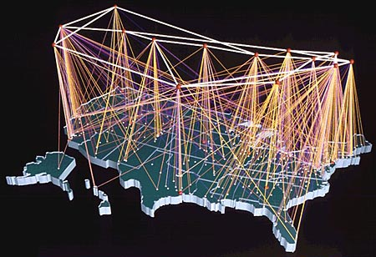
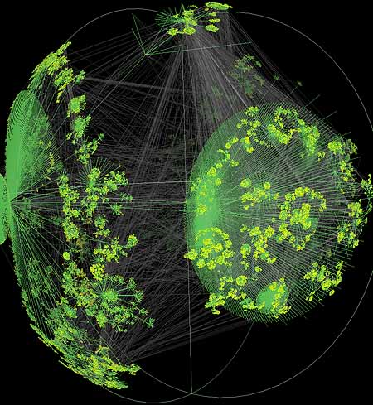
Internet and the WWW
The world-wide web can be represented as a directed graph
Web search and crawl: traversal
Link analysis, ranking: Page rank and HITS
Document classification and clustering
Internet topologies (router networks) are naturally modeled as graphs

Slide 7
Large Graphs in Scientific Computing
1
2
3
4
5
1
2
3
4
5
1
1
1
4
2
2
2
5
3
3
3
3
4
1
5
4
4
2
A
5
5
PA
Matching in bipartite graphs: Permuting to heavy diagonal or block triangular form

Slide 8
Designing parallel graph algorithms

Slide 9
The PRAM model
Many PRAM graph algorithms in 1980s.
Idealized parallel shared memory system model
Unbounded number of synchronous processors; no synchronization, communication cost; no parallel overhead
EREW (Exclusive Read Exclusive Write), CREW (Concurrent Read Exclusive Write)
Measuring performance: space and time complexity; total number of operations (work)

Slide 10
PRAM Pros and Cons
Pros
Simple and clean semantics.
The majority of theoretical parallel algorithms are designed using the PRAM model.
Independent of the communication network topology.
Cons
Not realistic, too powerful communication model.
Communication costs are ignored.
Synchronized processors.
No local memory.
Big-O notation is often misleading.

Slide 11
Graph representations
Compressed sparse rows (CSR) = cache-efficient adjacency lists
7
1
1
12
3
26
12
4
14
2
1
2
19
3
2
19
26
3
4
2
14
4
7
Index into
adjacency
array
 | 1 | 2 | 3 | 4
1 | 12 |  | 26
2
3 |  | 19
4 |  | 14 |  | 7
1 | 3 | 3 | 4 | 6
(row pointers in CSR)
Adjacencies
1 | 3 | 2 | 2 | 4
(column ids in CSR)
Weights
12 | 26 | 19 | 14 | 7
(numerical values in CSR)

Slide 12
Distributed graph representations
Each processor stores the entire graph
(“full replication”)
Each processor stores n/p vertices and all adjacencies out of these vertices (“1D partitioning”)
How to create these “p” vertex partitions?
Graph partitioning algorithms: recursively optimize for conductance (edge cut/size of smaller partition)
Randomly shuffling the vertex identifiers ensures that edge count/processor are roughly the same
TSP: travelling salesman problem

Slide 13
2D checkerboard distribution
Consider a logical 2D processor grid (p_{r} * p_{c} = p) and the matrix representation of the graph
Assign each processor a sub-matrix (i.e, the edges within the sub-matrix)
9 vertices, 9 processors, 3x3 processor grid
 |  | x |  |  | x |  | x
 |  |  |  |  |  | x
x |  |  | x
 |  | x |  | x |  |  | x
 |  |  | x |  |  | x |  | x
x |  |  |  |  |  |  |  | x
 | x |  |  | x |  |  |  | x
x |  |  | x |  |  |  |  | x
 |  |  |  | x | x | x | x
5
8
1
0
7
3
4
6
Flatten
Sparse matrices
2
Per-processor local graph
representation
13

Slide 14
Graph traversals: Breadth-first search

Slide 15
Graph traversal: Depth-first search (DFS)
9
7
5
8
preorder
vertex number
6
1
8
2
3
4
5
0
7
3
4
6
9
source
vertex
1
2
Parallelizing DFS is a bad idea: span(DFS) = O(n)

Slide 16
Graph traversal : Breadth-first search (BFS)
1
2
Input:
distance from
source vertex
Output:
5
8
4
1
1
2
3
3
4
0
7
3
4
6
9
source
vertex
1
2

Slide 17
Parallel BFS Strategies
1. Expand current frontier (level-synchronous approach, suited for low diameter graphs)
5
8
1
O(D) parallel steps
Adjacencies of all vertices
in current frontier are
visited in parallel
0
7
3
4
6
9
source
vertex
2
2. Stitch multiple concurrent traversals (Ullman-Yannakakis approach, suited for high-diameter graphs)
5
8
1
path-limited searches from “super vertices”
APSP between “super vertices”
source
vertex
0
7
3
4
6
9
2

Slide 18
2
1
Breadth-first search using matrix algebra
4
7
5
from
1
7
3
6
1
0
to
parents:
7
A^{T}

Slide 19
2
1
Replace scalar operations
Multiply -> select
Add -> minimum
4
7
5
from
1
7
3
6
1
1
1
0
to
→
1
1
parents:
1
7
A^{T}
X
A^{T}X

Slide 20
2
1
Select vertex with
minimum label as parent
4
7
5
from
1
7
3
6
1
2
0
4
→
4
to
1
4
4
2
2
parents:
1
2
7
2
4
2
A^{T}
X
A^{T}X

Slide 21
2
1
4
7
5
from
1
7
3
6
1
0
3
→
to
1
4
5
parents:
1
3
5
3
2
7
7
3
A^{T}
X
A^{T}X

Slide 22
2
1
4
7
5
from
1
7
3
6
1
to
→
6
7
A^{T}
X
A^{T}X

Slide 23
1D Parallel BFS algorithm
1
2
x
→
4
5
7
3
6
A^{T}
frontier
x
ALGORITHM:
Find owners of the current frontier’s adjacency [computation]
Exchange adjacencies via all-to-all. [communication]
Update distances/parents for unvisited vertices. [computation]

Slide 24
2D Parallel BFS algorithm
1
2
x
→
4
5
7
3
6
A^{T}
frontier
x
ALGORITHM:
Gather vertices in processor column [communication]
Find owners of the current frontier’s adjacency [computation]
Exchange adjacencies in processor row [communication]
Update distances/parents for unvisited vertices. [computation]

Slide 25
Maximal Independent Sets: Luby’s algorithm

Slide 26
Maximal Independent Set
Graph with vertices V = {1,2,…,n}
A set S of vertices is independent if no two vertices in S are neighbors.
An independent set S is maximal if it is impossible to add another vertex and stay independent
An independent set S is maximum if no other independent set has more vertices
Finding a maximum independent set is intractably difficult (NP-hard)
Finding a maximal independent set is easy, at least on one processor.
1
2
3
4
5
6
7
8
The set of red vertices S = {4, 5} is independent and is maximal but not maximum

Slide 27
Sequential Maximal Independent Set Algorithm
S = empty set;
for vertex v = 1 to n {
if (v has no neighbor in S) {
add v to S
}
}
1
2
3
4
5
6
7
8
S = { }

Slide 28
Sequential Maximal Independent Set Algorithm
S = empty set;
for vertex v = 1 to n {
if (v has no neighbor in S) {
add v to S
}
}
1
2
3
4
5
6
7
8
S = { 1 }

Slide 29
Sequential Maximal Independent Set Algorithm
S = empty set;
for vertex v = 1 to n {
if (v has no neighbor in S) {
add v to S
}
}
1
2
3
4
5
6
7
8
S = { 1, 5 }

Slide 30
Sequential Maximal Independent Set Algorithm
S = empty set;
for vertex v = 1 to n {
if (v has no neighbor in S) {
add v to S
}
}
1
2
3
4
5
6
7
8
S = { 1, 5, 6 }

Slide 31
Parallel, Randomized MIS Algorithm
1
2
S = empty set; C = V;
while C is not empty {
label each v in C with a random r(v);
for all v in C in parallel {
if r(v) < min( r(neighbors of v) ) {
move v from C to S;
remove neighbors of v from C;
}
}
}
3
4
5
6
7
8
S = { }
C = { 1, 2, 3, 4, 5, 6, 7, 8 }

Slide 32
Parallel, Randomized MIS Algorithm
2.6
4.1
1
2
S = empty set; C = V;
while C is not empty {
label each v in C with a random r(v);
for all v in C in parallel {
if r(v) < min( r(neighbors of v) ) {
move v from C to S;
remove neighbors of v from C;
}
}
}
5.9
3.1
4
5.8
3
5
1.2
6
7
8
9.7
9.3
S = { }
C = { 1, 2, 3, 4, 5, 6, 7, 8 }

Slide 33
Parallel, Randomized MIS Algorithm
2.6
4.1
1
2
S = empty set; C = V;
while C is not empty {
label each v in C with a random r(v);
for all v in C in parallel {
if r(v) < min( r(neighbors of v) ) {
move v from C to S;
remove neighbors of v from C;
}
}
}
5.9
3.1
4
5.8
3
5
1.2
6
7
8
9.7
9.3
S = { 1, 5 }
C = { 6, 8 }

Slide 34
Parallel, Randomized MIS Algorithm
1
2
S = empty set; C = V;
while C is not empty {
label each v in C with a random r(v);
for all v in C in parallel {
if r(v) < min( r(neighbors of v) ) {
move v from C to S;
remove neighbors of v from C;
}
}
}
4
2.7
3
5
6
7
8
1.8
S = { 1, 5 }
C = { 6, 8 }

Slide 35
Parallel, Randomized MIS Algorithm
1
2
S = empty set; C = V;
while C is not empty {
label each v in C with a random r(v);
for all v in C in parallel {
if r(v) < min( r(neighbors of v) ) {
move v from C to S;
remove neighbors of v from C;
}
}
}
4
2.7
3
5
6
7
8
1.8
S = { 1, 5, 8 }
C = { }

Slide 36
Thanks!

