Slide 1
SPICE SIMULATION
王乐平
2023.04.17

Slide 2
CONTENT
Flow Overview
MNA Stamping
Nonlinear Component
Transient Analysis
Nonlinear Transient Analysis

Slide 3
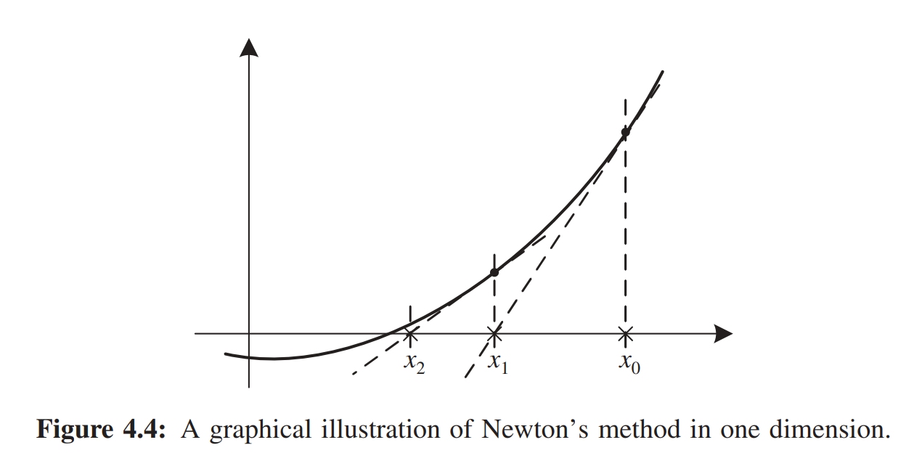
Simulation Flow Overview
R0 n1 0 2.0
R1 n2 0 2.0
I0 n2 n1 0.05
…
Circuit Description File
stamping
Nonlinear Differential Equations F(x,x’)=0
$$GV+CV′=I$$
C or G can be a function of U
e.g. Back Euler
Normally, C is singular. To avoid C inverse, multiply C in both side:
$$C\left(V_{n+1}−V_{n}\right)=hCV_{n+1}^{′}=h(I_{n+1}−GV_{n+1})$$
Then we get:
$$\left(\frac{C}{h}+G\right)V_{n+1}=\frac{C}{h}V_{n}+I_{n+1}$$
This equation also show the companion model for linear C, for the case of Back Euler.
The right side is given, it is easy to solve if C and G are constant. However, when C or G is a function of $U_{n+1}$, we get a nonlinear equation, denoted as:
$$H(x)=b$$
Or we want to solve:
$$F\left(x\right)=H\left(x\right)−b=0$$
Where:
$$H\left(x\right)=\left(\frac{C\left(x\right)}{h}+G(x)\right)$$
Nonlinear Algebraic Equations F(x)=0
$$V_{n+1}−V_{n}=hV_{n+1}^{′}=hC^{−1}(I_{n+1}−GV_{n+1})$$
e.g. Newton’s Method
Linear Algebraic Equations Ax=b
$$−F\left(x_{0}\right)=\frac{∂F\left(x\right)}{∂x}|_{x=x_{0}}(x−x_{0})$$
No
Converged?
Instead of solve nonlinear algebraic equation $F\left(x\right)=0$
Solve this linear algebraic equation iteratively until converges.
However, Jacobian matrix is difficult to calculate directly.
We can use companion models to improve the general Newton’s method.
$$\left\|x^{(k+1)}−x^{(k)}\right\|<δ$$
Yes
Reduce Step Length
LTE
Acceptable?
Yes
Increase Step Length?
Next Step
Overall circuit simulation flow.
FROM: CIRCUIT SIMULATION FARID N. NAJM
Notes:
In general, it can be shown that the global truncation error (GTE) of an LMS method of order p is 0.h p/, in contrast to the LTE which is 0.h pC1/

Slide 4
MNA Stamping

Slide 5
一些说明
列方程的基础：KCL和KVL
在节点电压法中，电路方程被表示为$GV+CV′=I$的形式，而在改进节点法中，电路方程会进行拓展，同时为方便表示，电路方程一律采用拉氏变换后的形式，记作：
$$AX=B$$
其中$X$既包含未知电势变量，也包含未知电流变量。$B$既包含已知电流源电流，也包含已知电压源电压（短路可视作0V电压源）。而$A$中即包含导纳矩阵（$s$分量表示电纳），也包含电势间关系，受控关系等。

Slide 6
独立电压源
$I_{i}=J$
$I_{j}=−J$
$V_{i}−V_{j}=E$
$$V_{i}$$
$$V_{j}$$
$$I$$
A: | i | j | k
i |  |  | 1
j |  |  | -1
k | 1 | -1
X:
B:
i | $V_{i}$
j | $V_{j}$
k | $$J$$
i
j
k | E
$$I_{i}$$
$$I_{j}$$
$$E$$

Slide 7
独立电流源
$I_{i}=I$
$I_{j}=−I$
B:
i | -I
j | I

Slide 8
电阻（电导）
$I_{i}=(V_{i}−V_{j})/R$
$I_{j}=−(V_{i}−V_{j})/R$
A: | i | j
i | 1/R | -1/R
j | -1/R | 1/R

Slide 9
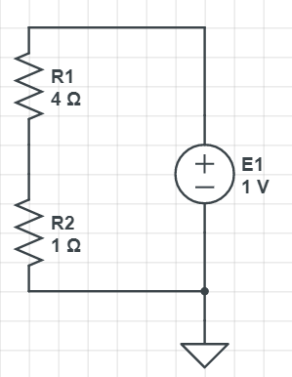
$$A\left[\begin{matrix}V_{1} \\ V_{2} \\ J_{1}\end{matrix}\right]=\left[\begin{matrix}b_{1} \\ b_{2} \\ b_{3}\end{matrix}\right]$$
注意：电路求解需要一个参考节点，也就是电势为0的点，通常称为接地，注入该节点的电流方程可以不填（自动满足），该节点对别的节点的电流影响可以不填（乘以0依旧为0）
电路模型
元件 | E1 | R1 | R2
电路方程 | $$I_{1}=J_{1}$$ $$I_{0}=−J_{1}$$ $$V_{1}−V_{0}=E_{1}$$ | $$I_{1}=(V_{1}−V_{2})/R_{1}$$ $$I_{2}=(V_{2}−V_{1})/R_{1}$$ | $$I_{2}=(V_{2}−V_{0})/R_{2}$$ $$I_{0}=(V_{0}−V_{2})/R_{2}$$
矩阵填充 | $$\left[\begin{matrix} & & 1 \\ & & \\ 1 & & \end{matrix}\right]$$ $$\left[\begin{matrix} \\ \\ E_{1}\end{matrix}\right]$$ | $$\left[\begin{matrix}1/R_{1} & −1/R_{1} & \\ −1/R_{1} & 1/R_{1} & \\ & & \end{matrix}\right]$$ | $$\left[\begin{matrix} & & \\ & 1/R_{2} & \\ & & \end{matrix}\right]$$
$$V_{1}$$
$$V_{2}$$
$$J_{1}$$
$$V_{0}$$
$$\left[\begin{matrix}\frac{1}{R_{1}} & −\frac{1}{R_{1}} & 1 \\ −\frac{1}{R_{1}} & \frac{1}{R_{1}}+\frac{1}{R_{2}} & 0 \\ 1 & 0 & 0\end{matrix}\right]\left[\begin{matrix}V_{1} \\ V_{2} \\ J_{1}\end{matrix}\right]=\left[\begin{matrix}0 \\ 0 \\ E_{1}\end{matrix}\right]$$

Slide 10
电容
$I_{i}=(V_{i}−V_{j})sC$
$I_{j}=−(V_{i}−V_{j})sC$
A: | i | j
i | sC | -sC
j | -sC | sC

Slide 11
电感
$I_{i}=J_{L}$
$I_{j}=−J_{L}$
$V_{i}−V_{j}−sLJ_{L}=0$
A: | i | j | k
i |  |  | 1
j |  |  | -1
k | 1 | -1 | -sL
i
j
k | 0

Slide 12
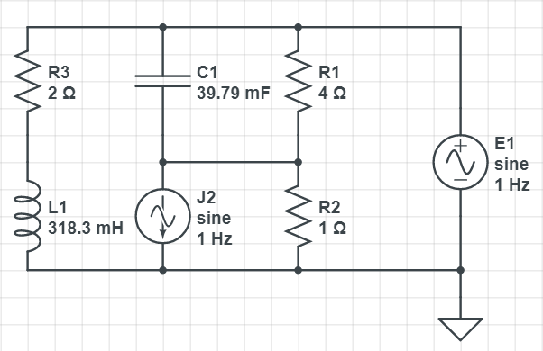
case0
电路模型
电路方程：
$$V_{1}$$
$$A\left[\begin{matrix}\begin{matrix}V_{1} \\ V_{2} \\ V_{3}\end{matrix} \\ \begin{matrix}J_{1} \\ J_{3}\end{matrix}\end{matrix}\right]=\left[\begin{matrix}\begin{matrix}I_{1} \\ I_{2} \\ I_{3}\end{matrix} \\ \begin{matrix}E_{1} \\ E_{3}\end{matrix}\end{matrix}\right]$$
$$V_{3}$$
$$V_{2}$$
$$J_{1}$$
接下来对各元件对应在方程中的贡献进行一一分析
$$J_{3}$$
$$V_{0}$$

Slide 13
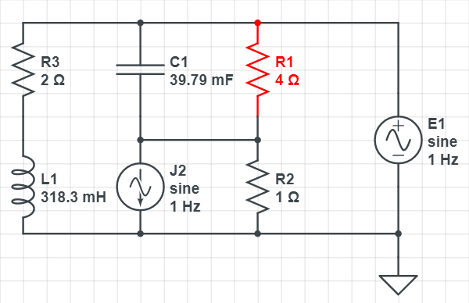
R1
电路方程：
$$A\left[\begin{matrix}\begin{matrix}V_{1} \\ V_{2} \\ V_{3}\end{matrix} \\ \begin{matrix}J_{1} \\ J_{3}\end{matrix}\end{matrix}\right]=\left[\begin{matrix}\begin{matrix}I_{1} \\ I_{2} \\ I_{3}\end{matrix} \\ \begin{matrix}E_{1} \\ E_{3}\end{matrix}\end{matrix}\right]$$
$I_{1}=(V_{1}−V_{2})/R_{1}$
$I_{2}=(V_{2}−V_{1})/R_{1}$
电路模型
$$1/R_{1}$$ | $$−1/R_{1}$$
$$−1/R_{1}$$ | $$1/R_{1}$$
$$V_{1}$$
$$V_{3}$$
$$V_{2}$$
$$J_{1}$$
$$J_{3}$$
$$V_{0}$$

Slide 14
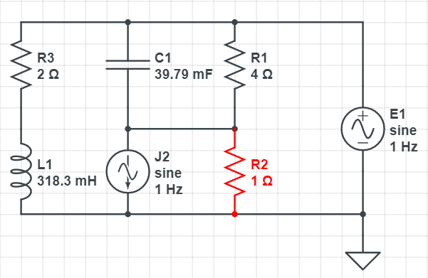
R2
电路方程：
$$A\left[\begin{matrix}\begin{matrix}V_{1} \\ V_{2} \\ V_{3}\end{matrix} \\ \begin{matrix}J_{1} \\ J_{3}\end{matrix}\end{matrix}\right]=\left[\begin{matrix}\begin{matrix}I_{1} \\ I_{2} \\ I_{3}\end{matrix} \\ \begin{matrix}E_{1} \\ E_{3}\end{matrix}\end{matrix}\right]$$
$I_{2}=(V_{2}−V_{0})/R_{2}$
$I_{0}=(V_{0}−V_{2})/R_{2}$
电路模型
 | $$1/R_{2}$$
$$V_{1}$$
$$V_{3}$$
$$V_{2}$$
$$J_{1}$$
$$J_{3}$$
$$V_{0}$$

Slide 15
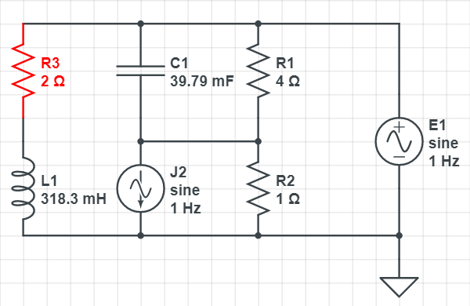
R3
电路方程：
$$A\left[\begin{matrix}\begin{matrix}V_{1} \\ V_{2} \\ V_{3}\end{matrix} \\ \begin{matrix}J_{1} \\ J_{3}\end{matrix}\end{matrix}\right]=\left[\begin{matrix}\begin{matrix}I_{1} \\ I_{2} \\ I_{3}\end{matrix} \\ \begin{matrix}E_{1} \\ E_{3}\end{matrix}\end{matrix}\right]$$
$I_{1}=(V_{1}−V_{3})/R_{3}$
$I_{3}=(V_{1}−V_{3})/R_{3}$
电路模型
$$1/R_{3}$$ |  | $$−1/R_{3}$$
$$−1/R_{3}$$ |  | $$1/R_{3}$$
$$V_{1}$$
$$V_{3}$$
$$V_{2}$$
$$J_{1}$$
$$J_{3}$$
$$V_{0}$$

Slide 16
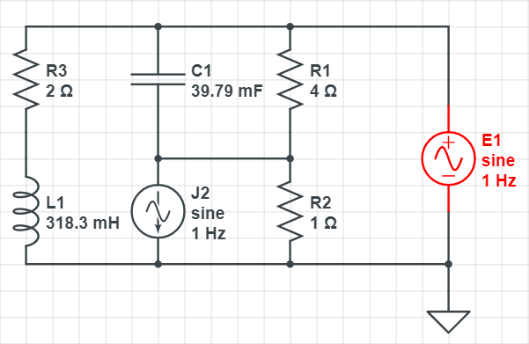
E1
电路方程：
$$A\left[\begin{matrix}\begin{matrix}V_{1} \\ V_{2} \\ V_{3}\end{matrix} \\ \begin{matrix}J_{1} \\ J_{3}\end{matrix}\end{matrix}\right]=\left[\begin{matrix}\begin{matrix}I_{1} \\ I_{2} \\ I_{3}\end{matrix} \\ \begin{matrix}E_{1} \\ E_{3}\end{matrix}\end{matrix}\right]$$
$I_{1}=J_{1}$
$I_{0}=−J_{1}$
$V_{1}−V_{0}=E_{1}$
电路模型
 |  |  | 1
1
$$V_{1}$$
$$V_{3}$$
$$V_{2}$$
$$J_{1}$$
$$E_{1}$$
$$J_{3}$$
$$V_{0}$$

Slide 17
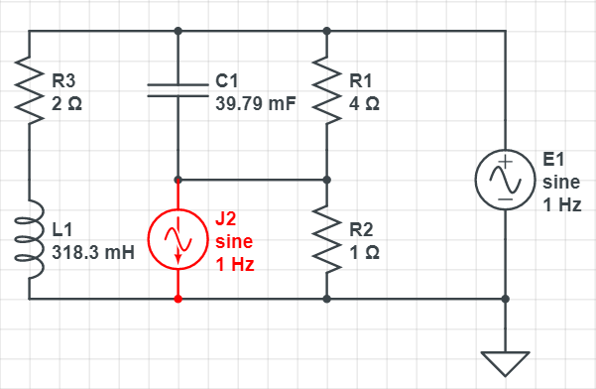
J2
电路方程：
$$A\left[\begin{matrix}\begin{matrix}V_{1} \\ V_{2} \\ V_{3}\end{matrix} \\ \begin{matrix}J_{1} \\ J_{3}\end{matrix}\end{matrix}\right]=\left[\begin{matrix}\begin{matrix}I_{1} \\ I_{2} \\ I_{3}\end{matrix} \\ \begin{matrix}E_{1} \\ E_{3}\end{matrix}\end{matrix}\right]$$
$I_{2}=J_{2}$
$I_{0}=−J_{2}$
电路模型
$$V_{1}$$
$$V_{3}$$
$$V_{2}$$
$$J_{1}$$
$$−J_{2}$$
$$J_{3}$$
$$V_{0}$$

Slide 18
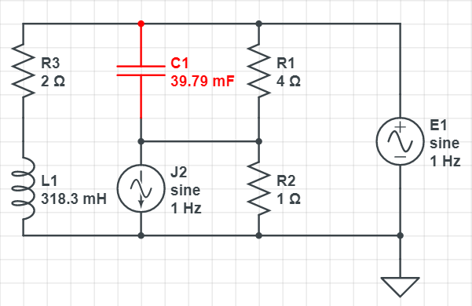
C1
电路方程：
$$A\left[\begin{matrix}\begin{matrix}V_{1} \\ V_{2} \\ V_{3}\end{matrix} \\ \begin{matrix}J_{1} \\ J_{3}\end{matrix}\end{matrix}\right]=\left[\begin{matrix}\begin{matrix}I_{1} \\ I_{2} \\ I_{3}\end{matrix} \\ \begin{matrix}E_{1} \\ E_{3}\end{matrix}\end{matrix}\right]$$
$I_{1}=sC_{1}(V_{1}−V_{2})$
$I_{2}=sC_{1}(V_{2}−V_{1})$
电路模型
$$sC_{1}$$ | $$−sC_{1}$$
$$−sC_{1}$$ | $$sC_{1}$$
$$V_{1}$$
$$V_{3}$$
$$V_{2}$$
$$J_{1}$$
$$J_{3}$$
$$V_{0}$$

Slide 19
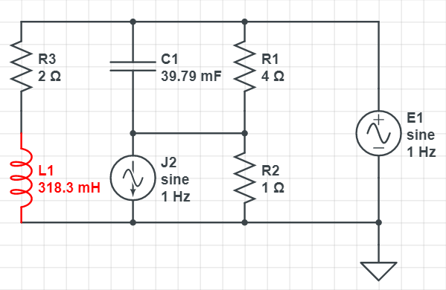
L1
电路方程：
$$A\left[\begin{matrix}\begin{matrix}V_{1} \\ V_{2} \\ V_{3}\end{matrix} \\ \begin{matrix}J_{1} \\ J_{3}\end{matrix}\end{matrix}\right]=\left[\begin{matrix}\begin{matrix}I_{1} \\ I_{2} \\ I_{3}\end{matrix} \\ \begin{matrix}E_{1} \\ E_{3}\end{matrix}\end{matrix}\right]$$
$I_{3}=J_{3}$
$I_{0}=−J_{3}$
$V_{3}−V_{0}−sL_{1}J_{3}=0$
电路模型
 |  |  |  | 1
 |  | 1 |  | $$−sL_{1}$$
$$V_{1}$$
$$V_{3}$$
$$V_{2}$$
$$J_{1}$$
0
$$J_{3}$$
$$V_{0}$$

Slide 20
case0
$$V_{1}$$
带入参数：
$R_{1}=4$
$R_{2}=1$
$R_{3}=2$
$C_{1}=1/(8π)$
$L_{1}=1/π$
$s=j2π$
$J_{2}=1/\sqrt{2}$
$E_{1}=1/\sqrt{2}$
解得：
$V_{1}=0.70710678$
$V_{2}=−0.38074981+0.21757132j$
$V_{3}=0.35355339+0.35355339j$
$J_{1}=−0.50313367−0.04079462j$
$J_{3}=0.1767767−0.1767767j$
$$V_{3}$$
$$V_{2}$$
$$J_{1}$$
$$J_{3}$$
电路综合方程：
$$V_{0}$$
$$\frac{1}{R_{1}}+\frac{1}{R_{3}}+sC_{1}$$ | $$−(\frac{1}{R_{1}}+sC_{1})$$ | $$−\frac{1}{R_{3}}$$ | 1 | 0
$$−(\frac{1}{R_{1}}+sC_{1})$$ | $$\frac{1}{R_{1}}+\frac{1}{R_{2}}+sC_{1}$$ | 0 | 0 | 0
$$−\frac{1}{R_{3}}$$ | 0 | $$\frac{1}{R_{3}}$$ | 0 | 1
1 | 0 | 0 | 0 | 0
0 | 0 | 1 | 0 | $$−sL_{1}$$
$$V_{1}$$
$$V_{2}$$
$$V_{3}$$
$$J_{1}$$
$$J_{3}$$
0
$$−J_{2}$$
$$0$$
$$E_{1}$$
0

Slide 21
解方程用python3代码
import numpy as np
import math
A=np.array([[3/4+1j/4,-(1/4+1j/4),-1/2,1,0],[-(1/4+1j/4),5/4+1j/4,0,0,0],[-1/2,0,1/2,0,1],[1,0,0,0,0],[0,0,1,0,-2j]])
b=np.array([0,-1/math.sqrt(2),0,1/math.sqrt(2),0])
x=np.linalg.solve(A,b)
print(x)
print(math.sqrt(2)*abs(x))
可以自行比对仿真结果和python3求解的幅值大小。多仿几个周期，可以用暂态分析结果代替AC分析。

Slide 22
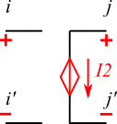
VCVS(压控电压源)
$E_{2}=e_{k}(V_{i}−V_{i^{′}})$
$E_{2}=V_{j}−V_{j^{′}}$
$I_{j}=I_{2}$
$I_{j^{′}}=−I_{2}$
 | i | i' | j | j' | k
i
i'
j |  |  |  |  | 1
j' |  |  |  |  | -1
k | -ek | ek | 1 | -1

Slide 23
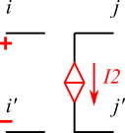
VCCS（压控电流源）
$I_{j}=g_{k}(V_{i}−V_{i^{′}})$
$I_{j^{′}}=−g_{k}(V_{i}−V_{i^{′}})$
A: | i | i' | j | j'
i
i'
j | gk | -gk
j' | -gk | gk

Slide 24
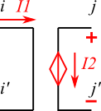
CCVS（流控电压源）
 | i | i' | j | j' | k | l
i |  |  |  |  | 1
i' |  |  |  |  | -1
j |  |  |  |  |  | 1
j' |  |  |  |  |  | -1
k | 1 | -1
l |  |  | 1 | -1 | -hk
$I_{i}=I_{1}$
$I_{i^{′}}=−I_{1}$
$V_{i}−V_{i^{′}}=0$
$I_{j}=I_{2}$
$I_{j^{′}}=−I_{2}$
$V_{j}−V_{j^{′}}=h_{k}I_{1}$

Slide 25
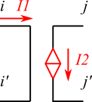
CCCS（流控电流源）
$I_{i}=I_{1}$
$I_{i^{′}}=−I_{1}$
$V_{i}−V_{i^{′}}=0$
$I_{j}=I_{2}$
$I_{j^{′}}=−I_{2}$
$I_{2}=f_{k}I_{1}$
 | i | i' | j | j' | k
i |  |  |  |  | 1
i' |  |  |  |  | -1
j |  |  |  |  | fk
j' |  |  |  |  | -fk
k | 1 | -1

Slide 26
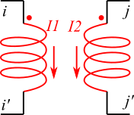
互感
 | i | i' | j | j' | k | l
i |  |  |  |  | 1
i' |  |  |  |  | -1
j |  |  |  |  |  | 1
j' |  |  |  |  |  | -1
k | 1 | -1 |  |  | $$−sL_{11}$$ | $$−sM_{12}$$
l |  |  | 1 | -1 | $$−sM_{21}$$ | $$−sL_{22}$$
$I_{i}=I_{1}$
$I_{i^{′}}=−I_{1}$
$V_{i}−V_{i^{′}}=sL_{11}I_{1}+sM_{12}I_{2}$
$I_{j}=I_{2}$
$I_{j^{′}}=−I_{2}$
$V_{j}−V_{j^{′}}=sL_{22}I_{2}+sM_{21}I_{1}$
可以看到，互感矩阵表现形式上十分类似于流控电压源。

Slide 27
Nonlinear Component

Slide 28
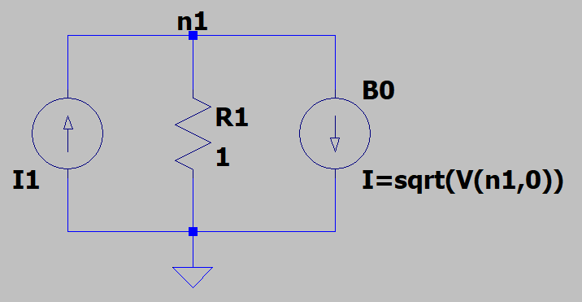
Case1 Nonlinear
$$\left[g_{1}+g_{0}\right]\left[v_{1}\right]=\left[i_{1}\right]$$
Stamping
$$F\left(v\right)=H\left(v\right)−b=\left[g_{1}+g_{0}\right]\left[v\right]−\left[i_{1}\right]$$
Solve for $F\left(v\right)=$0
电路模型
$$v^{(k+1)}=−\frac{F\left(v^{(k)}\right)}{\frac{∂F\left(v\right)}{∂v}|_{v=v^{(k)}}}+v^{(k)}$$
Newton’s Method
Iteration
Let $g_{1}=1$, $g_{0}=\frac{1}{\sqrt{u}}$
$$\frac{∂F\left(v\right)}{∂v}=\left[g_{1}+g_{0}\right]+\frac{∂\left[g_{1}+g_{0}\right]}{∂x}\left[v\right]=\left(1+\frac{1}{\sqrt{v_{1}}}\right)−\frac{1}{2\sqrt{v_{1}}}=1+\frac{1}{2\sqrt{v_{1}}}$$
$$\left[v_{1}^{(k+1)}\right]=−\frac{F\left(v^{(k)}\right)}{\frac{∂F\left(v\right)}{∂v}|_{v=v^{(k)}}}+v^{(k)}=−\frac{\left(1+\frac{1}{\sqrt{v_{1}^{(k)}}}\right)\left[v_{1}^{(k)}\right]−\left[i_{1}\right]}{\left[1+\frac{1}{2\sqrt{v_{1}^{(k)}}}\right]}+\left[v_{1}^{(k)}\right]$$
这里用行为电流源创建了一个等效非线性电阻，其电导值为：
$$g_{0}=\frac{i}{u}=\frac{\sqrt{u}}{u}=\frac{1}{\sqrt{u}}$$

Slide 29
case1
$v^{∗}=−\frac{\left(1+\frac{1}{\sqrt{v_{1}}}\right)v_{1}−i_{1}}{1+\frac{1}{2\sqrt{v_{1}}}}+v_{1}$ 迭代情况
迭代用Python脚本：
import math
i1=2
v=0.01
for i in range(5):
v=-((1+1/math.sqrt(v))*v-i1)/(1+1/2/math.sqrt(v))+v
print(v)
$I_{1}$值 | 2 | 2 | 10
$v_{1}$初值 | 0.01 | 10 | 5
迭代1次 | 0.325 | 0.361675 | 1.658333
迭代2次 | 0.913640 | 0.927870 | 6.739407
迭代3次 | 0.999330 | 0.999539 | 7.296640
迭代4次 | 1.000000 | 1.000000 | 7.298438
迭代5次 | 1.000000 | 1.000000 | 7.298438
… | … | … | …
LTSpice结果 | 1 | 1 | 7.29844
精确解 | 1 | 1 | $$\frac{21−\sqrt{41}}{2}=7.298438$$
可以看到收敛速度非常快
但存在问题：收敛情况和初值有关。如果初值取的不好，可能不收敛甚至在实数域内无法迭代运算。
譬如$I_{1}=2$ $v_{1}$初值取100时，迭代1次后解为-2.857143，此时无法继续开方
求整体雅可比矩阵的方法是困难的，往往只对非线性器件采用伴随模型线性化

Slide 30
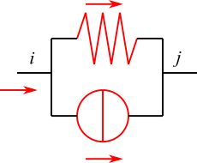
Case1 Companion model
Define affine function of $f\left(x\right)$ at $x_{0}$: ${\hat{f}}_{x_{0}}\left(x\right)≜f^{′}\left(x_{0}\right)\left(x−x_{0}\right)+f\left(x_{0}\right)$
Take a nonlinear resistor as an example, the original current equation: $f\left(u\right)=g\left(u\right)u$, where $g\left(u\right)=\frac{1}{\sqrt{u}}$
The affine function will be:
$${\hat{f}}_{u_{0}}\left(u\right)≜f^{′}\left(u_{0}\right)\left(u−u_{0}\right)+f\left(u_{0}\right)=f^{′}\left(u_{0}\right)u+[f\left(u_{0}\right)−f^{′}\left(u_{0}\right)u_{0}]$$
which include a resistor and current source.
In this case, $f^{′}\left(u_{0}\right)\left(u−u_{0}\right)+f\left(u_{0}\right)=\frac{u}{2\sqrt{u_{0}}}+\frac{\sqrt{u_{0}}}{2}$
The companion model is as shown:
$$g=f^{′}\left(u_{0}\right)=\frac{1}{2\sqrt{u_{0}}}$$
linearization
$$g=\frac{1}{\sqrt{u}}$$
$$i=[f\left(u_{0}\right)−f^{′}\left(u_{0}\right)u_{0}]=\frac{\sqrt{u_{0}}}{2}$$
$$f\left(u\right)=g\left(u\right)u=\sqrt{u}$$

Slide 31
Case1 Companion model
$$\left[1+\frac{1}{2\sqrt{v_{1}^{(k)}}}\right]\left[v_{1}^{(k+1)}\right]=\left[i_{1}−\frac{\sqrt{v_{1}^{(k)}}}{2}\right]$$
Stamping
电路模型
对比求此前解雅可比矩阵的迭代方程：
$$\left[v_{1}^{(k+1)}\right]=−\frac{\left(1+\frac{1}{\sqrt{v_{1}^{(k)}}}\right)\left[v_{1}^{(k)}\right]−\left[i_{1}\right]}{\left[1+\frac{1}{2\sqrt{v_{1}^{(k)}}}\right]}+\left[v_{1}^{(k)}\right]$$
两边同乘以$1+\frac{1}{2\sqrt{v_{1}^{(k)}}}$：
$$\left[1+\frac{1}{2\sqrt{v_{1}^{(k)}}}\right]\left[v_{1}^{(k+1)}\right]=−\left(1+\frac{1}{\sqrt{v_{1}^{(k)}}}\right)\left[v_{1}^{(k)}\right]+\left[i_{1}\right]+\left[1+\frac{1}{2\sqrt{v_{1}^{(k)}}}\right]\left[v_{1}^{(k)}\right]$$
可以看到化简后是一样的
$$g=\frac{1}{2\sqrt{v_{1}^{(k)}−0}}$$
$$i=\frac{\sqrt{v_{1}^{(k)}−0}}{2}$$

Slide 32
Transient Analysis

Slide 33
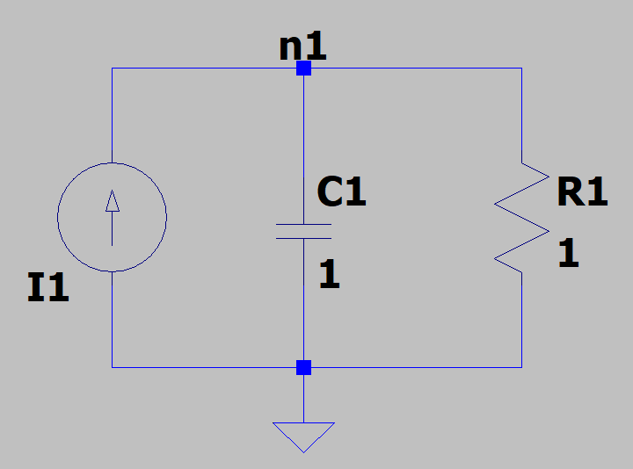
Case2 Transient
$$\left[g_{1}\right]\left[v_{1}\right]+\left[c_{1}\right]{\left[v_{1}\right]}^{′}=\left[i_{1}\right]$$
Stamping
$$\left(G+sC\right)V(s) =I(s)$$
Laplace Transform
Continuous
$$V(s) =\frac{1}{1+s}$$
Let $g_{1}=1,c_{1}=1,$
$I\left(s\right)=1$ (impulse)
电路模型
$$V(t)=e^{−t}$$
Solve
$$C\left(V_{n+1}−V_{n}\right)=hCV_{n+1}^{′}=h(I_{n+1}−GV_{n+1})$$
} Back Euler
$$\left(\frac{C}{h}+G\right)V_{n+1}=\frac{C}{h}V_{n}+I_{n+1}$$
Input:$I_{n}=\left\{\begin{matrix}\frac{1}{h} (n=1) \\ 0 (n≠1)\end{matrix}\right.$
Initial condition: $V_{0}=0$
$$\left(\frac{1}{h}+1\right)V_{1}=\frac{1}{h} \underset{⇒}{h≪1 } V_{1}=1$$
Discontinuous
} Solve Difference Equation
$$V_{n}={(1+h)}^{−(n−1)}V_{1}≈{(1+h)}^{−n}$$
$$V\left(t\right)=V_{\frac{t}{h}}={\left(1+h\right)}^{−\frac{t}{h}}={({\left(1+h\right)}^{\frac{1}{h}})}^{−t}≈e^{−t}$$

Slide 34
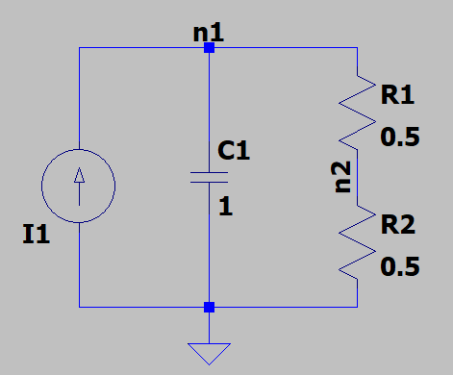
Case2 singular C
$$\left[\begin{matrix}g_{1} & {−g}_{1} \\ −g_{1} & g_{1}+g_{2}\end{matrix}\right]\left[\begin{matrix}v_{1} \\ v_{2}\end{matrix}\right]+\left[\begin{matrix}c_{1} & 0 \\ 0 & 0\end{matrix}\right]{\left[\begin{matrix}v_{1} \\ v_{2}\end{matrix}\right]}^{′}=\left[\begin{matrix}i_{1} \\ 0\end{matrix}\right]$$
$$\left(G+sC\right)V(s) =I(s)$$
where $G+sC=\left[\begin{matrix}2+s & −2 \\ −2 & 4\end{matrix}\right]$
$${(G+sC)}^{−1}=\frac{1}{4s+4}\left[\begin{matrix}4 & 2 \\ 2 & 2+s\end{matrix}\right]$$
Continuous
电路模型
$$V\left(s\right)=\frac{1}{4s+4}\left[\begin{matrix}4 & 2 \\ 2 & 2+s\end{matrix}\right]\left[\begin{matrix}1 \\ 0\end{matrix}\right]=\frac{1}{4s+4}\left[\begin{matrix}4 \\ 2\end{matrix}\right]$$
$$V(t)=\left[\begin{matrix}1 \\ 0.5\end{matrix}\right]e^{−t}$$
$$\left(\frac{C}{h}+G\right)V_{n+1}=\frac{C}{h}V_{n}+I_{n+1}$$
where $\frac{C}{h}+G=\left[\begin{matrix}2+1/h & −2 \\ −2 & 4\end{matrix}\right]$
$$V_{1}=\left[\begin{matrix}1 \\ 0.5\end{matrix}\right]$$
Discontinuous
$$V_{n}={({(\frac{C}{h}+G)}^{−1}\frac{C}{h})}^{(n−1)}V_{1}≈{\left(1+h\right)}^{−n}{\left[\begin{matrix}1 & 0 \\ 0.5 & 0\end{matrix}\right]}^{n}\left[\begin{matrix}1 \\ 0.5\end{matrix}\right]={\left(1+h\right)}^{−n}\left[\begin{matrix}1 \\ 0.5\end{matrix}\right]$$
$$V\left(t\right)=V_{\frac{t}{h}}={\left(1+h\right)}^{−\frac{t}{h}}\left[\begin{matrix}1 \\ 0.5\end{matrix}\right]≈e^{−t}\left[\begin{matrix}1 \\ 0.5\end{matrix}\right]$$

Slide 35
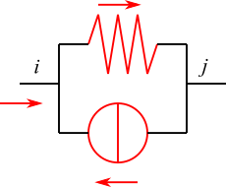
Case2 Companion model
Usually we use companion model instead to build the equation.
Take a linear capacitor for example. Using back Euler, we can get:
$$u_{n+1}−u_{n}=hu_{n+1}^{′}=h\frac{i_{n+1}}{c_{n+1}}$$
$$i_{n+1}=\frac{c}{h}\left(u_{n+1}−u_{n}\right)=\frac{c}{h}u_{n+1}−\frac{cu_{n}}{h}$$
Which behaves like the superposition of a resistor with conductance $\frac{c}{h}$ and a current source with DC current $\frac{cu_{n}}{h}$.
$$g=\frac{c}{h}$$
BE Discretization
$$c$$
$$i=\frac{cu_{n}}{h}$$

Slide 36
Case2 companion model
电路模型
Stamping:
$$i=\frac{cu_{n}}{h}$$
$$g=\frac{c}{h}$$
$$\left[\begin{matrix}2+1/h & −2 \\ −2 & 4\end{matrix}\right]V_{n+1}=\left[\begin{matrix}I_{1}+\frac{u_{n}}{h} \\ 0\end{matrix}\right]$$
Which has the same form as direct method.

Slide 37
Nonlinear Transient Analysis

Slide 38
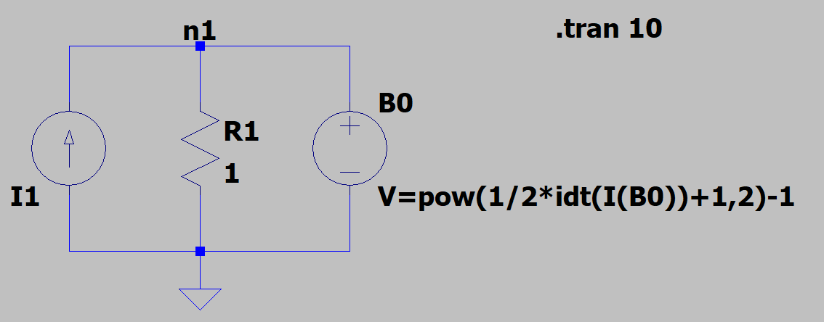
Case3 Nonlinear Transient
$$g_{1}v_{1}+\frac{1}{\sqrt{1+v_{1}}}v_{1}′=i_{1}$$
Continuous
Differential equation
It is difficult to solve analytically
电路模型
Discontinuous
$$C_{n+1}\left(V_{n+1}−V_{n}\right)=hC_{n+1}V_{n+1}^{′}=h(I_{n+1}−G_{n+1}V_{n+1})$$
} Back Euler
$$\left(\frac{C_{n+1}}{h}+G_{n+1}\right)V_{n+1}=\frac{C_{n+1}}{h}V_{n}+I_{n+1}$$
where the matrix $C_{n+1}$ is unknown. How to solve this equation?
Also, you may find we use equation: $V_{n+1}−V_{n}=hV_{n+1}^{′}$ rather than $Q_{n+1}−Q_{n}=hQ_{n+1}^{′}=hI_{n+1}$, where $Q_{n}=Q(V_{n})$ is the charge of capacitors. What will it cause?
这里用行为电流源创建了一个等效非线性电容，电容值为：
$$c(u)=\frac{dq(u)}{du}=\frac{d\int_{0}^{t}{i\left(t\right)dt}}{dt}×\frac{dt}{du}=\frac{1}{\sqrt{1+u}}$$

Slide 39
Case3 Companion model
Nonlinear Capacitor also holds: $cu^{′}=i$ However, $c$ is a function of $u$
Using back Euler, we can get:
$$u_{n+1}−u_{n}=hu_{n+1}^{′}=h\frac{i_{n+1}}{c_{n+1}}$$
$$i_{n+1}=\frac{c_{n+1}}{h}\left(u_{n+1}−u_{n}\right)=g_{c}(u_{n+1})$$
Which behaves like a nonlinear resistor.
Recall the linearization of nonlinear resistor:
Replace nonlinear function: $g_{c}(u_{n+1})$by affine function:
$$g_{c}\left(u_{n+1}^{\left(k\right)}\right)+g_{c}′\left(u_{n+1}^{\left(k\right)}\right)(u_{n+1}^{\left(k+1\right)}−u_{n+1}^{\left(k\right)})$$
Then solve for $u_{n+1}$ iteratively.
$$g=g_{c}′\left(u_{n+1}^{\left(k\right)}\right)$$
BE Discretization
Linearization
$$c(u)$$
$$g_{c}\left(u_{n+1}\right)=\frac{c_{n+1}}{h}\left(u_{n+1}−u_{n}\right)$$
$$i=g_{c}\left(u_{n+1}^{\left(k\right)}\right)−g_{c}′\left(u_{n+1}^{\left(k\right)}\right)u_{n+1}^{\left(k\right)}$$

Slide 40
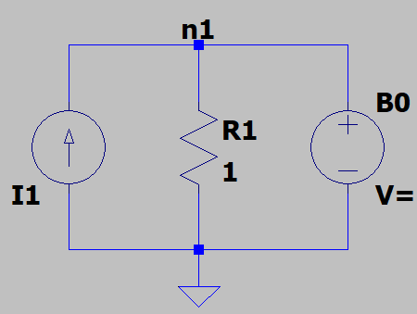
Case3 Companion model
$$g_{c}\left(u_{n+1}^{\left(k\right)}\right)=\frac{c_{n+1}}{h}\left(u_{n+1}^{\left(k\right)}−u_{n}\right)=\frac{u_{n+1}^{\left(k\right)}−u_{n}}{h\sqrt{1+u_{n+1}^{\left(k\right)}}}$$
$$g_{c}′\left(u_{n+1}^{\left(k\right)}\right)=\frac{1}{2h{\left(1+u_{n+1}^{\left(k\right)}\right)}^{\frac{3}{2}}}(2+u_{n+1}^{\left(k\right)}+u_{n})$$
$$\left[g_{1}+g_{c}′\left(u_{n+1}^{\left(k\right)}\right)\right]\left[u_{n+1}^{\left(k+1\right)}\right]=\left[i_{1}−(g_{c}\left(u_{n+1}^{\left(k\right)}\right)−g_{c}′\left(u_{n+1}^{\left(k\right)}\right)u_{n+1}^{\left(k\right)})\right]$$
$$g=g_{c}′\left(u_{n+1}^{\left(k\right)}\right)$$
Converged?
$$i=g_{c}\left(u_{n+1}^{\left(k\right)}\right)−g_{c}′\left(u_{n+1}^{\left(k\right)}\right)u_{n+1}^{\left(k\right)}$$
LTE Acceptable?
Next Step

Slide 41
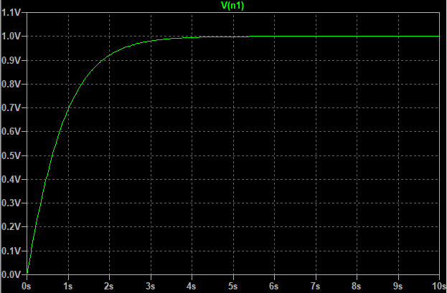
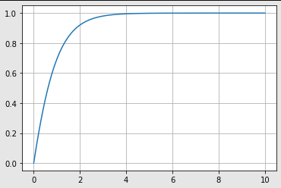
case3
结果比较：LTspice VS python
迭代用Python脚本：
import math
import matplotlib.pyplot as plt
import numpy
Trans = 10
h = 1e-3
delta = 1e-6
g1 = 1
i1 = 1
x = [i*h for i in range(1,int(Trans/h))]
y = list()
u0 = 0
for t in x:
u1 = u0
while True:
gc = (u1-u0)/(h*((1+u1)**0.5))
gcp = (2+u1+u0)/(2*h*((1+u1)**1.5))
G = g1+gcp
I = i1-(gc-gcp*u1)
u2 = I/G
if abs(u2-u1)<delta: break
else: u1 = u2
y.append(u2)
u0 = u2
plt.plot(x, y)
plt.grid()
plt.show()

