Slide 1
Basic knowlege
打造完整的国产芯片数字EDA平台

Slide 2
01.
Standard Cell Layout
02.
LEF/DEF/LIB
03.
CCSP

Slide 3
01.Standard cell layout

Slide 4
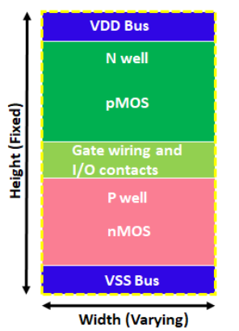
Standard Cell Layout
Standard cell
Standard cells are well defined and pre-characterized cell, used in ASIC design as a building blocks
Main advantage of standard cell based ASIC Design is, it requires lesser design time
Standard cell Layout Style
All the standard cells should have equal height and varying width
At the top of Standard cell, There is VDD bus and at bottom there is VSS bus
All the pMOS transistors are in top half and all nMOS transistors are in bottom half

Slide 5
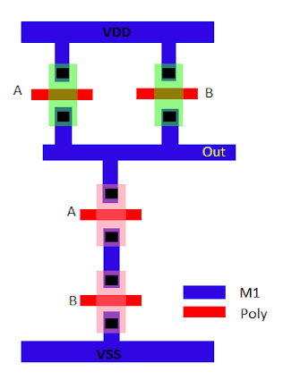
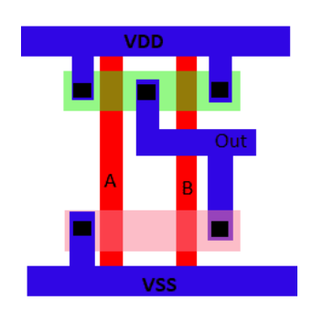
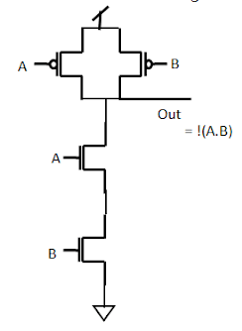
Standard Cell Layout
Save Design Area
Easy placement for APR tool: All the standard cells have the same height and easily can be fit into the standard cell row so make it easy for APR (Automatic Place and Route) to place them.
Easy to route: All the pins of standard cells are in the intersection of horizontal and vertical tracks, So it becomes easy to route them by the APR tool

Slide 6
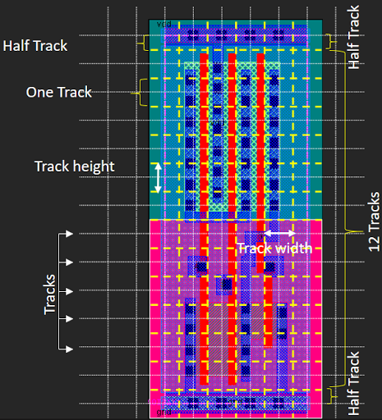
Standard Cell Layout
Track can be defined as a line on which metal layers are drawn. A track means one M1 Pitch. Height of Standard cell is generally measured in term of no. of tracks inside it. like a 13T standard cell means that the height of the standard cell is 13Track of M1.

Slide 7
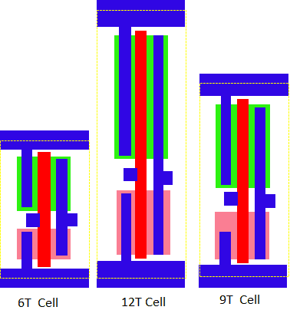
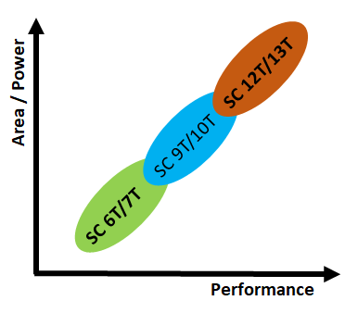
Standard Cell Layout
Small transistor standard cells are used for high-density design and these cells having low power consumption. Large transistors standard cells large area but having very good performance. Medium transistors standard cells have a balance between large transistors and small transistors. So there is a tradeoff between area/power vs performance.

Slide 8
02. LEF / DEF / .LIB
Test case: /scratch02/rnd/jchen/jcbuilds/test_build/test_mem_junc/run_time_dp_quick
/scratch02/rnd/jchen/jcbuilds/test_build/test_mem_junc/import_m ultiple_hier_defs

Slide 9
Library Exchange Format(LEF)
An ASCII data format, used to describe a standard cell library Includes the design rules for routing and the Abstract of the cells, no information about the internal netlist of the cells
A LEF file contains the following sections: 
Technology: layer, design rules, via definitions, metal capacitance 
Site: Site extension 
Macros: cell descriptions, cell dimensions, layout of pins and blockages, capacitances.
The technology is described by the Layer and Via statements. To each layer the following attributes may be associated: 
type: Layer type can be routing, cut (contact), masterslice (poly, active), overlap, implant. 
Layer descriptions must appear in process order, from bottom to top (POLY, METAL1, VIA12, METAL2，VIA23)
width/pitch/spacing rules 
direction 
resistance and capacitance per unit square 
antenna Factor

Slide 10
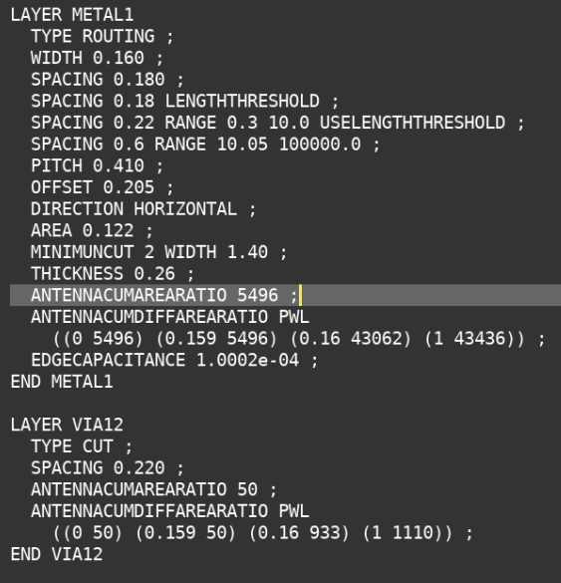
Library Exchange Format(LEF)
Required
via
overhang
Reference: antenna violations http://coriolis.lip6.fr/doc/lefdef/lefdefref/PAE.html

Slide 11
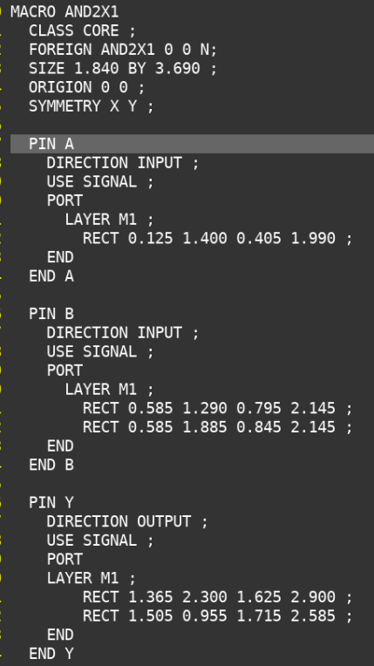
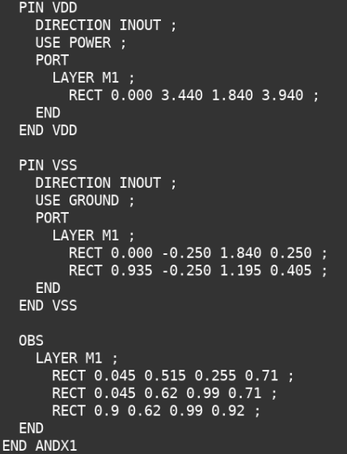
Library Exchange Format(LEF)
CLASS: COVER, RING, BLOCK, PAD, ENDCAP, CORE(default)
DIRCTION: INPUT, OUTPUT, INOUT，FREEDTHRU
USE: SIGNAL, ANALOG, POWER, GROUND, CLOCK
OBS: the set of obstructions(blockages) in the macro
Advanced klib flow will use detailed pin information in lef

Slide 12
Design Exchange Format(DEF)
An ASCII data format, used to describe the physical design data of a design. A DEF description include logical design data, such as netlist connectivity. Physical data includes locations of cells and macros in the design, and locations of routing wires
A DEF file is generated after a design has been physically placed or routed by a layout tool. And can be read in by a layout tool in order to perform ECOs or further layout changes
A DEF file along with its LEF files can be used by a parasitic extraction tool to obtain physical information of macro cells being used in a design

Slide 13
Design Exchange Format(DEF)
Row statement
rowName: Specifies the row name for this row.
siteName : Specify the LEF site to use for the row
origX origY : Specify the location of first site in the row, N S W E FN(F for flip)
siteOrientation : Specifies the orientation of all sites in the row
Do numX BY numY :
Specifies the repeating set of sites that create the row.
One of value must be 1.
If numY is 1, then row will be horizontal
STEP stepX stepY :Specifies the spacing between sites in Horizontal and Vertical row

Slide 14
Design Exchange Format(DEF)
Track statement
Specifies the direction and location of first track defined
X indicates vertical lines and Y indicates horizontal line
Start is the X or Y coordinate of first line, (0, 100)
Do numtracks ：Specifies the number of tracks to create for the grid
STEP space: Specifies the spacing between the tracks
LAYER layerName
Specifies the routing layer used for this track
We can specify more than one layer

Slide 15
Design Exchange Format(DEF)
Gcell Grid statement(global routing cells)
{X | Y } start :Specifies the location of first vertical (x) and first horizontal (y) track
Do numColumns+1, Do numRows+1 :Specifies the number of columns or rows in the grid(974 row, 811 col)
STEP space: Specifies the spacing between the tracks, size(1200 X 1200)

Slide 16
Design Exchange Format(DEF)
Via statement
All vias consist of shapes on three Layers
A cut layer
Two routing (or masterslice) layers that connect through that cut layer

Slide 17
Design Exchange Format(DEF)
Pin statement
It defines external pins
Each pin definition assigns a pin name for the external pin and associates the pin name with a corresponding internal net name
The pin name and the net name can be the same.

Slide 18
.Lib
Lib file is an ASCII representation of timing and power parameter associated with cells inside the standard cell library of a particular technology node
Lib file is basically a timing model file which contains cell delay, cell transition time, setup and hold time requirement of the cell. So Lib file basically contains the timing and electrical characteristics of a cell or macros.
Lib file is generated and provided to ASIC designer by a standard cell library vendor or Foundry if the foundry provides a standard cell library.

Slide 19
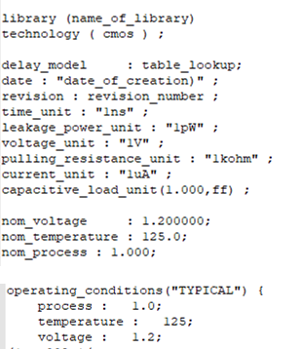
.Lib
Information common for all the standard cell
Library name and technology name
Units (of time, power, voltage, current, resistance and capacitance)
Value of operating condition ( process, voltage and temperature) – Max, Min and Typical

Slide 20
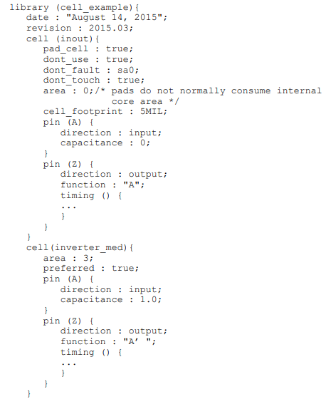
.Lib
Defining cell Groups
For each pin in a cell, the cell group must contain a description of the pin characteristics., always define pin characteristics in a pin group within the cell group.
A pin group often contains a timing group and an internal_power group.
• area: IO PAD area 0 or not define
• cell_footprint : use this attribute to assign the same footprint class to all cells that have the same layout boundary. Cells with the same footprint class are considered interchangeable and can be swapped during in-place optimization.
• clock_gating_integrated_cell : use for low power
• dont_touch
• dont_use
• preferred
• is_clock_gating_cell : use for low power
• is_macro_cell
• map_only
• pad_cell
• pad_type

Slide 21
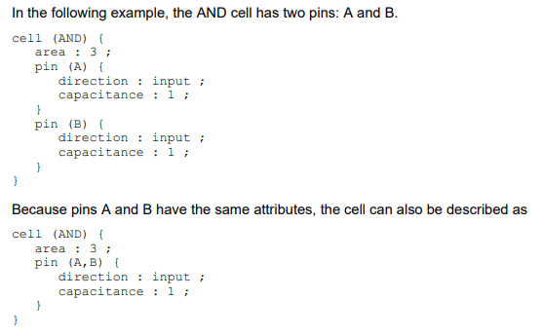
.Lib
Defining pin Groups
For each pin in a cell, the cell group must contain a description of the pin characteristics., always define pin characteristics in a pin group within the cell group.
A pin group often contains a timing group and an internal_power group.
• capacitance : defines the load of an input, output, inout, or internal pin, If the timing groups in a cell include the output-pin capacitance effect in the intrinsic-delay specification, do not specify capacitance values for the cell’s output pins.
• clock_gate_clock_pin : input pin connect to a clock signal
• clock_gate_enable_pin: input port connected to an enable signal for nonintegrated clock-gating cells and integrated clock-gating cells
• clock_gate_obs_pin
• clock_gate_out_pin
• clock_gate_test_pin
• direction : input, output, internal, or bidirectional pin
• function:
• driver_type :pull_up, pull_down, bus_hold, open_drain
• fall_capacitance
• fanout_load: 1
• is_analog : analog signal pin
• rise_capacitance
• max_transition min_transition
• max_capacitance: the maximum total capacitive load that an output pin can drive. This attribute can be specified only for an output or inout pin
• test_output_only

Slide 22
.Lib
Core cells
Sequential cells: Flip-Flop, Multi-bit Flip-Flop, Latch, Multi-bit latch
Test cells: scan cell, multi-bit scan cell
Timing arc: Delay Model , timing arc, constraints
Modeling Power and EM: switch activity, leakage power, internal power, switching power, Integrated Clock-gating Cells, EM
Advanced Low-Power Modeling: PG pin, level-shifter, isolation cell…
CCS modeling
Advanced CCS modeling
Nonlinear Signal Integrity Modeling
CCS power modeling
On-chip Variation(OCV) Modeling

Slide 23
03. CCSP

Slide 24
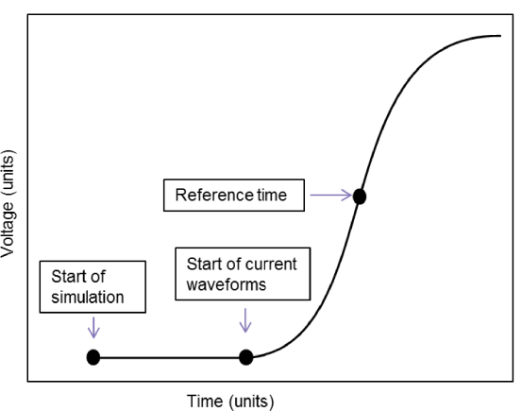
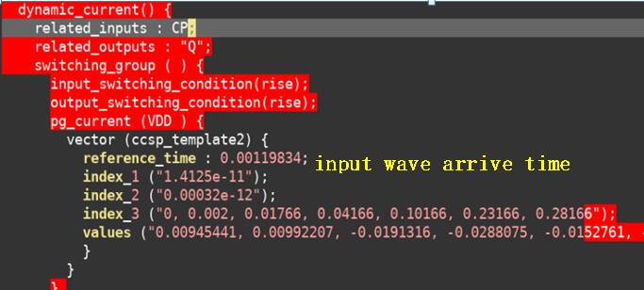
CCSP
Reference_time: the time at which input voltage characterization waveform crossed the input delay threshold, start time is the time at which the voltage transition on the input to the cell starts, always positive, otherwise, library compiler will issue an error

Slide 25
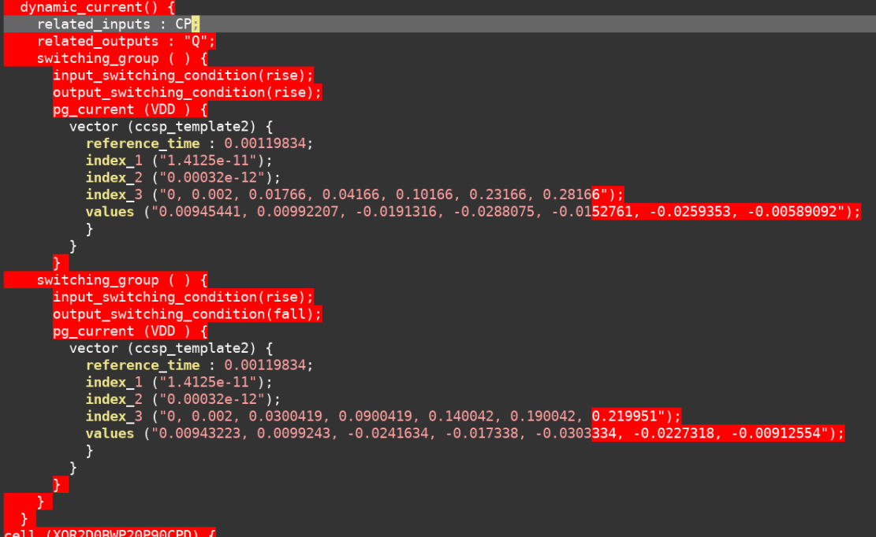
CCSP
Cell output(driver) pin switch, use ccsp_template2
Index1: input_trans(from twf)
Index2: output_load_cap(lump cap or effective cap)
Index3: time point, output pin switch time in vcd minus reference time
Values: current point
(internal current + switching current + leakage current）
First use pick up output_swtiching_condition then choose max current among all values from different input_switching_condition

Slide 26
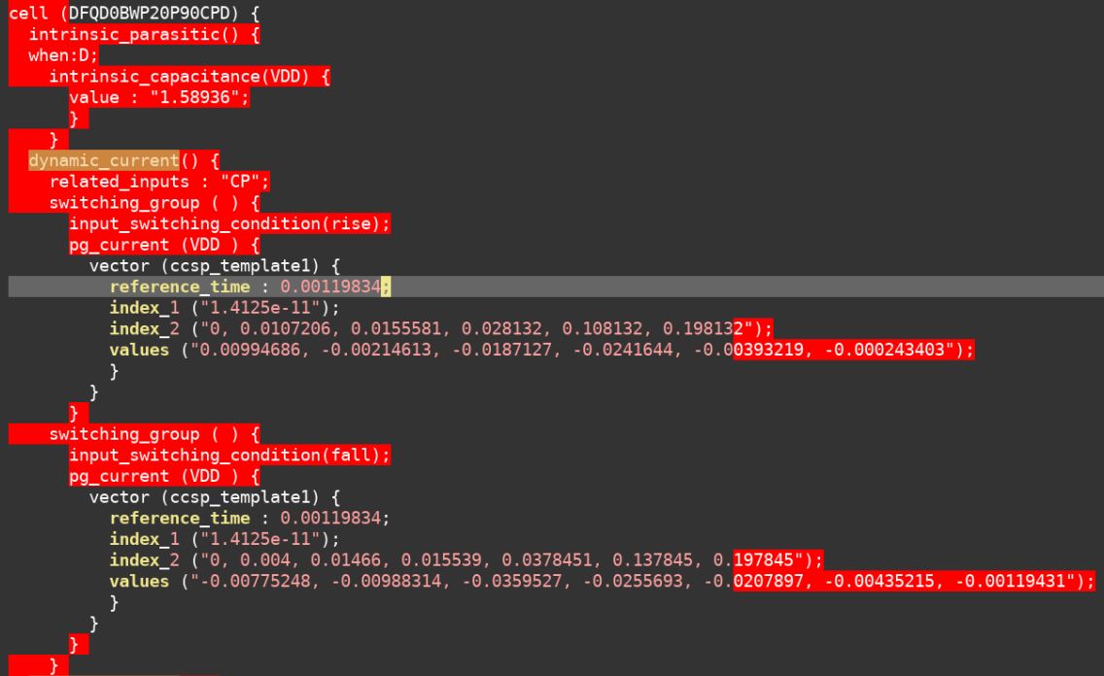
CCSP
Cell output(driver) pin do not switch, use ccsp_template1
Index1: input_trans(from twf, max or avg min_max|rise_fall)
Index2: time, cp pin switch time in vcd plus reference_time
Values: current(leakage current + internal current)

Slide 27
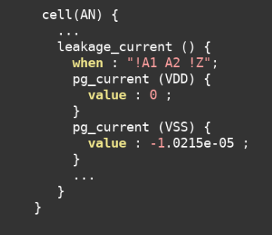
CCSP
Cell do not switch

Slide 28
THANK YOU
WWW.GIGA-DA.COM
电话：0755-61018899
邮箱：info@GIGA-DA.COM
邮编：518000

