Slide 1
PG wire parasitic extraction method

Slide 2
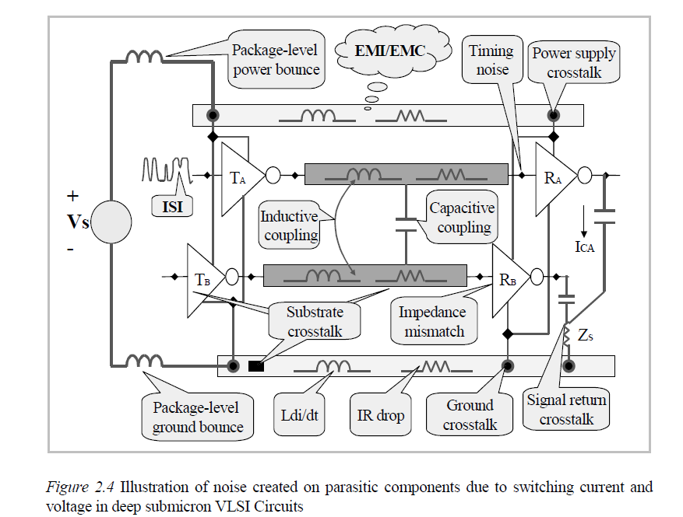
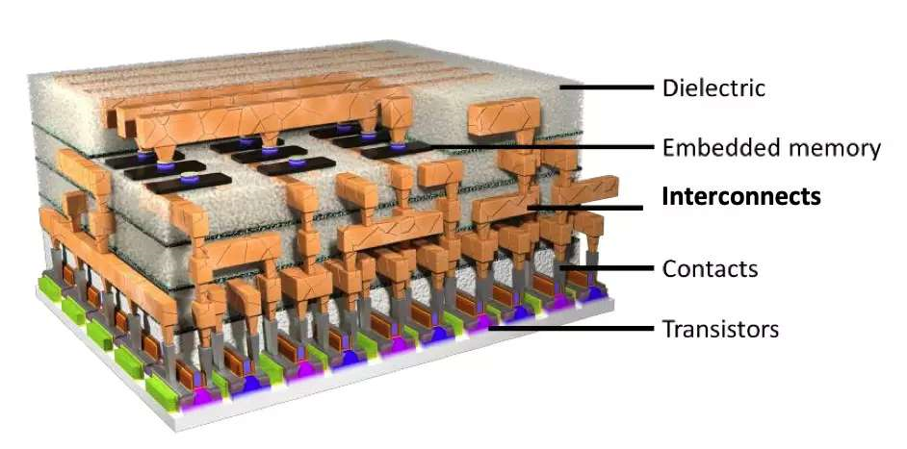
Interconnect and Its impact to IC
Metal (Al or Cu) wire/via as conductive path connecting functional elements (devices, gates, blocks, …)
Ideally does not affect design performance
Actually quit many impact to IC designs due to capacitive, resistive and inductive parasitics (RLC)
delay, SI, PI, power consumption
noise → circuit reliability

Slide 3
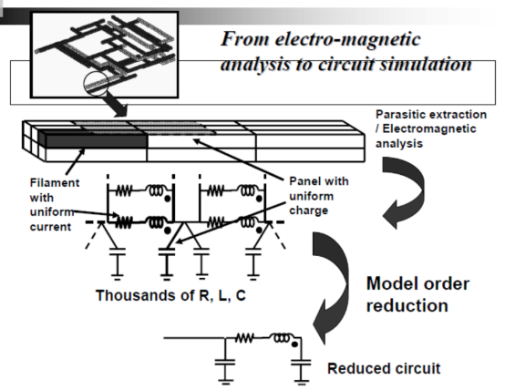
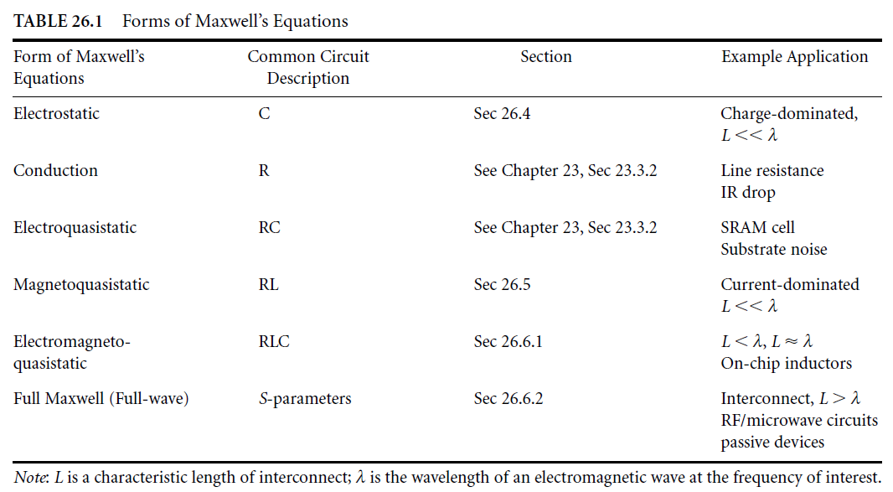
Interconnect and Its Modeling
Metal surrounded by COMPLEX dielectric materials
multi-dielectric layers
one or more conformal layers
S dependent ER (air gap)
Approximations from Maxwell’s equations.
Full wave：no assumption (PEEC，FastImp)
Electro-Magneto-Quasi-Static (EMQS): RLC (FastImp)
Magneto-Quasi-Static (MQS): RL (FastHenry, FastImp)
Electro-Quasi-Static(EQS): RC, no L (FastCap/FFTCap…)
Notes:
EMQS：忽略安培环路定律方程中的位移电流
MQS:
EQS：忽略法拉第电磁感应定律方程中磁通量变化
E/M 解耦

Slide 4
RC extraction at a glance
R extraction is straightforward (not 3D res for interconnect)
transistor-level may be complex (3D like): diffusion, FinFET gate
C extraction by solving electrostatic Poisson equation
$C=Q/V, C_{ij}={∂q_{i}}/{∂v_{j}}, q_{i}=\oint{\hat{n}dS∙\text{ε}E}$ (Gauss’ law)
$E=−∇_{r}φ\left(r\right)$
$∇_{}^{2}φ\left(r\right)=−\frac{ρ}{{ε_{r}ε}_{0}}$ (Poisson’s equation)
$∇_{}^{2}φ\left(r\right)=0 if no charge (Laplace^{′}s equation)$
Numerical solutions/classifications for cap extraction
Volume(differential form, discretization): FEM，FDM, etc. (RC3)
BEM(integral equation methods, GF): FastCap, HiCap, QBEM
Stochastic: Random walk (Monte Carlo）to solve integral equation
2D, 3D, quasi-3D (2.5D: 2D pattern matched in 3D environment)
FS: any tool that numerically solves some form of Maxwell’s Eq.’s
Academic tools
FastCap and other FS tools from MIT, RWCAP, HiCap, etc
Commercial tools
StarRC (Rapid3D), QuickCap, Raphael (RC2/RC3)
QRC (FS: BEM → random walk)
xRC (xACT 3D: HiCap)
…
Extraction Tools
accuracy
Foundry :
New features;
Certifications b/t TCAD and signoff tools;
PR vs Signoff?
EDA Vendor / Fabless CAD:
New features;
V2V/V2G
(PR vs Signoff)
TCAD (2D/3D)
TCAD-3D
SignOff-3D
SignOff-2.5D
P&R 2.5D
capacity/
typical applications
test structures
standard cells
blocks
full chip

Slide 5
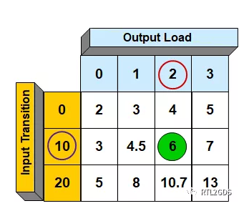
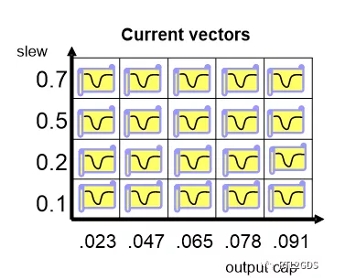
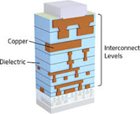
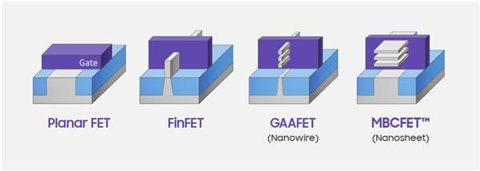
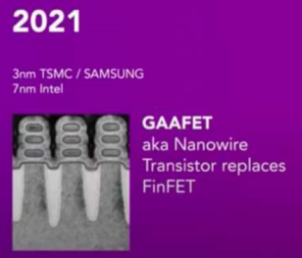
RC Extraction for Gate/Tx Level Designs
Gate level (interconnect + lib)
Extract RLC of interconnect outside of gate-level blocks
Huge design
Purse PCA (Performance, Capacity, Accuracy)
SMC (Simultaneous Multi Corners)
Partition based run
Distributed run
…
Built-in FS (Rapid3D) for selected nets or comparison (DP/MT)
Transistor level (BEOL + MEOL + FEOL）
Small or medium design
Cap: G-S (ex Cfi), G-D (ex Cfi), S-D, G-sub, G-UTC/LTC
device cap ignore behavior
Res: diffusion res network, multi-gate res model
New device support: Pillar, FinFET, GAA/MBC…
boundary definition/tuning b/t parasitic and device
Special requests from users (res body)
Built-in FS (Rapid3D) for select nets or comparison

Slide 6
Where are cap contributors?

Slide 7
cap 种类：
Load cap
Intrinsic cap
Intentional cap
PG cap

Slide 8
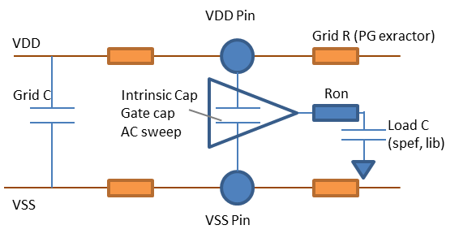
Load cap
就是计算switching power，sta时用的 load cap, 从spef, lib 中获得。
load cap 会以 0.5 倍折算到 IR 分析的 decap 中。
目前做correlation 主要以 1~ 1.5 倍计算 （以补全缺失的cap）

Slide 9
Intrinsic cap
就是PG pin间的cap。根据描述分为两种：
当cell翻转，那么intrinsic cap 无效
当cell不翻转，那么intrinsic cap生效
猜测：
如果bulk 接地，那么P导通时，等效电容应该略大于 LoadCap/2
Intrinsic cap + LoadCap/2

Slide 10
Intentional cap
特指k库后，识别出来的cap。有如下特征
Lpe 长得像std cell
PMOS和NMOS的gate/output分别接到 VDD/VSS，使得cell变成decap cell
最终cap是通过transistor 贡献出来的
如果没有k库的模型，那么 intentional cap 为0

Slide 11
PG cap
默认只看 PG routing 产生的电容
RK: BETWEEN Power and ground
VP: 里面是对地电容?
是否也可以通过设置下列参数考虑signal？
（需要确认行为）

