Slide 1
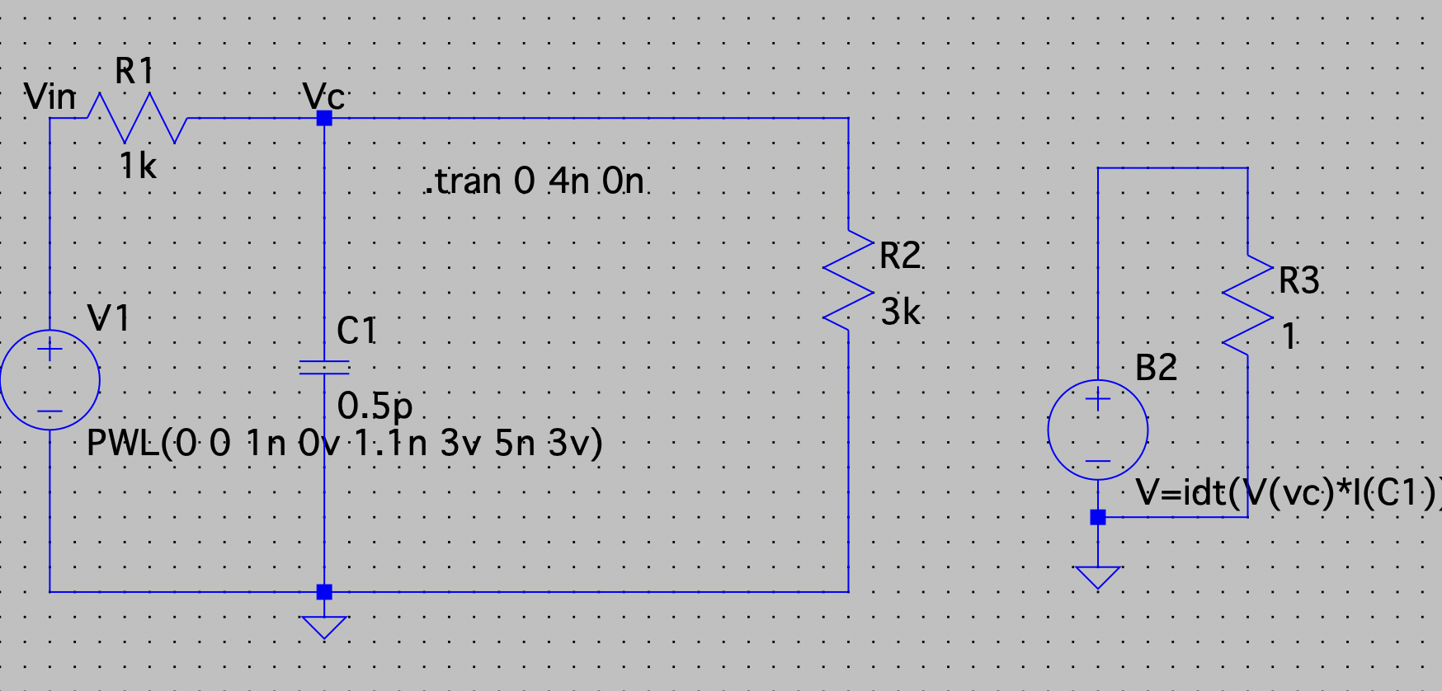

Slide 2
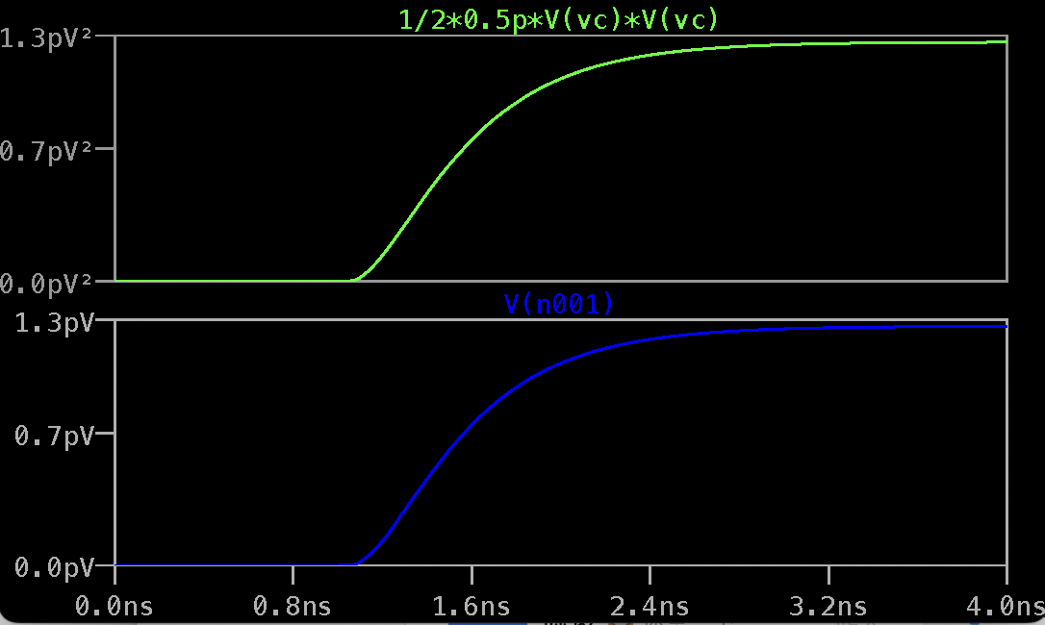
V(n001)=idt(V(vc)*I(C1))

