Slide 1
IncPIRD: Fast Learning-Based Prediction of Incremental IR Drop
Chia-Tung Ho and Andrew B. Kahng
CSE and ECE Departments, UC San Diego, La Jolla, CA, USA
Paper introduction by Jiaxiao Qin

Slide 2
Agenda
Background
IncPRID
Experiment Result
Conclusion

Slide 3
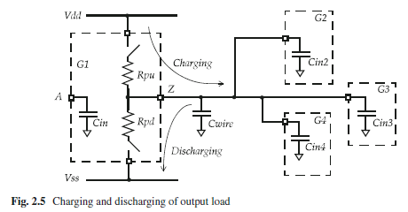
Background
When instance output is rising.
VDD will charge the load.
Cause VDD IR drop
I
t
VDD (IR drop)
t
(Power delivery network)
Similarly, if load is falling
Energy is dumping to VSS
Cause VSS IR baunce
VSS baunce
t

Slide 4
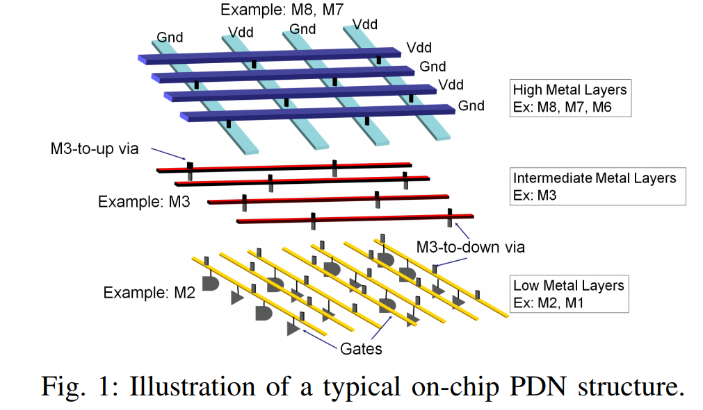
Why we need to care IR drop?
If too much IR drop,
Timing impact (slower)
Function error
Typically max 10% VDD
I
t
VDD (IR drop)
t

Slide 5
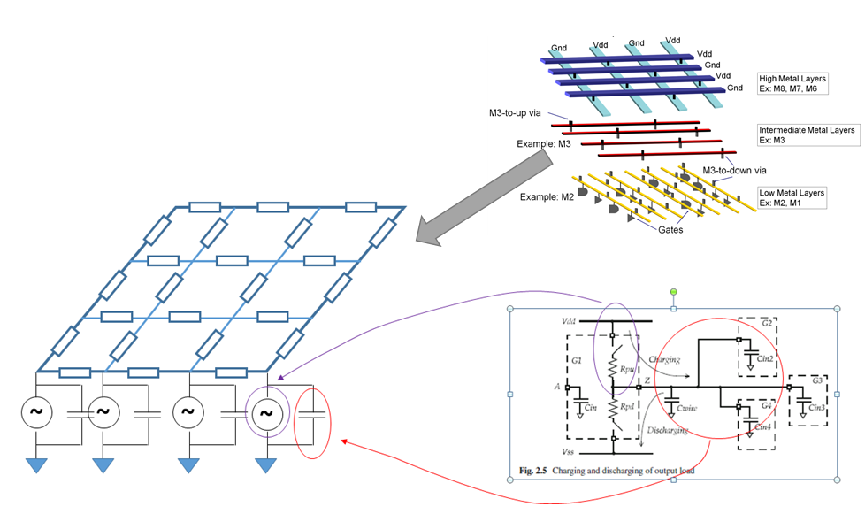
How to model IR drop
We need to solve a huge matrix!
Engineering changing order
Since numerous time-consuming iterations among PDN design, fast and accurate incremental IR prediction has emerged need.

Slide 6
IncPRID(Incremental Prediction of IR Drop)
IR drop report file;
Current distribution
Incremental modification by designer (macro/cell block movement or change ; modification of the PDN to have a denser grid; adding/moving power pad
Original design information (DEF, LEF; golden tool power pad file, GSR file, Technology file)
(Golden tool)
IncPRID
Model
Static IR drop of each power node that has tap current source attached

Slide 7
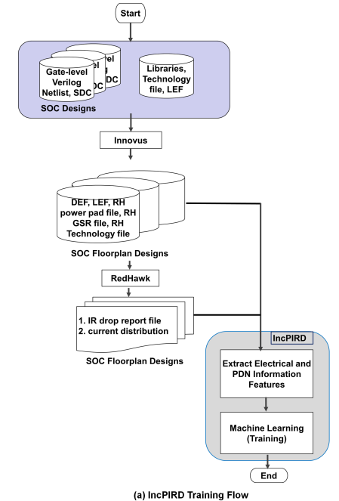
Training Flow
Use KVL, KCL, branch equations and
superposition to efficiently extract
relevant electrical features.
(Golden tool)
Use XGBoost as machine learning model

Slide 8
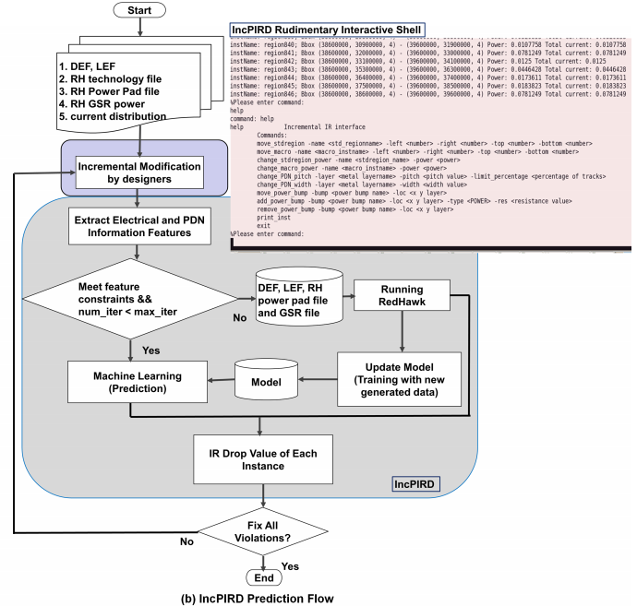
Prediction Flow
Constraints come from
robustness experiment, when
break the constrains, the error
would be large

Slide 9
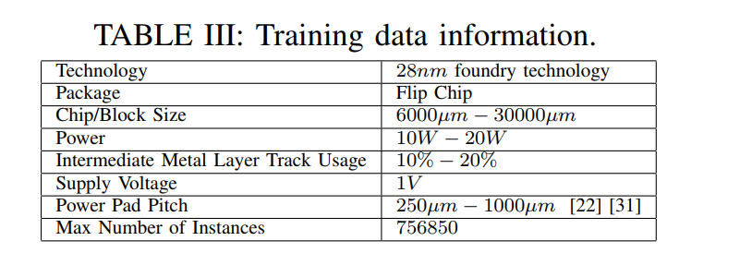
Experiment
Experimental Setup
In C++ with LEF/DEF reader/writer parsers
On a 2.6Ghz Intel Xeon Dual-CPU server with 256GB RAM
150 SOC floorplan designs(80% training data and 20% testing data)
RedHawk as golden tool

Slide 10
Experiment Result
Model accuracy experiment

Slide 11
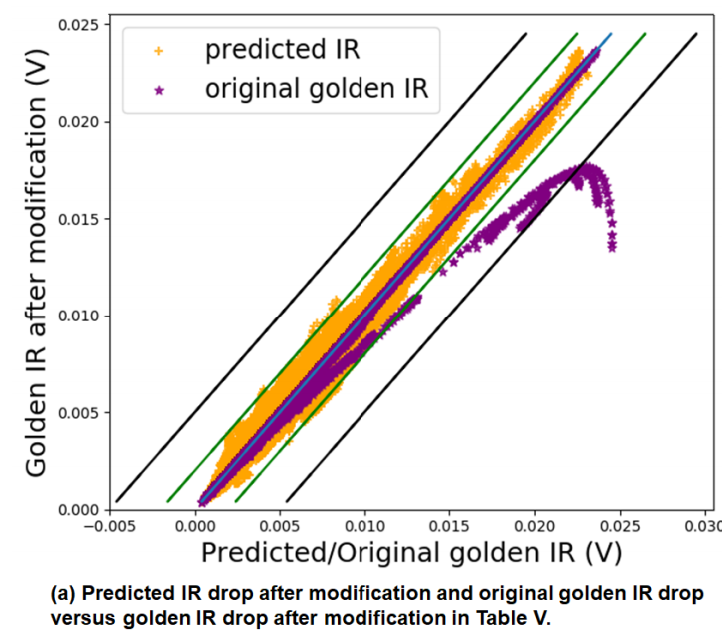
Experiment Result
Incremental IR Prediction experiment
Perform one incremental modification.
Separately perform modifications of macro and cell block, power pads, and intermediate metal layer track usage.

Slide 12
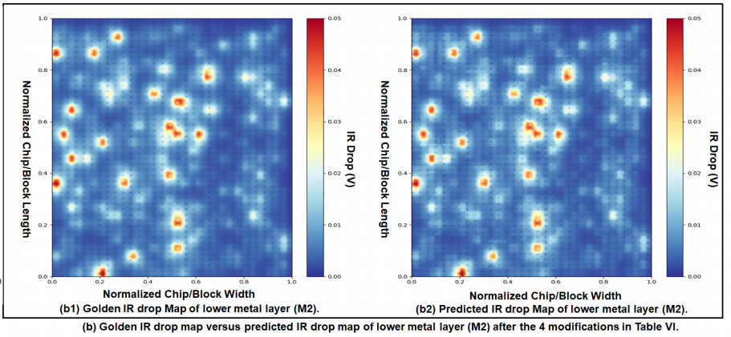
Experiment Result
Chain incremental modifications
(i) change the power of one cell
block from 10mW to 100mW,
(ii) move a macro,
(iii) add a power pad, and
(iv) use denser intermediate
metal layer

Slide 13
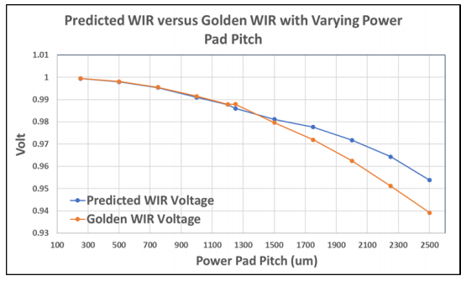
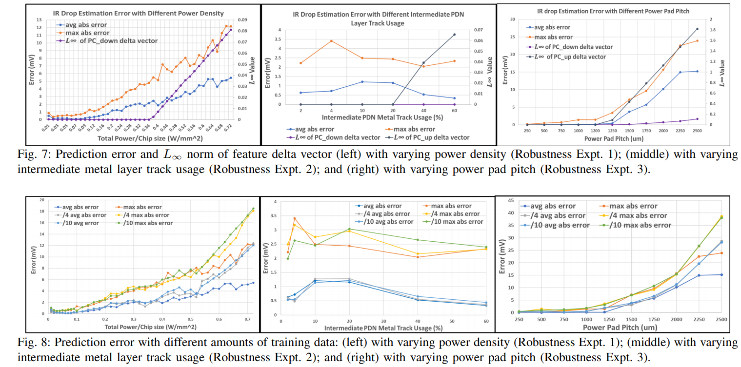
Experiment Result
Robustness of model

Slide 14
Experiment result
Model accuracy on different designs
To test the ability to predict IR drop in new designs without retraining model.
Most of the test designs with prediction error larger than 5mv do not satisfy the constraint1.

Slide 15
Conclusion
The approach can handle modifications of macro/cell block locations, PDN structure, and power pads and predict IR drop.
achieves 22-1000X speedup compared to RedHawk with average error less than 1mV and maximum error around 5mV.

Slide 16
Q&A

Slide 17
Thanks for listening!

