Slide 1
Accurate Estimation of Dynamic Timing Slacks using Event-Driven Simulation
Dimitrios Garyfallou*†, Ioannis Tsiokanos†, Nestor Evmorfopoulos*, Georgios Stamoulis*, and Georgios Karakonstantis
Paper introduction by Jicun Li

Slide 2
Agenda
Background
Proposed Solution
Experiment Result
Conclusion

Slide 3
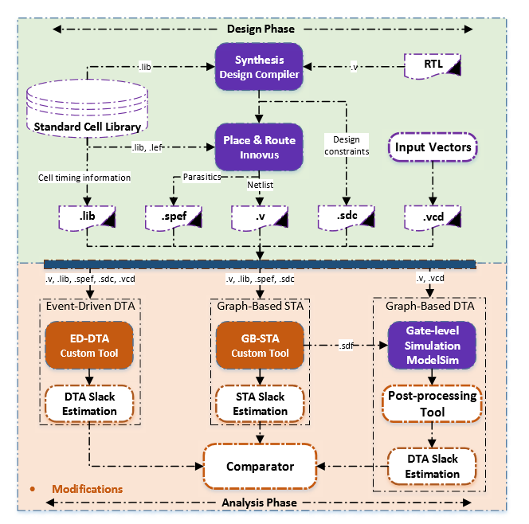
Background
1. Extensive static and dynamic parametric variations result in up-to 50% delay variations, Circuits prone to timing failures.
2. Timing margins(slack).
3. Statically estimation lead to lower frequency or at higher voltage.

Slide 4
statically based approach
Static Timing Analysis
Advantage:
Quickly revealing the most critical paths
Disadvantage:
Ignoring the data-dependent excitation of each path
Graph Based Dynamic Timing Analysis
Advantage:
Roughly 99% of critical paths are triggered by less than 10% of all operations and the chance to experience the worst-case input conditions and the upper slew bounds assumed by STA is very low
Disadvantage:
still assume ﬁxed, worst-case delays which are estimated by Graph Based Analysis (GBA).

Slide 5
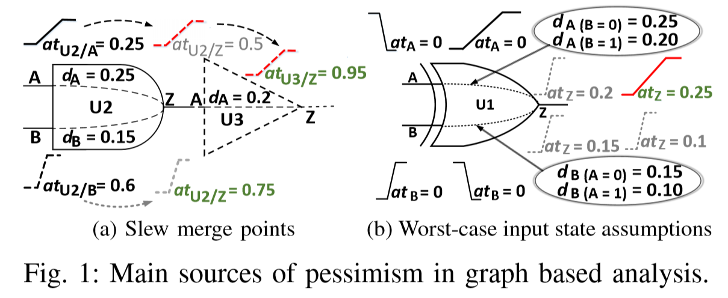
Graph Based Analysis
Slew merge points
Worse-case input state assumptions
Use figures, tables to explain!

Slide 6
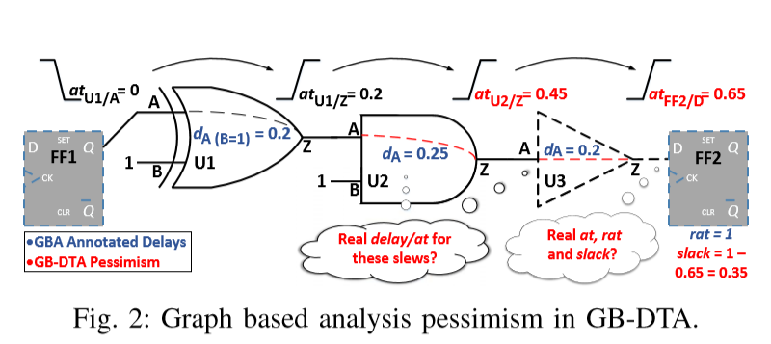
GB-DTA
Assuming
GB-DTA estimates the DTS

Slide 7
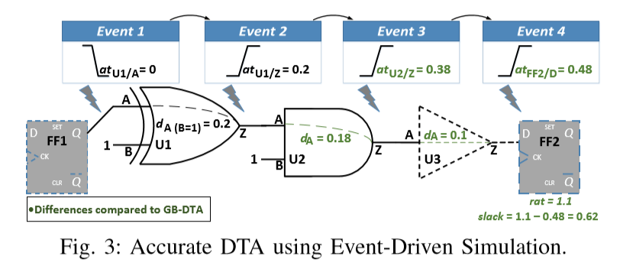
ED-DTA
The key idea behind the proposed method is that the slew and at of the generated event depend only on the triggering input events

Slide 8
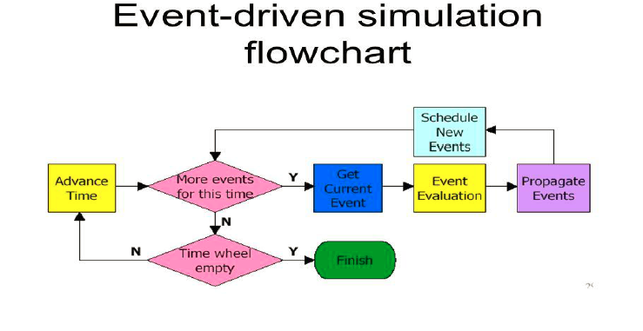
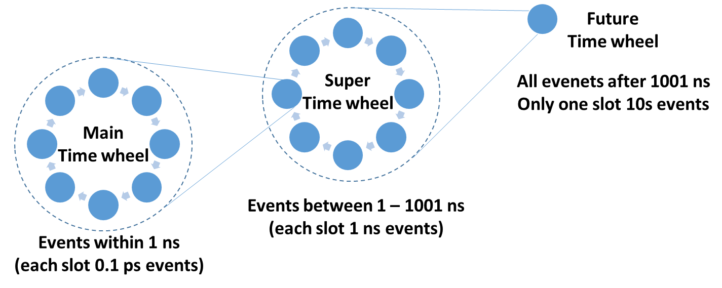
Simulation Structure Overview
event
event
Execute
Scuedule event
Fetch event
Execute event
Generate new event
Schedule new event
…

Slide 9
Experiment Result
1. DTS-GB is up-to 4.3× bigger than the average STS-GB.
2. The average AE-DTA ranges up-to 0.049ns, while the maximum (max) AE-DTA observed is equal to 0.158ns.
3. Overall, the proposed ED-DTA reveals on average 2.35% more DTS than GB-DTA

Slide 10
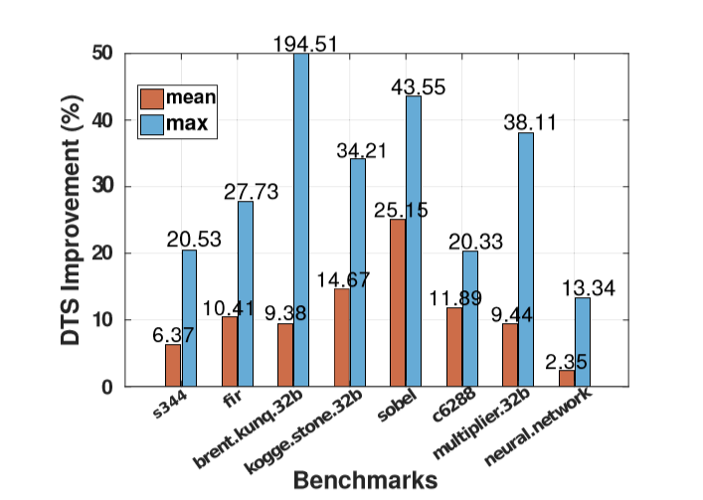
Experiment Result
we extract the top 5% critical activated paths (5% of the activated paths with the smallest slack). We observe that the average DTSimp. has been increased to 11.2%.

Slide 11
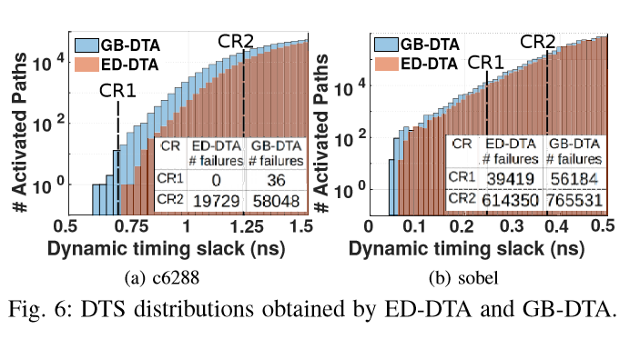
Experiment Result
1. ED-DTA results in 1.89% on average and up-to 6.22% higher clock frequency than GB-DTA
2. GB-DTA results in 2.94× more failures than ED-DTA

Slide 12
Conclusion
ED-DTA approach unveils 2.35% on average and up-to 194.51% more DTS, compared to GB-DTA.
2. When only the critical activated paths are considered, the average DTS improvement is increased to 11.2%.
3. Increase of the clock frequency by up-to 10.42% compared to existing frequency scaling schemes
4. Reveals that timing failures can be up-to 2.94× less than the ones estimated by existing failure estimation techniques

Slide 13
Conclusion

Slide 14
Q & A

