Slide 1
Usage of Makefile
JiaXiao Qin
2020/08/26

Slide 2
contents
What is makefile
Why we need makefile
How to use makefile

Slide 3
What is makefile
Some basic knowledge in program
Compiling
Processing the source code files(.c, .cc, or .cpp) and create ‘object’ file. This step doesn’t create anything that user can actually run. If you compile three separate files, you will have three object files as output.
Linking
Linking refers to creation of a single executable file from multiple object files.

Slide 4
What is makefile
E.g. Assume we have following source files:
function1.cpp
function2.cpp
functions.h
main.cpp
>>gcc –c function1.cpp
>>gcc –c function2.cpp
>>gcc –c main.cpp
>>gcc –o hello function1.o function2.o main.o
Besides, we can use makefile to accomplish the step.(Giga also use makefile!)

Slide 5
What is makefile
A makefile is used with the “make” utility to determine which portions of a program to compile. A makefile is basically a script that guides the “make” utility to choose the appropriate program files that are to be compiled and linked together.

Slide 6
Why we need makefile
Compling the source code files can be tiring, especially when you have to include several source files and type the compiling command every time you need to compile.
Makefiles are the solution to simplify this task

Slide 7
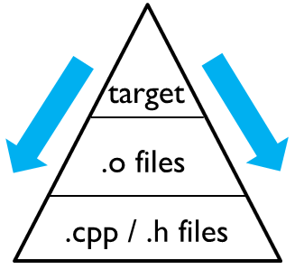
How to use makefile
Basic rules:
target … : prerequisites…
command
Target: a target file, can be object file, executable file, even a Lable.
Prerequisites: the files which are required to create target.
Command: the command “make” needs to run

Slide 8
How to use makefile
Instance:
Assume we have a program, which has 3 .h files and 8 .cpp files. The makefile should be like:
edit : main.o kbd.o command.o display.o\
insert.o search.o files.o utils.o
gcc –o edit main.o kbd.o command.o display.o\
insert.o search.o files.o utils.o

Slide 9
How to use makefile
main.o : main.c defs.h gcc -c main.c kbd.o : kbd.c defs.h command.h gcc -c kbd.c command.o : command.c defs.h command.h gcc -c command.c display.o : display.c defs.h buffer.h gcc -c display.c insert.o : insert.c defs.h buffer.h gcc -c insert.c search.o : search.c defs.h buffer.h gcc -c search.c files.o : files.c defs.h buffer.h command.h gcc -c files.c utils.o : utils.c defs.h gcc -c utils.c

Slide 10
Simple test
Use both methods to create executable file.
You can find the source code in the path below, copy them to your own directory:
/home/stor20d2p1/jxqin/first_try/makefile_test

Slide 11
Special characters
$^ : represents all the prerequisites, separated by space.
$@ :represents the target file.
$< : represents the first prerequisites file.
$? : represents the prerequisites files which are updated
Etc.

Slide 12
Some advanced function
Phony target(like “clean”)
Using variables
Working with several directories
List of corresponding files
Etc.
Here you can find some explanations and examples:
https://www.tutorialspoint.com/makefile/index.htm

Slide 13
Thanks for listening!

