Slide 1
show_emir_correlatin_result Intro Siqi

Slide 2
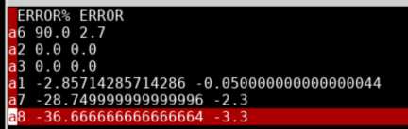
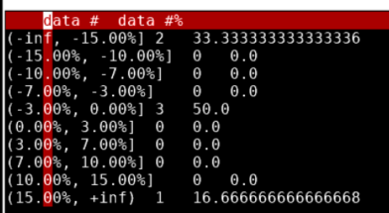
Basic Intro
show_emir_correlation_result
  This cmd is meant to parse ref tool result report and VP result report, to dump correlation results
  Will get:
    HTML and csv file of error (w/ abs & rel error)list, from biggest positive abs error to biggest negative abs error
    HTML and csv file of error distribution range

Slide 3
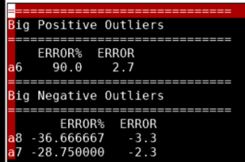
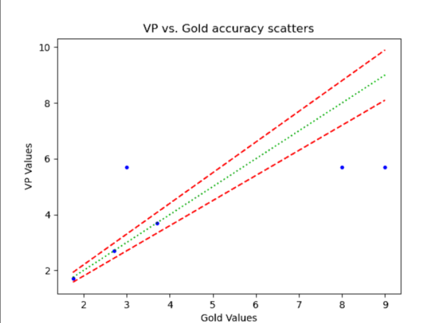
Basic Intro
show_emir_correlation_result
  Will get:
    HTML and csv file of 10 biggest positive outliers & 10 biggest negative outliers
    Scatter plot if enabled

Slide 4
Input param
Required param:
  -test_file {test_file_path}
  -ref_file {refer_file_path}
  -test_index_name {string}: name of column w/ index name in test file
    Or –test_index_num {int}: column number for index name column
  -test_value_name {string}: name of column w/ data in test file
    Or –test_value_num {int}: column number for data column
  -ref_index_name {string}: name of column w/ index name in ref file
    Or –ref_index_num {int}: column number for index name column
  -ref_value_name {string}: name of column w/ data in ref file
    Or –ref_value_num {int}: column number for data column

Slide 5
Input param
Optional param:
  -test_scale {float}: scale value for test data. Default 1.0
  -ref_scale {float}: scale value for ref data. Default 1.0
  -output_prefix {string}: prefix name for output files. Default is cor_result_
  -stop_filter_diff: stop filtering out lines with different names
  -distribute_range “-20,-10,0,10,20”: distribution range by percent
  Plot related:
    -plot_scatter: enable scatter plot generation
    -plot_test_scale {float}: test data scale for plot. Default 1.0
    -plot_ref_scale {float}: ref data scale for plot. Default 1.0
    -plot_abs_tol {float}: abs tolerance for small values when plotting. Default 0.01
    -plot_rel_tol {float}: rel tolerance for small values when plotting. Default 0.1
    -plot_tol_boundary {float}: abs/rel tolerance boundary based on gold data when plotting. Default 0.1
    -plot_transparent_scale {float}: transparent scale for points in scatter plot. Range from 0 to 1. Default is 0.5. The smaller the value is, the more different the colors are

Slide 6
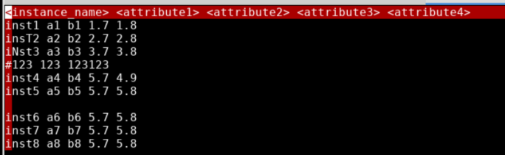
Test & Ref data file format

Slide 7
Note
Notes
  Must set “-test_index_name”& “-test_value_name” at the same time, or “-test_index_num”and “-test_value_num” at the same time.
  So it is same as “-ref_index_XX” and “-ref_value_XX”
  For some data, like IR drop report got by report_misc, wee need to first deal with drop, to get what is actually needed for correlation check, and then run show_emir_correlation_result

