Slide 1
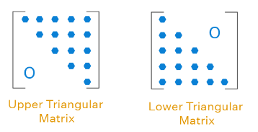
A triangular matrix is a square matrix in which elements below and/or above the diagonal are all zeros. We have mainly two types of triangular matrices.
An n × n square matrix A = [a_{ij}] is said to be an upper triangular matrix if and only if a_{ij} = 0, for all i > j.
An n × n square matrix A = [a_{ij}] is said to be a lower triangular matrix if and only if a_{ij} = 0, for all i < j.

Slide 2
Gaussian elimination is a method in which an augmented matrix is subjected to row operations until the component corresponding to the coefficient matrix is reduced to triangular form.
After we have obtained our triangular matrix, there are two different approaches we can use to solve a system of linear equations:
Forward substitution
Back substitution
PA = L U Ax = b => LUx = b
=> Ly = b , y = Ux
=> y = L’b forward substitution, y = Ux
=> x = U’y back substitution
MNA modified nodal analysis, by lpwang
http://10.30.200.21:8088/projects/hongtu-emir/wiki/Python_Coding_Template
code:/scratch02/rnd/dpzhang/tiny/solver.py

Slide 3
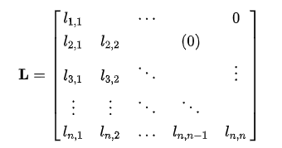
Forward substitution
The procedure of solving a system of linear algebraic equations (SLAE) with a lower triangular coefficient matrix is known as forward substitution. Solving an SLAE with a triangular matrix form is a variant of the generic substitution approach.
Equation Lx=b
L represents the factor of the matrix of the lower triangle.
x represents the variable of matrix.
b is the result vector.
L = l_{11 (1x1)} , l_{21((n-1)x1)} , L_{22((n-1)x(n-1))}
x = x_{1 (1x1)} , x_{2((n-1)x1)}
b = b_{1 (1x1)} , b_{2((n-1)x1)}
l₁₁ | 0
l₂₁ | L₂₂
x₁
x₂
b₁
b₂

Slide 4
Lx=b => X =
=> l₁₁ x₁ = b₁
l₂₁ x₁ + L₂₂ x₂ = b₂
=> x₁ = b₁ / l₁₁
=> L₂₂ x₂ = b₂ - l₂₁b₁ / l₁₁ , a new lower triangular system, can be solved recursively for x₂ , and will get x₁, x₂ -> x_{n}
Pseudocode:
x = b
for j = 0 to n – 1 do
x_{j} = x_{j} /l_{jj}
for each i > j for which l_{ij} ≠ 0 do
x_{i} = x_{i} - l_{ij} x_{j}
l₁₁ | 0
l₂₁ | L₂₂
x₁
x₂
b₁
b₂

Slide 5
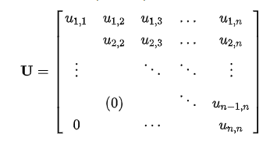
Back substitution
The procedure of solving an SLAE with an upper triangular coefficient matrix is known as back substitution.
Equation Ux=b
U represents the factor of matrix of upper triangle.
x represents the variable of matrix.
b is the result vector.
U = U_{11 ((n-1)x(n-1))} , u_{21((n-1)x1)} , u_{22 (1x1)}
x = x_{1 ((n-1)x1)}, x_{2 (1x1)}
b = b_{1 ((n-1)x1)}, b_{2 (1x1)}
U₁₁ | u₂₁
0 | u₂₂
x₁
x₂
b₁
b₂

Slide 6
Ux=b => X =
=> U₂₂ x₁ + u₂₁ x₂ = b₁
u₂₂ x₂ = b₂
=> x₂ = b₂ / u₂₂
=> U₁₁ x₁ = b₁ - u₂₁b₂ / u₂₂ , a new lower triangular system, can be solved recursively for x_{1,} and will get x_{n}, x_{n-1} -> x₁
Pseudocode:
x = b
for j = n -1 to 0 do
x_{j} = x_{j} / u_{jj}
for each i < j for which u_{ij} ≠ 0 do
x_{i} = x_{i} - u_{ij} x_{j}
U₁₁ | u₂₁
0 | u₂₂
x₁
x₂
b₁
b₂

Slide 7
Thanks!

