Slide 1
消去树和后序遍历树 Elimination Tree & Postordering a tree
王佳敏
2023-09-19

Slide 2
Cholesky Factorization
A=L’*L
Entries in L that do not appear in A are called fill-in;
The undirected graph of L+L^T is denoted as

Slide 3
Numerical Cholesky Factorization
3 steps;
Recursively
Sparse triangular solve
Sparse dot product
And a square root
Up-looking method;

Slide 4
Sparse triangular solve
The nonzero pattern
G_{k-1} is the directed graph of L_{11};
A_{k} is the nonzero pattern of upper triangular part of the k–th column of A ;
L_{k} is the nonzero pattern of k-th column of L;

Slide 5
Suppose that i<j<k

Slide 6
The path from I to j via k does not traverse the edge (I,k), the edge (I,k) is not needed to compute ;
The removal of these edges leaves at most one out-going from node I;
This leads to the elimination tree;

Slide 7
Elimination Tree
Definition: the parent of node i in the tree is j, the first off-diagonal nonzero in column I has row index j；
Theorem(Liu) the nonzero pattern of L_k of the k-th row is given by

Slide 8
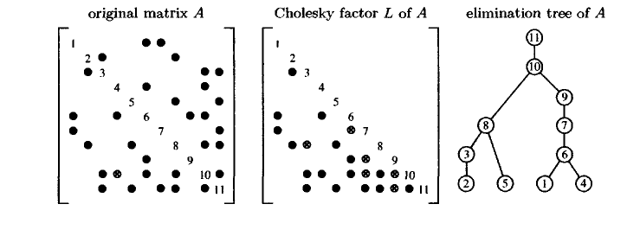
An Example
The total tree can be assembled from the subtrees

Slide 9
Postordering a tree
It is required for computing the nnz in each column of L;
Nnz unchanged but its pattern will be more structured;
Theorem(Liu) the filled graphs of A and PAP^T are isomorphic if P is a postordering of the elimination tree of A;

Slide 10
The d descendants of a node k are numbered k-d –k-1;
Posterordering preserves the relative ordering of the children;

Slide 11
Row Counts
Five concepts
The least common ancestor of two nodes
Path decomposition
The first descendant
The level of a node
Skeleton matrix

Slide 12
Skeleton matrix and subtrees

Slide 13
Path decomposition of T^11 from Fig4.4

Slide 14
An Example(1)
L_61

Slide 15
An Example(2)
L_32

Slide 16
An Example(3)
L_83

Slide 17
An Example(4)
L_64

Slide 18
An Example(5)
L_85

Slide 19
An Example(6)
L_76

Slide 20
An Example(7’)
计算T_9,假定已经计算出T_8
9是6的祖先，6在T_8的祖先是7，连接7→9

Slide 21
An Example(7)
L_97

Slide 22
An Example(8)
L_10,8

Slide 23
An Example(9)
L_60,9

Slide 24
An Example(10)
L_11,10

Slide 25
Reference
Direct methods for sparse linear systems, T. A. Davis, SIAM, Philadelphia, 2006.
Matlab help document(etree).

