Slide 1
Multi Threading

Slide 2
Python multi threading
Thread
Multiprocessing
2. Test demo
3. Confusion
GIL
Why so fast， replace numpy.dot
4.Solution:
How to cut matrix more reasonable （load balancing， thread communicate）
1 | 1 | 1 | 1 | 1 | 1
1 | 1 | 1 | 1 | 1 | 1
1 | 1 | 1 | 1 | 1 | 1
1 | 1 | 1 | 1 | 1 | 1
1 | 1 | 1 | 1 | 1 | 1
1 | 1 | 1 | 1 | 1 | 1
6/2 = 3 = step
start =0
For I in 2:
stop = 0+3
start = stop

Slide 4
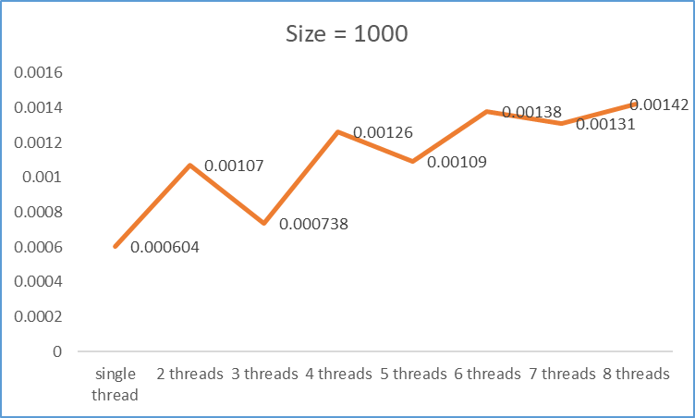
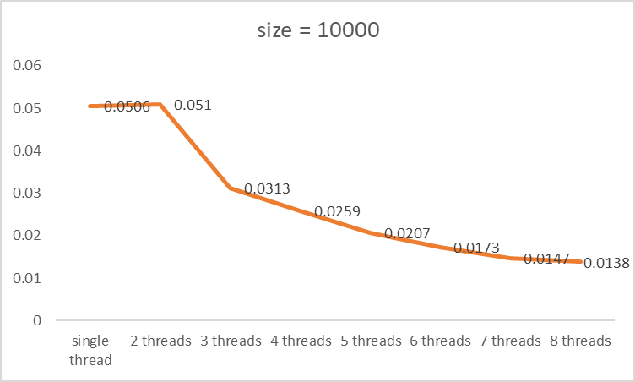
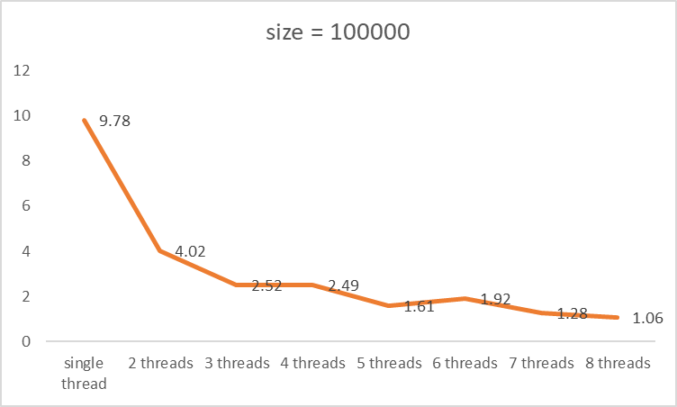
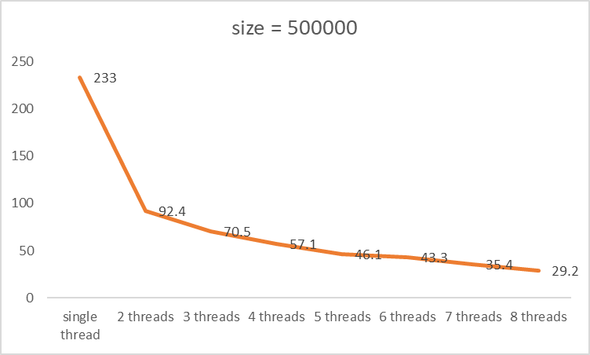
Advantages:
1.Data sharing
2.Low mem consumption
No speed up

Slide 6
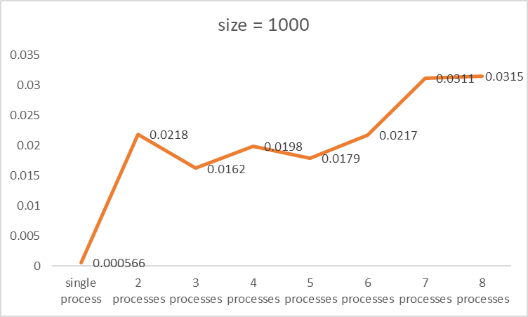
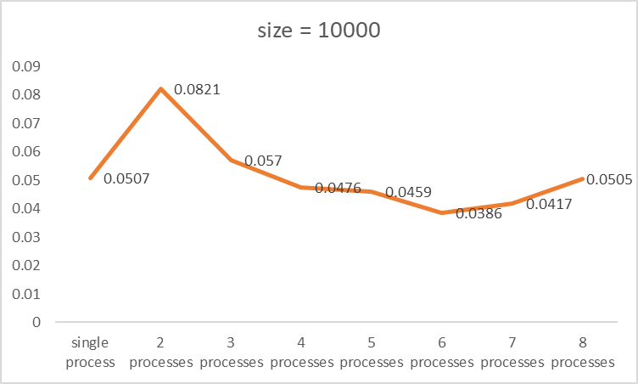
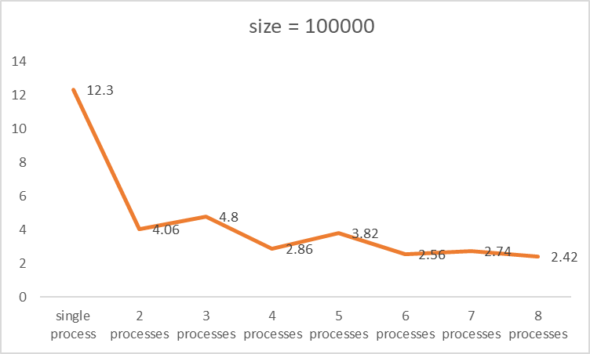
No speed up
Advantages:
1.Data independent
Disadvantages:
1.High mem consumption
Notes:
Difference:
threading和multiprocessing的区别threading是开启线程，只有一个进程，并且线程间共享数据正常，但是在多核CPU电脑运行时并没有真正并行。
multiprocessing是开启进程，多个进程，并且共享数据失败(进程共享数据)，而且在多核CPU电脑上能实现真正的并行运行

