Slide 1
Multi Threading

Slide 2
First share
Python multi threading
Thread
Multiprocessing
2. Test demo
3. Confusion
GIL
Why so fast， replace numpy.dot
4.Solution:
How to cut matrix more reasonable （load balancing， thread communicate）
1 | 1 | 1 | 1 | 1 | 1
1 | 1 | 1 | 1 | 1 | 1
1 | 1 | 1 | 1 | 1 | 1
1 | 1 | 1 | 1 | 1 | 1
1 | 1 | 1 | 1 | 1 | 1
1 | 1 | 1 | 1 | 1 | 1
6/2 = 3 = step
start =0
For i in 2:
stop = 0+3
start = stop

Slide 4
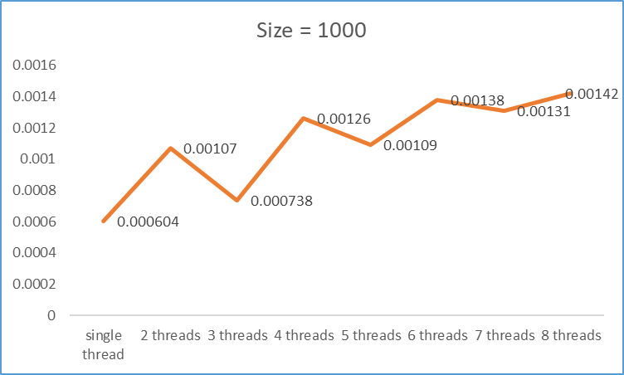
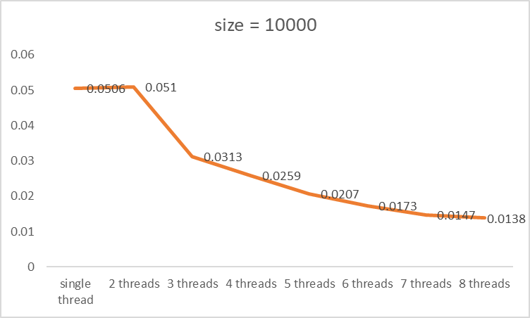
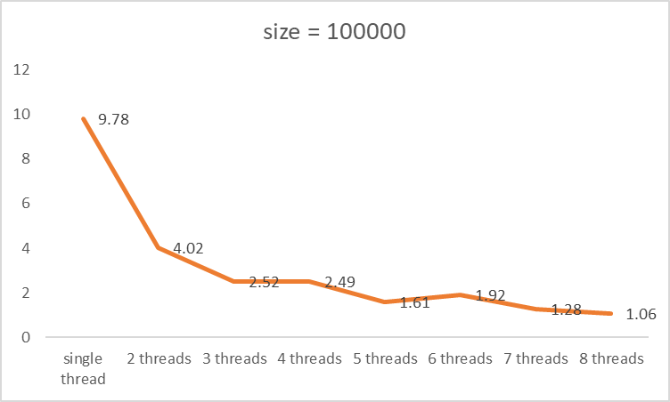
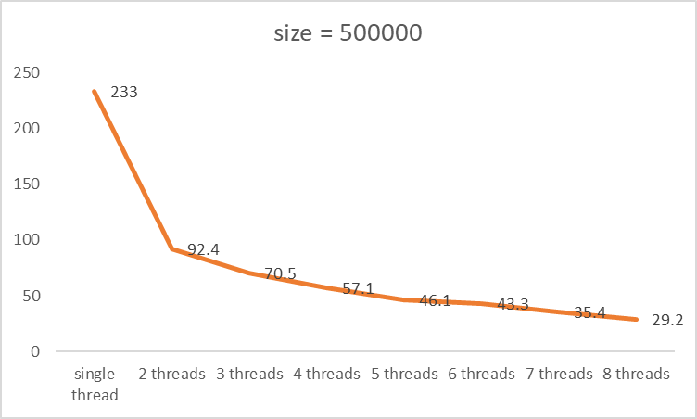
Advantages:
1.Data sharing
2.Low mem consumption
No speed up

Slide 6
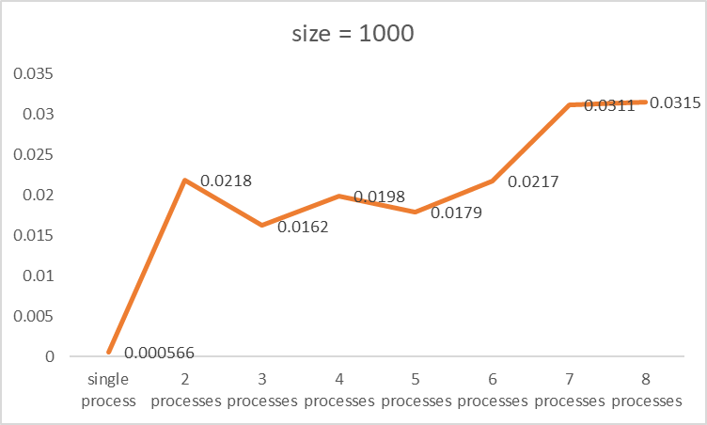
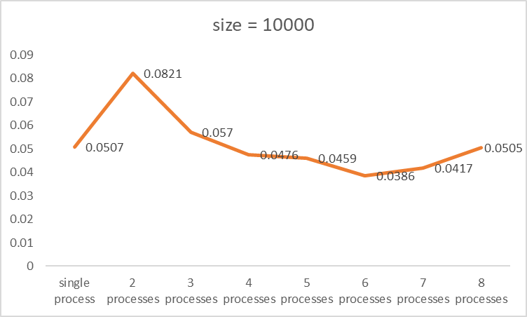
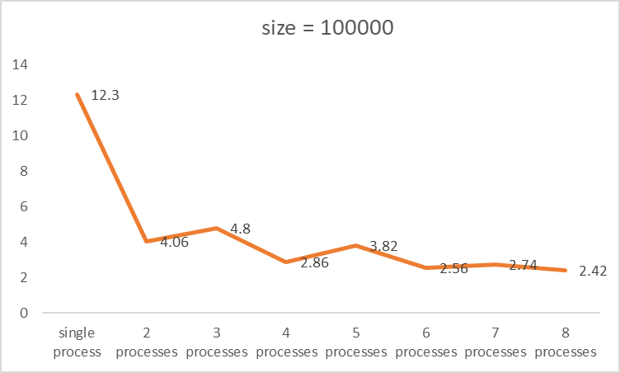
No speed up
Advantages:
1.Data independent
Disadvantages:
1.High mem consumption
Notes:
Difference:
threading和multiprocessing的区别threading是开启线程，只有一个进程，并且线程间共享数据正常，但是在多核CPU电脑运行时并没有真正并行。
multiprocessing是开启进程，多个进程，并且共享数据失败(进程共享数据)，而且在多核CPU电脑上能实现真正的并行运行

Slide 7
Second share
In this section, I replace numpy.dot by for. I can get the following conclusion:
Threading would not speed up for GIL.
Multiprocessing would speed up.
Numpy would bypass GIL for calculation operation is realized by c++.
GIL would be realized when process IO intensive operation.
Confusion：
Gevent (coroutine)
How to count all time and cpu time
Replace python for by c++ for.
Based on third point to use openmp
How to use GPU

Slide 8
Third share
Greenlet
Gevent
Matrix
Cpu time and wall time
Notes:
gevent是coroutine(大部分翻译为: 协程)，基于Python的（networking library）网络库这个库使用了greenlet。gevent提供了在libev和libuv（event loop）事件循环之上的一个high-level的同步API
1Python中GIL的存在，导致多线程一直不是很好用，相形之下，协程的优势就更加突出了。
2Gevent的基本思想是：当遇到IO操作时，会自动写换到其他gevent，再在适当的时间切回来继续执行。这样就减少了IO操作时的等待耗时，从而能够提高硬件资源的利用率。

Slide 9
Third share
In this section, we will introduce what is gevent (coroutine)?
Offical definitin :
  gevent is a coroutine -based Python networking library that uses greenlet to provide a high-level synchronous API on top of the libev or libuv event loop. (greenlet_demo.py)
  Adavatages: 1 可以方便控制输出 2 避免在IO操作浪费时间
  Question : 对于IO 密集型操作会阻塞，切换到别的任务，需要用另一个线程的协程来接管这个任务吗 , epoll, go, IO accelerate demo
What is the difference between gevent and greenlet.
  gevent_demo.py
  For gevent, it will automatic scheduling of incomplete coroutines while greenlet would not.
  Greenlet 只支持非阻塞的
why we need it?
Due to GIL, threading is not very user-friendly.
When an IO operation is encountered, it automatically writes to another gevent and then cuts back to continue execution at the appropriate time. This reduces the waiting time for IO operations and improves the utilization of hardware resources.
Notes:
gevent是coroutine(大部分翻译为: 协程)，基于Python的（networking library）网络库这个库使用了greenlet。gevent提供了在libev和libuv（event loop）事件循环之上的一个high-level的同步API
1Python中GIL的存在，导致多线程一直不是很好用，相形之下，协程的优势就更加突出了。
2Gevent的基本思想是：当遇到IO操作时，会自动写换到其他gevent，再在适当的时间切回来继续执行。这样就减少了IO操作时的等待耗时，从而能够提高硬件资源的利用率。

Slide 10
Third share
How do I collect cpu time statistics?
Function: time.process_time()

Slide 11
Third share
Notes:
调用起多线程的任务的时间

Slide 12
Definition
Theory introduction
Demo result analysis
Notes:
调用起多线程的任务的时间
CPU执行时间=程序所含时钟周期数/时钟频率 =程序所含时钟周期数*时钟周期 程序总时钟周期数=程序所含指令条数*CPI =Σ（CPI * 条数） 由于以上两个公式可以得出： CPU执行时间=CPI * 程序总执令条数 * 时钟周期

Slide 13
Third share
Definition:
  Wall time : Real word time, (what the clock on the wall shows).
  CPU time : The real running time of a program.
Notes:
调用起多线程的任务的时间
CPU执行时间=程序所含时钟周期数/时钟频率 =程序所含时钟周期数*时钟周期 程序总时钟周期数=程序所含指令条数*CPI =Σ（CPI * 条数） 由于以上两个公式可以得出： CPU执行时间=CPI * 程序总执令条数 * 时钟周期

Slide 14
Thread
Parallel time
Serial time
Thread 1
P/3
S
Thread 2
P/3
Thread 3
P/3
Three thread Wall time = P/3 + S
Single wall time = P +S
Three thread CPU time = P/3 + P/3 + P/3 + S
Theoretical acceleration ratio = (P + S) / (P/3 + S) < 3
Notes:
按照最优条件，所有线程都一起开始，不考虑IO和阻塞
Wall time : 程序从计算开始到计算 结束的时间（真实时间）
Cpu time: cpu 做计算的时间

Slide 15
The time each thread waits to acquire a lock
Parallel time
Serial time
Thread 1
P/3
L
S
B
Thread 2
P/3
L
Thread 3
P/3
L
Blocked
Wall time = P/3 + L + S + B
Three thread CPU time = P/3 + L + P/3 + L + P/3 + L + S
Theoretical acceleration ratio (TAR) = (P + S + B) / (P/3 + L + S + B )
Increase TAR
Decrease TAR
Notes:
这里我们假设串行的任务是IO操作，考虑阻塞.
尽可能地减少程序的串行部分来提高理论加速比的上限，使用不需要同步的算法来提高并行部分的效率。如下图所示，通过改进最终达到理想的加速比。

