Slide 1
GIGA
TWF
FORMAT

Slide 2
Background
We use twf to annotate timing result
Twf is used to report timing, ir, power
Many twf formats
R**k
P**t
Celtic (Now we are using)
We need to define new twf with
min change effort
twf
sdc
.lib, def, lef, db..
AG, VP, CHT
Timing report
IR analysis
Power analysis

Slide 3
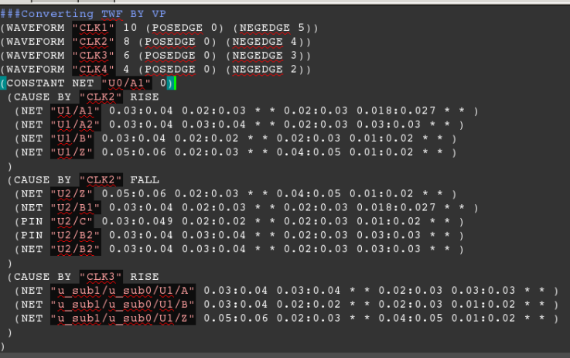
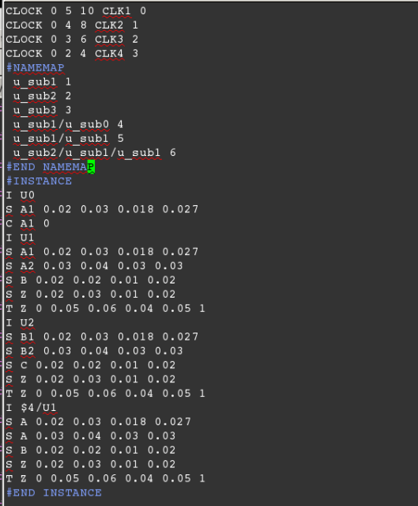
Celtic twf format
R**K format
Inst. name
Slew of B pin
Transition
R**k has mapping section, cell, net name is replaced by mapping id (save disk)
R**k also use index to map clock name
R**K is pin based, C**t is net based

Slide 4
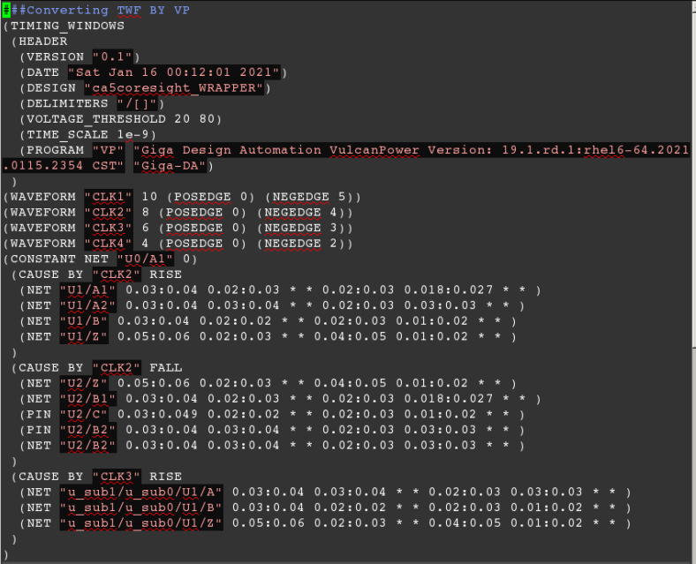
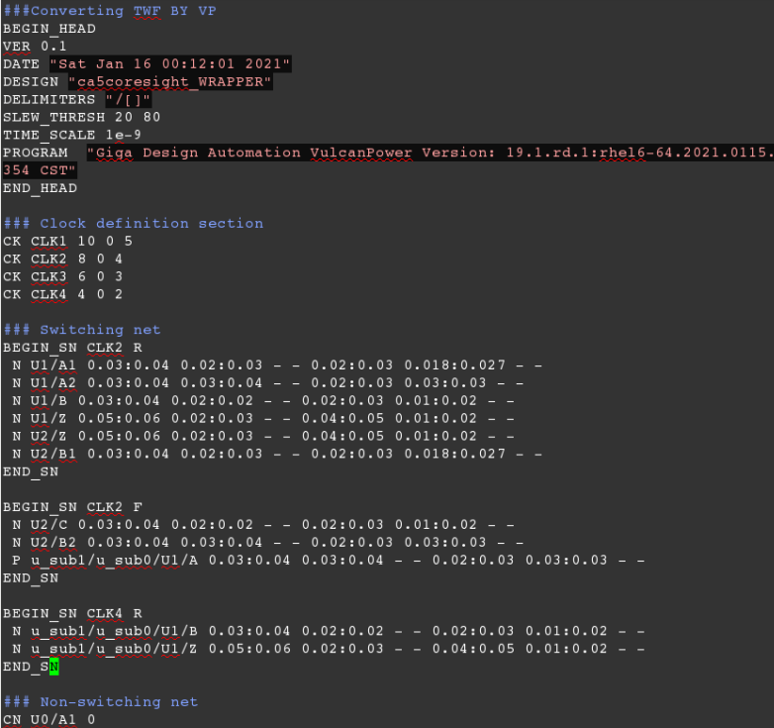
Celtic twf format
New Giga twf format

Slide 5
Celtic twf format
New Giga twf format
Change 0: Use HEAD section

Slide 6
Celtic twf format
New Giga twf format
Change 1: Simplify clock definition

Slide 7
Celtic twf format
New Giga twf format
Change 2: CN for constant net

Slide 8
Celtic twf format
New Giga twf format
Change 3: remove brace, and use “BEGIN_CAUSE, END_CAUSE”

Slide 9
Celtic twf format
New Giga twf format
Change 4: replace NET->N, PIN -> P. Remove “”, remove (), replace *-> -

Slide 10
Replay directory:
/scratch/rnd/jchen/twftest/
Rh.twf: example r**k twf
c.twf: example (existing) C twf
Giga.twf target twf
TWFGEN_new.py rh.twf # will convert rh twf to c twf

Slide 11
R**k twf format
DTH will prepare script to transfer twf formats. (also tech, rlc …)
# section 1: clock domain definition
Clk_name rise fall period root clockIdx
……
# section 2: module name indix
Hier_name/hier_name/ findIdx
…..
# section 3: timing window information
# inst-identifier inst-name
# S pin-name min-rise max-rise min-fall max-fall
# T pin-name is_clk min-rise max-rise min-fall max-fall clockIdx
I $findIdx/U123
S I 0.004 0.055 0.012 0.034
T Z 0 0.01 0.02 0.01 0.03 2

Slide 12
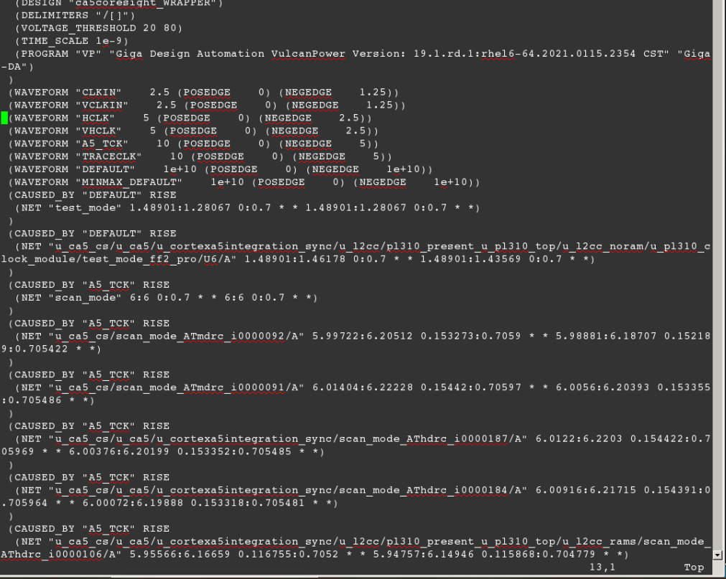
Giga existing twf

