Slide 1
MVDD Training
Lab Workbook

Slide 2
LAB 1 MVDD Design Exploration 20 Min

Slide 3
LAB1: MVDD Design Exploration
In this lab you will explore a MVDD design
1.1: Lab Startup
Change to lab1 directory % cd lab1
Start AG by run
% RUN
Explore the design and answer the lab1 questions (on next page)
Hint: The following commands may be helpful:
get_cells
report_property
report_power_domain
export_setup –power_domain
check_power_domain –rule_only
set_link_path –print
Exit AG when done % exit

Slide 4
LAB1: MVDD Design Exploration
Questions:
Fill in the missing information in the following table:
Power Domain | Module Instance | Primary Power Net | Voltage | Linked Stdcell Library
 | sparc (top module) |  |  | tsmc-090g-slow.lib
 | lsu
 | spu
 | ffu
 | ifu
 | tlu
Isolation library cell name: ___________________
Level shifter library cell name: ___________________

Slide 5
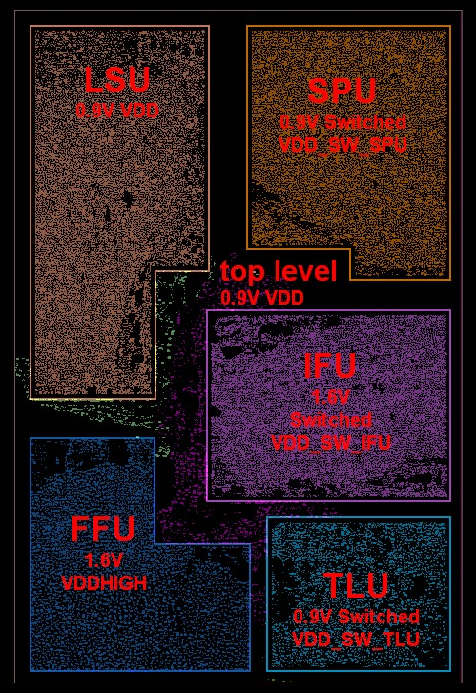
Figure 1: Power Domain Regions

Slide 6
LAB 2 Power Domain Creation
1 Hour

Slide 7
LAB2: Power Domain Creation (Overview)
In this lab you will create the power domains, associate them with particular modules, and physically define their regions as in Figure 2:
Logical
The logical power domains will be defined as in Table 2.1
Physical
The physical areas will be specified using the following methods:
Specify module bounday (set_cell_boundary)
Place groups
Islands
Table 2.1
Domain | Voltage | Primary Power Net | Primary Ground Net | Always On?
pd_low | 0.9V | VDD | VSS | No
pd_low_aon | 0.9V | VDD_AON | VSS | Yes
pd_hi | 1.6V | VDDH | VSS | No
pd_hi_aon | 1.6V | VDDH_AON | VSS | Yes

Slide 8
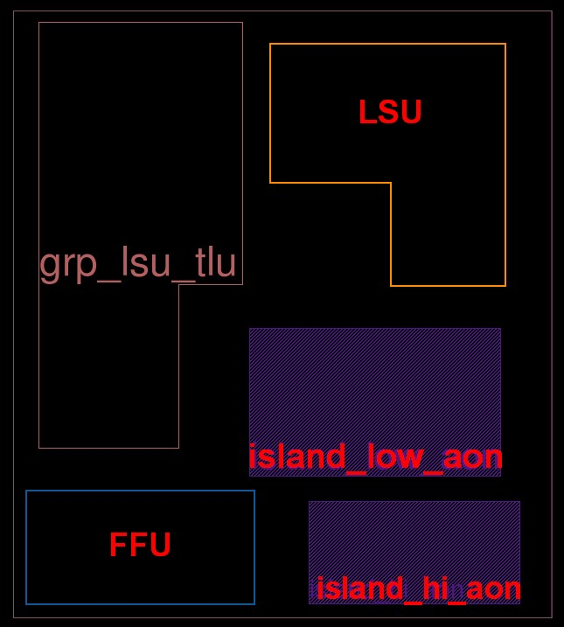
Figure 2: Final Power Domain Regions
LAB2: Power Domain Regions

Slide 9
LAB2: Power Domain Creation (Logical Definition)
2.1: Initialize Design
Do the following to read in the netlist, setup the design and generate the pre-power domain floorplan:
Start an AG session in the lab2 directory and source init.tcl
2.2: Logically Define Power Domains
In this section you will logically define the power domains.
Edit power_domain.tcl:
Define missing power domain information as in Table 2.1 with set_power_domain
Specify the –voltage for each
Use –can_shutoff if it is a switched domain (not always on)
Specify the –primary_power_net and –primary_ground_net for each domain
Assign power domains to the following module instances with assign_power_domain
pd_low → sparc
pd_low_aon → lsu, tlu, ifu/ict
pd_hi → spu, ffu
pd_hi_aon → exu
Source modified power_domain.tcl and insure that no error is returned
For correct answer
see:
power_domain.tcl-complete

Slide 10
LAB2: Power Domain Setup (Physical Regioning)
2.3: Specify Power Domain Physical Regions
In this section you will physically region the power domains using 3 methods:
set_cell_boundary
Physical region for a module instance
Can be made into a partition
place_group
Physical region for any number cells
voltage island
Physical region to place cells which belong to same domain
Restrictions can be placed by cell type
Level shifters
Isolation cells
Top level always on buffering
Domain associated with island

Slide 11
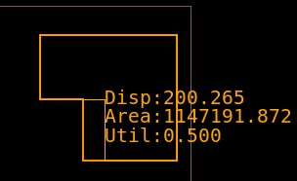
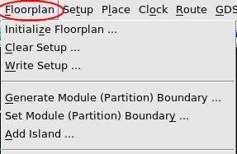
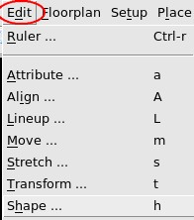
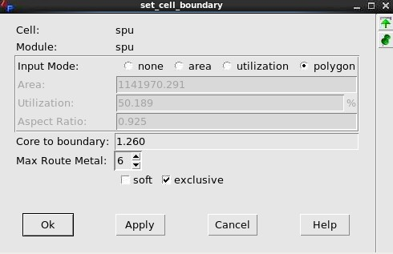
LAB2: Power Domain Setup (set_cell_boundary)
2.3.1: Define Power Domain Regions (set_cell_boundary)
Set the cell boundary (Floorplan → “Set Module (Partition) Boundary”)
Fill in set_cell_boundary dialog
Specify module spu
Select polygon or utilization “Input Mode“
Specify “Core to boundary” of 1.26
Select exclusive
Draw region in upper right hand side of layout
Bring up the Shape tool (in Edit menu)
Move edges until region is 50% utilized
1
2
3
4
5
3
SPU
1
2
5
4

Slide 12
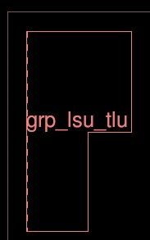
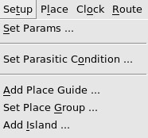
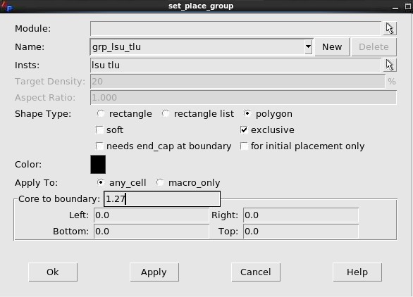
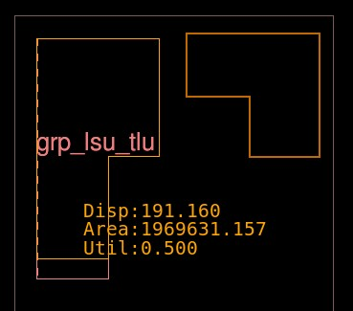
LAB2: Power Domain Setup (place group)
2.3.2: Define Power Domain Regions (place_group)
Combining lsu & tlu in a single power domain with a place_group:
Setup→”Set Place Group”
Fill in set_place_group dialog
Name: grp_lsu_tlu
Insts: lsu tlu
Shape Type: polygon & exclusive
Core to boundary: 1.27
Draw shape in upper left corner
Use shape tool to modify shape to have 50% utilization (2.3.1 steps 4 & 5)
1
2
3
3
4
2
1
4

Slide 13
LAB2: Power Domain Setup (Islands)
2.3.3: Define Always On Island
In this step you will create a top level AON islands:
Setup→”Add Island”
Fill in add_island (as in dialog below)
Name: island_low_aon
Level Shifter: for level shifter
Isolation Cells: for_isolation_cell
Always_on Cells: for retention/always_on cell
Stay-On PG Route Mode: split_rail
Stay-On Power Domain: pd_low_aon
Draw box near center of chip (refer to figure 2)
Repeat to create an island for the pd_hi_aon power domain
1
2
2
1

Slide 14
LAB2: Power Domain Setup
2.4: Analyzing Physical Domain Regions
In this step you will check the properties on each of the domain regions created
Check spu properties
% get_property [get_cells spu] boundary
% get_property [get_cells spu] utilization
Check place_group properties
% get_misc_objects -class place_group
% report_property [get_misc_objects -class place_group]
Check island properties
% get_misc_objects –class island
% report_property [get_misc_objects -class island]
2.5: Save & Exit
% save_project db/region.proj
% exit

Slide 15
LAB 3 Linking Voltage Specific Libraries 10 Min

Slide 16
LAB3: Linking Voltage Specific Libraries
In this lab you will link the power domains to stdcell libraries of the corresponding voltage
3.1: Read in the Regioned Design
Start an AG session in the lab3 directory and source init.tcl
3.2: Link libraries to equivalent voltage modules
Edit the set_link_path.tcl script to add the following 1.6v library to the spu link path:
tsmc160g-slow.lib
source set_link_path.tcl
Insure that all cells are linked with report_link –link_path
Check link_path with set_link_path -print
Save the project as db/link.proj and exit

Slide 17
LAB 4 Creating Domain Power Structures 20 Min

Slide 18
LAB4: Creating Domain Power Structures
In this lab you will create the power and rail stripes for each power domain
4.1: Initialize the Design
Start an AG session in the lab4 directory and source init.tcl
4.2: Create the Power Mesh
Examine and source the power_mesh.tcl script
Notice how the stripes and rings are regioned
Create the power stripes and rails: % source power_mesh.tcl
Examine how the rails are separated for the block and island boundaries that have a different power domain than the top.
Save the project & exit % save_project db/power_mesh.proj % exit

Slide 19
LAB 5 Defining Inter Power Domain Rules & Checking 30 Min

Slide 20
LAB5: Inter Power Domain Rules (Defining)
In this lab you will define isolation and levelshifter rules, specify the power states, and verify that all power conditions are covered.
5.1: Initialize the Design
Start an AG session in the lab5 directory and source init.tcl
5.2: Define Inter-Power Domain (IPD) rules
Run the check_power_domain –rule_only command and note the missing rules
Examine and source ipd_rules.tcl.
Run check_power_domain –rule_only again and notice that there are still some missing rule warnings.
Add the missing rules to ipd_rules.tcl and source it again.
Verify that all rules are complete with check_power_domain –rule_only
Notes:
#
# power state table
#
create_pst sparc_pst \
-supplies {
{}
{}
{}
{}
}
add_pst_state s1 -pst sparc_pst -state { pwr_DN V90_UP pwr_DN V16_UP }
add_pst_state s2 -pst sparc_pst -state { pwr_DN V90_UP V16_UP V16_UP }
add_pst_state s3 -pst sparc_pst -state { V90_UP V90_UP pwr_DN V16_UP }
add_pst_state s4 -pst sparc_pst -state { V90_UP V90_UP V16_UP V16_UP }

Slide 21
LAB5: Inter Power Domain Rules (Defining cont.)
5.4: Create Power State Table
Edit the power_state.tcl file to fill in the missing the power state information as in the table below (Hint: need additional add_pst_state lines).
Source power_state.tcl.
State Name | PD_LOW | PD_LOW_AON | PD_HI | PD_HI_AON
S1 | off | 0.9 | off | 1.6
S2 | off | 0.9 | 1.6 | 1.6
S3 | 0.9 | 0.9 | off | 1.6
S4 | 0.9 | 0.9 | 1.6 | 1.6

Slide 22
LAB5: Inter Power Domain Rules (Checking)
5.5: Check the power domain rules
Run check_power_domain –rule_only and check for any missing rules.
Output the power domain information in a UPF and native AP formats and examine the differences (Hint: use export_upf & export_setup –power_domain)
Save the project & exit % save_project db/power_domain.proj % exit

Slide 23
LAB 6 Hierarchical SPU Pushdown & IPD Fixing 45 Min

Slide 24
LAB6: Hierarchical- SPU Pushdown & IPD Fixing
In this lab you will fix power domain violations in a top-down MVDD flow. Starting with the top level, the spu partition is saved into a project. Then level shifters and isolation cells are inserted in the block and the spu block is abstracted. IPD cell insertion is then done at the top level with the abstracted spu block.
6.1: Data pushdown
Start an AG session in the lab6 directory and source init.tcl
Examine and source the spu-pushdown.tcl script. This pushes down the top level power mesh and island into the spu block and saves into spu_db/spu.proj.
Examine the layout to see how the top level power mesh has been pruned over the spu block

Slide 25
LAB6: Hierarchical- SPU Pushdown & IPD Fixing
6.2: SPU Island Creation
Load the spu_db/spu.proj, insure it is the current project (check with list_projects)
Source the spu power domain script (spu-power_domain.tcl).
Do open_layout and notice that the layout of the spu block is displayed
Examine and source spu-island.tcl which creates a series of island regions for the pd_low_aon and pd_hi_aon domains. Examine the new islands in the layout after sourcing.
Set the stay_on_buffer_method attribute of the spu module to use_split_rail_island
Legalize all cells with “place_cell –legalize_only” and notice how the stdcells are moved outside of the island regions.

Slide 26
LAB6: Hierarchical- SPU Pushdown & IPD Fixing
6.3: SPU Level Shifter and Isolation Cell Insertion
Run check_power_domain –rule_only to verify there are no issues with the rules.
Run check_power_domain and examine the inter power domain problems that need to be fixed.
Insert Level Shifter & Isolation Cells with the insert_ipd_cells –use_split_rail_island command.
Examine the islands and notice that they are now populated with IPD cells.
Run check_power_domain to verify if all power domain violations have been fixed.
Save the project as db/spu_ipd.proj and exit.

Slide 27
LAB 7 Hierarchical Block Abstraction & Top IPD Fixing 30 Min

Slide 28
LAB7: Hierarchical- Block Abstraction & Top IPD Fixing
In this lab you will abstract the SPU block and then perform Inter-Power Domain (IPD) fixing at the top using this abstracted block.
7.1: SPU Block Abstraction
Start an AG session in the lab7 directory and source init.tcl. This loads the top level block into memory.
Examine (but don’t source) the spu-abstract.tcl script which was used to create the abstract of the spu block. This created a timing model and physical abstract so that the block can be used as a macro at the top level.
7.2: Top Level SPU Replacement with Abstract
Examine and source load_abstract.tcl.
Examine the resulting spu abstract in the top level layout. Examine the spu macro pins and routing blockages

Slide 29
LAB7: Hierarchical- Block Abstraction & Top IPD Fixing
7.3: Top Level IPD Cell Insertion
Run check_power_domain –rule_only and verify that there are no missing rules.
Run check_power_domain -summary and notice the power domain errors.
Insert Isolation and Level Shifter Cells into the top level with insert_ipd_cells –use_split_rail_island command.
Run check_power_domain and examine the power domain issues.
What’s causing the improper isolation cell enable connection warnings?
(Hint: check what the PD pin of all the reported cells is connected to)

Slide 30
LAB7: Hierarchical- Block Abstraction & Top IPD Fixing
7.4: Fixing Problem with IPD Insertion
Fix the issue causing the unconnected IPD enable pins
(Hint: Examine all db params for preserving ports: report_param db *preserv*)
Redo IPD insertion
Delete the existing IPD cells with delete_ipd_cells
Run check_design -fix_conflict_name to correct any name conflicts created
Reinsert with insert_ipd_cells (–use_split_rail_island?)
Run check_power_domain to verify if all power domain issues have been fixed. (Besides the 5 improper isolation-cell/level-shifter location warnings)
Save the project as db/top_ipd.proj and exit.

Slide 31
Answer Key

Slide 32
LAB1: MVDD Design Exploration (Answer Key)
Determining power domains
get_property [get_modules sparc] power_domain
export_setup –power_domain pd.txt
Determining Primary Power Nets & Voltage
report_power_domain [get_modules tlu]
export_setup –power_domain pd.txt
report_property [get_misc_objects pd_tlu -class power_domain]
Determining Linked StdCell Libraries
set_link_path -print
Determining Isolation & Level Shifter Cells
export_setup –power_domain pd.txt
assign_power_domain pd_top [get_modules {sparc}]
assign_power_domain pd_lsu [get_cells {lsu}]
assign_power_domain pd_spu [get_cells {spu}]
assign_power_domain pd_tlu [get_cells {tlu}]
assign_power_domain pd_ffu [get_cells {ffu}]
assign_power_domain pd_ifu [get_cells {ifu}]
set_power_domain pd_tlu \
-voltage 0.900 \
-can_shutoff \
-primary_power_net VDD_SW_TLU
set_link_path -instance { ffu ifu } {
tsmc160g-slow.lib
ipd_slow.lib
}
set_isolation_cell_rule isolation_spu \
-lib_cell {ISOHIGHX10}
set_level_shifter_rule ls_rule_low_hi \
-lib_cell {LS_LHX10} \

Slide 33
LAB1: MVDD Design Exploration (Answer Key)
Questions:
Fill in the missing information in the following table:
Power Domain | Module Instance | Primary Power Net | Voltage | Linked Stdcell Library
pd_top | sparc (top module) | VDD | 0.9 | tsmc090g-slow.lib
pd_lsu | lsu | VDD | 0.9 | tsmc090g-fast.lib
pd_spu | spu | VDD_SW_SPU | 0.9 | tsmc090g-slow.lib
pd_ffu | ffu | VDDHIGH | 1.6 | tsmc160g-slow.lib
pd_ifu | ifu | VDD_SW_IFU | 1.6 | tsmc160g-slow.lib
pd_tlu | tlu | VDD_SW_TLU | 0.9 | tsmc090g-fast.lib
Isolation library cell name: ISOHIGHX10
Level shifter library cell name: LS_LHX10, LS_HLX10

