Slide 1
NLPM Power Calculation

Slide 2
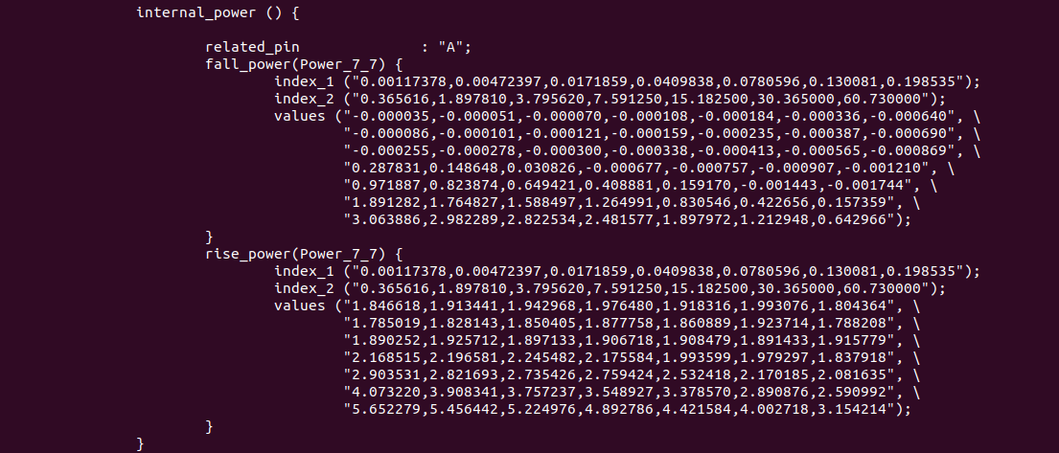
NLPM Calculation
Simulate NLPM rise_power for, 0.00117n slew, 03656f load and 0.00117n slew and 60.73f load

Slide 3
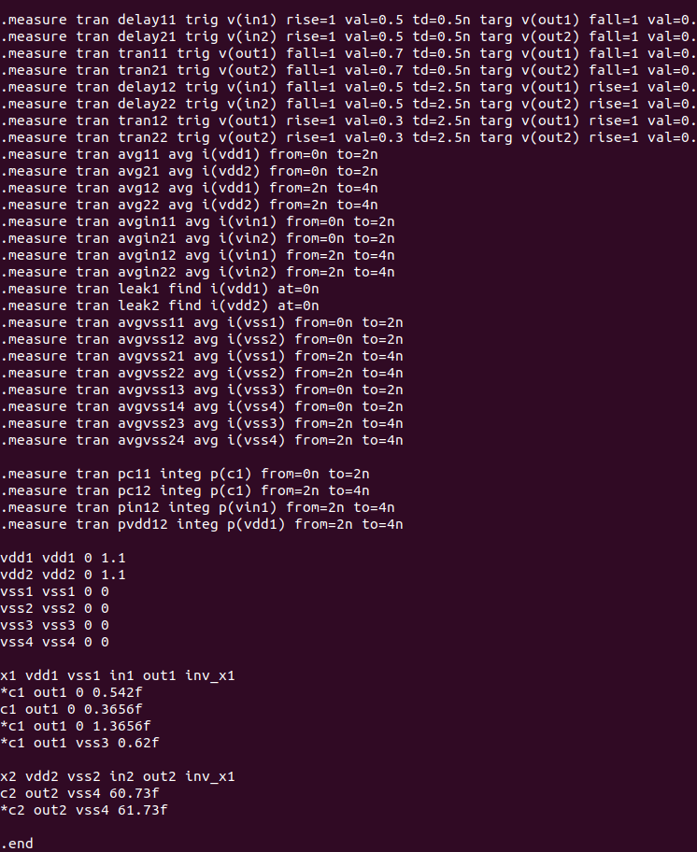
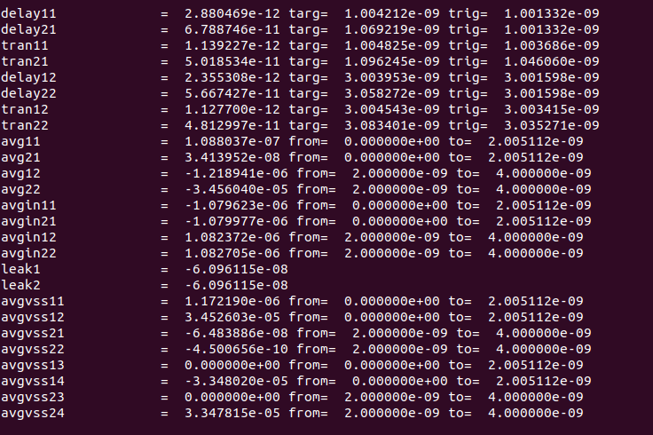
NLPM Calculation

Slide 4
NLPM Calculation
0.00117n slew, 0.3656f load
1.2189e-6 * 2n * 1.1 = 2.681e-15
0.3656f * 1.1 * 1.1 = 0.4417e-15
2.681e-15 – 0.4417e-15 = 2.2393e-15
2.2393e-15 / 1n = 2.239 uW vs 1.846uW in NLPM
0.00117n slew, 60.73f load
34.56e-6 * 2n * 1.1 = 76.032e-15
60.73e-15 * 1.1 * 1.1 = 73.48e-15
76.032e-15 - 76.032e-15 = 2.552e-15
2.552e-15 / 1n = 2.552 uW vs 1.804uW in NLPM

Slide 5
电子信息夺学院
电子信息科学与技术203班
导师：代用名
深圳鸿芯微纳技术有限公司
2022/1/20

