Slide 1
Power
Analysis
Basics III

Slide 2
Outline
Basic knowledge
Signal probability
Switching activity
Reference on paper

Slide 3

An ASIC Low Power Primer: Analysis, Techniques and Specification
Must
Read!
Leakage power
from subthreshold leakage / gate-oxide tunneling /
/ reverse biased junction leakage
Output pin switching power
load capacitor charging/discharging
estimate / extract switching activity
glitch generation and propagation
Input pin internal power
PMOS and NMOS both turn on (T_overlap is overlap time)
caused by crowbar current/ overlap current.
short curretn larger if rise time is slow (large slew)
input pin switch but output does not switch
input pin switch, output pin switch

Slide 4

How to get power of a cell?
Report_power_analysis [get_cell an_and_gate]
VDD
A
Y
B
C
From VCD/ SAIF annotation
And propagation altorithm
VSS
In .lib file
Cell power =
Leakage power
+ Internal power
+ Switching power
Sum of: State-probability * state-leakage-value
Switching probability (toggle rate) and lookup table
$$SWA\left(y\right)C_{L}V_{DD}^{2}$$
From extraction or wire/cell model
Alternatively, get from .lib default value (fast, but NOT accurate at all!)

Slide 5
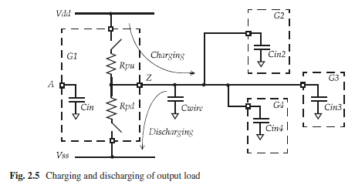
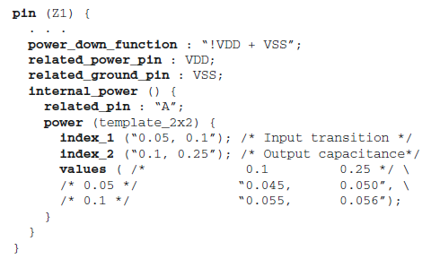
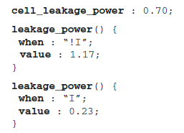
Require 1: power value in .lib
Internal power table in .lib
inverter A triggered internal power
related to input transition and
output cap
Leakage power
state dependent value

Slide 6

Require 2: signal probability and switching activity
By annotation or propagation
VDD
Input
vectors
0
A
1
Y
…
B
C
1
VSS
Annotation method
run simulation, generate VCD for each wire
convert to SAIF, then annonate to net
Propagation method
We only know the input vector
Extract SWA from input pin
Propagate to entire whole chip
extract_toggle_activity
get_toggle_activity_pins
report_toggle_activity
set_toggle_activity
In many cases:
We have some annotation information
Need to propagate to other nets

Slide 7
Require 3: load capacitance, VDD level, and so on…
Load capacitance from RC extraction, or .lib, or estimation
VDD from scenario, setting, .lib
We also need timing support (reason in later slides)
These details will not be discussed in this PPT

Slide 8
How GIGA run report_power_analysis?
// UI entrance
taTclReportPowAnnCmd::Eval
Direct use lib default power value?
No, for VP analysis purpose.
Yes, for fast optimization purpose.
powMgr::CalcInstPower
PowMgr::CalcInstPower(dbInst*)
GetInstSDCPower ()
CalcAvgInternalPow
CalcAvgSwitchingPow
CalcLeakagePow
Check the switching activity of input pin
Then calculate using lib lookup table
powMgr::CalcInternalPow
Check switching activity
Check load capacitance
Then calculate switching power
Get defautl leakage power from lib
Or calculate State dependent leakage power
dbInst::GetAvgLeakagePower()
check signal probability, then use lib data
Calculation signal probability
Glitch pattern
Logic difference…
CUDD
Symbolic
algorithm
Switching Activity
Algorithm
Propagate signal propability from input to output

Slide 9
Outline
Basic knowledge
Signal probability
Switching activity
Reference on paper

Slide 10



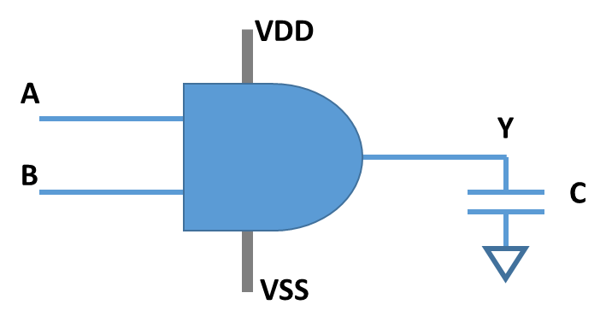


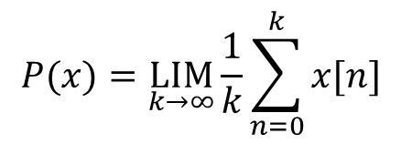
Signal probability (requried by leakage power)
Several difinations… Suppose x(t) (or x[n]) is the signal value (1 or 0 ) at time t ( or clock cycle n)
$$P(x)=\underset{k→∞}{LIM}{\frac{1}{k}}\sum_{n=0}^{k}{x[n]}$$
P(x) means, for a clock cycle (or a given time):
What is the probability of wire x == 1?
if P(x) == 1 , wire x is always 1
if P(x) == 0, wire x is always 0
Example, P(Y) waves has same signal probability. (similar as duty ratio)

Slide 11
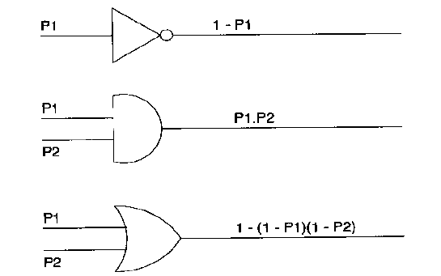

Extract and propagate signal probability
Suppose input vectors (VCD or test bench for example), we cancluate P(x) as follows
Then internal nodes can be propagated as this:
= p1+p2-p1p2
Can we propagate P(x) now?
Fanout-reconvergent problem.
Even original input is SSS, local P(x) propagation can fail.

Slide 12

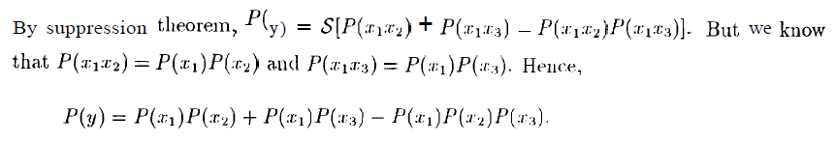
No! Local P(x) propagation can over or under estimate !!!
…
P(A)
…
P(AAAAAAA…) = P(A)
Since signal logic exponent can not exist
P(A)
P(AB)
P(ABB) = P(AB)
Therefore, we
supress exponent in expression
P(B)
Example: suppose we want to calculate the signal probability of
Calculate minus is awkward…
Notes:
Question: see low power cmos vlsi , page 73. z = x x’…

Slide 13
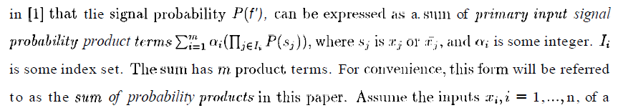
How to supress and deduce P(x) effectively?
First: We know any logic function f(x1, x2, x3…..) can be convert to sum-prod format
Any expression can be expressed as
Sum of input products
The P(x) is combinatino of
“and” / product, “xor” / sum
…

Slide 14

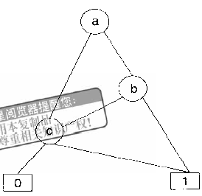
Then use BDD (binary decision diagram) to supress exponents
Then ab +c can be expressed as BDD form based on Shannon’s expansion:
Deep first transverse to find out (ab+c) signal probability
P(a’)P(c’)0 + P(a’)P(c)1 + P(a)P(b’)P(c’)0 + P(a)P(b’)P(c)1+P(a)P(b)1
= P(a’)P(c) + P(a)P(b’)P(c) + P(a) P(b)
1
0
0
1
0
1

Slide 15
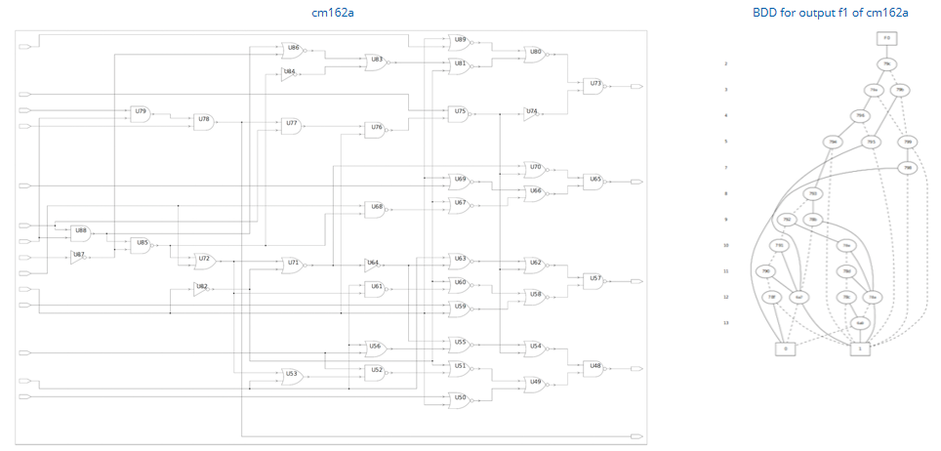
Some other BDD examples for logic functions
a+b
a
b
0
1
Giga use CUDD to build BDD, and propagate P(x)
https://davidkebo.com/cudd
https://davidkebo.com/verilog-binary-decision-diagram-parser

Slide 16
Find out how BDD (CUDD package) is used in GIGA products
Anlib/anlibcell.cpp
Db/dbProject.cpp
Db/dbGroupCells.cpp
Db/dbBool.cpp
Db/dbLibCell.cpp
Db/dbSocv.cpp
Db/dbLibPin.cpp
Db/dbScope.cpp
Fe/feBddBdd2Ptrs.h
feTcl/feTclInit.cpp
feTcl/feTclHelp.doc
Pow/powGlitch.h
Pow/pow.h
Pow/powUtil.cpp
Sch/schSymbolCG.cpp
Sch/schSymFFGenerator.cpp
Sch/schSYmbol.cpp
Sch/schSymLatchGenerator.cpp
Ta/ta.h
Ut/utGV.h
Xe/
Get BDD tree here
Logic equivalance check
(verification)
Propagate P(x)
Get glitch pattern
(logic patters that will trigger glitch)
Logic optimization
And so on…

Slide 17
Your task:
Read through CUDD link and example
study how to build a node, and evaluate logic table.
Grep “EvalProbability” in work/src/db/dbInst.cpp
explain how CUDD is used in leakage calculation?
dbInst::GetAvgLeakagePower()
Where you can get state leakage power?
How you get state probability , P(x)?

Slide 18
Outline
Basic knowledge
Signal probability
Switching activity
Reference on paper

Slide 19
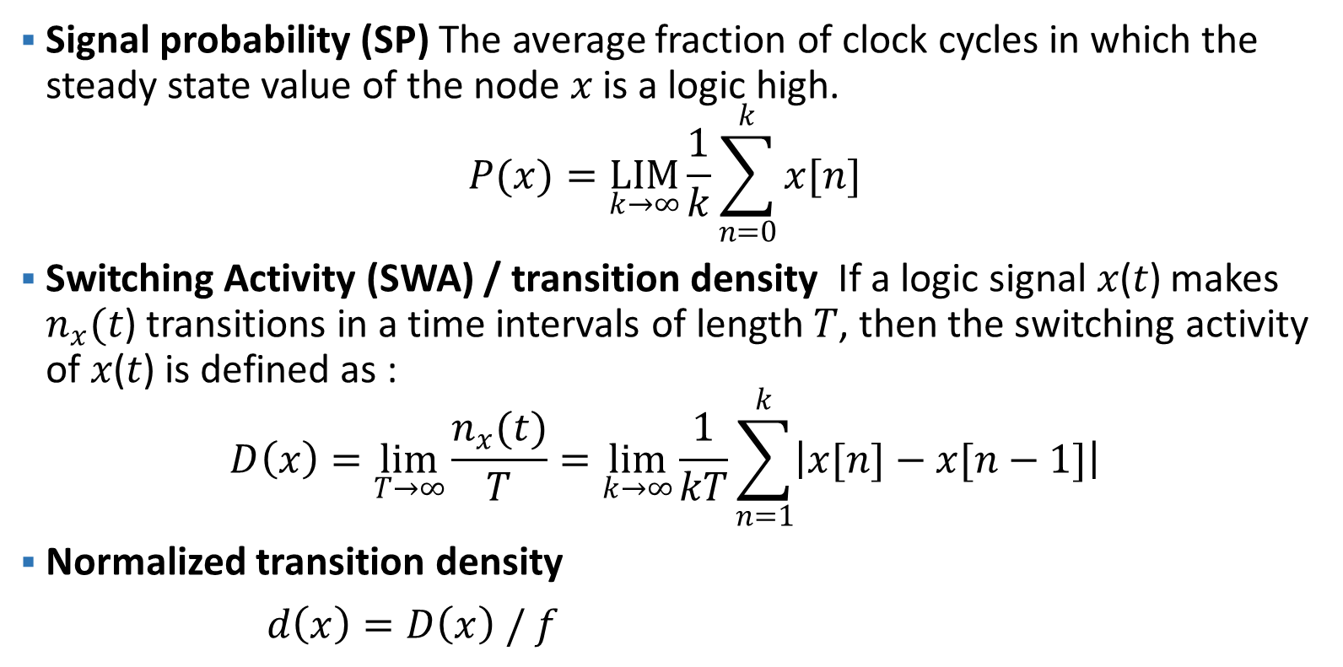
What is signal probability, toggle rate,
switching activity, transition density…
Signal probability (SP) The average fraction of clock cycles in which the steady state value of the node 𝑥 is a logic high.
$$P(x)=\underset{k→∞}{LIM}{\frac{1}{k}}\sum_{n=0}^{k}{x[n]}$$
Switching Activity (SWA) / transition density If a logic signal 𝑥(𝑡) makes $n_{x}(t$) transitions in a time intervals of length 𝑇, then the switching activity of 𝑥(𝑡) is defined as :
$$D\left(x\right)=\lim_{T→∞}{\frac{n_{x}(t)}{T}}=\lim_{k→∞}{\frac{1}{kT}}\sum_{n=1}^{k}{\left|x[n]\right.−\left.x[n−1]\right|}$$
Normalized transition density
$d\left(x\right)=D\left(x\right) / f$
A wire X is 0 or 1
P(x) is the probability x is 1 in a clock cycle.
P(x) = 1 means wire x is always 1
P(x) = 0.5 half of the time, wire is 1
How many transitions (0->1 or 1->0)
Per second?
How many transitions in a clock cycle

Slide 20
Signal probability {P(x)} and transition density {D(x)} example
D(x) of a clock is 2f: for each clock cycle, clock toggles twice.
Example, P(Y) is equivalent in both case (50%) for case 1 and case 2
But transition density is different!
D(y) in case 1 is 2X larger than case2!
case 1 has much higher dynamic power than case 2!
case 3 and case 2 has same D(y), but P(y) is different. Leakage is different.

Slide 21
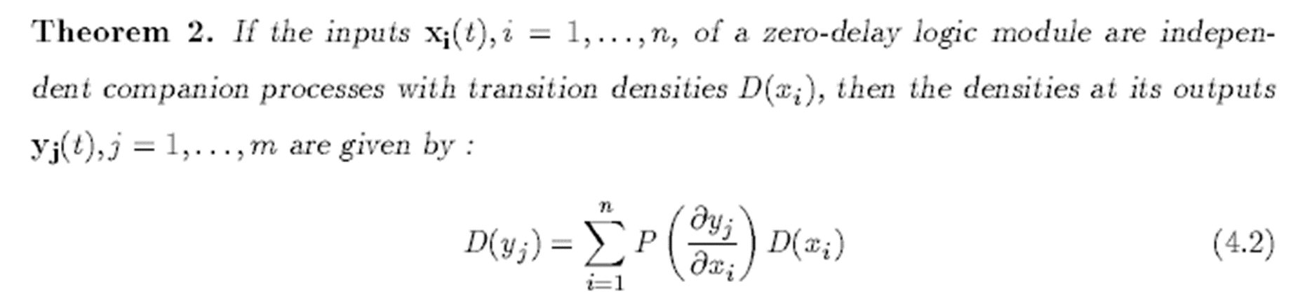
Switching activity/ transition density/ toggle rate is very complex
We need to estimate SWA to calculate dynamic power!
Case 1: Functional switch:
A input pin switched, cause Y switch
0->1
0->1
If a input pin switch,
And the switch can pass to output
Then output pin can switch
1
*1991_Najm_Transition delay, a new measure of activity in digital circuits.pdf

Slide 22


Wait, what is boolean difference?
Deisnty propagation problem:
Means X switches can impact output y
X is transfer to y
Y(x) + Y(x’) = yx’ + y’x
CUDD / BDD can help on this

Slide 23
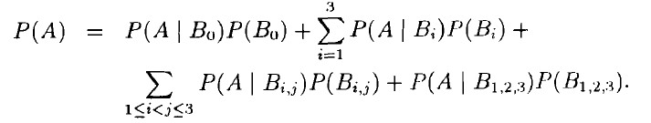
Switching activity/ transition density/ toggle rate is very complex
We need to estimate SWA to calculate dynamic power!
Case 2: Simultaneous fake switch. Case 1 is over-estimated
0->1
No switch!
What if 1 pin switches
What if 2 pin switche simultaneously
……..
Whst if n pin switche simultaneously
1->0
The propability this switch is propatated to output
Switching prpb. At out
Must be zero. Why?
Only one pin switches
Now consider two pins switch

Slide 24
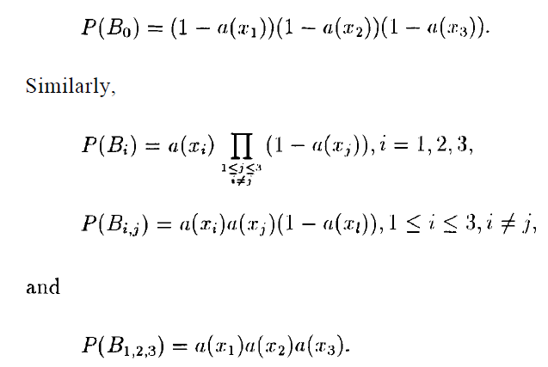
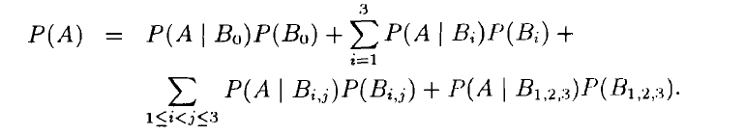
Normalized activity/ the probability of x switching in current cycle
Zero!!!

Slide 25
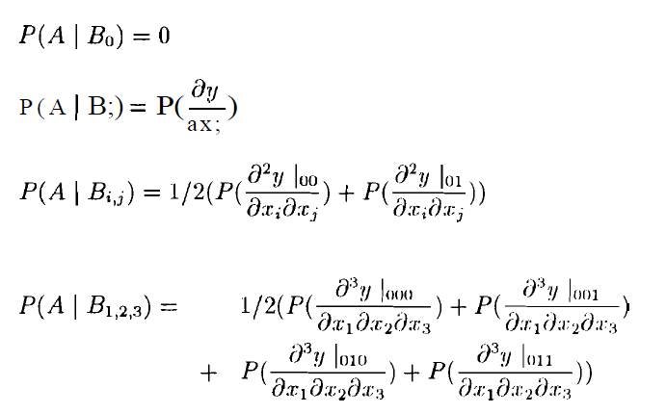
Remove half, because
00 -> 11 can not happen contineously.
If xi xj trans from 00 to 11
Or trans from 11 to 00
Cause y switches

Slide 26
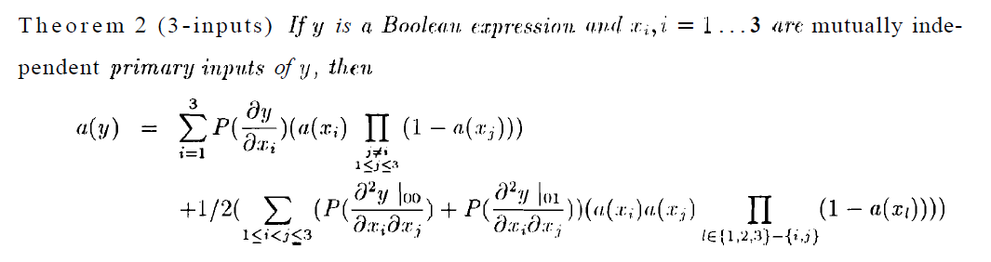
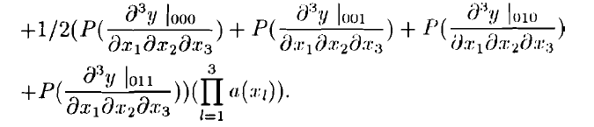
How GIGA calculate functional switching

Slide 27
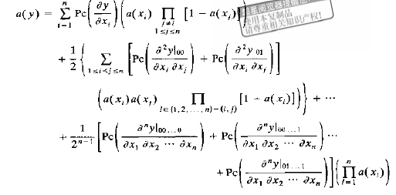
Note: n input switch simtinously
Can be very rare, therefore ignore

Slide 28
Switching activity/ transition density/ toggle rate is very complex
We need to estimate SWA to calculate dynamic power!
Case 3: generated glitch
0->1
If input pins are glitch pattern.
And edge is wider than arc delay
Then output glitch happen!
1->0
How many glitch switch at output per second
Glitch rate:
How many glitch pattern can generated per second
Determined by gate type and frequency (Again BDD!)
Glitch propagation probability
Wider than arc delay

Slide 29
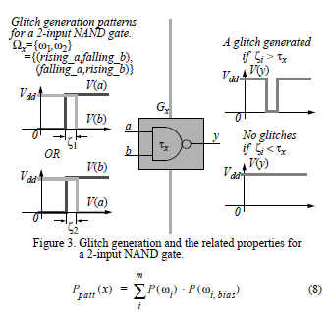


Glitch rate 1997 Lim paper consider arc delay. Delay can filter glitch.
Generated glitch probability in a clock cycle
The switch probability in a clock cycle is D(a)/f
The rising probability is (D(a)/f)/2
Glitch rate: how many glitch patterns can generated per second
Non-switching pins, and they are biased to a value
So that glitch can be propagated to output

Slide 30
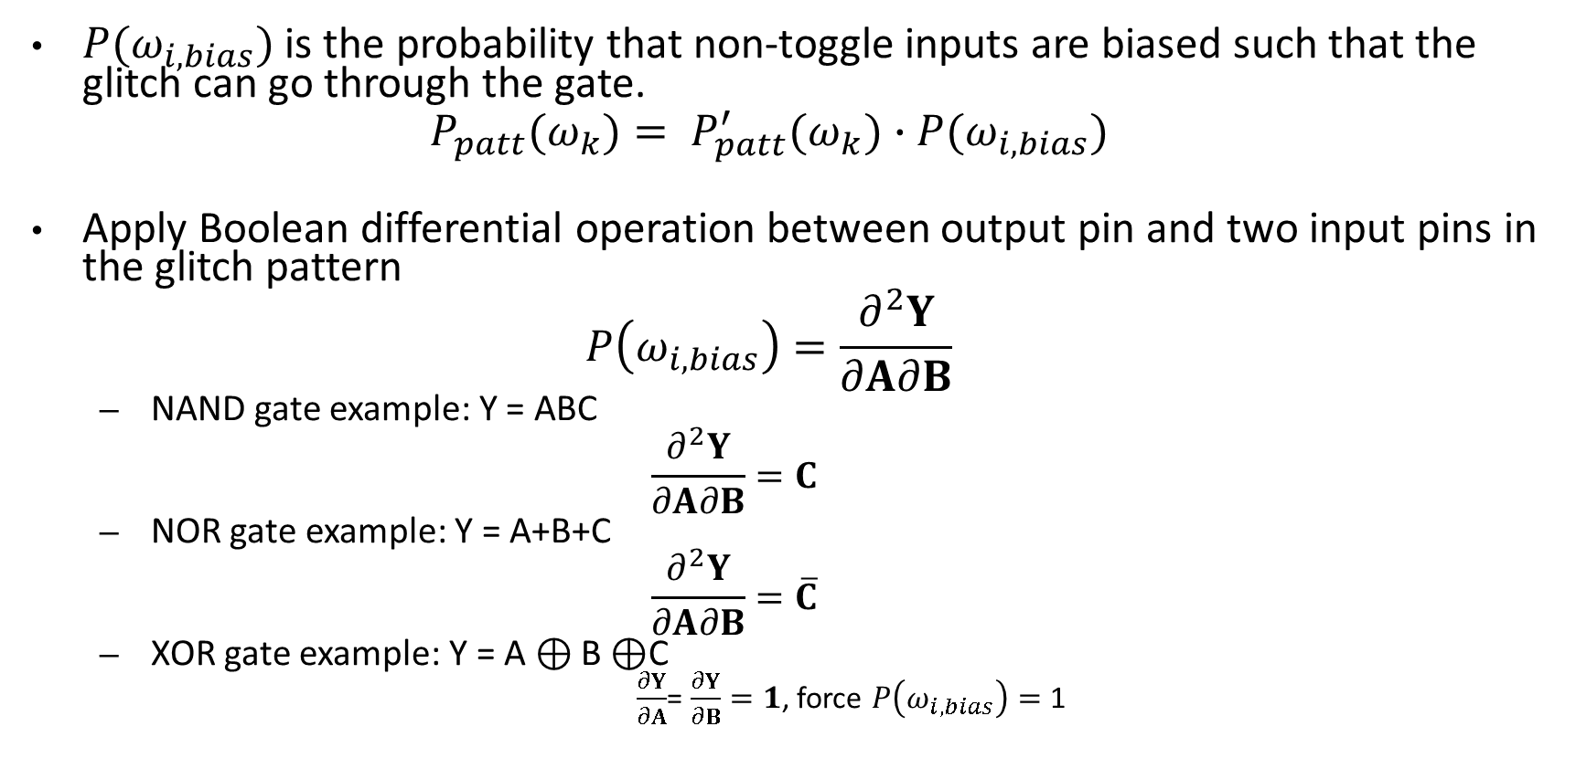
How to get glitch rate in GIGA?
“all_input_pins” in code
$P(ω_{i,bias})$ is the probability that non-toggle inputs are biased such that the glitch can go through the gate.
$$P_{patt}(ω_{k})= P_{patt}^{′}(ω_{k})∙P(ω_{i,bias})$$
Apply Boolean differential operation between output pin and two input pins in the glitch pattern
$$P\left(ω_{i,bias}\right)=\frac{∂^{2}Y}{∂A∂B}$$
  NAND gate example: Y = ABC
  $$\frac{∂^{2}Y}{∂A∂B}=C$$
  NOR gate example: Y = A+B+C
  $$\frac{∂^{2}Y}{∂A∂B}=\overline{C}$$
  XOR gate example: Y = A $⊕\text{B}⊕$C
  $\frac{∂Y}{∂A}$= $\frac{∂Y}{∂B}=1$, force $P\left(ω_{i,bias}\right)=$ 1
“other_input_pins” in code
CUDD gives you glitch patterns, and evaluate probabilities

Slide 31
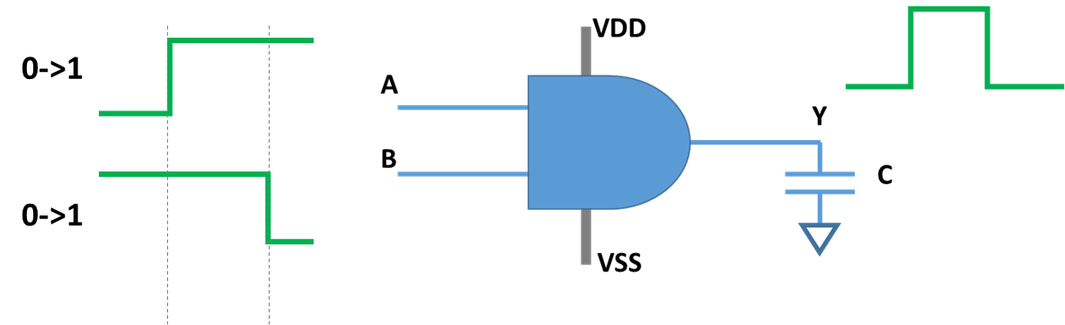
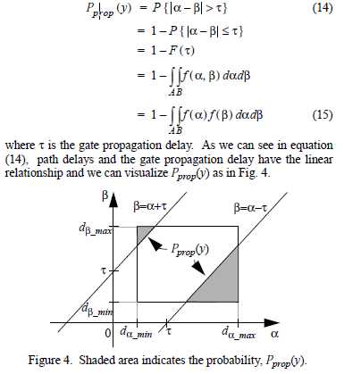
The probabilty that glitch can pass…
If a glitch pattern is generated.
The edge of a and b arrives at random value α, β
Then | α – β | must > τ, then glitch can pass.
The probability of this is :
Edges are too close
Shorter than arc delay
Glitch is filtered
GIGA needs timing update to get
Arrive time range

Slide 32

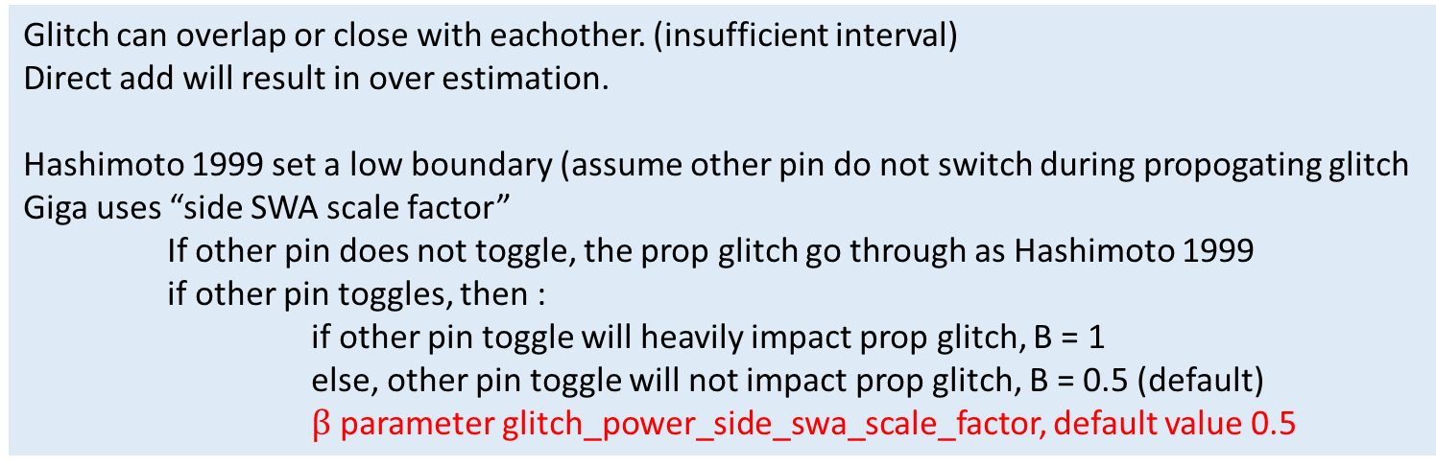
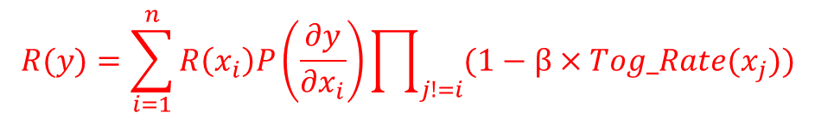
Total transition rate
(switching activity
How many toggle edge per second)
A glitch means one rising and one falling
D(x), transition density. Probability of transition in a clock.
How many functional transition per second.
1st proposed in 1991_Najm
2nd removed simutaneously switch in 1994_Chou
3rd improve calculation efficiency in 1994_Kappor
Pattern P: Some pattern can generate glitch.
Prppagate P: The pattern input events shall wider than arc delay
Proposed in 1997_Lim
A glitch can pass from previous input.
Proposed in 1999_hashimoto
Glitch can overlap or close with eachother. (insufficient interval)
Direct add will result in over estimation.
Hashimoto 1999 set a low boundary (assume other pin do not switch during propogating glitch
Giga uses “side SWA scale factor”
If other pin does not toggle, the prop glitch go through as Hashimoto 1999
if other pin toggles, then :
if other pin toggle will heavily impact prop glitch, B = 1
else, other pin toggle will not impact prop glitch, B = 0.5 (default)
  $β$ parameter glitch_power_side_swa_scale_factor, default value 0.5
$$R(y)=\sum_{i=1}^{n}{R\left(x_{i}\right)P\left(\frac{∂y}{∂x_{i}}\right)\prod_{j!=i}{(1−β×Tog_Rate(x_{j}))}}$$

Slide 33
Your task:
1. Search work/src/pow. Find out where GIGA calculate switching power?
Run a report_power_analysis QA case.
Set breakpoint on below functions.
What is call stack? How GIGA uses these API?
CalcPropagatingGlitchPow()
UpdateAnnGlitchRate()

Slide 34
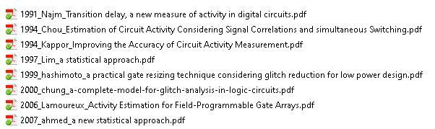
Reference:
Find out in wiki!

Slide 35
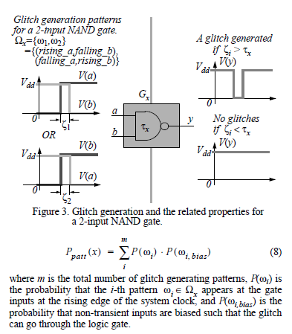
The probability of pattern happens
All other pins are not in the pattern,
And biased in the logic level, which can pass the glitch generated
By pattern

Slide 36
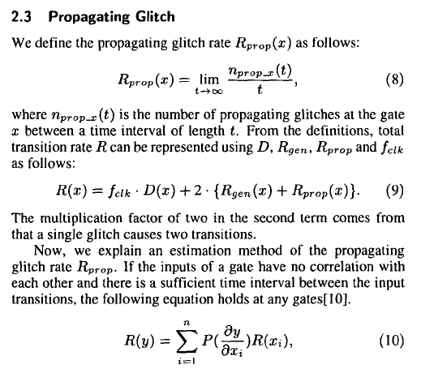
1999 hashimoto
Our optimization method consists of two techniques; a statistical
estimation method of glitch activities and an optimization
algorithm for gate resizing. For the estimation of glitch activities,
we classify glitches into two classes; generated glitches and propagating
glitches. As for the generated glitches, we adopt a statistical
estimation method proposed by Lim and Soma[8]. The propagating
glitches, however, are not considered in their method, and therefore
we have devised a statistical estimation method. The optimization
algorithm has been designed to have the ability of escaping from a
bad local solution while keeping small computational costs.

Slide 37
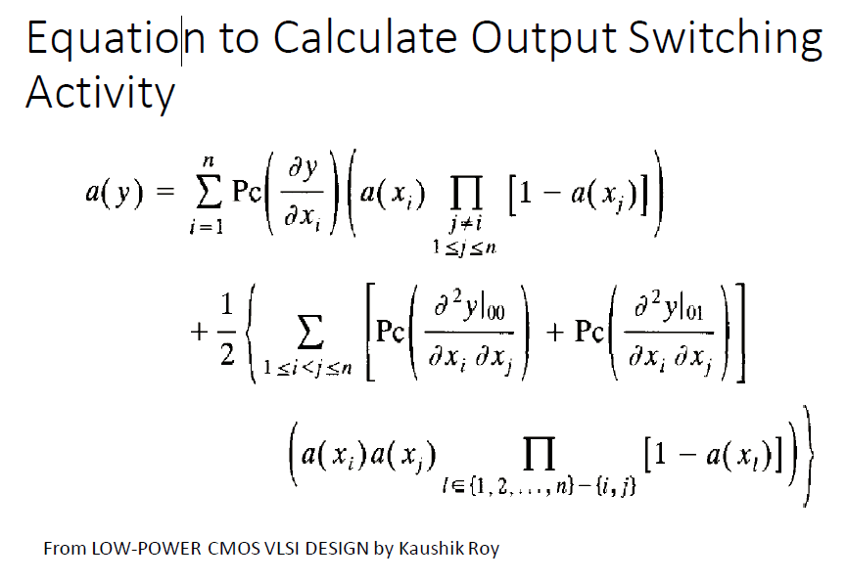

Slide 38
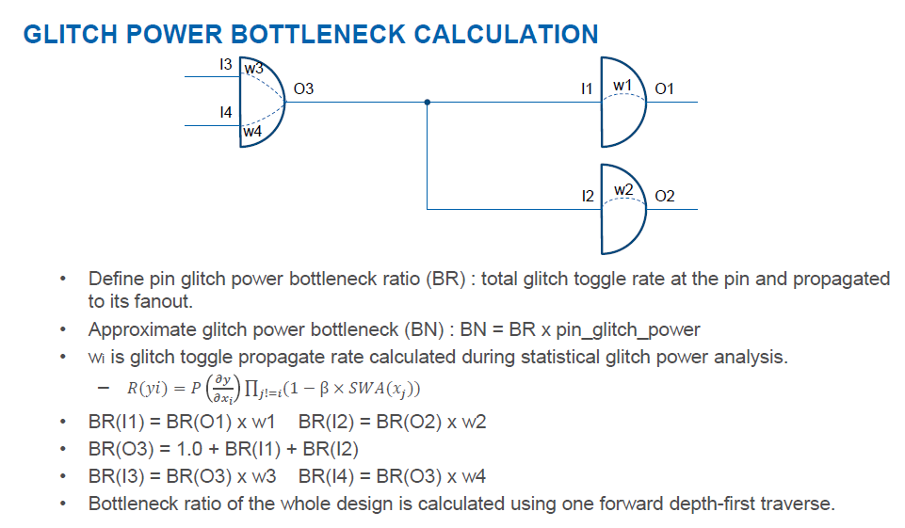

Slide 39
Inter connection aware glith propagation
Glitch reduction optimization
https://ieeexplore.ieee.org/document/1432125
https://ieeexplore.ieee.org/document/7124828

