Slide 1
IR drop
Analyze, Solve,
& Validation 2

Slide 2
Outline
IR drop background knowledge
Main routine
Main code structure

Slide 3
Why we need to care IR drop?
If too much IR drop,
Timing impact (slower)
Function error
Typically max 10% VDD
I
t
VDD (IR drop)
t

Slide 4
To debug ir case, you can find some data/design under:
/rnd/jchen/VP_QA_base/QA_test_template/
ir_test (IR analysis on full ARM core block)
dyna_ir_fastrun (IR analysis on tiny ARM case, very fast)
vector_ir_test/ (IR analysis on 16nm case)
You can find other designs under
/rnd/jchen/VP_QA_base/QA_designs/
We will use tiny ARM case as demo

Slide 5
Step 1.
Copy dyna_ir_fastrun to your local directory (e.g., /scratch/rnd/jchen/new/demo/)
Step 2.
Check-out code and build VP using
vp_make ir prTcl pow powTcl
This command will build debug-version code under emir code module.
Where:
ir IR analysis core code
prTcl IR analysis UI code
pow power analysis core code
powTcl power analysis UI code
db database， object
After build finished, make a soft link under your dyna_ir_fastrun/ directory.

Slide 6
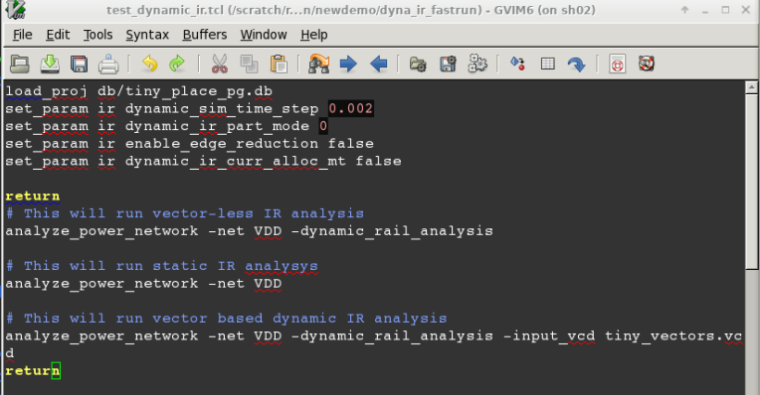
Step 4.
Open script test_dynamic_ir.tcl,
Try to understand the script (using --help for the command )
Try to answer:
What is static IR analysis
What is vector-less IR analysis
What is vector-based IR analysis
Step 3. Check main routine of static IR analysis
Use gdb (or ddd) to run VP:
$gdb
(gdb) file VP
(gdb) r
% source test_dynamic_ir.tcl

Slide 7
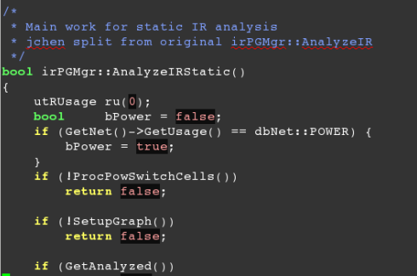
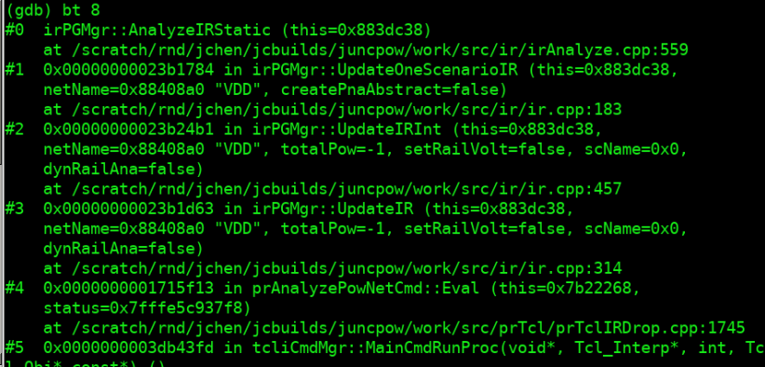
How to analyze static IR drop
Step 3. Understand code
% press ctrl-c enter into gdb
(gdb) b irPGMgr::AnalyzeIRStatic()
(gdb) c
Then run this command in VP
% analyze_power_network -net VDD
Now, you should see the main call stack of static IR analysis

Slide 8
Code flow
irMgr.h: manage data, infrastructure
irGraph.h: hold PG graph
irParamTbl: Parameter list of ir engine
irReport: Report message class
irSolve : classical LDL solver
irSolver : New solver
Ir/irSolve.cpp
Matrix solving
Flat calculate
Or partition
DMP, MT…
Ir/irPartition.cpp
Ir/irAnalyze.cpp
Setup PG graph
CalculateStaticIR
Update EM
Print result
Save db
Ir/ir.cpp
Entrance of IR
prTclIRDrop.cpp
UI command

Slide 9
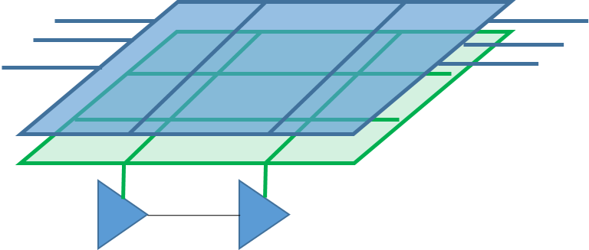
How to model IR drop
bool irPGMgr::ExtractPGraph
Will build up PG graph model
irGraph.h
irParaGraph.cpp
(Try to understand irPGraph, how to iterate all node, edge?
How to get source node, target node? Middle node?)
~
~
~
~
irCurrCap.cpp
(How to get static current and dynamic current? How to set cap?)

Slide 10
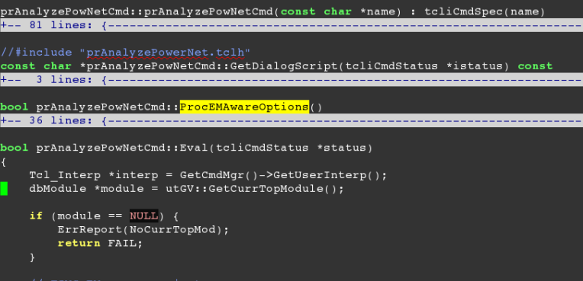
UI level
Constructor
Define options, name, hidden, etc.
Evaluation
Do option, design check
Do static ir
Do dynamic ir (vector-less)
Do dynamic ir (vector-based)
…

Slide 11
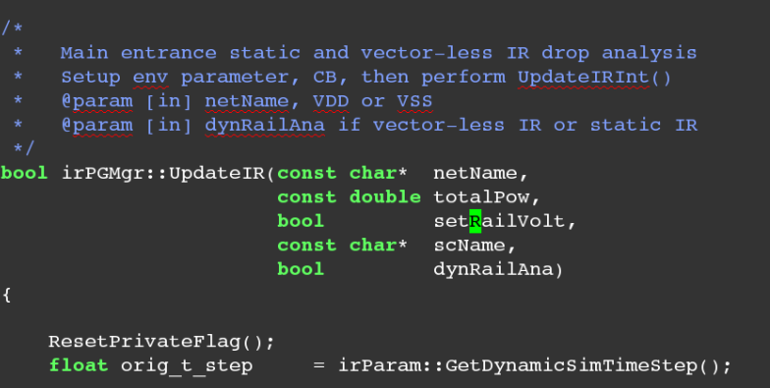
Function level (static IR)
You are encouraged to add comments
Main entrance of Static IR analysis
ir.cpp
-> Ir/irAnalyze.cpp
-> ir/irSolve.cpp
-> matrix solving

Slide 12
To start with…
Setup a very simple pg network ( for example, 4X4 PG network, with four current source)
Run the ngSPICE, and try to extract voltage drop for each node.
Try to dump out target node (instance voltage drop ) from VP.
(You can check report_power_network)
If anything is missing, please let me know, I can enhance.
Try to compare worst static voltage drop, difference? Relative error?
Try to compare the voltage drop node-by-node, error, deviation, correlation, etc.

Slide 13
Dynamic IR drop analysis
/home/stor19d2p1/jchen2/VP_QA_base/QA_designs_v2/ARM_tiny_case
A very tiny case with 400 instance (target nodes)
tiny_arm.tcl Read design, link
tiny_sim.tcl script to perform simulation, generate VCD
tiny_arm_pg.tcl script to create power network (you can modify and try)
tiny_arm_stage2.tcl analyze static, dynamic v-less, v-based IR drop
tiny_arm_dynamicir/ dynamic IR analysis result directory
pg.sp SPICE netlist of power network. Current source is “average current”
pg_current.sp Current value of each target node + middle node
pg_voltage.sp voltage drop value of each target node + middle node

Slide 14
To start with…
Write a script to parse pg_current.sp, pg_voltage.sp
Try to draw waveforms for a node.
Replace current source in pg.sp, replace with pwl source.
The pwl source can be extracted from pg_current.sp
Measure the volage drop value on each target node.
Measure the max dynamic voltage drop on each target node.

Slide 15
Modify PG structure, and check Irdrop (1)
After testing the correlation of static IR drop and dynamic IR drop.
We can also test the PG network shape impacts on IR drop. (narrower PG, larger IR drop)
/home/stor19d2p1/jchen2/VP_QA_base/QA_designs_v2/ARM_tiny_case
In tiny_arm_stage2.tcl, suppose the static IR drop of VDD is shown in below.
Then, if we down-size the power rail width, we should see larger IR drop.
Please refer to tiny_arm_stage3.tcl for reference.
In the script, I modify the rail width from 0.3 to 0.2 (compare tiny_arm_pg3.tcl and tiny_arm_pg.tcl)
You can see the IR drop becomes larger.
Please modify the pg parameter, and
perform more correlation check.

Slide 16
Modify PG structure, and check Irdrop (2)
How to generate new data?
Use customized AG build: /home/jchen/work_stor19d2p1/jchen2/dyna_build/AG
Source tiny_arm_stage2.tcl
the vector-based IR drop analysis will generate SPICE netlist and waveform
perform correlation check
Modify tiny_arm_pg3.tcl , source tiny_arm_stage3.tcl
run vector-based IR drop to generae new SPICE netlist and waveform
perform correlation check
More details on PG structure can be found in manual:
http://172.168.8.15:8088/projects/aguda-techpub/wiki/Aguda_user_guide

