Slide 1
IR drop
Analyze, Solve,
& Validation 3

Slide 2
Outline
Why partition?
How to do partition?
Next step

Slide 3
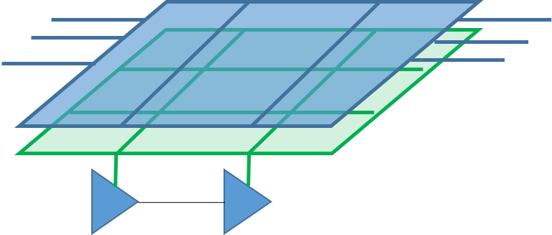
How to model IR drop
bool irPGMgr::ExtractPGraph
Will build up PG graph model
irGraph.h
irParaGraph.cpp
(Try to understand irPGraph, how to iterate all node, edge?
How to get source node, target node? Middle node?)
~
~
~
~
irCurrCap.cpp
(How to get static current and dynamic current? How to set cap?)

Slide 4
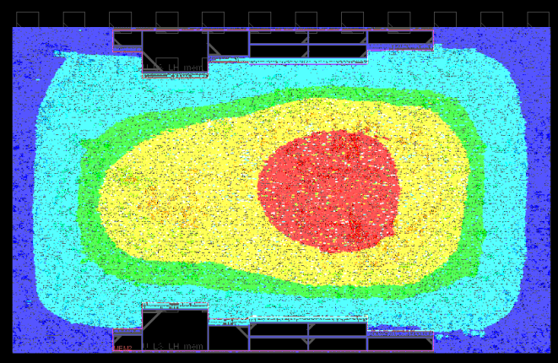
How we did circuit partition
Rely on margin
Partitions do NOT talk
NOT accurate
But achieves speed-up

Slide 5
We want partition
V1
V2
Assume current i
If circuit is balanced
Then I, V across boundary agrees with each other

Slide 6
We want partition
V1
V2
+
-
Assume current i
If we got the correct V2
Then we can do partition
accurately

Slide 7
We want partition
V1(step1)
VDD
+
-
I1 (step 1)
If we got the correct V2
Then we can do partition
accurately

Slide 8
We want partition
VDD
V2(step1)
+
-
I2 (step 1)
If we got the correct V2
Then we can do partition
accurately

Slide 9
We want partition
V1(step2)
V2(step1)
+
-
I2 (step 1)
If we got the correct V2
Then we can do partition
accurately

Slide 10
We want partition
V1(step1)
V2(step2)
+
-
I2 (step 1)
If we got the correct V2
Then we can do partition
accurately

Slide 11
IR analysis swap talk
Phase 0:
If partition is perfect,
Then I,V agree at all boundary
Phase 1:
If boundary disagree
Swap boundary condition
Phase 2:
DMP solve with new boundary condition
Repeat phase 1-2 until convergent

Slide 12
How we do static IR analysis without partition
Src node
Src node is NOT included in Ax = b solving
(Since V already known, want full rank A)
Size of A is (Mid# + Tgt#)
Usually, I_mid is 0
i2
Middle node
i1
Target node
V
I
SPD
Sparse G
=
Src
nodes

Slide 13
How to swap
V1
VDD
+
-
Assume current i
If we got the correct V2
Then we can do partition
accurately

Slide 14
How to swap
V1
0
->
Boundary current
source
Norton equivalent circuit
诺顿等效电路
电流元//电阻 替换 电压源===电阻

Slide 15
How to swap
V1
V2(Step n)
+
-
Assume current i
If we got the correct V2
Then we can do partition
accurately

Slide 16
How to swap
V1
0
->
Boundary current
Source (Step n)
Norton equivalent circuit
诺顿等效电路
电流元//电阻 替换 电压源===电阻

Slide 17
IR analysis swap talk
Phase 0:
If partition is perfect,
Then I,V agree at all boundary
Phase 1:
If boundary disagree
Swap boundary condition
Phase 2:
DMP solve with new boundary condition
Repeat phase 1-2 until convergent

Slide 18
V
I
SPD
Sparse G
=
Src
nodes
Partition 1
=
Partition 2

Slide 19
IR analysis Double-Partition DMP (DP-DMP)
Phase 0:
If partition is perfect,
Then I,V agree at all boundary
Phase 1:
If boundary disagree
Add a double-partition, set new boundary
Phase 2:
DMP solve with new boundary condition
Repeat phase 1-2 until convergent
Why DP-DMP works:
Double-partition will carry/propagate
I/V info among partitions

Slide 20
诺顿定理
https://max.book118.com/html/2017/0620/116780000.shtm

Slide 21
Coding starting point
In irPGMgr::CalcStaticIRDropByZone() // static IR analysis entrance
result = SolveStaticIR(false) // this is default flat IR solve (use PCG solver, which is MT solving)
else clause // this part we need to work on
// Currently, I made partition, solving
// But iteration talk sync is not added yet
As first step, we need to use MT method for partition version of static IR analysis
We need to use LDL solver (rather than PCG MT solver, since MT code can mess up with each other)
How to talk using Norton current source in middle node?
Please check irPGraph::PreCalcTermCurrOnPNode() as reference

Slide 22
Testing start point
Please study /rnd/jchen/VP_QA_base/QA_utility/test_report_power_network.py
And
/rnd/jchen/VP_QA_base/QA_suite_v2/ir
These testing cases and utility are preliminary work, please help to enhance script:
If there is difference between IR analysis,
what is max difference?
what is average difference?
what is MSE?
Figure out error region?

