Slide 1
Resistance path related issue：
Length width inconsistent with bbox
pgraph->savegraph2db->map->buildgraphfromdb->pgraph
savegraph2db will save width length in edge, and abandon edge original bbox, use 2 nodes cordinate as bbox, and some edge width and length inconsisitent with nodes’
width
New bbox saved in edge
length
Original bbox saved in edge

Slide 2
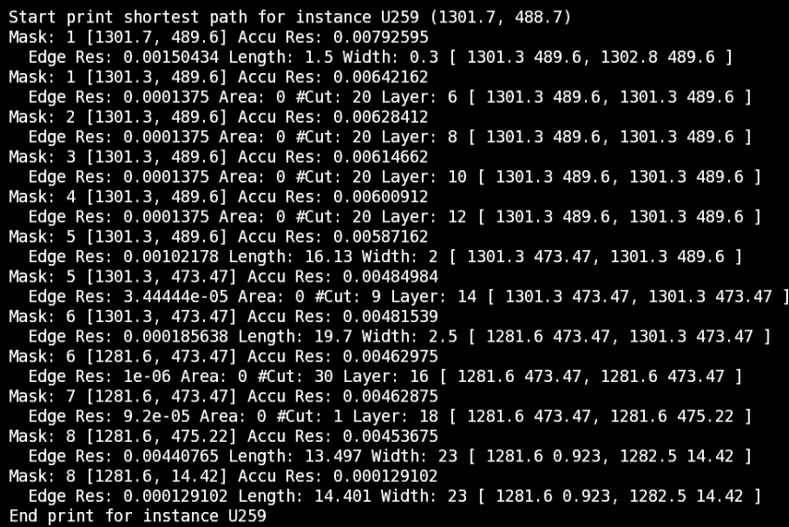
Resistance path related issue：
2. When align center, inst cordinate will jump

Slide 3
Before align center
data_wd_q_reg_57_
1293.6
1301.3
U259
pnode1
pnode2
U259
Data_wd_q_reg_57_
Middle node inside inst

Slide 4
After align center
data_wd_q_reg_57_
1293.6
1301.3
1301.7
1302.8
U259
pnode1
Pnode2
Middle node inside inst
U259
Data_wd_q_reg_57_

Slide 5
Resistance path related issue：
3. cordinate will jump

Slide 6
width
node1
1281.6 475.22
Node1 and node3 merge condition:
(Left1 == left2 && right1 == right2) ||
(top1 == top2 && bottom1 == bottom2
Merge fail:
Only report (node2 node3)
width
node2
1281.6 14.42
node3
1282.504 0.923

Slide 7
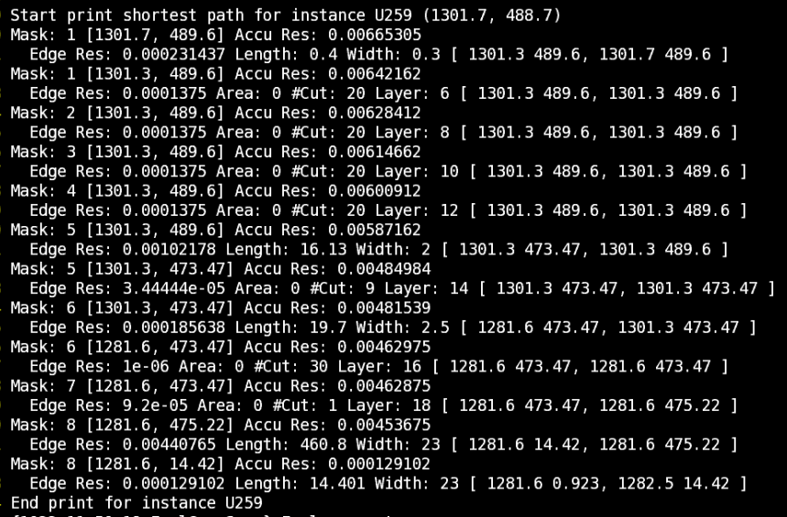
align center
R6 original o6 modify
1281.6 14.42

