Slide 1
Supply
Model
Project

Slide 2
Usage model
# Newly added command, to remove supply locations from db
delete_supply_locations -net VDD
delete_supply_locations
# added new options (hidden), default value is 0.0
add_supply_locations -net VDD -metal 5 { { 46.887 44.848 } } -voltage_drop 0.12
add_supply_locations -net VSS -metal 5 { { 48.890 45.419 } } -voltage_surge 0.12
# test script
delete_supply_locations
add_supply_locations -net VDD -metal 5 { { 46.887 44.848 } } -voltage_drop 0.12
add_supply_locations -net VSS -metal 5 { { 48.890 45.419 } } -voltage_surge 0.12
analyze_power_network -net VDD -disable_supply_gen
Test case location:
/home/stor19d2p1/jchen2/en212/ARM_tiny_case/tiny_ir_test_supply_location.tcl

Slide 3
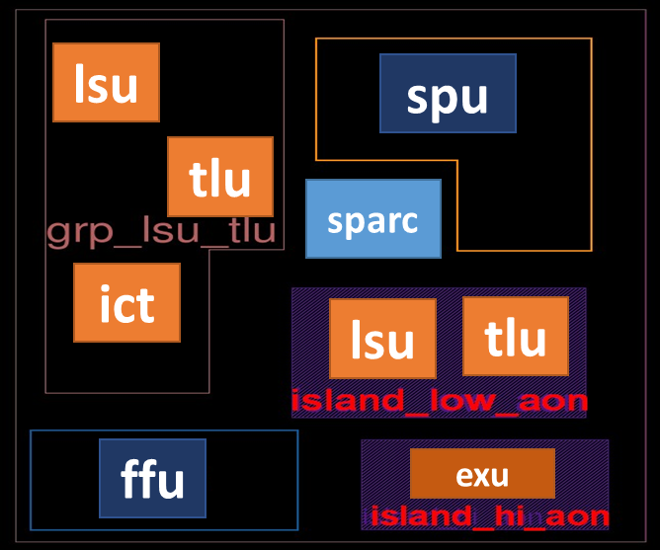
Supply model background
+
-
0.7V
+
-
1.1V
+
-
1.0V
+
-
1.6V
This project is used for dynamic IR drop analysis.
Jchen implemented phase one code in QHH, with b667698317d98904b40dd60f8e3df5e5

Slide 4
Gilbert giga 白耿 10:37
I have an idea to enhance add_supply_location command. We can add "-voltage_drop / -voltage_surge <float val>" to support voltage source with non-nominal value.
By doing this, all the ideal supply voltages do not have to use identical nominal supply value.
So we can claim that analog supply voltage module can be supported by our tool.
You can refer to PG partition code. When we do partition, the boundary node are treated as ideal voltage source with extra voltage drop applied.
You can use the same approach when making the enhancement.
Regarding "set_supply_location -drop / -surge" enhancement, you can refert to routine
double irPNode::GetCurrTermDelta (double nomVolt)
For regular voltage source node, it is converted into multiple current sources using Norton theory (depending on the source node adjacent resistive edges)
If "-drop/-surge" is defined, you can set the voltage source node ： SetDynamicV()
This dynamic voltage variation will be converged into current variation during stamping.
Jun, the surge / drop shall set as constant offset at the supply location. We will assume the output of voltage control module is constant voltage for now. It is just deviate from nominal supply voltage value by the constant offset. In the future, we can support varying voltage waveform. The enhancement is also not difficult, I think.

Slide 5
Implementation
// added _voltBias member
Add/delete/report
Supply locations
// Supply loc is aligned to wire/pitch center
// Supply model will not be loaded in Xgraph
// to save memory
irPGMgr::SetupGraph()
if (!ExtractXGraph(GetGenSupplyLoc()))
dbSupplyLoc
irXGraph
irPGraph
// Newly added irPGMgr::ExtractPGraph
// Attach model effect to src node
pnode2->AddSupplyModel(width)
// added _supplyModel in union
// for next step development
IR analysis
Report, export_setup,
SPICE

Slide 6
Next Step:
1. Enhance supply location related commands:
report/ delete supply locations
assigned issue: http://172.168.8.15:8088/issues/585
2. Rename to add_supply_source ?
Support voltage source , current source,
with/without voltage bias
pwl waveform , complex SPICE supply source model
3. Correlation with SPICE result
Add hidden dump_spice option for analyze_power_network

Slide 7
Partition approach
void irPGMgr::CalcDynamicIrDropPartition(int partId)
# define disabled.
CalcDynamicIrDropByZone
void irPGMgr::BuildSubGraphSetCurrByZone
void irPGMgr::BuildSubGraphSetCurrByZone(int partId)
subGraph->PreCalcTermCurrOnPNode();
Flatten approach
void irPGMgr::CalcDynamicIrDropPartition(int partId)
# define disabled.
CalcDynamicIrDropByZone
void irPGMgr::BuildSubGraphSetCurrByZone
void irPGMgr::BuildSubGraphSetCurrByZone(int partId)
subGraph->PreCalcTermCurrOnPNode();

Slide 8
#0 irPGMgr::GetDynaCurrent /src/ir/irSolve.cpp:766
#1 in irPGMgr::GetDynaCurrentCB ( work/src/ir/irMgr.h:569
#2 in irDynaSimLinear::RetriveInew ( src/ir/irDynaSim.cpp:1329
#3 in irDynaSimLinear::SetInitalIV ( ir/irDynaSim.cpp:1316
#4 in irDynaSimLinear::DynaSim ( /ir/irDynaSim.cpp:1264
#5 in irPGMgr::LDLSolveDyna ( ir/irSolve.cpp:929
#6 in irPGMgr::CalcDynamicIrDrop ( ir/irMgr.cpp:1113
#7 in irPGMgr::AnalyzeIR ( ir/irMgr.cpp:961

Slide 9
delete_supply_locations
set_param ir dynamic_sim_time_step 0.002
set_param ir dynamic_ir_part_mode 0
add_supply_locations -net VDD -metal 5 { { 46.887 44.848 } }
add_supply_locations -net VSS -metal 5 { { 48.890 45.419 } }
analyze_power_network -net VDD -disable_supply_gen -dynamic_rail_analysis
set_param ir enable_edge_reduction false
set_param ir dynamic_ir_curr_alloc_mt false
Without supply model drop/surge
Supply Voltage : 1.08000
Maximum Dynamic Drop : 0.02247 2.080% (46.900, 45.900)
Average Dynamic Drop : 0.01660 1.537%
With supply model drop/surge
Supply Voltage : 1.08000
Maximum Dynamic Drop : 0.06156 5.700% (46.900, 45.900)
Average Dynamic Drop : 0.04878 4.517%

