Slide 1
EM Calculation
打造完整的集成电路设计国产EDA平台

Slide 2
AVG EM limit current
VP calculate average EM limit current related parameters:
set_app_var em half_node_scale_factor 0.9
set_app_var em temperature_em 110
DC limit current = polymonial_current_cal * temp_rating_factor

Slide 3
AVG EM limit current
To calculation average EM limit current, EM rule based on length and width. For each shape, avg length are sum of block length, and multiplied by half node scale.
avg length: (0.695+0.05+1.4+0.05+2.21) * 0.9 = 3.9645 nm
For width, using each shape width, and multiplied by half node scale.
width: 0.05 * 0.9 = 0.045 nm
temp_rating_factor table: (based on .itf or .ircx)
temperature | 85 | 105 | 110 | 125 | 150
rating factor | 5.066 | 2.293 | 1.599 | 1.000 | 0.212

Slide 4
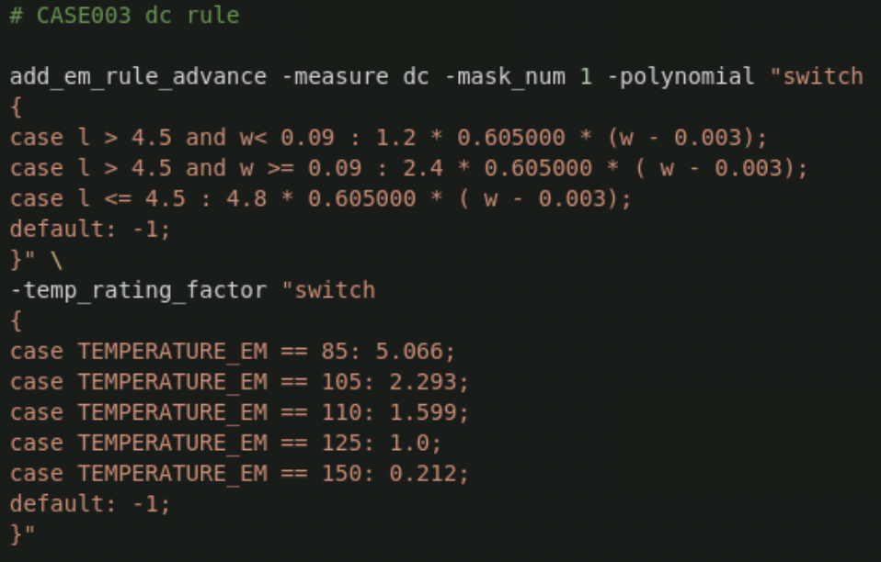
AVG EM limit current
VP [add_em_rule_advance] DC rule demo:
When got avg length and width, can lookup polynomial table and calculated polynomial based results.
Lookup temp_rating_factor table got temperature factor set by parameter.
DC limit current = polymonial_current_cal * temp_rating_factor

Slide 5
PEAK EM limit current
VP calculate Peak EM limit current related parameters:
set_app_var em half_node_scale_factor 0.9
set_app_var em em_peak_source_equation_techfile false
When em_peak_source_equation_techfile == true
Peak limit current = polymonial_current_cal
When em_peak_source_equation_techfile == false
Peak limt current = polymonial_current_cal * [1/sqrt(r)]

Slide 6
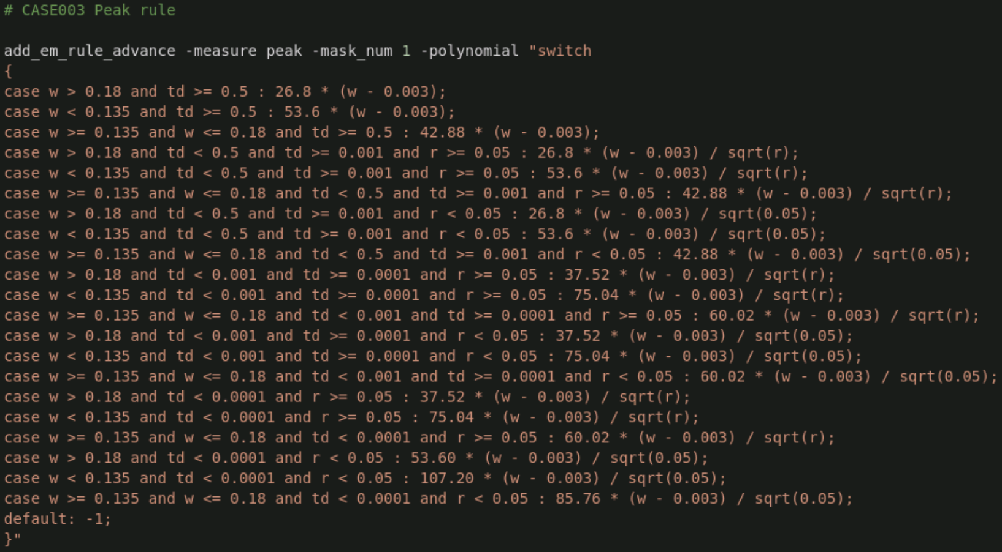
PEAK EM limit current
VP [add_em_rule_advance] PEAK rule demo:
w: width (half node scale)
td: pulse width
r: duty ratio

Slide 7
RMS EM limit current
VP calculate RMS EM limit current related parameters:
set_app_var em half_node_scale_factor 0.9
set_app_var em em_rms_metal_line_no 3
set_app_var em average_option false
RMS_current_limit = polynomial_current_cal * spacing_factor * rating_factor

Slide 8
RMS EM limit current
N (metal line number)
For 28nm N=3
rating factor table:
Metal line no (N) | N >= 9 | 9 >N>= 5 | 5 > N>= 3 | 3 >N>= 1
Rating factor of Irms | 1.0 | 1.05 | 1.32 | 1.5

Slide 9
RMS EM limit current
S (via-via spacing)
Related param: set_app_var em average_option false
via-via spacing (S) | S >= 9um Not average option | S >= 9um average option | 9um>S>2.7um | 2.7um>=S>0.9um | 0.9um>=S>0.27um | 0.27um>=S
Spacing factor of Irms | 1.0 | 1.2 | 1.05 | 1.3 | 2.0 | 2.2

Slide 10
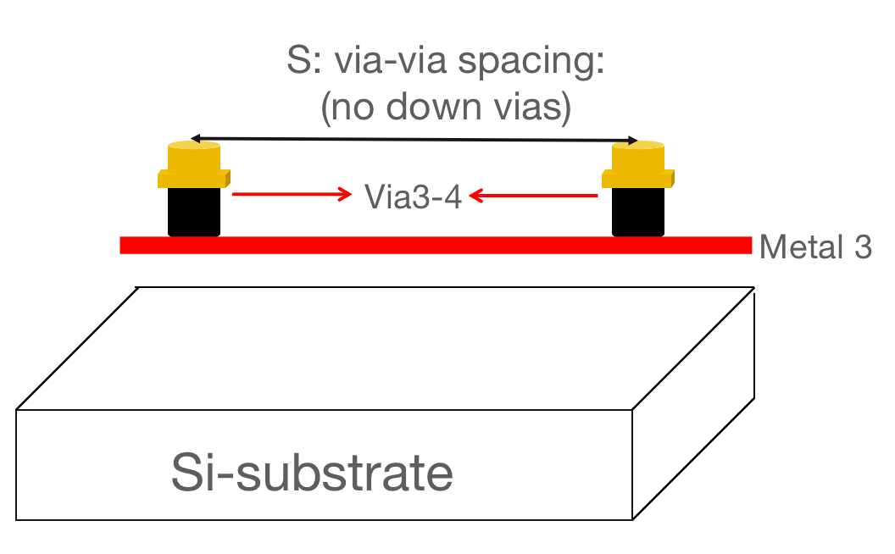
RMS EM limit current
When shape no down vias, didn't consider spacing factor.
via-via spacing using signal actually direction, sum of those distance and half node scale also used.
via-via spacing: (0.03+0.575+0.1+1.35+0.1+2.09+0.03) * 0.9 = 3.8475

Slide 11
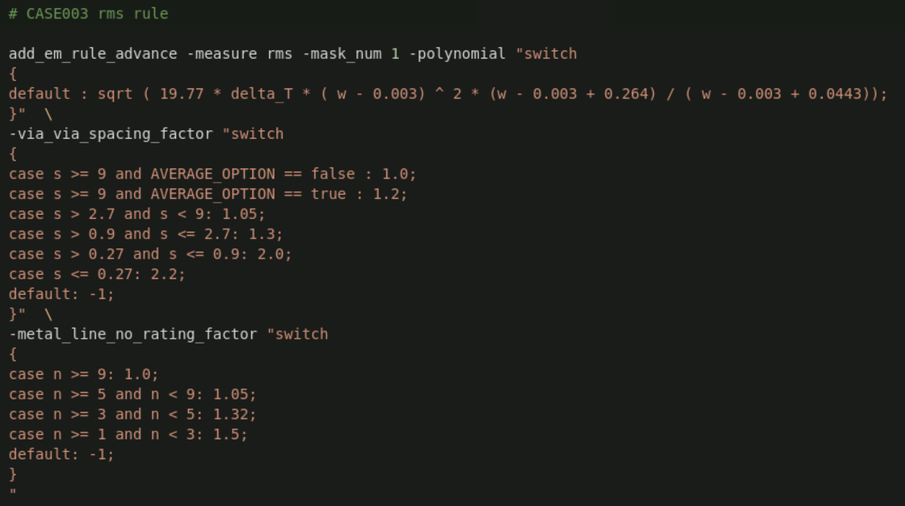
RMS EM limit current
VP [add_em_rule_advance] RMS rule demo:
When got N and S, then lookup via_via_spacing_factor and metal_line_no_rating_factor table to got factor.
RMS_current_limit = polynomial_current_cal * spacing_factor * rating_factor

Slide 12
THANK YOU
WWW.GIGA-DA.COM
电话：0755-61018899
邮箱：HR@GIGA-DA.COM
邮编：518000

